Slide 1




Tobaco smoking
Student Name:Sharifa Saleh
Student number:3626
Supervisor: makram
BLOCK: P.T.S
Date: 6/6/2022
1

Slide 2

Objectives
1
Describe types of cancers that may be caused by tobacco smoking.
2
Discuss the effect of tobacco smoking on the nervous system.
3
Outline the strategies to improve smoking cessation in primary care.
2

Slide 3

Introduction
Did you know ?
3

Slide 4
Describe types of cancers that may be caused by tobacco smoking.
1
4

Slide 5


Lung Cancer
1
2
Hematopoietic Cancer
3
Laryngeal Cancer
5
Notes:
Cigarette smoking is the leading cause of lung cancer, accounting for 90 percent of lung cancer in males and 79 percent in women. The number of cigarettes smoked each day and the length of the smoking period is directly linked to the increased risk in both sexes. Smoking raises the risk of all four major forms of lung cancer: squamous cell lung cancer, small cell lung cancer, large cell lung cancer, and adenocarcinoma. Smoking quitting lowers the risk of lung cancer by 20 percent to 90 percent
A significant increase in the risk of leukemia was linked to the number of cigarettes smoked. There was a twofold increase in the risk of lymphoid leukemia among cigarette smokers and a triple increase in the risk of myeloid leukemia among men.

Slide 6
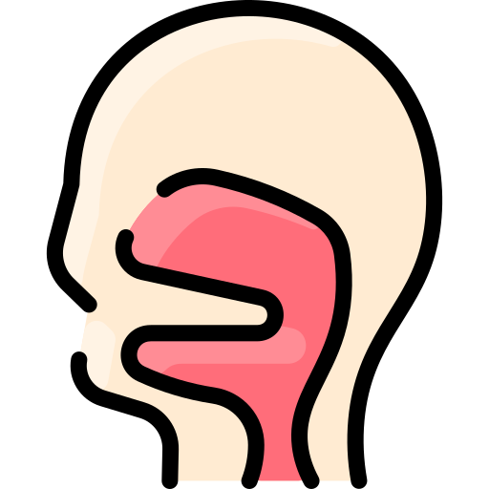
4
Esophageal Cancer
5
Oral Cancer
6
Bladder and Kidney Cancer
6
Notes:
Smoking is one of the most common causes of laryngeal cancer, with the majority of smokers dying after 21 cigarettes per day for a long period of their life. Other smoking features, such as the number of years of smoking, the age at which smoking began, the depth of inhalation, and the type of cigarettes smoked, most of which influence the degree of the quit reduction.
Inhaled cigarette smoke condenses on the mucous membranes of the mouth and pharynx and is swallowed, increasing the risk of esophageal cancer in people who drink a lot of alcohol and smoke too. As a result, contact carcinogenesis is the most likely pathogenetic pathway for esophageal cancer

Slide 7



Pancreatic Carcinoma
7
8
Stomach Cancer
9
Cervical Cancer
8
Notes:
Smokers who smoke more than 40 cigarettes a day are at risk for pancreatic cancer. a fivefold increase in the risk of pancreatic cancer over that of nonsmokers.
Cigarette smoking is responsible for roughly 20% of stomach cancers
Cervical cancer risk is higher in women who smoke 20 or more cigarettes per day, as well as those who have smoked for 40 years or more, making them more likely to develop both intraepithelial, in situ, and invasive cancer.

Slide 8
Discuss the effect of tobacco smoking on the nervous system.
2
9

Slide 9



The nicotinic and muscarinic acetylcholine receptors are found in many cells throughout the human body. Nicotine and acetylcholine both are neurotransmitters, but nicotine has a higher affinity to be attracted to its receptor.
Nicotine cannot be easily removed from the synaptic cleft due to prolonged receptor triggering, which activates and then desensitizes post synaptic neurons, making signal transmission problematic.
Because of the presence of menthol, which is frequently used as a flavor ingredient in cigarettes, this desensitization can be worsened and prolonged.
10

Slide 10
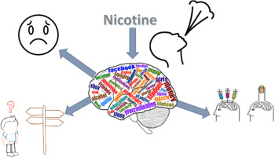
11

Slide 11
Outline the strategies to improve smoking cessation in primary care.
3
12

Slide 12
1. Smokers and providers have specific identified barriers such as a lack of knowledge and skills, attitudes and perceptions of one another, a lack of time and organizational support, a lack of patient motivation, and other patient problems.
2. Interventions are based to address the barriers which are listed above to accelerate the rates of tobacco cessation.
13
Notes:
: During a normal consultation and/or interaction with a physician or health care provider, all tobacco users are offered advice to quit smoking, which usually takes only a few minutes.

Slide 13
3. Population-level approaches:
a. Brief advice.
b. Quit lines.
C. mTobacco cessation.
14
Notes:
Text messaging is used to provide tobacco cessation programs on mobile phones. Text messaging can give individualized tobacco cessation help in an efficient and effective manner, and mobile technologies provide the opportunity to reach a wider audience.

Slide 14
4. individual specialist approaches:
a. intensive behavioral support.
b. Cessation clinics:
15
Notes:
Multiple sessions of individual or group counseling focused at helping people quit smoking are referred to as behavior support. It encompasses all tobacco cessation aid that communicates knowledge about tobacco use and quitting, as well as support and resources to help people develop skills and strategies to change their habits
Clinics that specialize on cigarette cessation services can be found in various countries. These clinics provide extensive behavioral assistance, as well as drugs or advise on medication administration, where necessary, administered by specially trained practitioners.

Slide 15
5. Nicotine replacement therapies (NRTs):
6. Non-nicotine pharmacotherapies:
16
Notes:
Gum, lozenges, patches, inhalers, and nasal spray are some of the nicotine replacement therapies available. Cessation aids provide a low, controlled dosage of nicotine without the chemicals present in cigarettes, reducing cravings and withdrawal symptoms. NRTs doses are gradually reduced over time to help smokers wean themselves off nicotine by becoming accustomed to less and less stimulation.
Non-nicotine pharmacotherapies, such as bupropion, varenicline, and cytisine, are examples. These pharmacotherapies minimize the pleasant benefits of cigarettes and other tobacco products by reducing cravings and withdrawal symptoms.

Slide 16
Conclusion
Tobacco smoking is associated with a lot of different types of cancers through out the body, and also it has a massive effect in the central and peripheral nerves system and make us addicted to the dopamine, thus we must put a strict strategies to quit it quickly.
17

Slide 17
references
Newcomb PA, Carbone PP. The health consequences of smoking. Cancer. Med Clin North Am. 1992;76(2):305-331. doi:10.1016/s0025-7125(16)30355-8
2. Hajdusianek W, Żórawik A, Waliszewska-Prosół M, Poręba R, Gać P. Tobacco and Nervous System Development and Function-New Findings 2015-2020. Brain Sci. 2021;11(6):797. Published 2021 Jun 16. doi:10.3390/brainsci11060797
3. Lindson N, Pritchard G, Hong B, Fanshawe TR, Pipe A, Papadakis S. Strategies to improve smoking cessation rates in primary care. Cochrane Database Syst Rev. 2021;9(9):CD011556. Published 2021 Sep 6. doi:10.1002/14651858.CD011556.pub2
4. WHO report on the global tobacco epidemic 2019: offer help to quit tobacco use. Who.int. https://www.who.int/publications-detail-redirect/9789241516204. Published 2022. Accessed June 2, 2022
18

Slide 18

19

