Slide 1


Libyan International Medical University
Faculty of Business Administration
Verbal and non-verbal Messages
Interpersonal Communication (7027)
Group names :
Nouri Founas 2733
Derar Gargoum 2727
Mohamed A Eldeep 2754
Ahmed Jadallah 2726
Salim Mohamed 2708
Submitted To:
Mr. Farag Elmegresi

Slide 2
Table of contents
1
Introduction
3
Non-Verbal Messages
2
Verbal Messages
4
Verbal vs Non Verbal Messages
5
Conclusion
6
References

Slide 3
Introduction

Slide 4
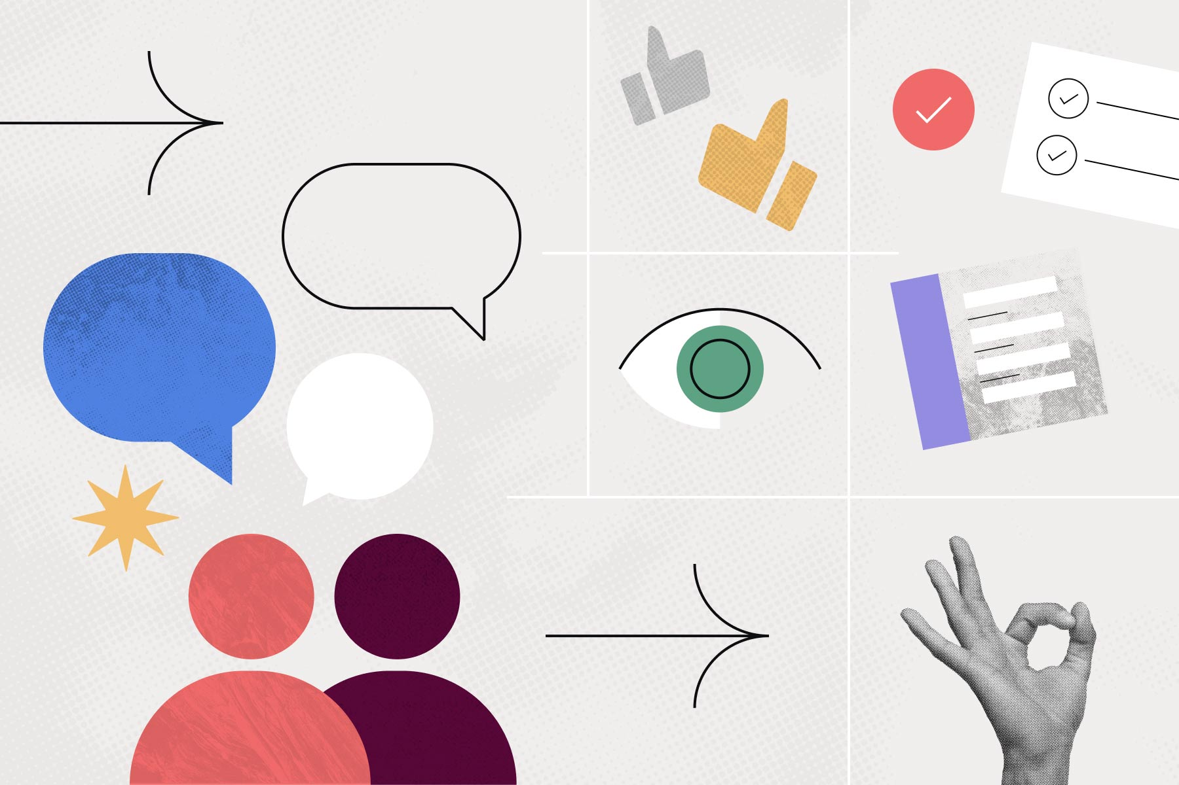
When we consider different types of communication, speech may be the first thing that comes to mind. Nonverbal communication, on the other hand, is frequently overlooked. Nonverbal cues like body language have been shown in studies to be just as important as, if not more important than, what we say. Understanding nonverbal communication, for example, can help us navigate conversations with people who are deaf.

Slide 5
What is Verbal Messages

Slide 6
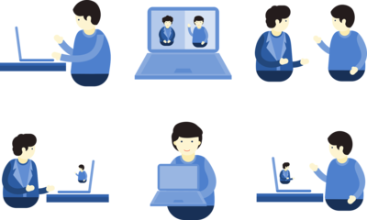

Language, both written and spoken, is central to verbal communication. In general, verbal communication refers to how we communicate using words, whereas nonverbal communication refers to how we communicate using nonverbal means such as body language, gestures, and silence. Speaking and writing are both forms of verbal and nonverbal communication.

Slide 7
Examples of Verbal Messages
Oral communication
Written communication

Slide 8
Oral communication
Because there is a personal touch, it is more effective. The conversation can be properly understood, and any doubts can be cleared right away. Action can be used to emphasize key themes.

Slide 9

Written communication
Any message that uses the written word is included in this category. When messages are written down—in the form of letters, memoranda, e-mails, and the like—the likelihood of misinterpretation of the sender's words is minimized.

Slide 10
What is Non Verbal Messages ?

Slide 11
Body language, such as eye contact, facial expressions, gestures, and more, is used to convey information through nonverbal communication. Smiles, for example, express friendliness, acceptance, and openness when you first meet someone.

Slide 12
Examples about Non- Verbal Messages
1- Body language :is how a person positions their body in relation to the situation, the environment, and how they feel.
2- Facial expressions :Facial expressions are one of the most common types of nonverbal communication. It is possible to transmit emotion or information by using the brows, mouth, eyes, and facial movements.
3- Eye contact : Using eye content (or lack of eye contact) strategically to show your attention and interest is incredibly effective.
4- Paralanguage : The non-language aspects of speech, such as your speaking pace, pitch, intonation, loudness, and so on, are referred to as paralanguage.

Slide 13

Examples about Non- Verbal Messages
5- Posture : The way you sit or stand can convey your level of comfort, professionalism, and general attitude toward a person or topic.
6- Gesture : While gestures differ greatly throughout cultures, they are commonly employed to transmit information to others, both purposefully and unintentionally.

Slide 14
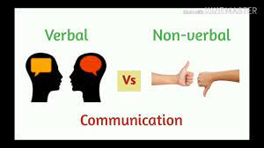
Verbal vs Non-Verbal Messages

Slide 15
Parameter of Comparison | Verbal messages | Non Verbal messages
Communication Type | Both formal and informal | Informal
Impact of the Message | As reported, it had a huge influence. | It's really detailed since it depicts the person's true feelings.
Communicates | Information that is precise. | Required and at times more information.
Conveyed Through | Emails, letters, notes, reports, and anything else written or spoken that contains words. | Through body language, gestures, eye contact, and facial emotions, to name a few.
Transparency Status | Simple and to the point and clear. | Complex and at times perplexing.

Slide 16
Conclusion
Both verbal and nonverbal communications are important since certain things can't always be communicated through structured means of verbal communication, necessitating the usage of nonverbal communication methods.

Slide 17

Bashir, M. T., & Bashir, M. T. (2020, July 21). Verbal and nonverbal communication: Communication skills. Scientips. Retrieved December 10, 2021, from https://scientips.com/verbal-and-nonverbal-communication-skills/.
Nonverbal communication skills: Definition and examples. Indeed Career Guide. (n.d.). Retrieved December 10, 2021, from https://www.indeed.com/career-advice/career-development/nonverbal-communication-skills.
Phil Venditti, O. C. L. (n.d.). Introduction to communication. Lumen. Retrieved December 10, 2021, from https://courses.lumenlearning.com/introductiontocommunication/chapter/defining-verbal-communication/.
Types of verbal communication and examples. Why we are here. (n.d.). Retrieved December 10, 2021, from https://ifioque.com/miscellaneous/verbal_communication.
YouTube. (n.d.). Https://www.google.es/url?sa=t&source=web&rct=j&ur. YouTube. Retrieved December 10, 2021, from https://www.youtube.com/playlist?list=PLW5Dwn3GEpujBFDA_IASy9HvVXK4OD0yn.

Slide 18
Thank you!
Do you have any questions ?

