Slide 1


Libyan International
Medical University
Faculty of
Business Administration
Balanced Scorecard & Control System
Prepared and presented by:
Heba N Bushiha
Email: hbitalla_3285@limu.edu.ly
ID Number:
3285
Notes:
Download more minimal templates here: https://crmrkt.com/GK9Dwa

Slide 2
2
Introduction
Balanced Scorecard
Contents
Advantages of Balanced Scorecard
Types of Control System Used in the Organizations
Conclusion
Reflection
References
Notes:
Download more minimal templates here: https://crmrkt.com/GK9Dwa

Slide 3

Introduction
3
Balanced scorecard evaluation is a strategy in management that helps to outline and improve the internal problems so they can improve the external outcomes.(Traver,2022)
According to some researchers, organizational control systems allow administrators to track how well the organization is performing and then take action to address the concerns, and there are three types of control system.

Slide 4
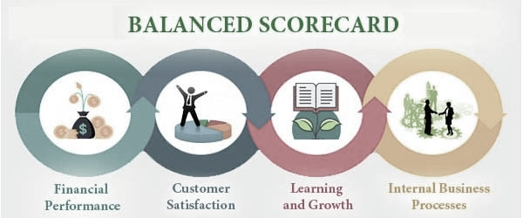
4

Slide 5
Balanced Scorecard
5
Financial performance: It focuses on measuring the financial performance of the organization for example the cash flow and net income.
Costumer satisfaction: It is collected to measure how satisfied the costumers are with the products and the services.
Learning and growth: Its about how well the information is understood and how effective they use it to make it a competitive advantage.
Internal business process: The are evaluated to see is the product evaluated properly and in the operational side it analyzed to identify any gaps ,delays or shortages.
(Agarwal,2015)

Slide 6

Aadvantages of Balanced Scorecard
6
It makes it easy to communicate your strategy.
It helps your employees see how their individual goals link to the organizational strategy.
It gives structure to your strategy.
(Jackson,2017)

Slide 7
Types of Control System Used in the Organizations
7
Output Controls
Output control focuses on measurable results within the organization.
Behavioral control
Clan Control
Behavioral control focuses on the action done to get the result.
Clan control depends on shared traditions, expectations, values, and standards.
(Edwards,2017)
Notes:
Download more minimal templates here: https://crmrkt.com/GK9Dwa

Slide 8

Conclusion
8
To sum up, balanced scorecard helps the management by identifying mistakes to improve the outcome.
There are three basic types of control system:
Output control.
Behavioral control.
Clan control.

Slide 9

9
Reflection
In my opinion , balanced scorecard is essential in managnment because it Will result in Good outcomes because you improves the incomes.
Control system is good becauses it helps to tracks the actions to acheive their goals.

Slide 10
References
10
Tarver, Evan. “How a Balanced Scorecard (BSC) Is Used.” Investopedia, 1 July 2021.
Agarwal, Rohit. “Perspectives in Balanced Scorecard (4 Perspectives ).” Your Article Library, 13 May 2015.
Jackson, Ted. “A Thorough List of Balanced Scorecard Advantages & Disadvantages.” ClearPoint Strategy, 16 Feb. 2017.
Edwards, Janice. “Creating Organizational Control Systems.” Opentextbc.ca, 12 Sept. 2014.
Notes:
Download more minimal templates here: https://crmrkt.com/GK9Dwa

Slide 11
THANK YOU
Heba N Bushiha
Notes:
Download more minimal templates here: https://crmrkt.com/GK9Dwa

