Slide 1
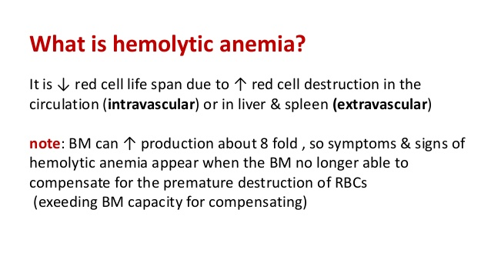

Slide 2
HEMOLYTIC ANAEMIA
Definition:-
Anemia develops in situations were there is
a reduction in RBCs life span due to increase in
RBCs destruction associated with failure of
compensatory marrow hematopoiesis .
Epidemiology :-
not common disease , the incidence
varying 0.8:1000,000 ---3:1000,000 / year
both males & females are equally affected , no
definite age of occurrence .

Slide 3
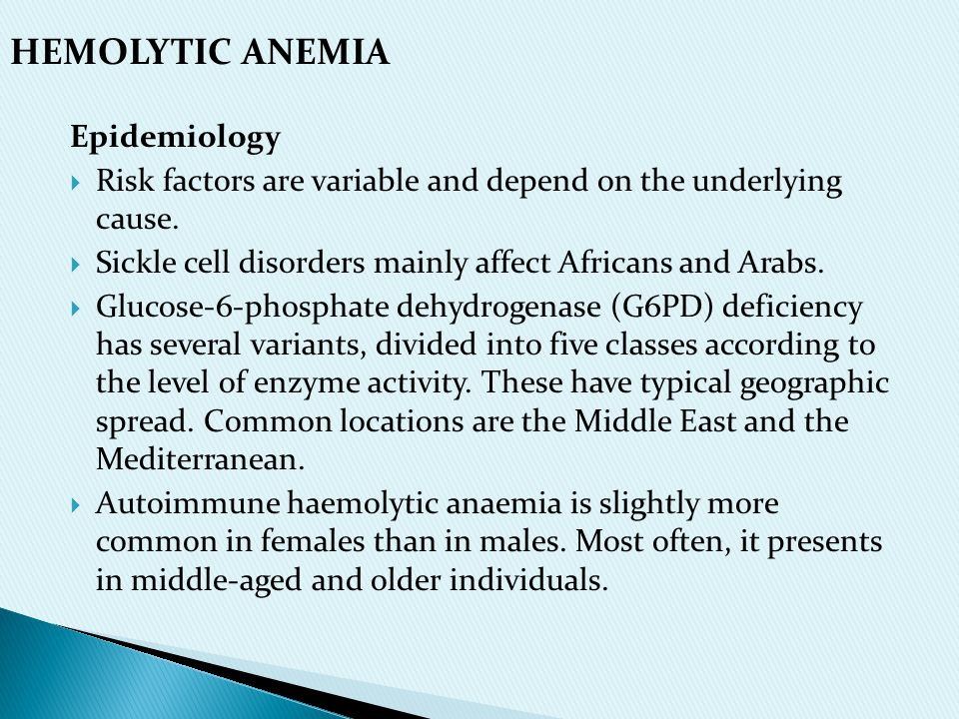

Slide 4
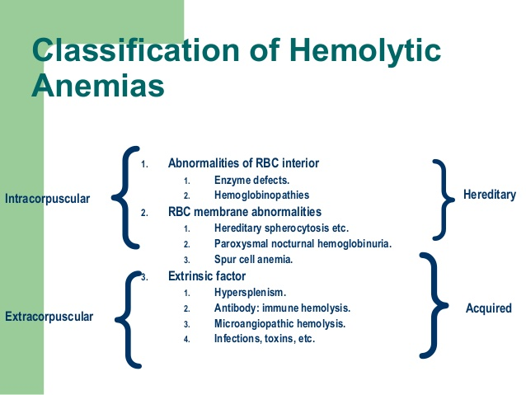

Slide 5
A. Etiology & Causes:-
A- CONGENITAL (hereditary) :
1- Membrane abnormality :- hereditary.
spherocytosis, hereditary elliptocytosis.
2-Hemoglobinopathies :- Thalassemia, sickle cell
disease.
3- Red cell enzymopathies :- glucose -6-PD def.
pyruvate kinase def.
B- AQUIRED :
1- Immune :- AIHA ( warm Ab , cold Ab ).
alloimmune(HDN , RBCs transfusion
incompatibility).
, isoimmune .

Slide 6
2- Non-immune :-
a- Mechanical :- artificial cardiac valves, burns,
microangiopathic( sepsis, TTP ).
b- Infectiuos :- malaria, clostridium welchi.
c- Drugs :- penicillins, quinidin.
d- Chemicals.
e- Dyserythropoietic :- paroxysmal nocturnal
hemoglobinuria.

Slide 7
Pathphysiology :-
depends on the cause ?
eg. AIHA , RBCs will be coated by antibodies
which is recognised by RES, and will be hemolysed
Clinical Features :-
Symptoms :- asymptomatic
fatigue , headaches , loss of conc.
palpitation , SOB , angina , HF.
abdominal pain (GB stones , spleenic
infarction).
urinary symptoms “ red or dark brown”
clinically :- pallor , jaundice
splenomegally ± hepatomegally ± LAP.

Slide 8
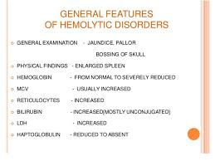

Slide 9
Investigation :
CBC ē PBF reticutocytes & ESR.
LFT : including total billirubin “ D & I”, LDH.
S. ferritin , RFT & coomb’s test (antiglobulin test )
D & I.
S. Haptoglobin “ ” .
Radilogical assessment CXR & ultrasound abdomen,
C.T. scan or MRI & Echo.
Urine : hemoglobinuria , urobilinogenuria .

Slide 10
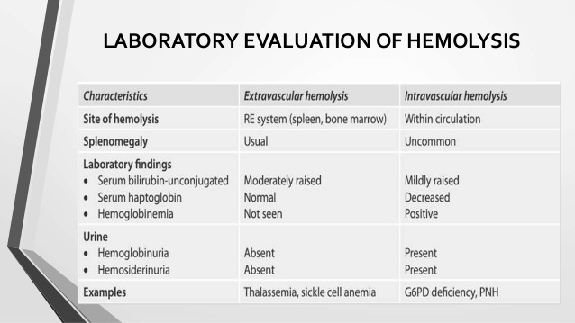

Slide 11
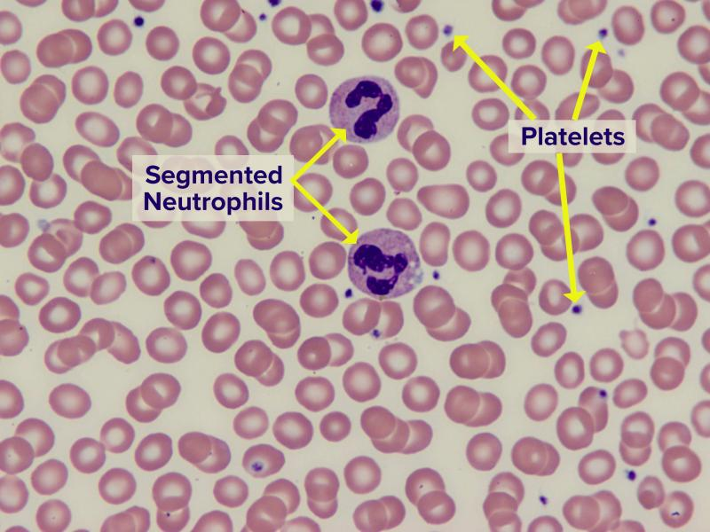
Normal PBF

Slide 12
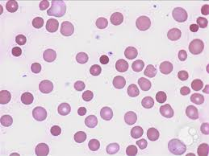
PBF shows Spherocytes, polychromsia

Slide 13
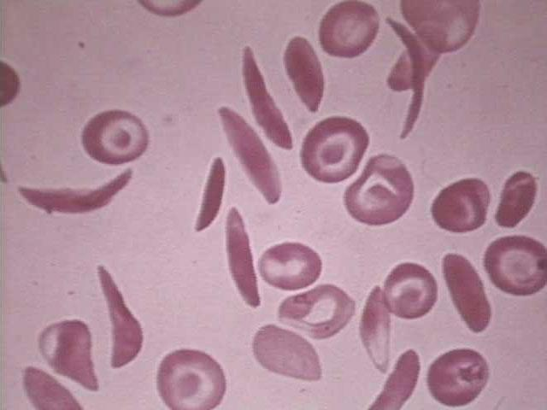
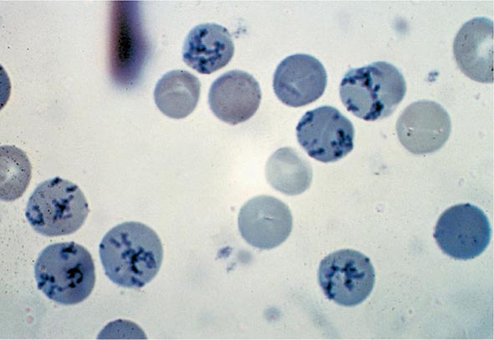

Slide 14
Treatment :
According to etiological cause
- supportive & symptomatic.
- Folic acid.
- Corticosteroids.
- Blood transfusion.
- Surgical.

Slide 15
Hereditary Spherocytosis
Hemolytic anemia occurs secondary to RBCs
membrane defect , inherited as autosomal
dominant , presents at any age , both sexes
are affected.
Clinically :
pallor, jaundice, mild to moderate splenomegaly.
leg ulceration .

Slide 16
Pathphysiology :
The abnormal RBCs lysis is caused by
a defect in cytoskeleton ; involves a
partial deficiency of Spectrin , the
spherical shape has two effects on RBC
*trapped in the spleen (shorten
life span ) .
* the abn.memb. Also increases the
permeability of sodium .

Slide 17
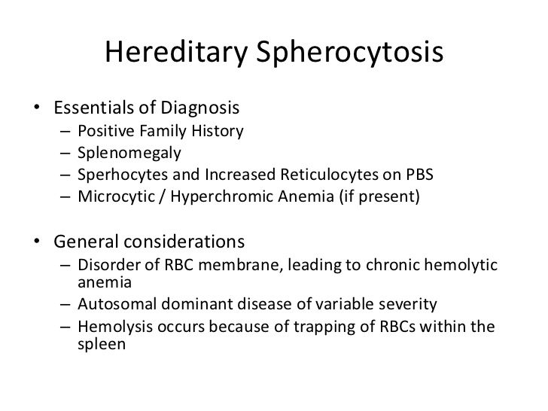

Slide 18
Symptoms :
- Anemia (compensated to symptomatic).
- Gallstones with cholecystitis.
The clinical course may be complicated by crisis.
- Hemolytic crisis – associated with infection.
- Megaloblastic crisis – following folic acid.
deficiency especially in pregnancy.
- Aplastic crisis – associated with parvovirus
infection.

Slide 19
Investigations:
- CBC & PBF : spherocytes ,reticulocytosis.
- Increased total bilirubin (uncojugated) , high
s. LDH ,+ve. Urinary urobilinogen.
- (- ve. )Coombs test.
Treatment :
- Folic acid 5 mg/day life long .
- Blood transfusion .
- Splenectomy .

Slide 20
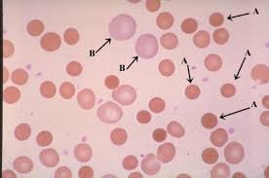

Slide 21
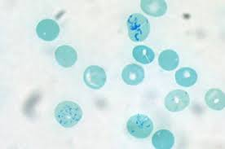
Spherocytes Reticulocytes

Slide 22
Autoimmune Hemolytic Anemia :
Anemia occurred as a result of presence of
RBCs autoantibodies which will coat the
RBCs leading to their destruction, it is
either warm antibody (IgG) or cold antibody
(IgM).
Occurs either idiopathic or associated with
connective tissue diseases or lymphoma or
other lymphoproliferative disorders, Drugs .

Slide 23
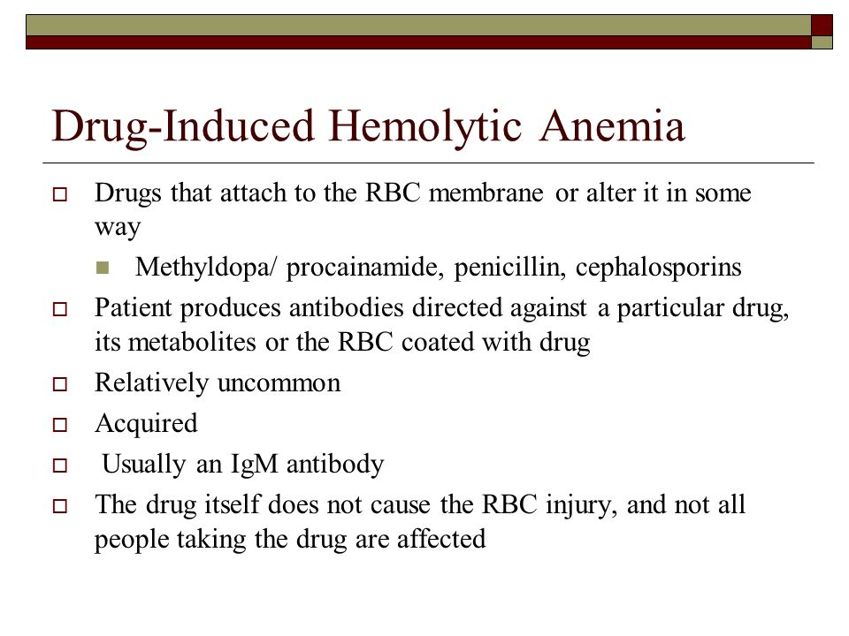

Slide 24
Warm autoimmune H. A.
IgG binds RBCs in 37◦c ,will be hemolysed
it accounts 80% of cases, occurs at all ages
but common in middle ages and females.
clinical features :
- symptoms of anemia .
- pallor + jaundice .
- splenomegaly .

Slide 25
Investigations :
- CBC & PBF ( spherocytes , reticulocytosis).
- Unconjugated hyperbilirubinemia.
- Raised s. LDH levels , reduced haptoglobulins
- +ve direct coomb’s test.
- NB: connective tissue diseases and
lymphoma should be excluded.

Slide 26
Treatment :
- Prednisolone 1mg /kg + folic acid .
- Splenectomy.
- Rituximab (anti CD20) .
- Immunosuppression ( cyclophosphamide ,
azathioprine , ciclosporine ) .

Slide 27
Cold Autoimmune H. A. :
RBCs are coated by IgM antibodies in 32 ˚c
represents 20 % of cases , commoner in
elderly patients.
either idiopathic or occurs in association
of lymphoma , infectious mononucleosis
or mycoplasma infection .
Clinical presentation :
- Pallor, +/- jaundice, splenomegaly.
- Acrocyanosis ; painfull, blue fingers, toes,
nose, ears on exposure to cold.

Slide 28
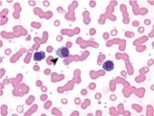
RBCs agglutination

Slide 29
Investigation :
-CBCs & PBF (agglutination of RBCs)
- other inv . Same as in warm AIHA .
Treatment :
- Folic acid 5mg.
- Blood trasfusion.
- Prednisolone.
- Rituximab.
- Treat the underling cause.

Slide 30
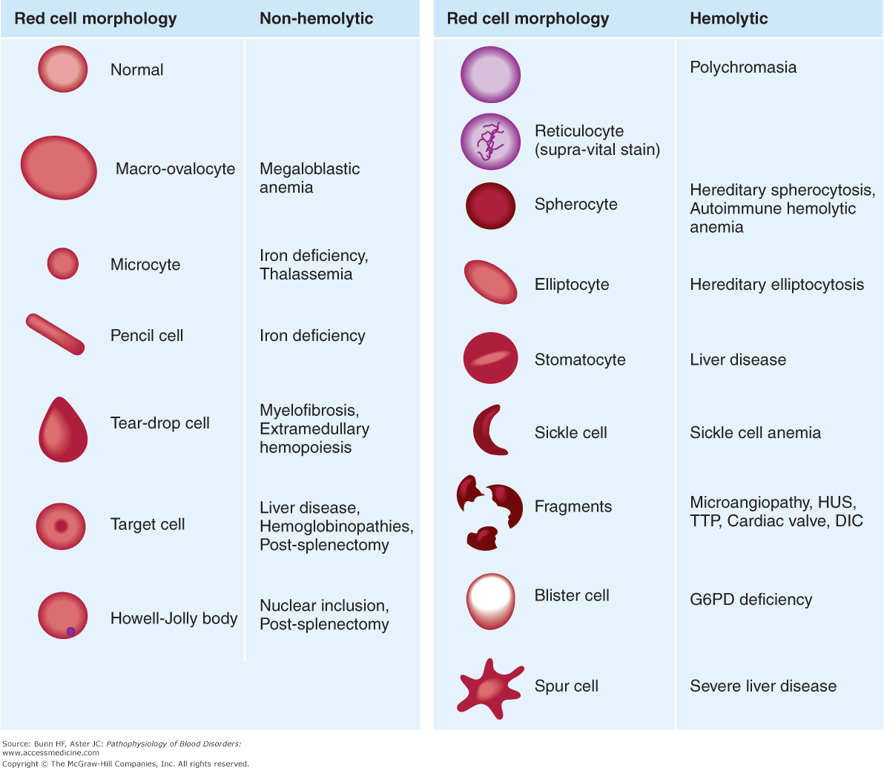

Slide 31

THANK YOU

