Slide 1


Climate Change
The Global Warming Holocaust
Presenter’s Name: Khalid Alwerfalli
Student ID : 3548
Year 1 AMS
18-5-2022

Slide 2
Table of Contents
1
2
3
Define
Climate Change
Tips and Recommendations
Practice Zero Waste Concept

Slide 3
1
What is the Climate Change?

Slide 4
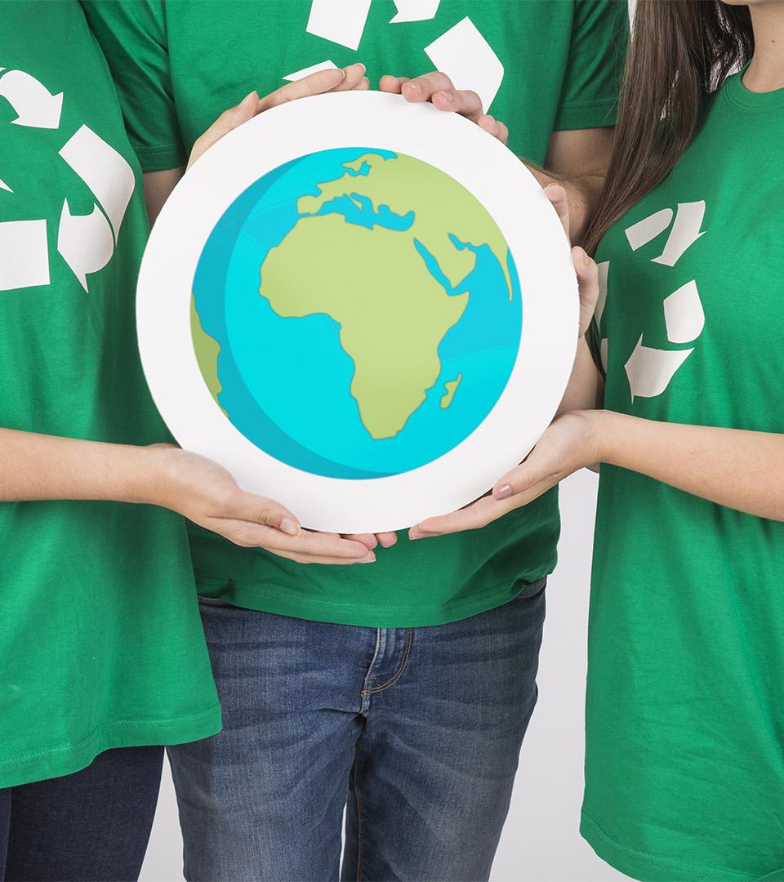
Our planet
Earth has an uneven gravitational field
Melting glaciers have an impact on Earth’s Shape
Sea levels were very different in the past
Contains 74% water

Slide 5
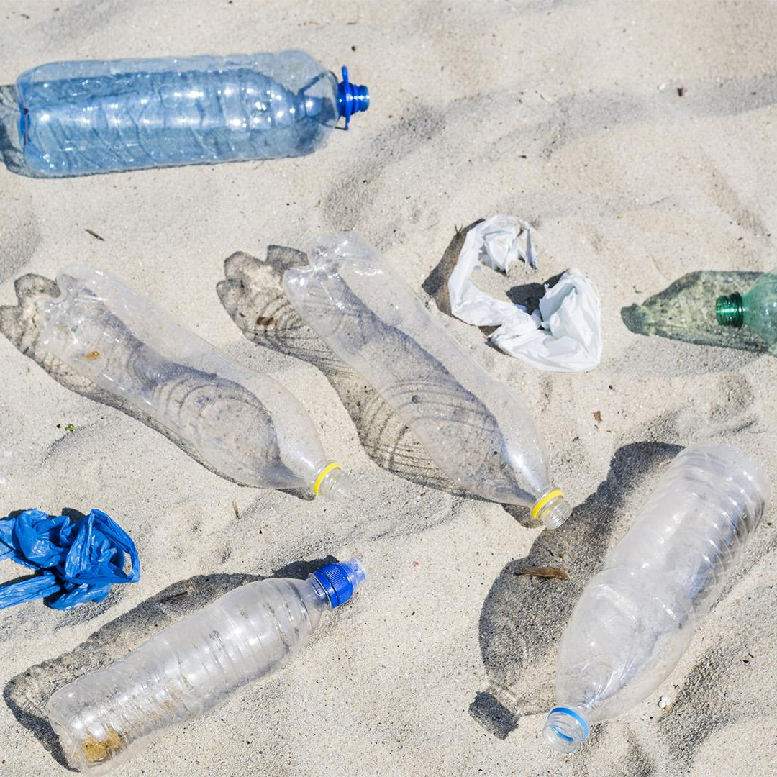
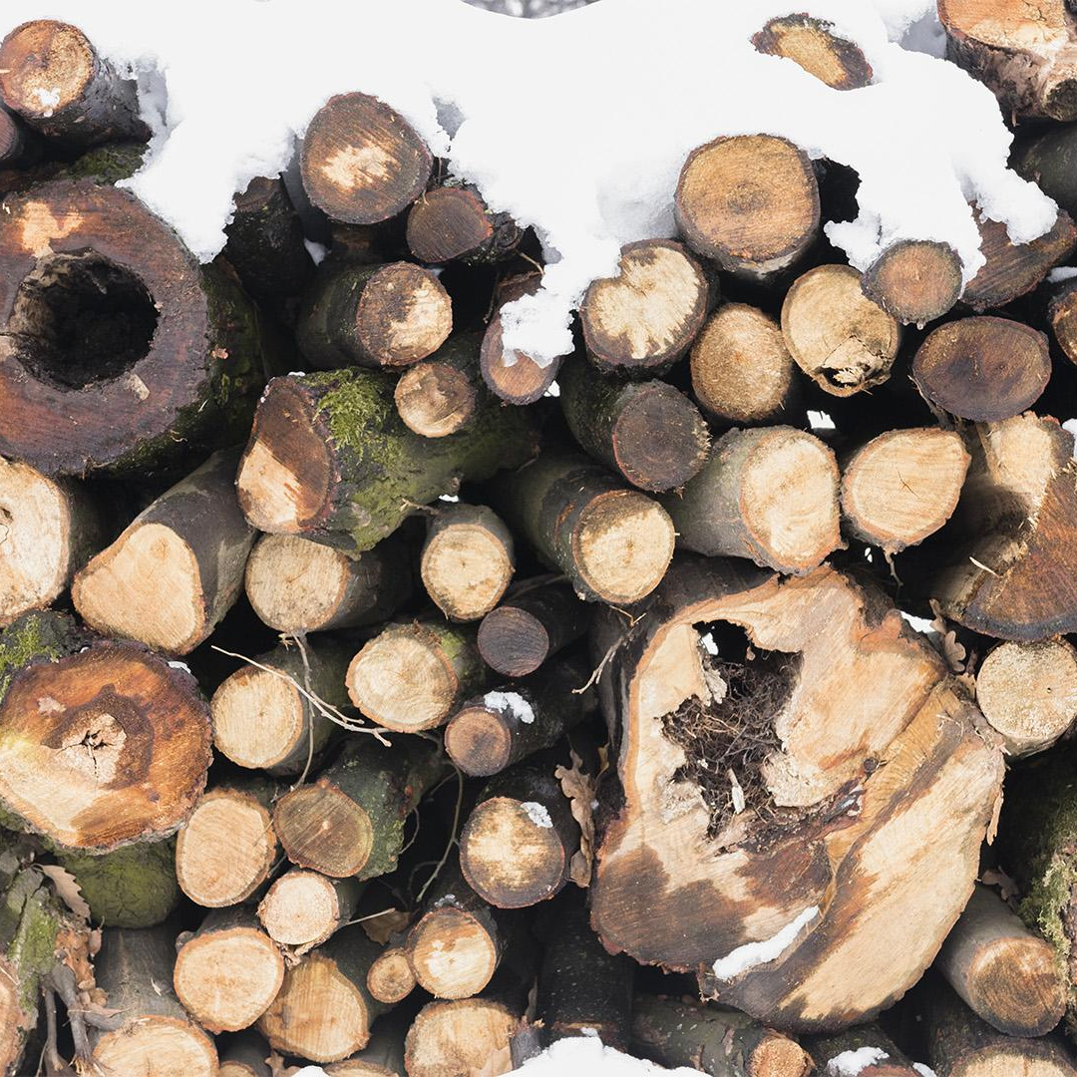
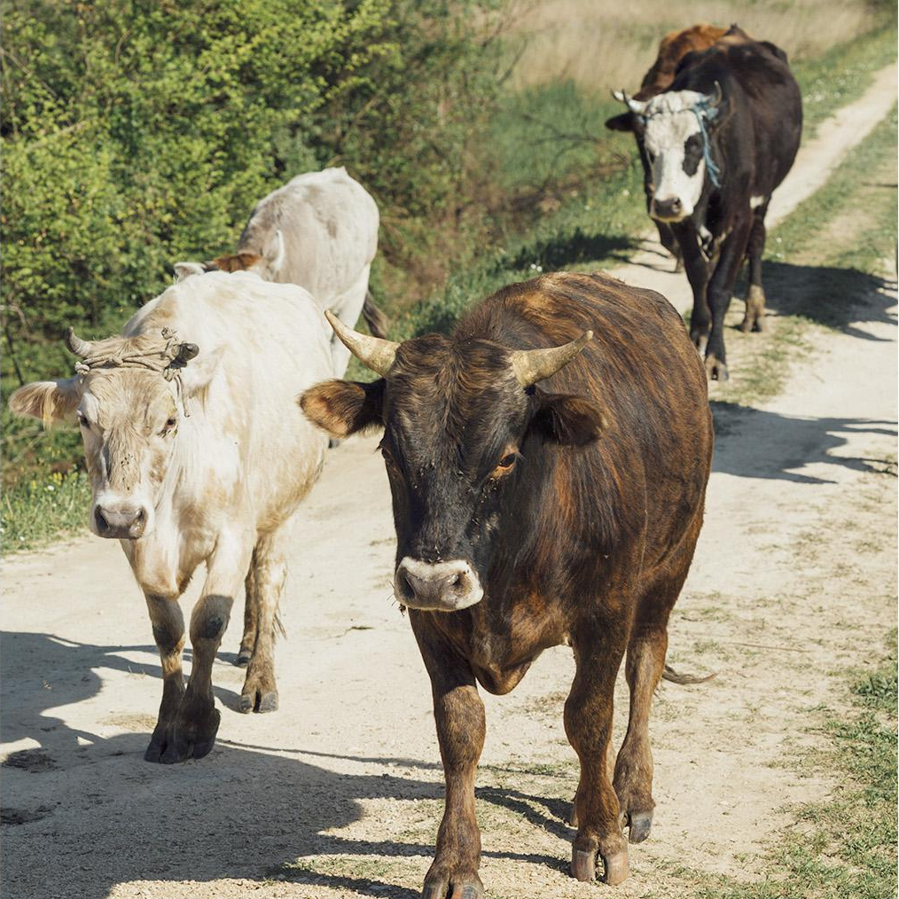

Causes of Climate Change
Waste
Deforestation
Breeding
Industry
Food Waste
versus
Plastic Waste
Release of Carbon Dioxide into the atmosphere
Offspring Size in most species
Greenhouse Gas Emissions

Slide 6
Consequences
 | Sea ​​level Rise | Erosion of beaches, Flooding and loss of marshes and wetlands
 | Extreme Weather Conditions | Heavy downpours, Heat waves, Droughts, Wildfires and Strong winds
 | Increased Precipitation | Crop Damage, Soil Erosion and an increase in flood risk due to heavy rain
 | Risks To The Nature | Biodiversity loss and ecosystem degradation

Slide 7
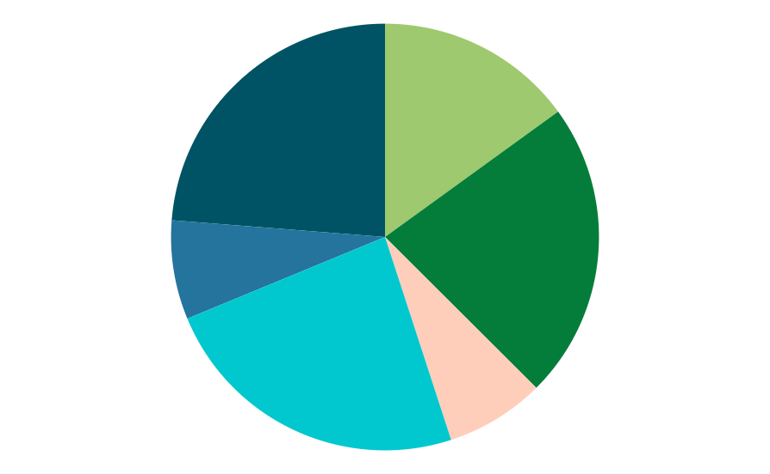
Expenditures in the World Economy
Asia
Europe
23,8%
15,0%
Africa
North America
7,5%
22,5%
South America
Oceania
23,8%
7,5%

Slide 8
3.04 trillion
According to a study published in the journal Nature

Slide 9
Water in Climate Change
9,700
6,800
8,030
7,568
Liters in 2020
Liters in 2018
Liters in 2019
Liters in 2017

Slide 10
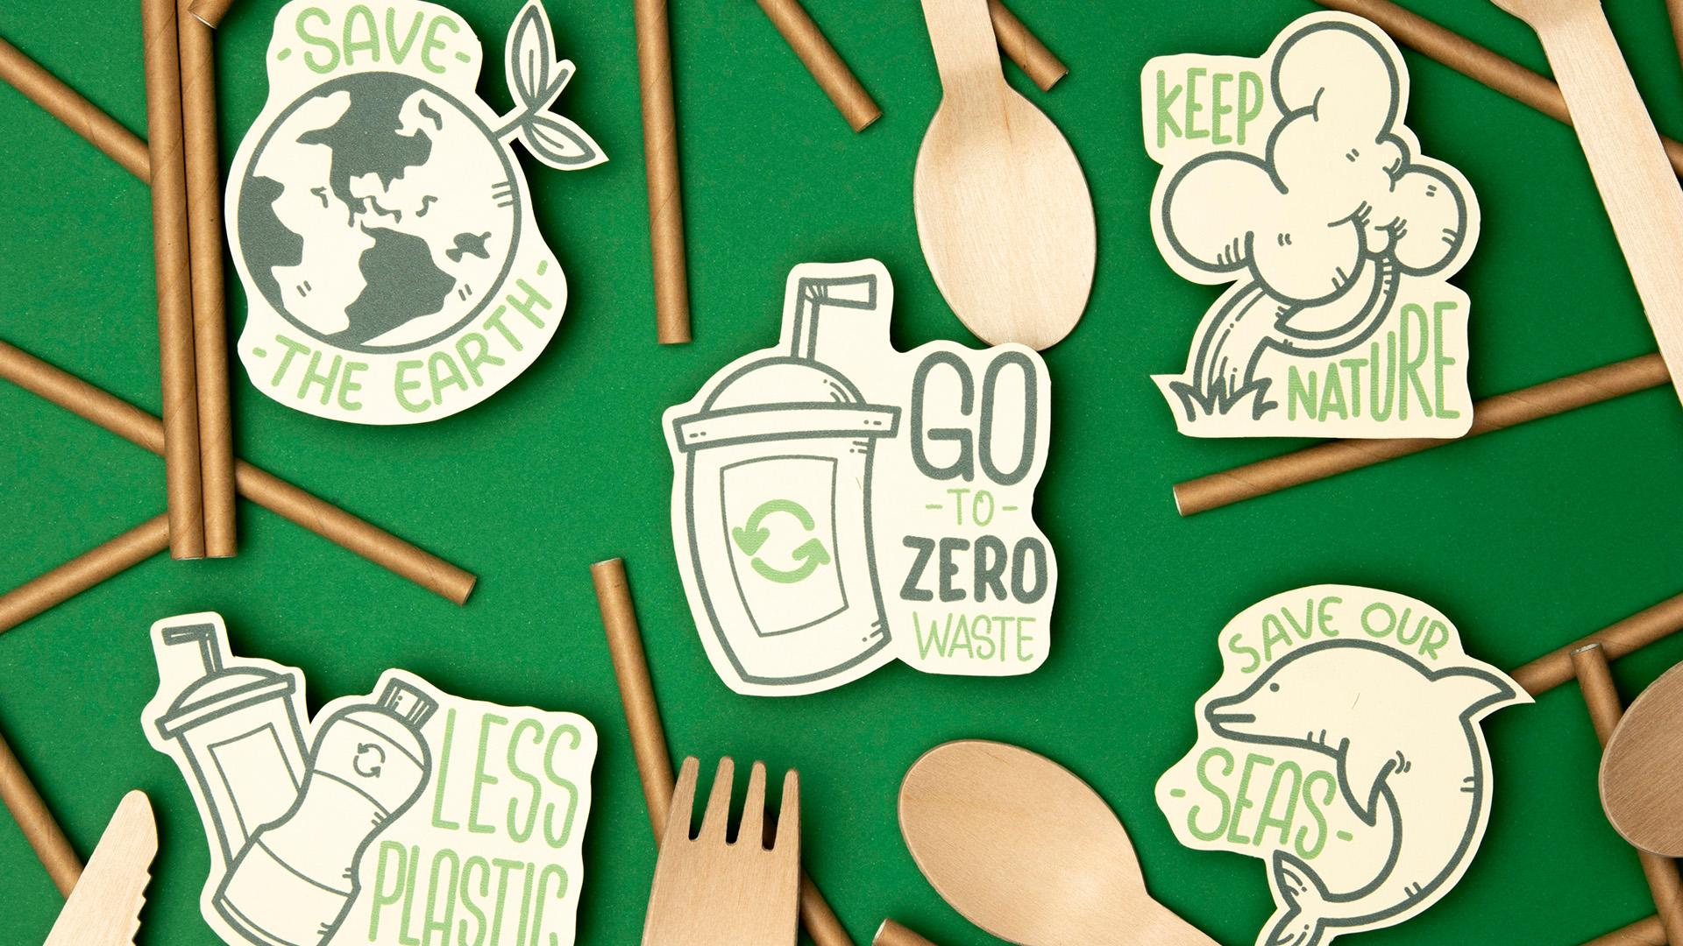
A Picture Is Worth A Thousand Words!

Slide 11
2
Tips and Recommendations

Slide 12
Recommendations
Eco Light
Bio Fruits
Glass
Reduce greenhouse emissions
Organic Agriculture
Prefering glass to plastics

Slide 13
Also Save the Animals
In Oceans
In Forests
Species adapted to life under sea ice are directly threatened by habitat loss due to climate change
Alteration of the frequency and intensity of forest disturbances lead to reduction of forest productivity

Slide 14
— Arnold Schwarzenegger
“We simply must do everything we can in our power to slow down global warming before its too late…. The science is clear. The global warming debate is over .”

Slide 15
Tips to Save the planet
Change a light!
Drive less!
Four R’s!
Packagings!
Electronics!
Plant a Tree!
Favoring compact fluorescent light bulbs.
Making less trips to (malls, parks, etc. …)
Reduce, Reuse, Recycle and Recover.
Avoid Products with a lot of packaging.
Turning off Electronics not in use is helpful!
A single tree will absorb a ton of CO2.

Slide 16
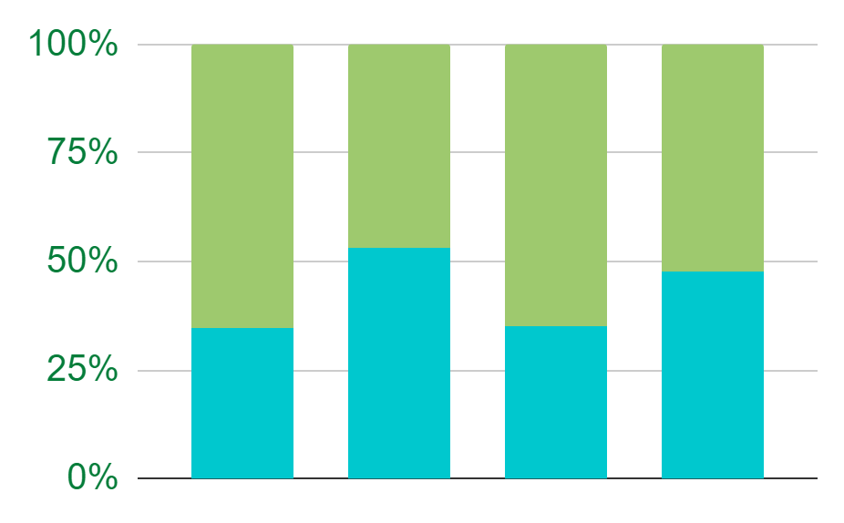
Recyclable Plastic
Plastic
Other
Recycled Plastic throughout the years ranging from 2018 – 2021.
2018
2019
2020
2021

Slide 17
3
Practice Zero Waste Concept

Slide 18
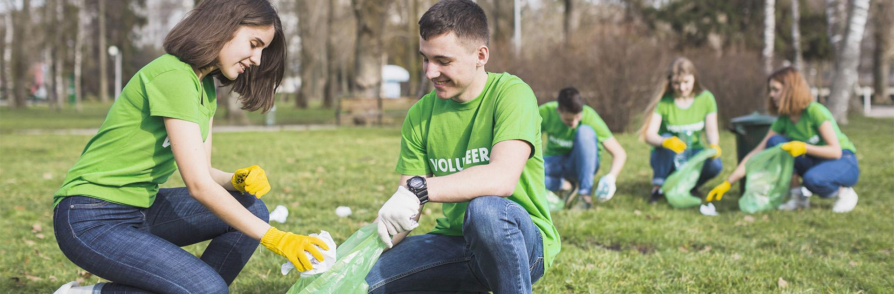
To do Volunteering Works...
A mission to create, promote and implement programs and policies that maximize management and conservation of resources, reduce greenhouse emissions.

Slide 19
Principal Recycling
Paper/ Cardboard
Glass
Plastic
65%
Turning old paper into new papers to use
31%
Readily available domestic materials
10%
Usage of Different resins to create plastic

Slide 20
Sustainable Development
The links between global climate change and sustainable development are unit sturdy. Poor and developing countries, are among those most adversely affected and least ready to deal with the anticipated shocks to their social, economic and natural systems.

Slide 21
Sustainable Features Matrix
Take urgent action to combat climate change
Sustainable Development
Promote
Favors
Clean air, safe drinking water, sufficient food
Helps the environment to regain its construct
Health
Environment
Biospheric and alturistic impact
Values
Improvement
Stimulates

Slide 22
Summary
Climate change is defined as gradual changes in all the interconnect weather elements on our planet over approximately 30 years.
Nevertheless, the conclusion is that natural systems around the world are being affected by regional climate changes, particularly temperature increases.
The data shows that the Earth is warming and it’s up to us to make the changes necessary for a healthier planet.

Slide 23
Resources
Wheeler N, Watts N. Climate change: from science to practice. Current environmental health reports. 2018 Mar;5(1):170-8.
Butler CD. Climate change, health and existential risks to civilization: A comprehensive review (1989–2013). International journal of environmental research and public health. 2018 Oct;15(10):2266.
Malhi Y, Franklin J, Seddon N, Solan M, Turner MG, Field CB, Knowlton N. Climate change and ecosystems: Threats, opportunities and solutions. Philosophical Transactions of the Royal Society B. 2020 Mar 16;375(1794):20190104.

Slide 24
Thank You!
Do you have any questions?
Feel free to ask anytime, and ask other people or use online resources!

