Slide 1

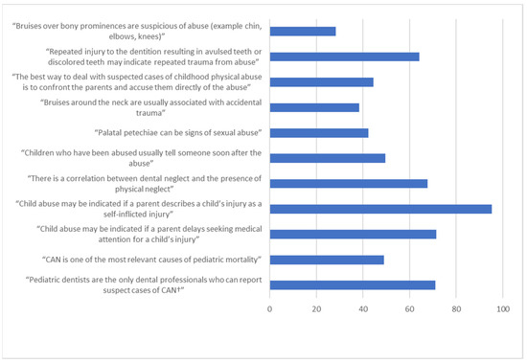


CHILD ABUSE RECOGNITION AND ROLE OF DENTIST DETECTING THEM
Analysis
NOT CONFIDENT
CONFIDET
Student name: Sara El-Shakmak
Student number: 2947
Year: 2nd dent
Introduction:
Methodology
Background: Child abuse and neglect (CAN) is considered a serious problem worldwide. Dentists have a significant role in recognizing and reporting CAN cases. Aim: The aim of this study was to assess the CAN-related knowledge and educational experiences among Saudi dental graduates. Design: Self-administered questionnaires were distributed to dental graduates from all dental schools in Saudi Arabia (n = 1552). Bivariate and multivariate logistic regression analyses were performed to assess the associations between knowledge level and different predictors. Results: A total of 988 dental graduates completed the questionnaire. The majority of them were dissatisfied with the amount of education they had received in their school (56.4%). Around 60% of the participants had inadequate knowledge regarding CAN. Graduates from government schools who received dental education about CAN and female participants had significantly higher odds of having adequate knowledge scores than others
Results/Findings
Conclusion:
”Somewhere in the world a child is suffering deliberate harm, inflicted by someone who is supposed to care about them, at this very moment. ”
Hinchliffe
RESOURCES
Sulimany AM, Alsamhan A, Alawwad AA, Aqueel M, Alzaid N, Bawazir OA, Hamdan HM. Knowledge Levels and Educational Experiences among Dental Graduates in Saudi Arabia Regarding Child Abuse and Neglect: A National Study. Children. 2021; 8(9):724. https://doi.org/10.3390/children8090724

