Slide 1


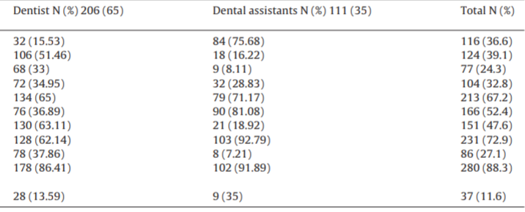
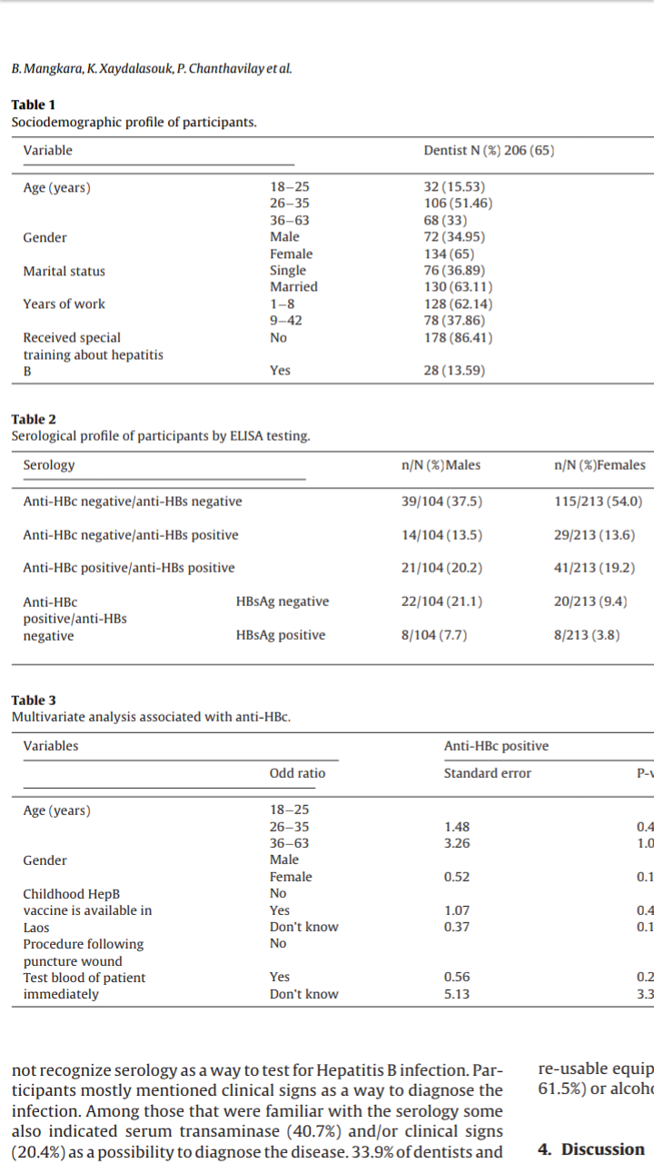
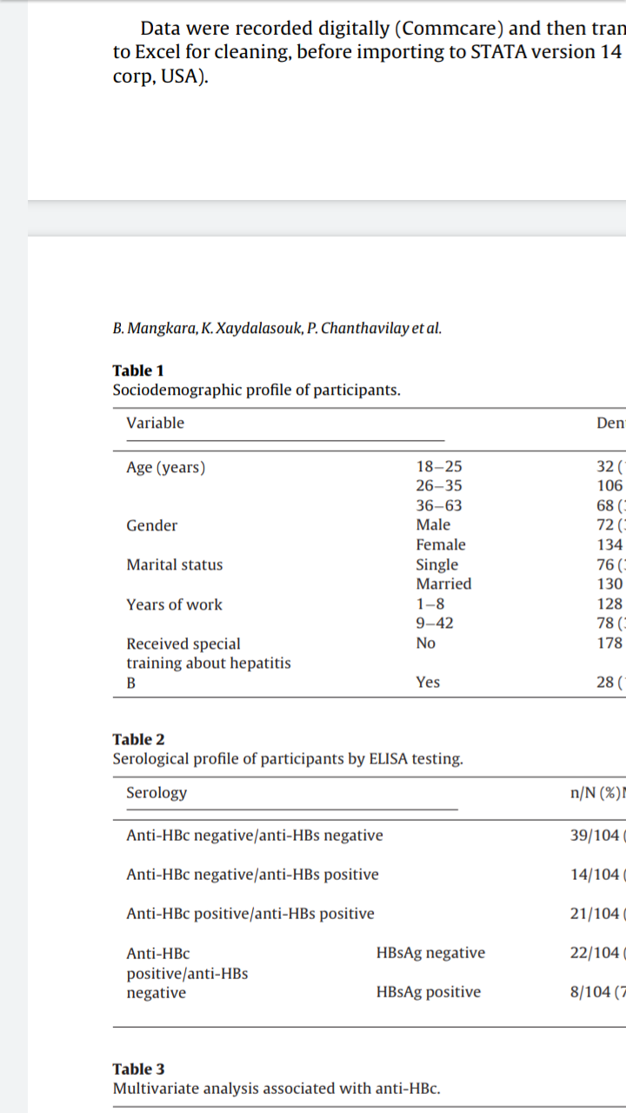
Hepatitis B in dental clinic
Safa Aljazwi / 2864
Introduction
Hepatitis B virus (HBV) is a global public health problem which hcan cause chronic infections, cirrhosis and liver cancer.
known as an occupational hazard among dentists
The virus is spread by blood and other body fluids such as by sexual intercourse , during pregnancy and birth and exposure to contaminated medical equipment. The WHO estimates that there are approximately260 million chronic carriers of HBV worldwide
risk factors among DCW in selected dental clinics in Sana’a city.
Materials and methods
Participant s This cross-sectional study
targeted dentists and dental assistants / aged 18–65 years
in Nasaythong, Saythany, Sikhottabong,Chanthabouly, Saysettha, Sisattanak and Hatsayfong districts of Vientiane Capital (March and May 2021).
The list of clinics was obtained from Lao Dental Association.
The clinics were contactedin advance to explain the purpose and method of the study
A sample size of at least 347 was calculated according
Written informed consent was obtained from all participants.
Questionnaire /Serology
Results
Discussion
Participants A total of 255 dental clinics
31 (12.1%) clinics could not be located
17 (6.7%) clinics were shut down
21 (8.2%)clinics refused to participate.
The reasons for refusal included: already screened for HBV; fear of needles; already vaccinated; busy with patients and “don’t want to be screened”.
186 clinics participated with 317 staff aged between 18–63 years including 206
dentists (65.0%) 111 dental assistants (35.0%).
The majority of participants were female (67.2%) and about half were married.
All dentists had completed 6 years at the Lao University of Health Science.
Dental assistants were either dental students or had completed 2–3 years vocational training in dentistry.
Very few participants (11.6%) reported to have had received training specifically on HBV.
Previous studies have shown that dentists are at high risk of infection Indeed , in the current study, about one quarter of participants said that they had accidental blood exposure during the last six months.
This confirms the high risk of HBV (and other blood-borne infections) in this group. Previous studies have confirmed that HBV infections among health care workers are caused by contaminated sharps or different percutaneous injuries such as wire injuries or cuts .
Other risks of infection can be blood splashes to the eye, nose or mouth during routine work. Infection of patients within the dental health-care setting can occur similar ways to the dentists them selves.
For example, skin prick with contaminated sharps or use of
contaminated equipment such as lancets or scalpels during surgical or routine dental practice
In this study, approximately two thirds of the participants were serologically unprotected against HBV infection, lacking anti-HBs antibodies. This large proportion of susceptible is concerning, and is higher than in a previous study in healthcare workers in Lao PDR
Conclusion and Recommendations
The prevalence of current and life time exposure to HBV infection
was high. Exposure to potentially infectious body fluids was high
and yet only a small percentage of DCWs were vaccinated, so there
is need to vaccinate all DCWs as a matter of policy and ensure a safer
work environment
Reference
[1] WHO. https://www.who.int/. Accessed 26th November 2020.
[2] Lewis JD, Enfield KB, Sifri CD. Hepatitis B in healthcare 2015;7
(3) http:// V. Hepatitis B and C infection dental practice. Dent 2013
[4] Garus-pakowska A, Górajski M, Szatko F. Knowledge and attitudes of dentist with respect to the risks of blood-borne pathogens
5- Res Public Health 2017;14(1):69, http://dx.doi.org/10.3390/ijerph14010069.

