Slide 1


Basics of
E-Government
Libyan International Medical University
Faculty of Business Administration
Name: Abdullah zwawi
Id: 2826
Email: Abdullah_2826@limu.edu.ly

Slide 2
Content
Introduction
The goal of e-government
The four types of e-government
Conclusion
Reference

Slide 3

Introduction
E-Government is the implementation of Information and Communication Technology in the government.

Slide 4
The goal of e-government
The primary goal of e-government, is to serve the citizen and facilitate citizen interaction with government by making public information more accessible through the use of websites.

Slide 5
Four types of services
Government to-Citizen | Government -to-business | Government-to-Government | Government-to-Employee

Slide 6
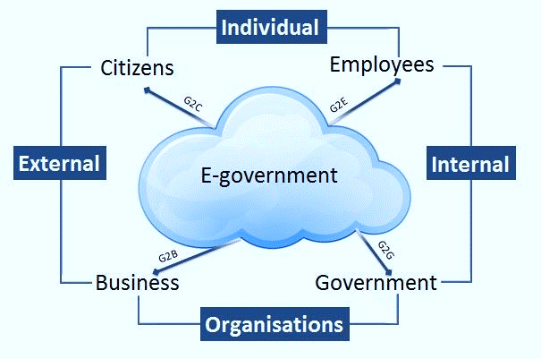

Slide 7
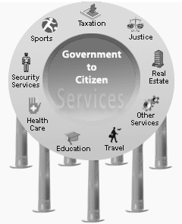
1.Government-to-Citizen
A citizen can have access to the services anytime from anywhere.

Slide 8
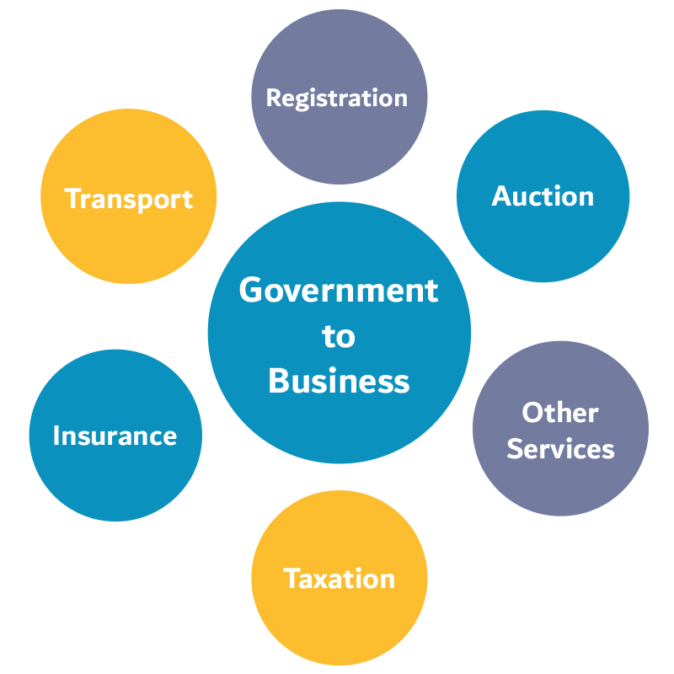
2.Government-to-business
Is the exchange of services between Government and Business organizations.

Slide 9

3.Government-to-Employee
aims to bring employees together and improvise knowledge sharing.

Slide 10
4.Government-to-Government
is the interaction between different government department, organizations, and agencies.

Slide 11
Conclusion

Slide 12
Reference
Editor Mina Aryal. “What Is E-Governance? What Are the Types of E-Governance Transactions?” ICT Frame Technology, 18 Mar. 2018, ictframe.com/what-is-e-governance-what-is-the-type-of-e-governance/. Accessed 12 Jan. 2021.

Slide 13
Thanks!
Any questions?
You can find me at:
abdullah_2826@limu.edu.ly

