Slide 1



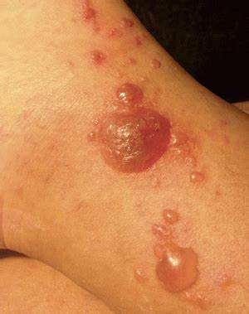
Skin cancer
Student name : FATIMA ALFAITORY .
Student number : 3280 .
Presentation date : SATURDAY ,4 .JUNE .
Year : 2021/2022 .
Block: PTS .

Slide 2
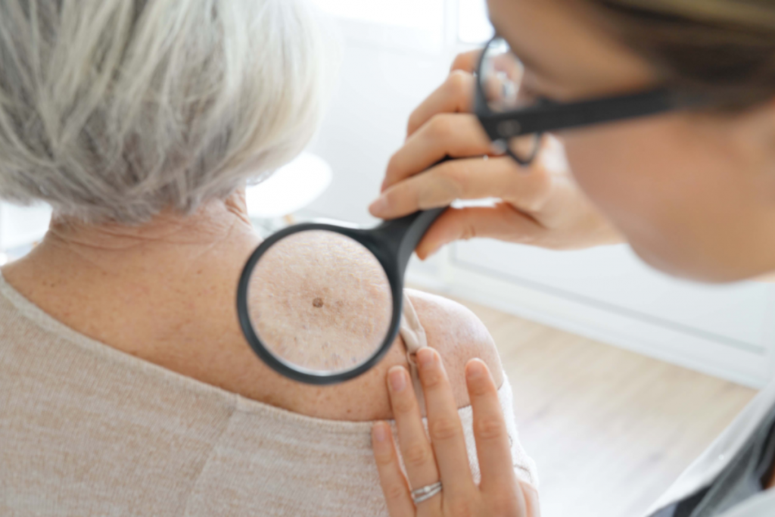
INTRODACTI0N :
Skin cancer is the most common form of cancer in the united states .
In 2021, doctors diagnosed more than 207,000 new cases of melanoma.
Another study found that 1 in 5 Americans developed non melanoma skin cancer by age 70 .
Non melanoma skin cancer refers to group of cancers that slowly develop in the upper layers of the skin .

Slide 3

Objective:
Define skin cancer .
Out line the Causes of skin cancer and list its risk factors.
Discuss different Types of skin cancer .
Out line treatment of skin cancer .
2

Slide 4

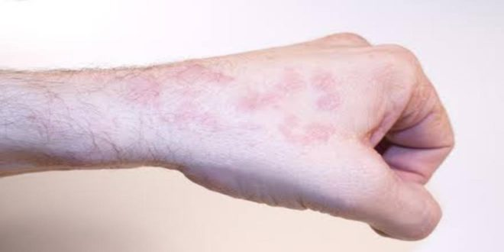
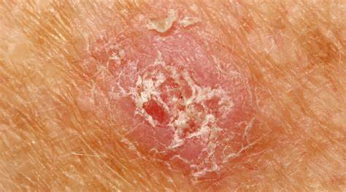
What is the skin cancer ?
3

Slide 5
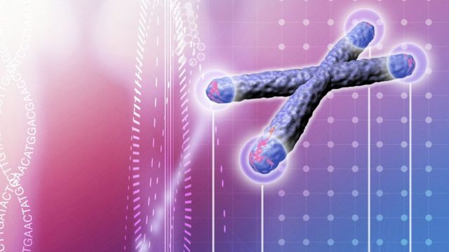

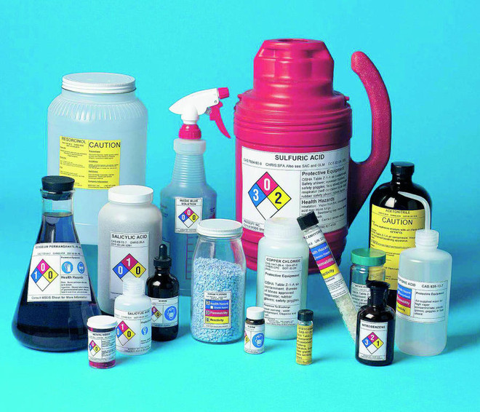

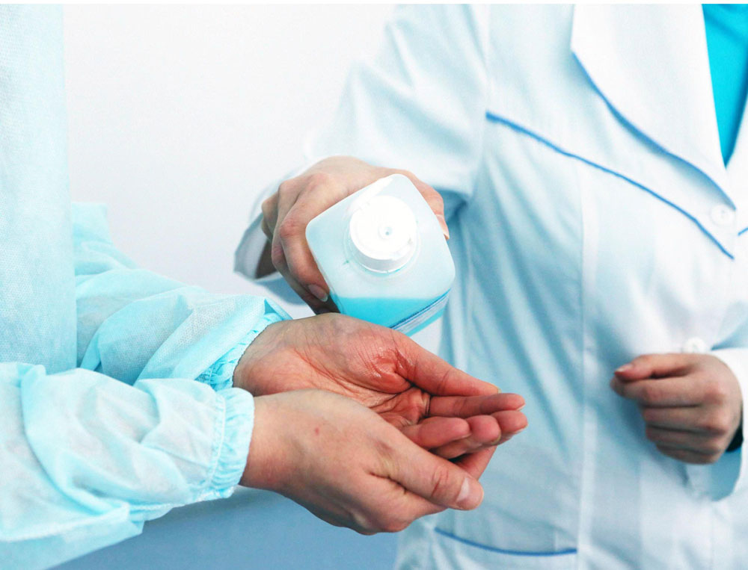
Causes of skin cancer :
UV radiation .
The fault in the genes .
Infection.
Pharmaceutical .
Chemicals .
4

Slide 6

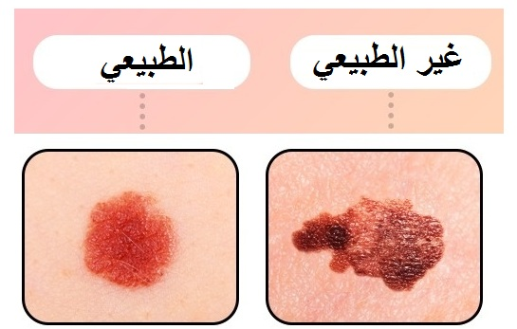
Risk factors of the skin cancer :
Actively tanned or used solariums .
Worked been exposed to arsenic .
A weakened immune system , this may having leukemia or lymphoma . .
Moles with an irregular shape and uneven color (dysplastic naevi ) .
A Previous skin cancer or a family skin cancer
Certain skin conditions such as sunspots .
5

Slide 7
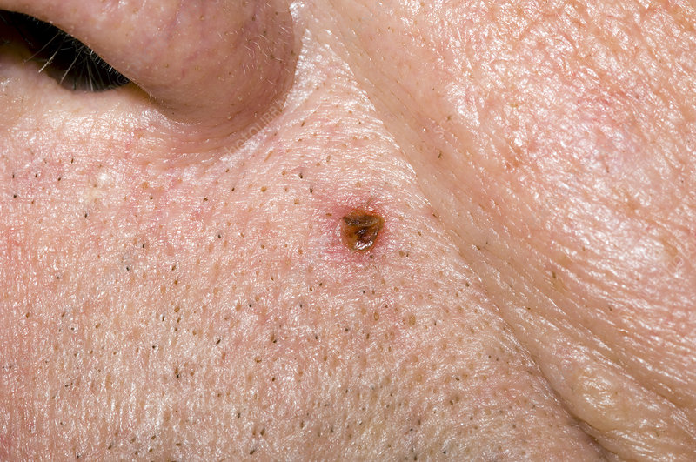
types of skin cancer :
The three main type of skin cancer are :
Basal cell carcinoma :
The most common type (about 66% of the skin cancer) , starts in basal cells of the skin .
Usually grows slowly over months or years .
Some BBC can grow deeper into the skin , invade nerves and damage nearby the skin , making treatment more difficult .
9

Slide 8
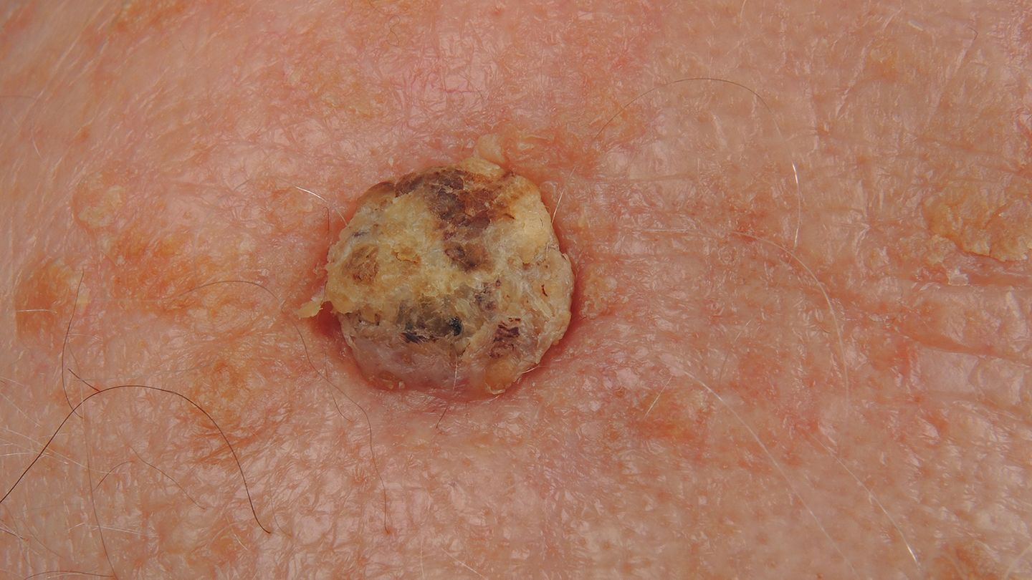
Types of skin cancer :
2. Squamous cell carcinoma :
the second most common type (about 33% of skin caner) , start in the squamous cell of the skin .
Usually grow quickly over several weeks or months .
Some are found only in the top layer of the skin , this called SCC in situ , inter epidermal or Bowens disease.
8

Slide 9
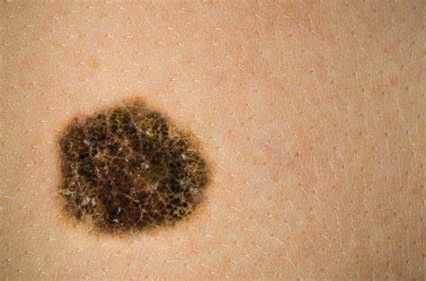
Types of skin cancer :
3. Melanoma :
Melanoma is one of deadliest forms of the skin cancer.
It grows very fast and can spread to the lymph nodes or internal organs .
Melanoma can be brown patch or bump.
And can be an irregular in shape .
Most melanoma grow out of normal skin.
9

Slide 10
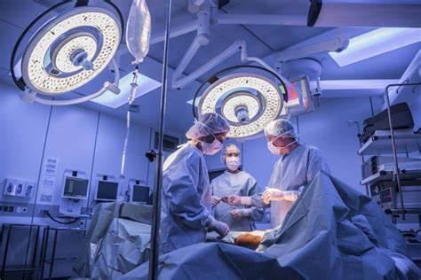
Treatment of skin cancer :
Surgery:
Surgery to remove the cancer is the most common treatment for invasive BCC and SCC .
Most small skin cancer are remove by a GP or dermatologist in their consulting rooms .
A Surgeon may treat more complex cases .
10

Slide 11
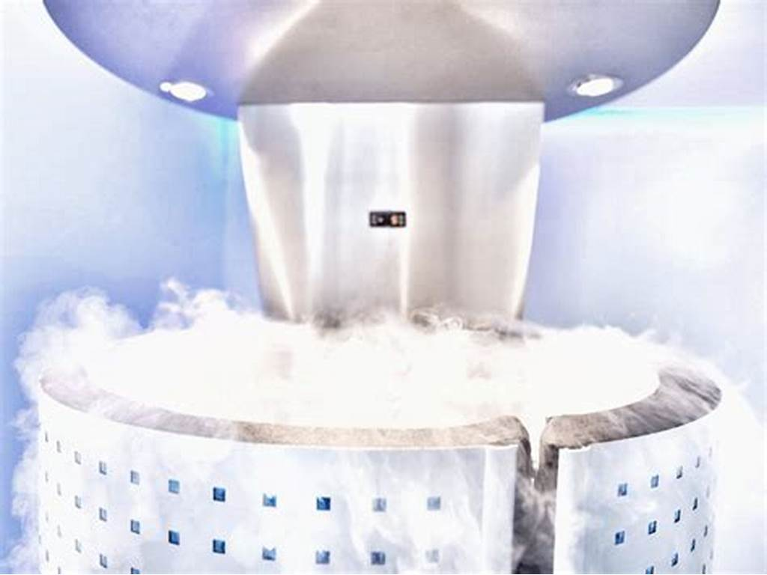
Treatment of skin cancer :
2. Cryotherapy :
Is procedure that uses extreme cold liquid nitrogen to remove sunspots and some BCC and SCC .
The GP sprays liquid nitrogen onto the sunspots or skin cancer .
The liquid nitrogen freezes and kills the abnormal skin cells and creates a wound in some .
11

Slide 12
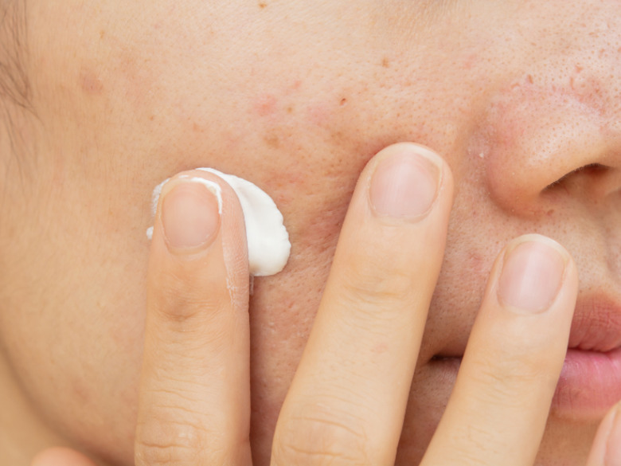
TREATMENT OF SKIN CANCER :
3. Topical treatment :
Some skin spots and superficial skin cancer can be treated with creams or gels that you apply to the skin . These are called topical treatment .
They may contain immunotherapy or chemotherapy drugs .
12

Slide 13

conclusion:
skin cancer is the uncontrolled growth of abnormal cells in the skin .
Skin cancer is one the most common cancers in the words .
The three main types of skin cancer BCC and SCC and melanoma .
BCC the most common type about 66%of the skin cancer and grow slowly .
SCC the second most common type about 33% of the skin and grow quickly .
Over 95% of skin cancer causes by exposure UV radiation .
Skin cancer can be treated by surgery , cryotherapy , topical treatment .
13

Slide 14
Reference :
Cancer Council Australia keratinocyte cancers Guideline working party, clinical practice Guidelines for keratinocyte cancer , cancer council Australia , Sydney, viewed 13 July 2021,available from wiki.cancer.org.au/Australia/Guidelines:keratinocyte__carcinoma.
Cancer Council Victoria and department of health Victoria , optimal care pathway for people with keratinocyte cancer (basal cell carcinoma or squamous cell carcinoma), second edition , cancer Counical Victoria , Melbourne,2021.
Australian institute of health and welfare (AIHW), skin cancer in Australia,AIHW,cenberra,2016.
Services Australia, Medicare Item Reports , Services , Australia, Canberra,2020,viewed 3 November2021 available from medicarestatistics.humanserives.gov.eu/statisics/mbs_item.Jsp.
14

Slide 15

Thank you ..

