Slide 1


Libyan International Medical University
Faculty of Business Administration
The Difference between Private and Public Sector
Name:Alaa Said Rashwan
ID:3313

Slide 2
TABLE OF CONTENTS
01
02
03
What is private and public sector
The differences between private and public sector
Introduction
04
05
06
Public or private
Conclusion
Reference
2

Slide 3
Learning Objective:
Recognise the difference between private and public sector.
3

Slide 4
Introduction:
Public Sector refers to the part of the Country's overall economy which is controlled by the Government or various Government bodies. The private Sector refers to the part of the Country's overall economy which is controlled by Individuals or Private Companies.“Madhuri , 2021“.
4

Slide 5
What is Private and Public Sector:
Private sector organisations are owned and controlled by entrepreneurs, private individuals, or groups of people. They are not owned or managed by government entities.
Public sector organisations are owned by the government. They provide goods and services for the benefit of the community and social welfare.They are run by the government. They operate with money raised from taxes.
5

Slide 6
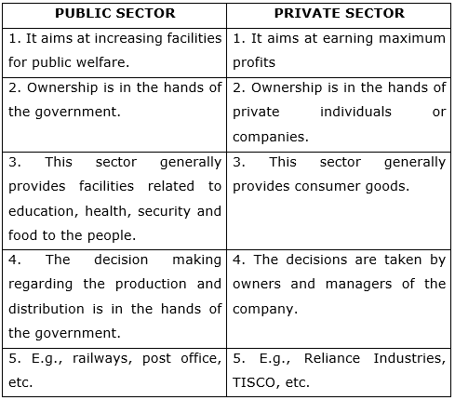
The Differences between Private and Public Sector
6

Slide 7



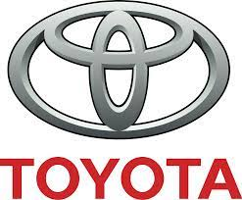
Public or Private
7

Slide 8
Conclusion
Private sector is owned by private individuals such as sole traders and partnership.
Public sector is owned by government such as schools,hospitals,and banks.
8

Slide 9
Reference:
Vaidya, A. byM. T. R. byD., Thakur, A. byM., by, A., Thakur, M., Vaidya, R. byD., by, R., Vaidya, D., Siaffa, J., isaiah, B., & Kiran. (2021, September 20). Public sector vs private sector. WallStreetMojo.
BBC. (n.d.). Types of organisation - types of business organisations - national 5 business management revision - BBC bitesize. BBC News.
GoCardless. (n.d.). What is the private sector? United Kingdom.
Goprep. (2019, February 18). Differentiate between public and private sectors.
9

Slide 10
THANKS!
10

