Slide 1


Libyan International Medical University
Faculty of Business Administration
The Major Obstacles Preventing the Effective Communication of Emotions
Name: Mohamed Fathi
ID:3761 Email:mohammed_3761@limu.edu.ly

Slide 2
Table of contents
01
02
03
04
05
06
The three main obstacles to effective communication
Introduction
Obstacle to effective communication
Conclusion
Reflection
References
2

Slide 3
Introduction
The process of communication has multiple barriers. The intended communique will often be disturbed and distorted leading to a condition of misunderstanding and failure of communication
3

Slide 4

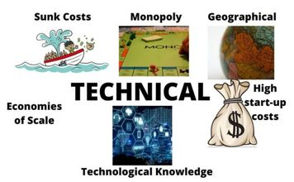

The three main obstacles to effective communication
OUR LOGO
Types of Effective Communication Barriers:
1:Language barriers.
Example>
2:Technical barriers.
Example>
3:Psychological barriers.
Example>
4

Slide 5
First obstacle to effective communication
Lack of alignment happens when what you mean is not what you say and/or what gets heard. It's the #1 obstacle to effective communication
5

Slide 6
The major difficulties in communication
Communication problems
1:Cultural differences
2:Attitude.
3:Lack of motivation.
4:Listening skills.
5:Written communication quality.
6:Appropriate communication tools.
7:Oversharing
6

Slide 7
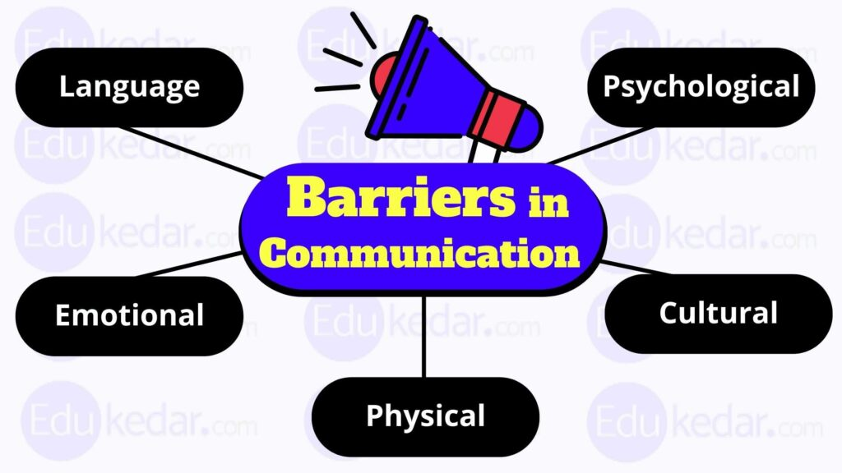
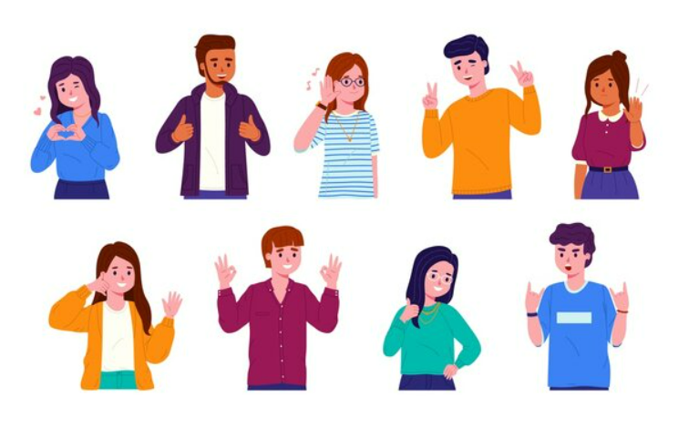
7

Slide 8
Conclusion
Communication may break down as a result of many communication barriers that may be attributed to the sender or receiver. Therefore, effective communication requires familiarity with the barriers. Choosing the right channel for communication is also important, because choosing the wrong medium undermines the message
8

Slide 9
Reflection
The emotions may also hold you back from listening to others attentively and accepting their point of view on matters discussed
9

Slide 10
References
Overcoming emotional barriers to communication. Nulab. (n.d.). Retrieved December 6, 2022, from https://nulab.com/learn/collaboration/overcoming-emotional-barriers-to-communication/
Communication barriers: 3 types of barriers to effective communication. SubjectQuery.Com. (2019, August 3). Retrieved December 6, 2022, from https://subjectquery.com/communication-barriers/
7 barriers to effective workplace communication. Pepper Content. (n.d.). Retrieved December 6, 2022, from https://www.peppercontent.io/blog/communication-barriers-in-the-workplace/
10

Slide 11

Thank you
Any question?

