Slide 1
Computer crimes
Objectives:
list types of computer crime, cybercrime, and computer criminals
talk about computer system security risks
01
03
discuss how technology advances privacy and anonymity are increasingly threatened
02
describe how to protect your computer system and yourself
define encryption and online information secure
04
05
Mohanned mohammed baltu
4062
describe challenges the government faces in balancing the necessity to decrypt data with the right privacy
distinguish between electronic discovery and computer forensics
06
07

Slide 2



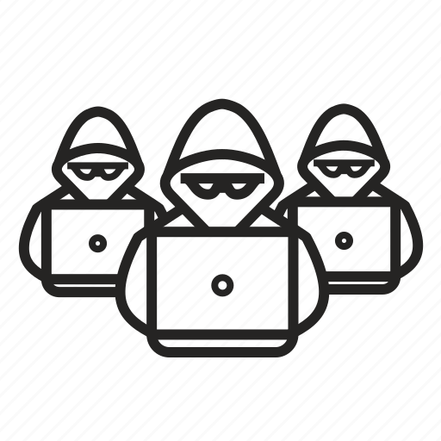
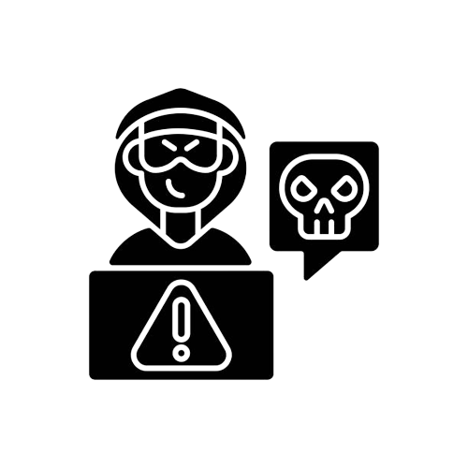



Objectives:
Cyberbullying
Hackers
list types of computer crime, cybercrime, and computer criminals
discuss how technology advances privacy and anonymity are increasingly threatened
talk about computer system security risks
01
02
03
Computer crimes
describe how to protect your computer system and yourself
define encryption and online information secure
04
05
Mohanned mohammed baltu
4062
Cybergangs
Cyberstalkers, Sexual Predators,
describe challenges the government faces in balancing the necessity to decrypt data with the right privacy
distinguish between electronic discovery and computer forensics
06
07
Swindlers Swindlers
Crackers
Ethical Hackers

Slide 3
list types of computer crime, cybercrime, and computer criminals
01
criminals
Computer crime, cybercrime
Hackers
Crackers
Cybergangs
Virus Authors
Identity Theft
Malware
Rogue Programs
Fraud, Theft, and Piracy
Cyber Gaming Crime
Tricks for Obtaining Passwords
Forgery
Internet Scams
Salami Shaving and Data Diddling

Slide 4
discuss how technology advances privacy and anonymity are increasingly threatened
02
Anonymity refers to the ability to convey a message without disclosing your name or identity
Anonymity is both a curse and a blessing.
On one hand, it can be seen as an abuse because it frees people from accountability.
On the other hand, as supported by the U.S. Supreme Courtit must be preserved in a democracy, to ensure that citizens have access to the full range of possible ideas to make decisions for themselves

Slide 5
talk about computer system security risks
03
Wireless Networks
Corporate Espionage
WEB WPA WPA2
vacation hacking
Information Warfare
Public Safety
Terrorism
Security Loophole Detection Programs

Slide 6
describe how to protect your computer system and yourself
04
how to protect your computer system
Several measures can safeguard computer systems, but none of them can make a computer system 100 percent secure.
A trade-off exists between security and usability: The more restrictions imposed by security tools, the less useful the system becomes.
you should always use a surge protector.

Slide 7
how to protect yourself
Do business with established companies that you know and trust.
Read the fine print. If you’re ordering something, make sure it’s in stock and that the company promises to deliver within 30 days
Don’t provide financial or other personal information or passwords to anyone, even if the request sounds legitimate.
Be skeptical when somebody in an Internet chat room tells you about a great new company or stock

Slide 8
define encryption and online information secure
05
Cryptography
is the study of transforming information into an encoded or scrambled format.
Individuals who practice in this field are known as cryptographers.
Encryption refers to a coding or scrambling process that renders a message unreadable by anyone except the intended recipient.

Slide 9
describe challenges the government faces in balancing the necessity to decrypt data with the right privacy
06
The U.S. government continues to look for ways to balance the government’s need to know with the public’s right to privacy. The government recently released a new random-number standard, a critical component of encryption methods. However, a backdoor was discovered that could enable someone to crack the code, compromising the security of this encryption and obtaining confidential information. The U.S. government understands the importance of encryption and the need to collect information, but within the limits of retaining the privacy of its citizens.

Slide 10
distinguish between electronic discovery and computer forensics
07
Computer Forensics
E-Discovery
Computer forensics, a complex branch of forensic science, pertains to legal evidence found in computers and digital storage media.
It is a field that requires careful preparation and procedural strictness. Because of the scope and technical requirements of this field, there are many subsections such as firewall forensics and mobile device forensics. However, all have the same purposes: to analyze computer systems related to court cases, evaluate a computer after a break in, recover lost data, gather evidence against an employee by an employer, and reverse engineer.
E-discovery, an abbreviated term for electronic discovery, is the obligation of parties to a lawsuit to exchange documents that exist only in electronic form, including e-mails, voicemails, instant messages, e-calendars, audio files, data on handheld devices, animation, metadata, graphics, photographs, spreadsheets, Web sites, drawings, and other types of digital data. Advances in technology have created an ever-expanding universe of such documents, making e-discovery more expensive, time-consuming, and burdensome than ever before.

Slide 11
Reference
Book: Computers Are Your Future, Author: Catherine LaBerta, Chapter9 .

