Slide 1


Planning and Levels of Planning
Libyan Medical International University
Faculty of Business Administration
Name: Saif Hamdi Rashed
ID:2963

Slide 2
Content
Introduction
Planning and Levels of Planning
Conclusion
References

Slide 3
Introduction
Planning involves selecting missions and objectives and the actions to achieve them An important aspect of planning is decision making - that is choosing the right alternatives for the future .

Slide 4
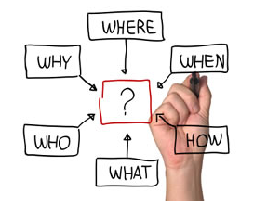
Define the Planning
  Planning is the fundamental management function, which involves deciding beforehand what is to be done, when is it to be done, how it is to be done and who is going to do it is an mental process which lays down an organisation’s objectives and develops various courses of action.

Slide 5
Level of Planning
Strategic
A strategic plan is the company’s big picture It defines the company’s goals for a set period of time, whether that’s one year or ten, and ensures that those goals align with the company’s mission, vision, and values. Strategic planning usually involves top managers

Slide 6
Tactical
The tactical strategy describes how a company will implement its strategic plan. A tactical plan is composed of several short-term goals, typically carried out within one year, that support the strategic plan. Generally.

Slide 7
Operational
Operational plans encompass what needs to happen continually, on a day-to-day basis, in order to execute tactical plans operational plans could include work schedules, policies, rules, or regulations that set standards for employees

Slide 8
Conclusion
The planning process of any organization is essential to the overall success of thecompany. All levels of planning must do their part to incorporate situational analysis, alternativegoals and plans, goals and plan evaluation.

Slide 9
References
What is Planning? definition, characteristics, steps and importance - Business Jargons. (2016). Retrieved 12 April 2022,
Organizational Planning Guide: Types of Plans, Steps, and Examples | Pingboard. (2020). Retrieved 12 April 2022,

Slide 10
Thank You ALL

