Slide 1

Medical Statistics
Dr. Amina Muftah Elsaid
Community Medicine

Slide 2

Objectives of lectures
-Statistics definition
- Type of statistics
- Type of data and variables
-Descriptive statistics
-Summarization of data
-Presentation of data
-Inferential statistics
-Comparisons and Association
-Hypothesis testing
-Normal distribution curve
- Sample definition
-Sampling techniques
-Sample types
-Sample size determination

Slide 3
Is a scientific field that deals with the collection, classification, description, analysis, interpretation and presentation of data
Medical statistics is a branch of statistics concerned with medical data
Types of statistics
1- Descriptive statistics ; tries to describe a situation. It consists of organization ,summarization, and presentation of data
2- Inferential ; numerical techniques for making conclusions about a pop. Based on the information obtained from a random sample drawn from that pop. Inference is done through estimation of pop. Parameter or hypothesis testing .

Slide 4
Data and information
Data ; are sets of values of one or more variables
( e.g. age, sex, education, received vaccination for rubella etc. ) collected from records, interviews, observations, research, etc. the data should be managed to provide information.
Information; it is the meaningful transformation of data to be evaluated and interpreted for specific use

Slide 5
Example;
Data ; A child’s body temp. is 37.9 C
Information; This child has mild fever
----------------------------------------------------------------------------
Data ; The no. of women using contraceptives is 600
Information ; In a pop. Of 1000 women of reproductive age the contraceptive prevalence rate (CPR ) is 60%

Slide 6
Classification of data
1- Primary data ; data collected by the investigator himself.
2- Secondary data ; data not collected by the investigator ,example medical records and cancer registry data

Slide 7
Variables
Definition ; is a type of information / characteristic being measured that varies among the persons , events, or objects being studied .
The variables could be quantitative or qualitative

Slide 8
Types of variables
A- Quantitative variables ; the measure is expressed in numbers.
1- Discrete variables; measurements of the different values of the variable are separated. They have a Countable number of values with no fraction.
Examples ; No. of live birth per mother
2- Continuous variables ; the measurements of the different values take on any numerical value within the variable’s range
Example ; weight , height , blood pressure, blood sugar
hemoglobin in gm.

Slide 9
B - Qualitative variables ;
1- Nominal variables ; the measurements have no specific order
they are called categorical variables
Example; sex ( males ,females )
In case of having two categories, it is called dichotomous variables
( have the disease or do not have the disease, vaccinated and not
vaccinated .
2- Ordinal variables; the measurement could be arranged in certain order.
Examples ; for disease conditions ( mild , moderate , severe ), for measuring knowledge (high, medium, low and no knowledge )

Slide 10
Variable
Quantitative
Qualitative
Numeric
Categorical
Continuous
BP, Ht. , Age
Discrete
No. children
No of Asthma attack/week
Ordinal
Grade of cancer
HTN; mild ,moderate, Severe
Nominal
Male or female
Bl. gp. A,B,O

Slide 11
Types of statistics
I- Descriptive statistics
Description is done through :
1- Summarization of data ( calculation of summary statistics )
2- Presentation of data a- Tabulation
b- Graphics
1- Summarization of data
statistics are not only good summary of data, but also are
used for statistical comparison and testing
A- for qualitative variables, a statistic is either proportion or ratio
Proportion = part x 100
total
Ratio = part 1
Part 2

Slide 12
Example
A sample of 80 individual, 20 males and 60 females.
1- The proportion of males in the sample = 20/80 x 100
= 25%
2- The ratio of males
= 20 : 60
= 1: 3 ( i.e. there are 1 male for each 3 females)

Slide 13
B- for quantitative variables :
1- Measures for central tendency ( location )
A way of summarizing the data using a single value that is most representative of the entire data set.
Mean ( average )
-The sum of values divided by their number.
is the most important because it calculated using all observations
- Affected by extreme value
- Used with numerical data only
Example;
If age of 5 children in year = 2,1,4,1,2
Arithmetic mean = 2+1+4+1+2 = 2 years

Slide 14
* The Median
The middle value of an orderly arranged group of values
or that divides the data into equal sets
For median calculation
1- Arrange values from lowest to highest
2- Depending on number of cases or observations proceed as
follows:
a- If No. of observations (n) is odd (e.g. 9 ) then;
the median = ( n+1 )/ 2
= (9+1)/ 2 = 5th value
b- If No. of observations is even ( 10) then there will be two values in the middle ,their ranks are n/ 2 and n/2 + 1
10/ 2 = 5 and 10/2 + 1 = 6
the median = average of the 2 values of the 5th
and 6th observations

Slide 15
Examples
Data set | Arranged data set | Observation no. | Median rank | Median
3,4,2,5,7 | 2,3,4,5,7 | 5 (odd) 1 value in middle | 5+1/2=3rd value | 4
3,4,2,5,7,5 | 2,3,4,5,5,7 | 6 (even) 2 values in the middle | 6/2=3rd and 3+ 1 = 4th = average of 3rd and 4th values | 4+5/2= 4.5
- Appropriate for ordinal scales
- Does not take into account the value of each and every score in the data
- Does not affect by extreme value.

Slide 16
*The Mode
-The most frequent value
- Appropriate for nominal scales
- Does not affected by extreme value
-There may be no mod or more than one mode ( bimodal, tri
modal, etc. )
Example
height values of 8 persons are 120, 111, 110 ,102 ,110, 98,110 , 98
Mode = 110 cm

Slide 17
2- Measures of variation or dispersion
We measure the extent of variation in a data set by calculating the measures of dispersion.
These include ;
a- Range
-The difference between smallest and largest observation.
- Does not consider the value of each observation
- Highly affected by the extreme values (outlier )
- Best for symmetric data with no extreme values
Example
Data set 2 , 3, 4, 6, 7,10
The range = 10 - 2
= 8

Slide 18
b- Variance and Standard Deviation
These measure the variability(difference)of values around the mean
The variance; ( average of square differences around the mean ) is the sum of the squared deviations from the mean divided by the no. of observation/ values minus one (n-1)
The standard Deviation; is the square root of the variance
SD has the same units as the observation values ( if speak about age in years, the variance unit is squared year while standard deviation unit is year )

Slide 19

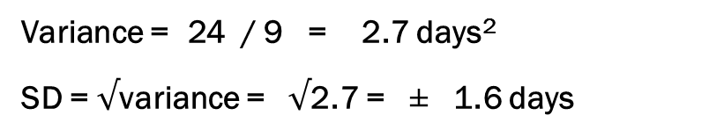
Example
The following sample is about no. of days 10 students were absent in the first term.
Values (absence days) | Deviation of each value from mean | ( value – mean )2
1 | 1-3= -2 | 4
1 | 1-3 = -2 | 4
2 | 2-3 = -1 | 1
2 | 2-3 = -1 | 1
3 | 3-3 = 0 | 0
3 | 3-3 = 0 | 0
3 | 3-3 = 0 | 0
4 | 4-3 = 1 | 1
5 | 5-3 = 2 | 4
6 | 6-3 = 3 | 9
Mean= 3 days |  | 24
Variance = 24 / 9 = 2.7 days²
SD = $√$variance = $√$2.7 = ± 1.6 days

Slide 20
Steps to calculate SD
Calculate the mean of all measurement
Calculate the differences between each individual measurements and the mean,
Square all these differences
Sum of all squared differences
Divide this sum by the no. of measurements minus one ( this is the variance)
the square root of the value obtained (variance ) = SD

Slide 21
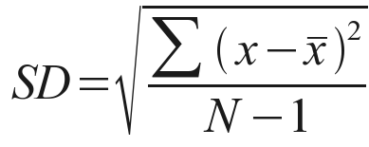
A large SD shows that there is a wide scatter of measured values around the mean
While a small SD shows that the individual values are concentrated around the mean with little variation.
X = value of each observation
X = mean value
N = no. of observation
∑ = sum of all values

Slide 22
C- Percentiles
Points that divided all the measurements / observations into 100 equal parts.
To determine percentiles, the observations should be first arranged from the lowest to the highest values, just like when finding the median, which is the 50th percentile ..
75th percentile is the value such that 75% of the observations fall below it and 25% percent fall above.

Slide 23
Example
100 newborn children was weighted and data arranged from the lowest to the highest.
Value (score) of 95th percentile = 3.8 kg
95% of children had body wt. < 3.8 and 5% had body wt. > 3.8 kg
Value of 5th percentile = 2.5kg
5% had body wt. < 2.5 and 95% had body wt. > 2.5 kg.
Children are considered within normal wt. if they are between
2.5 - 3.8 kg
5th and 95th percentile

Slide 24
D-Inter – Quartile range
Difference between third quartile (75th percentile ) and the first quartile (25th percentile )
so the middle half of the values. ( IQR = Q3 – Q1)
1st
Quartile
2nd
Quartile
3rd
^{Quartile}
25th
Percentile
Median
75th Percentile
50th
Percentile

Slide 25
2- Presentation of data
-Data could be presented by tables and / or graphs
-Both tables and graphs should be self- explained, easily understood without references to the text.
- Graphs are more capable of gaining attention, and giving quick idea about the general situation.
- Graphs are not substitutes for tables as they use approximate values.

Slide 26
A- Tables
Tables are constructed to present the data in a concise form.
A good table must have
A title describing its contents
Suitable No. of rows ( 4- 12) , avoid rows with zero frequencies
Header for each column and each row
Appropriate totals
Meaningful percent from row or column
Not everything displayed in the table needs to be mentioned in the text
It is useful to round No. in the table to one or two decimal places.

Slide 27
Types of tables
1- Simple tables, is shows the distribution of individual over one variable
* Data on qualitative variables ( ordinal or nominal ) with few categories, can be presented by simple table showing frequency / percentage of each value
Example ; Sex distribution of cases.
Sex | Number | Percent
Males Females | 4 6 | 40 60
Total | 10 | 100.0

Slide 28
For quantitative ( discrete or continuous ) variables with many possible values, we usually combine categories in some meaningful ways before constructing a table
Example ; Age distribution of cases
Age groups | Number | Percent
25- 30- 35- 40- 45- | 2 4 1 1 2 | 20 40 10 10 20
Total | 10 | 100.0

Slide 29
2- Cross tabulation of data
Tables used to analyze the relation between two or more variables most usually categorical variables.
Example
Distribution of studied individuals according to diagnoses obesity and diabetes conditions
Diabetes | Obese |  | Not- Obese |  | Total
 | No. | % | No. | % | No. | %
Diabetes | 68 | 28.3 | 12 | 7.5 | 80 | 20.0
Non – diabetes | 172 | 71.1 | 148 | 92.5 | 320 | 80.0
Total | 240 | 100.0 | 160 | 100.0 | 400 | 100.0

Slide 30
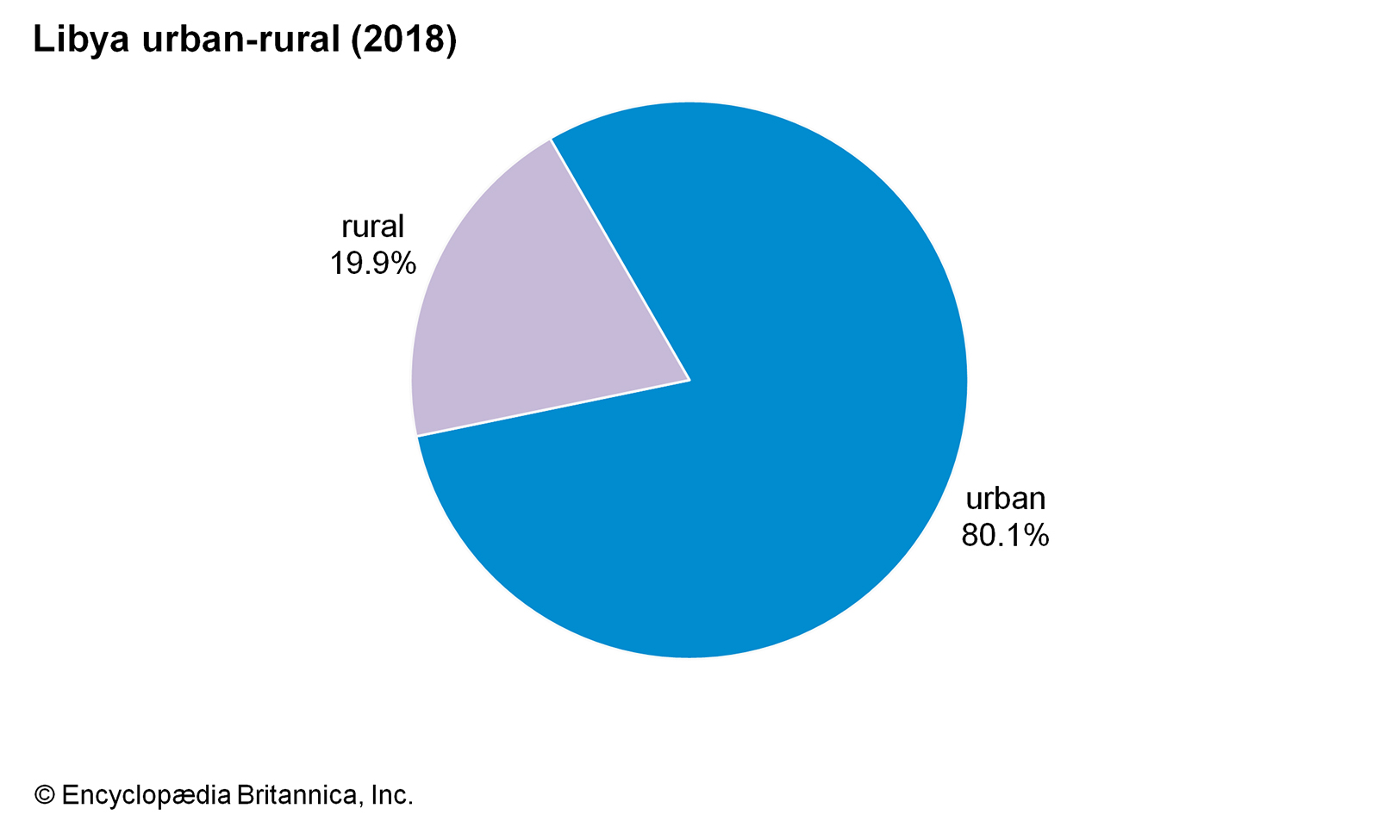
B- Graphs
1- For qualitative variables ;
to present data derived from qualitative variables ( nominal and ordinal ) , two types
Pie chart ;
It is a circle that has been portioned into percentage distribution
to construct the pie chart the total area is 100 % , with 1%
equivalent to 3.6 of circle

Slide 31
cont. pie chart
- We should use the percentages corresponding to each category
(not absolute frequency of each category ).
- Read the pie chart by beginning at 12 O’clock position and
proceeding clockwise
-Use no more than six sectors ; clarity is lost
- Make sure that sum of pie chart sectors equal 100%

Slide 32
Bar chart
In constructing bar charts, category labels are usually listed horizontally in systematic order.
Vertical bars are drawn to represent frequency or percentage (relative frequency) In each category
A space separates each bar to emphasize the nominal or ordinal nature of variable
It could make it easier to compare uni-variate distributions for two or more groups e.g. chart presents

Slide 33
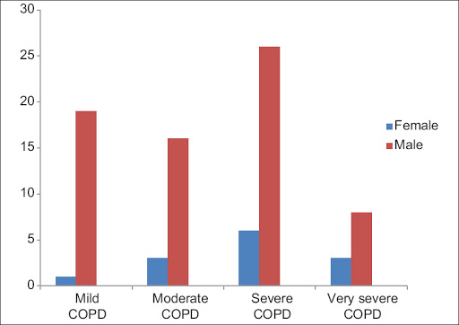
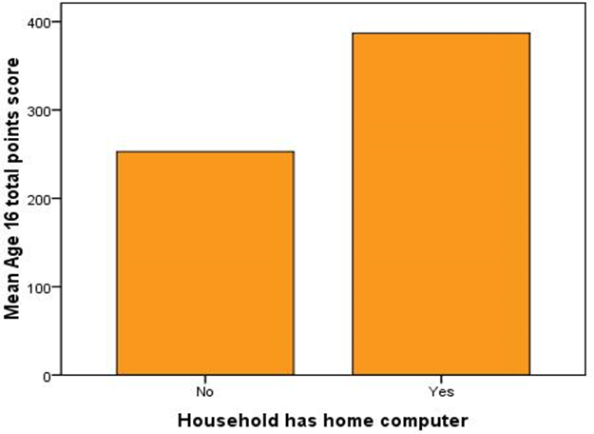

Slide 34
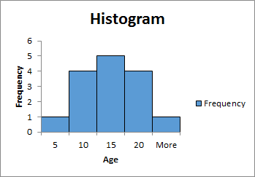
2- For quantitative variables
- to present data derived from quantitative variables ( discrete, and continuous ),we can used ;
A-Histogram
- for continuous variables
- similar to bar chart but in histogram bars are placed side by side
bar area represents the percent ( frequency) falling with each interval
Each histogram has a total area of 100%

Slide 35
B- Frequency Polygon
Is more useful for comparing two or more distribution.
The mid points of the class intervals are usually used on the horizontal axis,
The vertical axis still represents the frequencies ,
It is suitable only for quantitative data and can be continuous used for continuous and discrete data

Slide 36
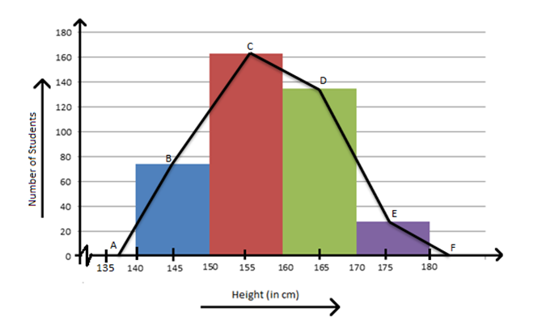
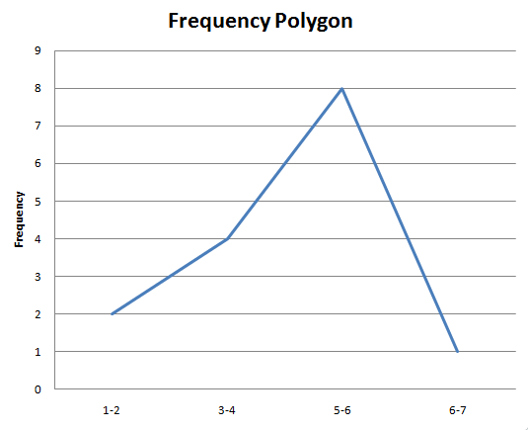

Slide 37
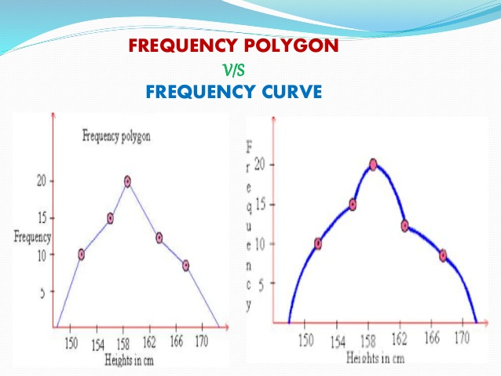
C – Frequency curve
By smoothing the sharp edges of frequency polygon we will get a frequency curve

Slide 38
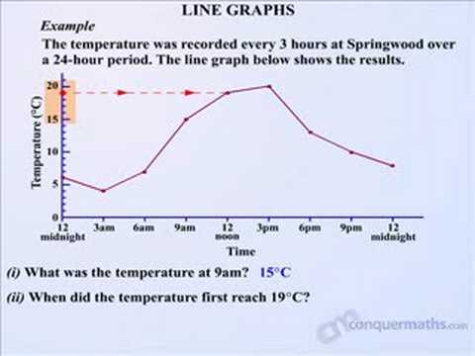
D- line graphs
A line graph is particularly useful for numerical data if you wish to show a trend over time

Slide 39
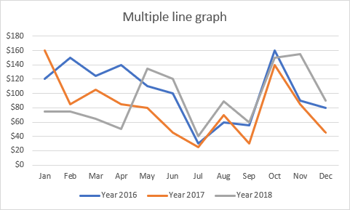

Slide 40
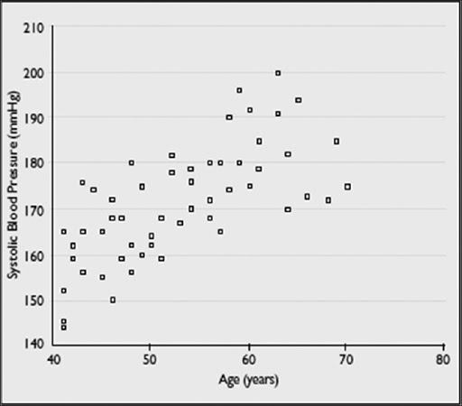
E- Scatter diagrams (plot)
- Useful for showing information on two quantitative variables
which are possibly related.
- Each point in the diagram represents the two variables for one
person
- used to display two quantitative variables against each other
Example how SBP changes with age

Slide 41
F- The box plot
- it is the five no. summary.
- The central box spans the quartiles
- a line within the box marks the median (Q2)
- lines extending above and below the box mark the smallest and
the largest observations ( i.e. the range)
- useful for comparing large sets of data
a box – plot is a visual description of the distribution based on
Minimum
Q1
Median (Q2)
Q3
Maximum

Slide 42
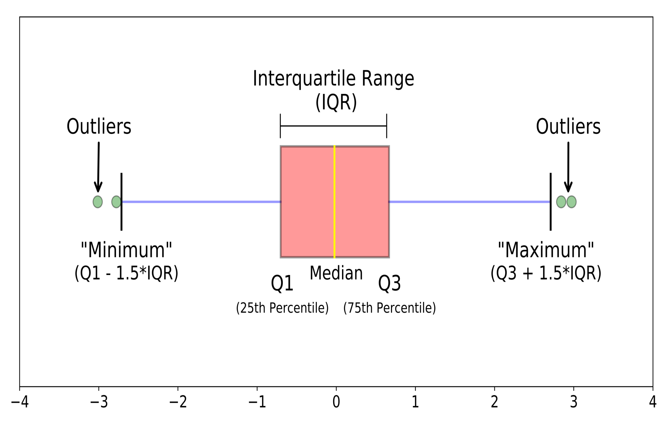

Slide 43
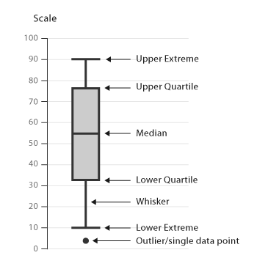

Slide 44
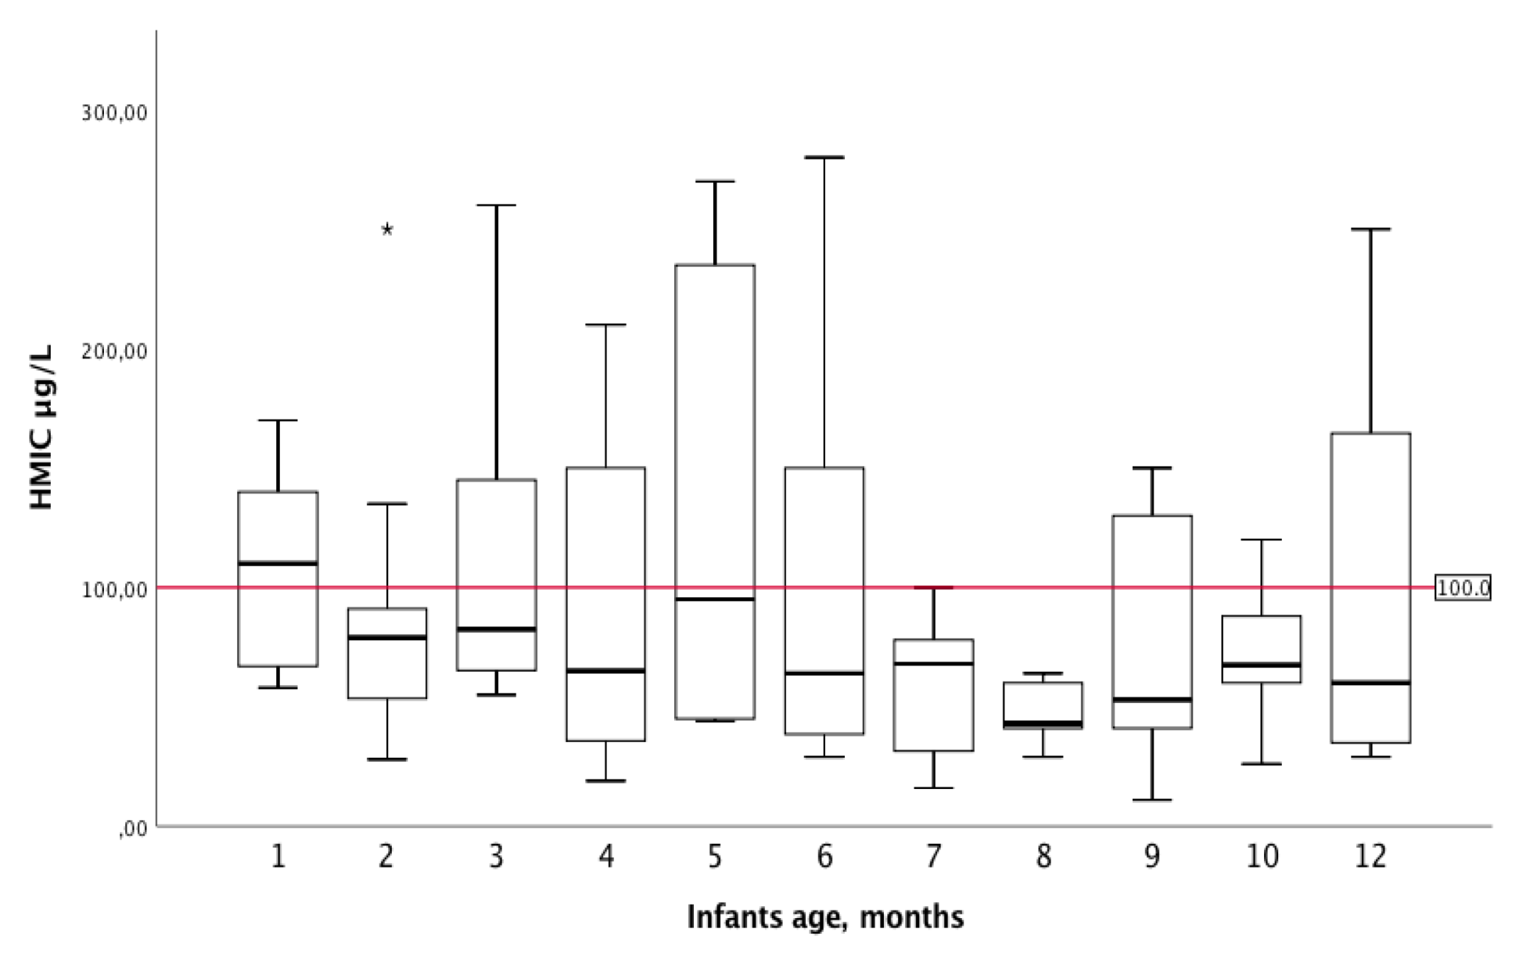
Human Milk Iodine Concentration - age

Slide 45
II- Inferential statistics
A- Comparisons between groups where tests of significance
are used.
Example
- Comparing mean cholesterol level ( quantitative )
among males and females using independent sample
t-test
- Comparing the proportion of diabetes ( qualitative )
among obese and non-obese using chi square test.

Slide 46
B- Association: correlation and regression.
1- Correlation; determining linear relationships between
variables indicates degree to which variables are related.
The correlation coefficient “ r” ranges -1 to 1
close to -1 = strong negative correlation
close to 1 = strong positive correlation
Pearson product-moment correlation; used with interval or ratio data
Spearman rank-order correlation; used when one variable is ordinal and second is at least ordinal

Slide 47
Interpretation of correlation coefficient
r = o No relationship
r = 1 Perfect linear relationship
r < 0.4 Weak relationship
0.4 ≤ r ≥ 0.7 Moderate relationship
r > 0.7 Strong relationship

Slide 48
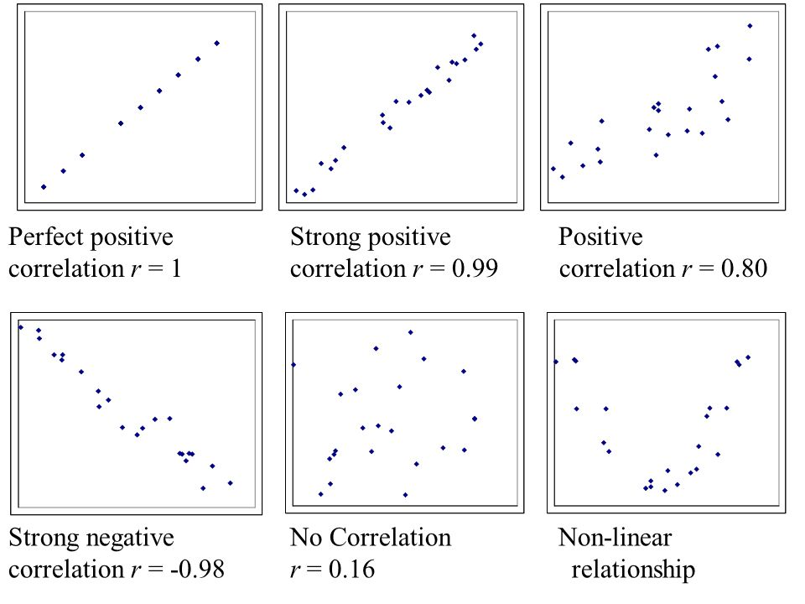

Slide 49
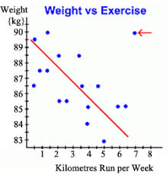

Slide 50
2- Regression ;
Making predictions about one variable (dependent ) when independent variable (s) is / are known using the
regression equation.
- when two quantitative variables are correlated and one is
known and other can be predicted
e.g.
Predicting height of young children by knowing their age

Slide 51
Hypothesis testing
An investigator conducting a study usually has a theory in mind
for example
patients with diabetes have a higher blood pressure than
non – diabetics .
this theory is known as the study hypothesis or the alternative
hypothesis.
The converse of the study hypothesis is the null hypothesis
e.g. diabetic patients do not have raised blood pressure
The statement being tested in a test of significance is the null
hypothesis

Slide 52
Ho = Null hypothesis
there is no significant difference
Ho = Alternative hypothesis
there is a significant difference ( two- sided)
this is significantly higher / lower ( one – sided)
Type I error
Incorrect rejection of Ho ( reject Ho when it is true ) concluding that there is difference when the difference occurs only by chance
Type II error
Incorrect acceptance of Ho when the H1 is true ( accept Ho when it is false ) concluding that there is no difference when such difference exists

Slide 53
Level of significance (α )
Is the probability of rejecting Ho ( null hypothesis ) when it is true
Probability of type II error (β ) : is the probability of accept Ho when it is false

Slide 54
Power of the test:
is the probability of rejecting Ho when it is false
power = 1 – β
Testing ---- location p - value ( significance level )
Significance level of 5% ( p< 0.05 ) means at most a 5% chance that this difference is due to random uncertainty and not real
P- value > significance level: accept Ho, cannot prove that observations and expectations differ.

Slide 55
Normal Distribution Curve
A probability distribution assumed by many statistical procedures
It could be * Discrete probability distribution
* Continuous probability distribution
- Uniform
- Normal
- Exponential

Slide 56
when a frequency curve is done for a large group of people it tends to have a shape called a normal distribution curve ( bell shape curve )
The normal distribution curve refers to the distribution of values

Slide 57
Normal distribution, also known as the Gaussian distribution, is a
probability distribution that is symmetric about the mean, showing that data near the mean are more frequent in occurrence than data far from the mean.
In graph form, normal distribution will appear as a bell curve
The mean, median, and mode of a normal distribution are equal. The area under the normal curve is equal to 1.0. Normal distributions are denser in the center and less dense in the tails. Normal distributions are defined by two parameters, the mean (μ) and the standard deviation (σ).

Slide 58
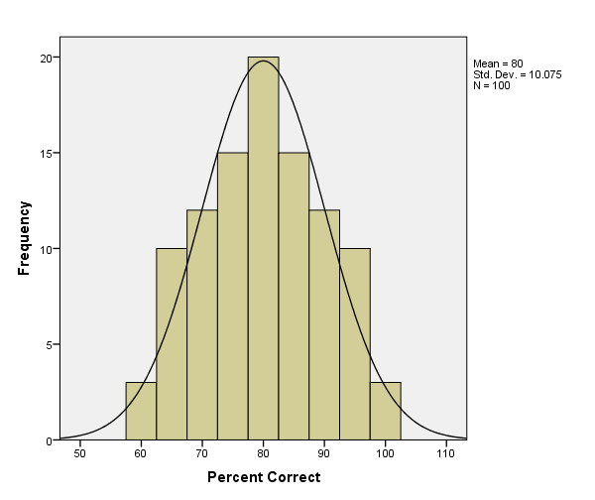

Slide 59
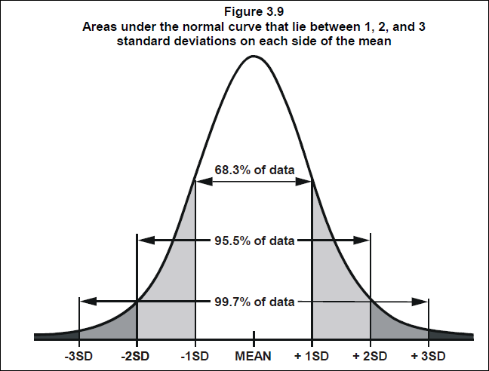

Slide 60
Characteristics of the normal distribution of curve
A bell shaped curves : most of the values are clustered near the mean
The values are distributed symmetrically around the mean
The mean, median and mode have the same value (coincide)
The percent of individuals with certain range of values is known:
* mean ± 1SD includes 68% of observations (in example 95% of normal males have blood pressure values between 115 and 125 mm/Hg
* mean ± 2 SD includes 95 % of observations ( in example 95% of normal males have blood pressure values between 110 and 130 mm/Hg

Slide 61
The variations of closed 95% of the data to the mean could be considered normal variations ( confidence interval )
* mean ± 3 SD includes 99.5% of observations ( almost all observations )
Areas under the normal curve can be derived from special tables and are used to calculate different percentiles ,
e.g.
3rd , 5th , 10th , 25th , 50th , 75th ,and 97th
Growth charts of children are often presented as percentile curves

Slide 62
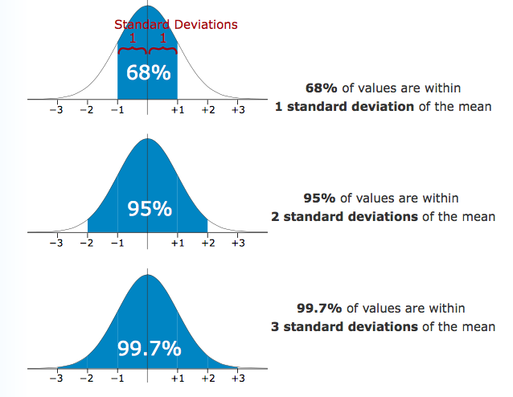

Slide 63

Thank you

