Slide 1


Verbal and non-verbal messages
Libyan International Medical University
Faculty of Business Administration
By:
Shatha Wail Werfalli (3299)
Shahed wail werfalli (3298 )
Ali bubaker (3329)
Ahmed A.B. Gargoum (3296)
Fahd Feisal Elsaite (3307)
Submitted To:
Mr. Farag Elmegresi

Slide 2
TABLE OF CONTENTS
1.
4.
2.
5.
3.
6.
Introduction
Differences
Verbal message
Conclusion
Non-verbal message
References
1

Slide 3
Introduction
There are many ways to communicate with people. The two main ways are verbal and nonverbal communication.
2

Slide 4
1
Verbal Messages
3

Slide 5
Verbal Message
Through our basic understanding, verbal communication is a way of conveying information in a spoken rather than written manner or it is a communication that uses words, either written or spoken.
4

Slide 6
Types Of verbal Message
Interpersonal communication
Intrapersonal communication
Small group conversation
Public communication
5

Slide 7
2
Non-verbal Message
6

Slide 8
Non-verbal message
Your facial expressions, gestures, posture, and tone of voice are powerful communication tools. Here’s how to read and use body language to build better relationships at home and work
7

Slide 9
Types Of Non-verbal Message
Facial expressions.
Body movement .
Gestures.
Eye contact.
Touch.
Space.
Voice.
Pay attention to inconsistencies.
8

Slide 10
Differences between both
Verbal communication involves the use of words or speech or auditory language to express emotions or thoughts or exchange information.
Non-verbal communication involves the use of visual or non-verbal cues such as facial expressions, eye or body movements, gestures, and many more without speaking.
Verbal communication is formal as well as Informal.
Non-verbal communication is informal.
Verbal communication is very impactful as it is documented.
Non-verbal communication is Very comprehensive as it shows the actual emotions of the person.
9

Slide 11

Conclusion
In Conclusion both Verbal and Non-Verbal Messages are important to communicate and make the significant other understand what you’re talking about , sometimes words are not enough to explain something or to talk about something expressions are very important as well .
10

Slide 12

References
1.Communication: Verbal vs nonverbal. LibGuides. (n.d.). Retrieved December 7, 2021, from https://cloviscenter.libguides.com/Communication/VerbalVSNonverbal.
2. Communication: Verbal vs nonverbal. LibGuides. (n.d.). Retrieved December 7, 2021, from https://cloviscenter.libguides.com/Communication/VerbalVSNonverbal
11

Slide 13
MAJOR REQUIREMENTS
NEPTUNE
Neptune is the farthest planet from the Sun
MERCURY
SATURN
Mercury is the closest planet to the Sun
Saturn is the ringed one and a gas giant
JUPITER
MARS
It’s the biggest planet in the Solar System
Despite being red, Mars is actually a cold place
12

Slide 14
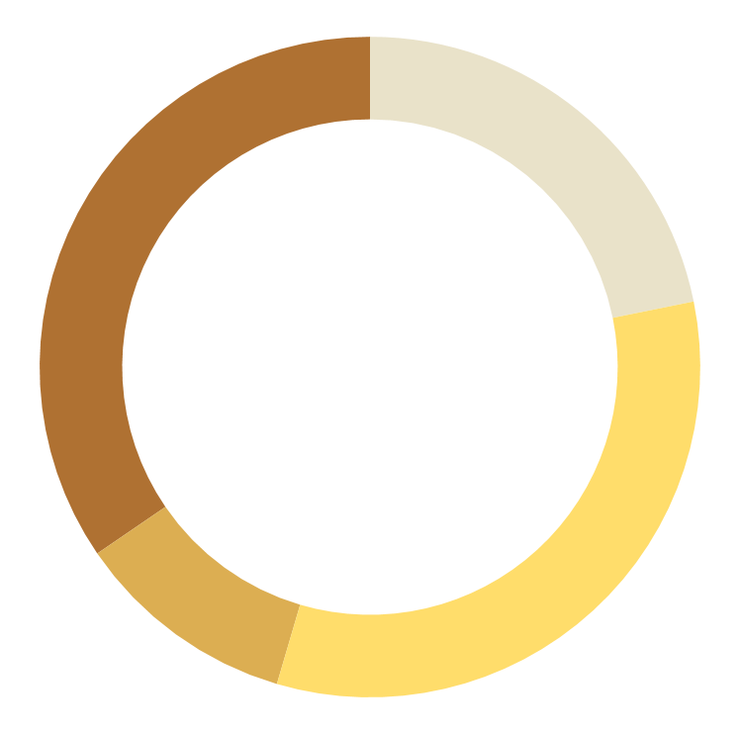
BUDGET
$2,000,000
VENUS
The Moon is a satellite
EARTH
Mars
Saturn
34.5%
21.8%
Jupiter
Earth
10.9%
32.7%
To modify this graph, click on it, follow the link, change the data and paste the new graph here
30%
50%
75%
13

Slide 15
COMPARISON OF BUDGETS
 | SATURN | MARS | NEPTUNE
SURFACE | 1,200 | 2,400 | 3,600
DIAMETER | 800 | 1,600 | 3,200
MASS | 2,500 | 5,000 | 7,500
14

Slide 16
4,000,000
Big numbers catch your audience’s attention
15

Slide 17
PROJECT GOALS
MERCURY
NEPTUNE
Mercury is the closest planet to the Sun and also the smallest one in the Solar System
Neptune is the farthest planet from the Sun and the fourth-largest in the Solar System
16

Slide 18
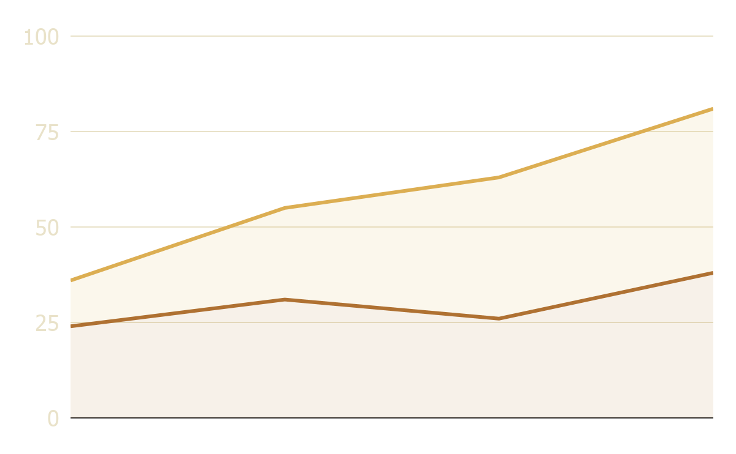
PREDICTED RESULTS
2,500,000+
The moon is a satellite
+68%
The Moon is a satellite
Mars
Jupiter
+46%
Jupiter is a gas giant
To modify this graph, click on it, follow the link, change the data and paste the new graph here
17

Slide 19


Any questions
Thank you for your attention

