Slide 1


Facebook Business Model
Libyan International Medical University
Faculty of Business
By: Sanad Nagem
ID: 2232
Instructor: Mr. Mohammed Alzwawi

Slide 2
Contents
Introduction
Target market of Facebook
Facebook Risks
Facebook SWOT Analysis
Business Model
Analysis of Facebook business model
Conclusion
References

Slide 3
Introduction
Facebook is a social networking platform that allows users to interact with friends, co-workers, and strangers online by creating free accounts. Users may share photos, music, movies, and articles, as well as their own views and opinions, with as many people as they choose.

Slide 4
Target Market
The target audience for Facebook is the exact group of individuals you wish to reach through your social media platforms. They're the ones who'll be most interested in your information, products, or services. Some similar factors, such as demographics and behaviour, are likely to bind them together.

Slide 5
Risks
China, Iran, North Korea, and Syria have all banned Facebook. Facebook cautions that this might happen in other countries as well, in which case "our rivals are able to effectively penetrate geographic regions that we are unable to access."
Facebook is governed by regulations that cover a wide range of topics, including privacy, intellectual property, and data security. These rules are always changing, and they might alter dramatically in a way that harms Facebook's business.
In 2011, the online gaming firm contributed for 12% of Facebook's income and drove significant traffic to the social network's website. If Zynga's games become less popular, or if Zynga began releasing games on alternative platforms, Facebook would suffer.
Users are increasingly accessing Facebook through mobile devices, many of which run Google's Android or Apple Inc.'s iOS, two of Facebook's competitors' operating systems.

Slide 6
SWOT Analysis

Slide 7
Strengths | Weaknesses
Strong Brand Diversified Portfolio Market Dominance Loyal Customer Base | User’s Privacy Concerns Overdependence on Advertising Spreading Fake News Friction in Management
Threats | Opportunities
Competition Increased Regulations Bans in Several Countries Data Breach | Diversify Portfolio Expansion of Existing Platforms Increasing Integration to other Applications

Slide 8
Business Model

Slide 9
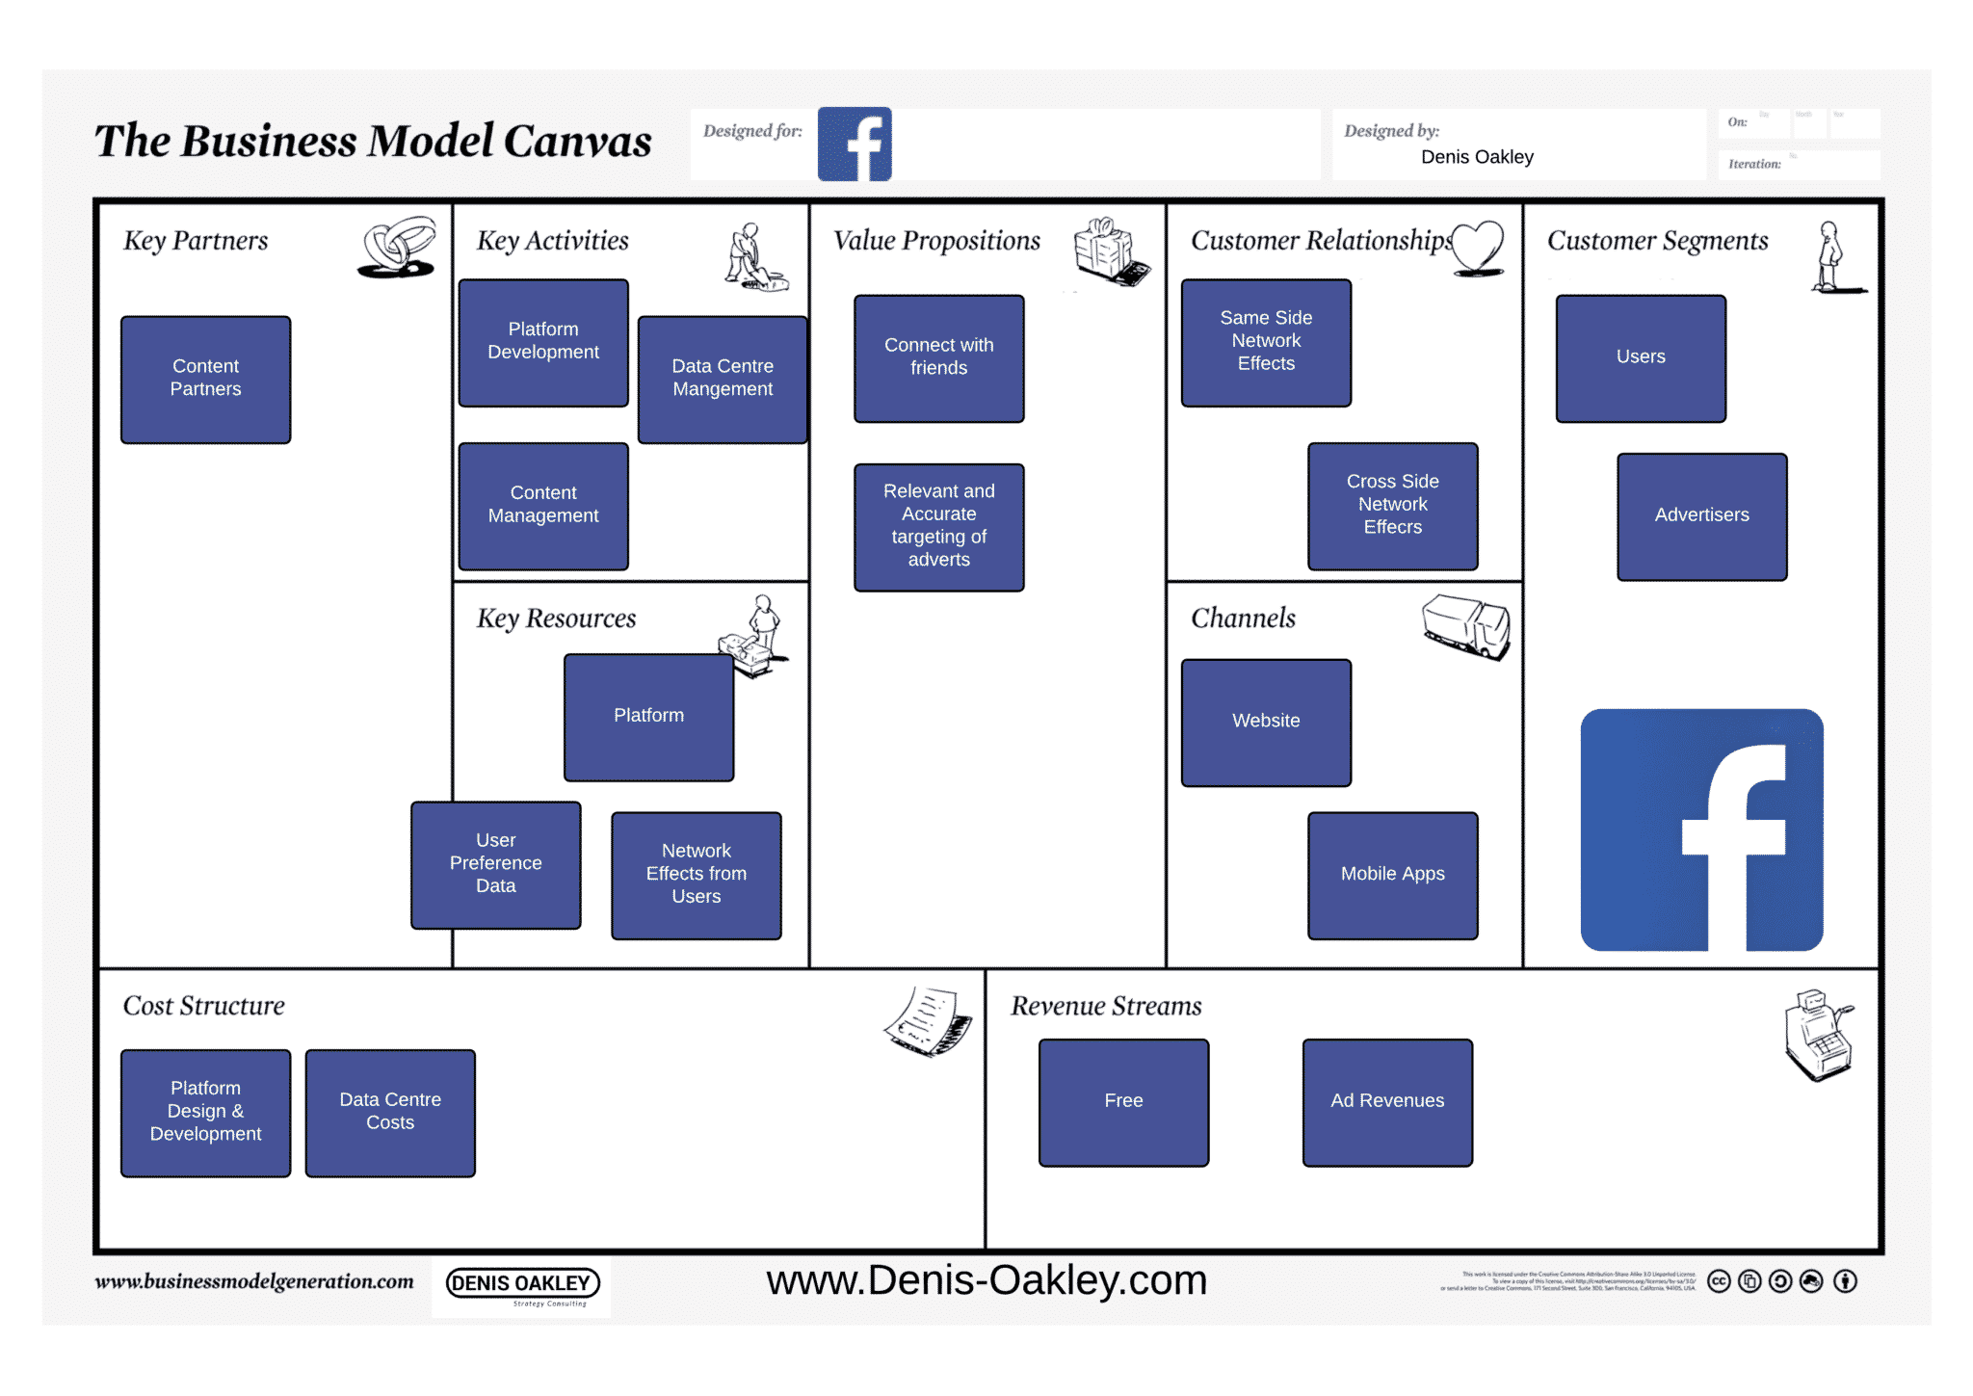

Slide 10
Analysis
The Facebook business model is a platform with several sides. Although other businesses, such as MySpace and Orkut, have labeled themselves "social networks," Facebook is without a doubt the first to transform this digital environment into a profitable business model. Facebook has more than 2 billion members worldwide and is still active and expanding after more than 15 years on the market.

Slide 11

Advertisers will no longer require Facebook in the near future. Facebook's trump card is that it allows advertisers to target the correct audience with their ads. Businesses may target their products/services to just American 25-30-year-old girls with a degree who are interested in marriage, for example, among more than 2 billion profiles.

Slide 12
Customer Segment
Users: They make up one-third of the world's population and are Facebook's largest client demographic. They are all the people who have accounts on the network and use them to engage and communicate with friends and people who share similar interests from all over the world. They don't pay Facebook anything, thus they aren't directly accountable for the money generated by the company.

Slide 13
Conclusion
Facebook is a very well-known company worldwide that dominates a huge market share globally. Facebook vision is to connect friends, and family with each other, and to discover what is going on around the world. The company has a very well base structure, and is growing every day.

Slide 14
References
Johnston, M. (2022, June 9). How facebook (meta) makes money. Investopedia. Retrieved June 20, 2022, from https://www.investopedia.com/ask/answers/120114/how-does-facebook-fb-make-money.asp#:~:text=(META)%2C%20the%20company%20that,communicate%20with%20family%20and%20friends.
Richard, M. (2021, January 27). Facebook Mission Statement 2022 | Facebook Mission & Vision Analysis. Richard M. https://mission-statement.com/facebook/#:%7E:text=Facebook%20vision%20statement%20is%20%E2%80%9CPeople,in%20the%20social%20media%20sector.
Gupta, S. K. (2022, February 11). Facebook SWOT Analysis (2022). Business Strategy Hub. https://bstrategyhub.com/facebook-swot-analysis/

