Slide 1

Libyan International Medical University Applied Medical Science 2021-2022
INFECTIOUS DISEASES PREVENTION
schistosomiasis
Presented by : Enas Sleh
Roll number:2071
A Second year student
Block: PTS

Slide 2

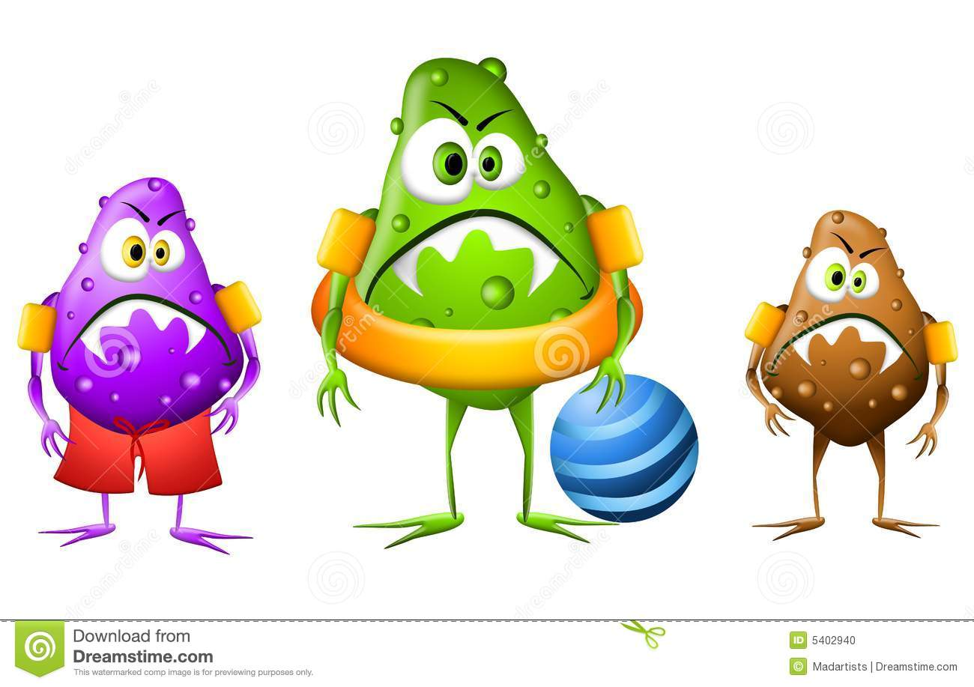
OBJECTIVES
1-Describe The Way Of Schistosomiasis Transmission
2- Outline The Epidemiology Of Schistosomiasis
3-Discuss Strategies Of Prevention And Control

Slide 3
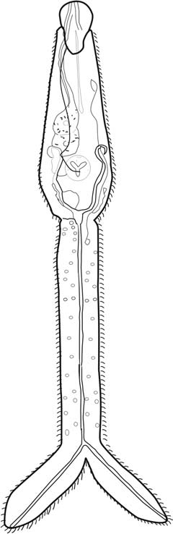
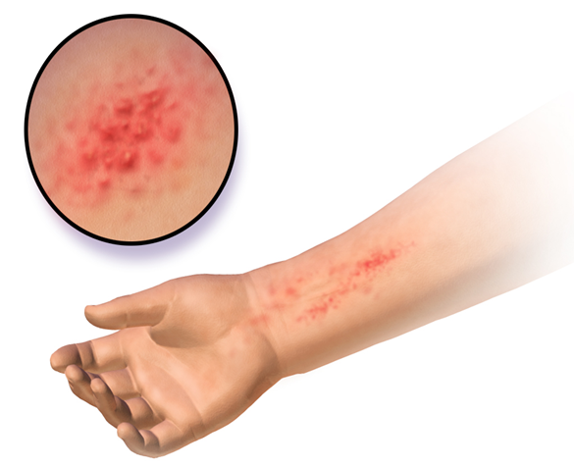
INTRODUCTION

Slide 4


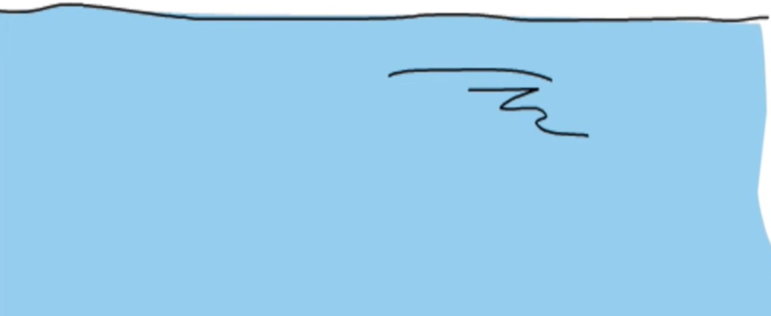

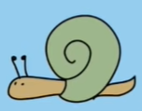
THE WAY OF ITS TRANSMISSION
Water use
Urine
Cerceria
eggs
faces
Freshwater snail
Infected human

Slide 5

Who are The Most Affected Populations?

Slide 6




Schistosoma haematobium
Schistosoma japanicum
Schistosoma mansoni
Schistosoma guineensis
Schistosoma mekongi
Urogenital disease
Africa Middle East
China Indonesia
Central Africa
Cambodia
Intestinal disease

Slide 7



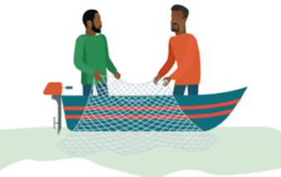
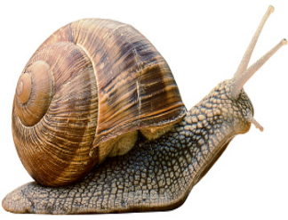
PREVENTION AND CONTROL

Slide 8


PREVENTION AND CONOTROL
1-Preventive chemotherapy
-Preschool-aged children
-School-aged children
-Pregnant women
-Lactating women

Slide 9


2-Reduce contamination of water
-Educating people on proper sanitation
-Building public toilets
3-Elimination of snails
By either:
-Physical control
-Biological control
-Chemical control

Slide 10
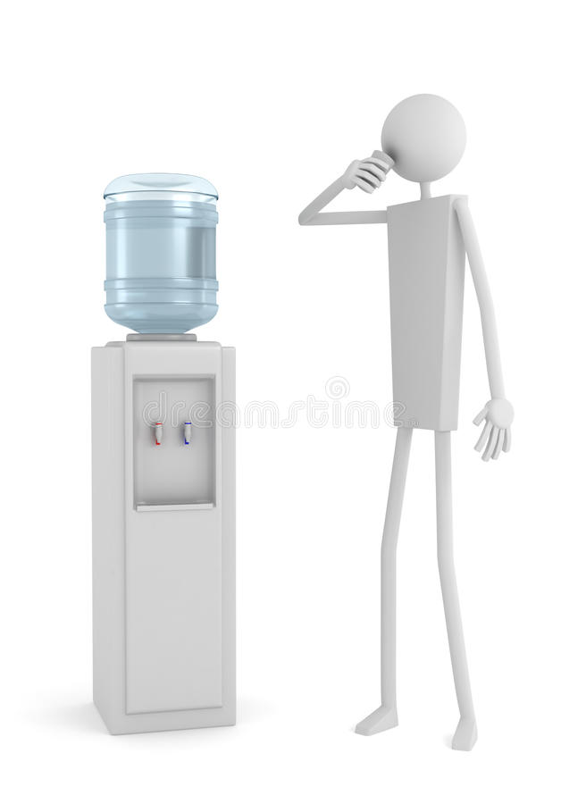



4-Reduce contact with contaminated water
-Access to safe and pure water
-Should filter or boil the water for 1 minute before using it
-Avoid swimming and wading in fresh water
-Avoid washing in fresh water

Slide 11
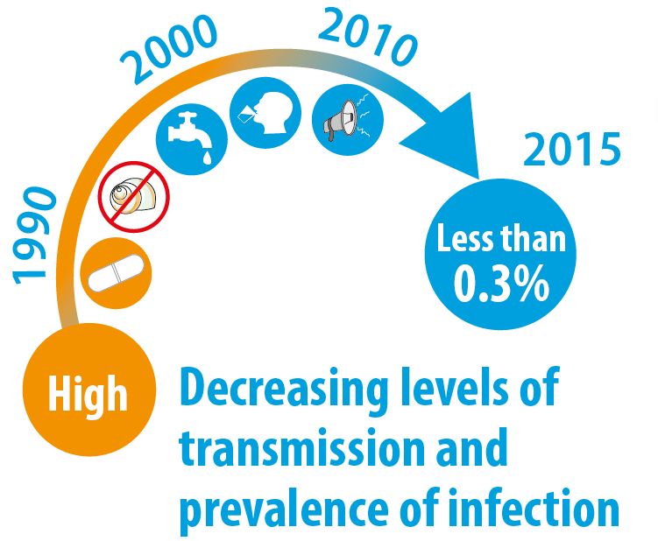
SUCCESS OF THE STRAREGIES

Slide 12

CONCLUSION
-Infectious diseases are one of the leading causes of death worldwide.
-waterborne diseases are rampant and the knowledge about their prevention is not widely available
-there are simple ways to avoid the infection

Slide 13
References
1-Apps.who.int. 2022. [online] Available at: <http://apps.who.int/iris/bitstream/10665/42588/1/WHO_TRS_912.pdf> [Accessed 20 May 2022].
2-Steinmann, P., Keiser, J., Bos, R., Tanner, M. and Utzinger, J., 2020. Schistosomiasis and water resources development: systematic review, meta-analysis, and estimates of people at risk. The Lancet Infectious Diseases, 6(7), pp.411-425.
3-https://www.who.int/news/item/29-11-2016-egypt-leverages-domestic-funding-to-eliminate-schistosomiasis

Slide 14

THANK YOU

