Slide 1
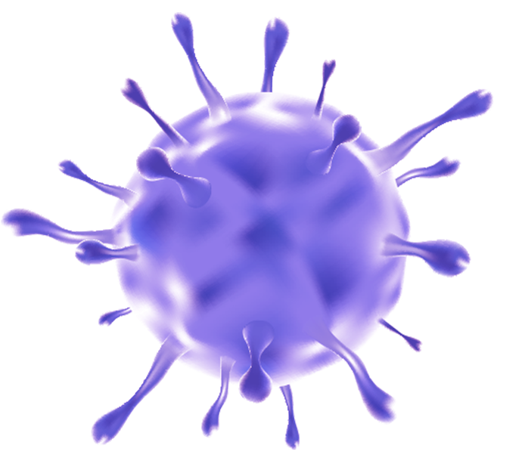



Impact of covid_19 on maternal health and child delivery
Name: Sara Ismail Almozoghi
S.N: 3498
Supvr: Dr.Asma Elshaikhy
Year 1
PTS Block

Slide 2

Objectives
2
4
1
3
Method of Transmission
Management
Definition of covid_19
Complication

Slide 3
Coronavirus belonging to Coronaviridae.
Coronavirus disease (COVID-19) is an infectious disease caused by the SARS-CoV-2 virus

Slide 4
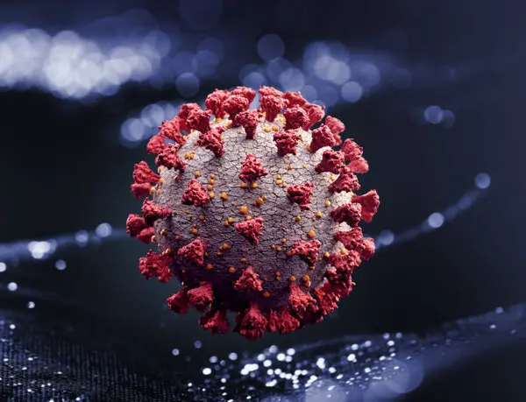
Structure of coronavirus

Slide 5


Transmission
Droplet
Transmission
Airborne
Transmission
Feco-Oral
Route
> 5-10 um in diameter
< 5 um in diameter
Only detected at 1 stool specimen

Slide 6

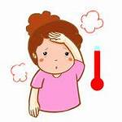

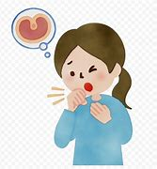
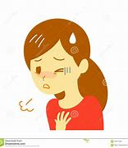


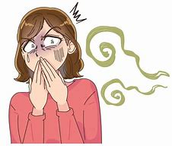
symptoms

Slide 7
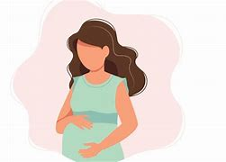
Complication
Post partum complication
Multiple organ dysfunction
Preterm or still birth baby
Moderate to Sever pneumonia
DIC
ICU Admission
Gestational hypertension
Ectopic pregnancy or Abortion
Death

Slide 8
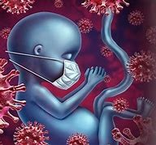
Complication
Pneumonia
Respiratory distress
GIT symptoms
Bacterial pneumonia
Shortness of breath
Cyanosis
Preterm or Still birth
DIC
Death

Slide 9
Diagnostic Methods
Computed tomography scan (CT Scan )
Throat swab NAT
Oropharyngeal swab
Amniotic fluid test
Placental cord test

Slide 10
Management
Medical treatments are safe for pregnant women with the coronavirus
Treatment for COVID-19 is similar to the treatment of other respiratory illnesses. Whether you’re pregnant or not, doctors advise:
Taking acetaminophen (Tylenol) for a fever of 100.4°F (38°C) or higher.
Staying well hydrated with water or low-sugar drinks.
Rest.
If Tylenol doesn’t bring down your fever, you have difficulty breathing, or you start vomiting, call your doctor for further guidance.

Slide 11
CONCLUSIONS
Based on a study of research papers at the beginning of covid-19 pandemic it has been observed that the most common impact of Covid-19 increase rate of caesarean section because of fear of vertical transmission also increase rate of premature neonate.

Slide 12
REFERENCES
1.Christiano.D, , March 25, 2020. Does Getting COVID-19 While Pregnant Harm Your Baby [cited 4 June 2022].
https://www.who.int/news-room/commentaries/detail/modes-of-transmission-of-virus-causing-covid- 19-implications-for-ipc-precaution-recommendations
2. Kotlar, Bethany et al 2020.05.011 .“The impact of the COVID-19 pandemic on maternal and perinatal health: a scoping review.” Reproductive health vol. 18,1 10. 18 Jan. doi:10.1186/s12978-021-01070-6 .(cited 2021, 4/6/2022).
https://www.ncbi.nlm.nih.gov/pmc/articles/PMC7260486/
3. Narang, Kavita et al . 2020.05.011 “SARS-CoV-2 Infection and COVID-19 During Pregnancy: A Multidisciplinary Review.” Mayo Clinic proceedings vol. 95,8 (2020): 1750-1765. doi:10.1016/j.mayocp. .(cited 2021, 4/6/2022).
https://www.ncbi.nlm.nih.gov/pmc/articles/PMC7260486/

Slide 13
THANKS!
Do u have any questions ?

