Slide 1
UVEAL TRACT
PART I
Anatomy & Physiology
By DR. Hala A. Buzakouk (MD.)

Slide 2
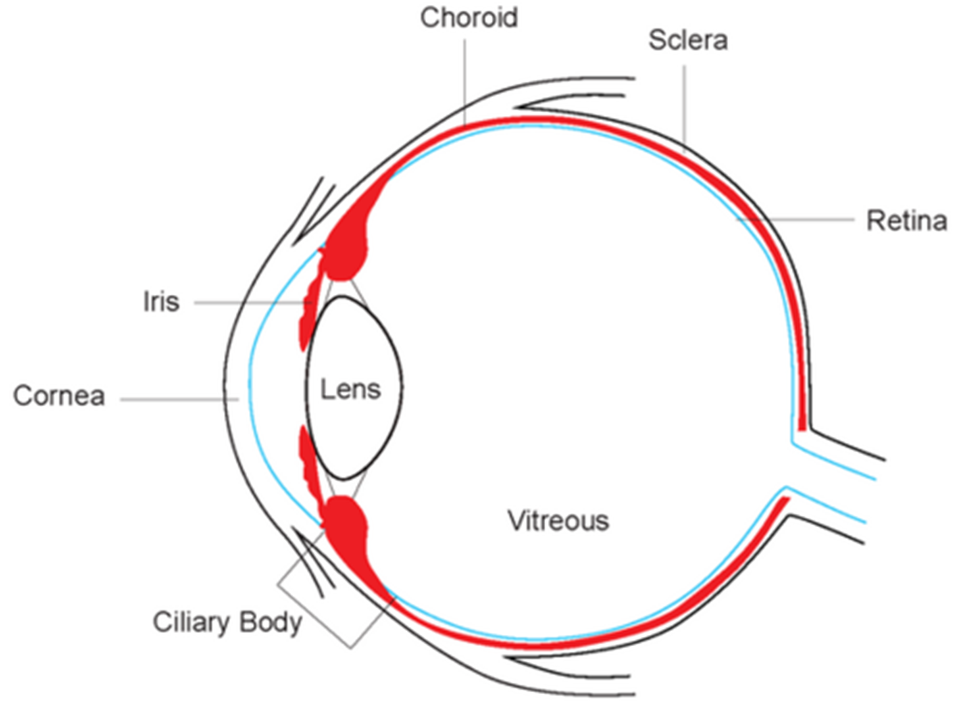
Middle vascular coat of eye ball
Iris
Ciliary body
Choroid

Slide 3
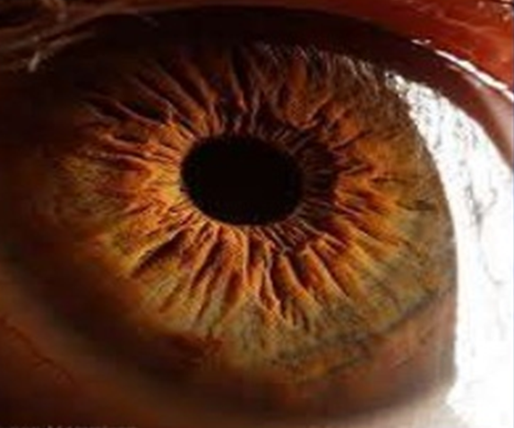
IRIS
GROSS ANATOMY
Anterior extension of uveal tract.
Thin, pigmented contractile, circular structure,
analogous to a diaphragm of camera.
Extends from iris root to iris margin forming
a central aperture pupil 3-4mm.
Lies on anterior lens surface, surrounded by aqueous humour.
Posteriorly, central part in contact with lens which gives its characteristic conical configuration.

Slide 4
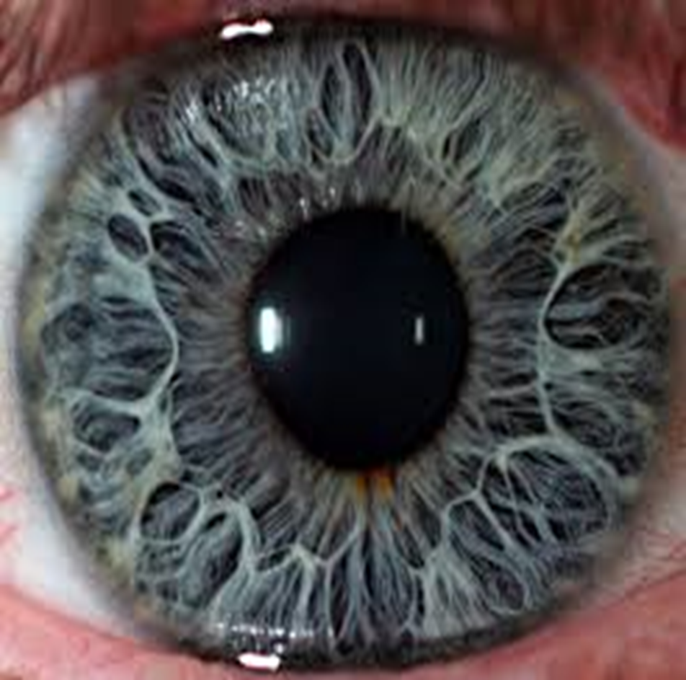
Average diameter: 12mm
Collarette thickened iris 2mm wide, divides anterior part into 2 parts:
Inner pupillary zone 1-2mm wide
Outer ciliary zone 3-4mm wide
Average thickness: 0.5 mm
Thickest at collarette
Thinnest at iris root
Attached peripherally to the midline
of anterior surface of ciliary body.

Slide 5
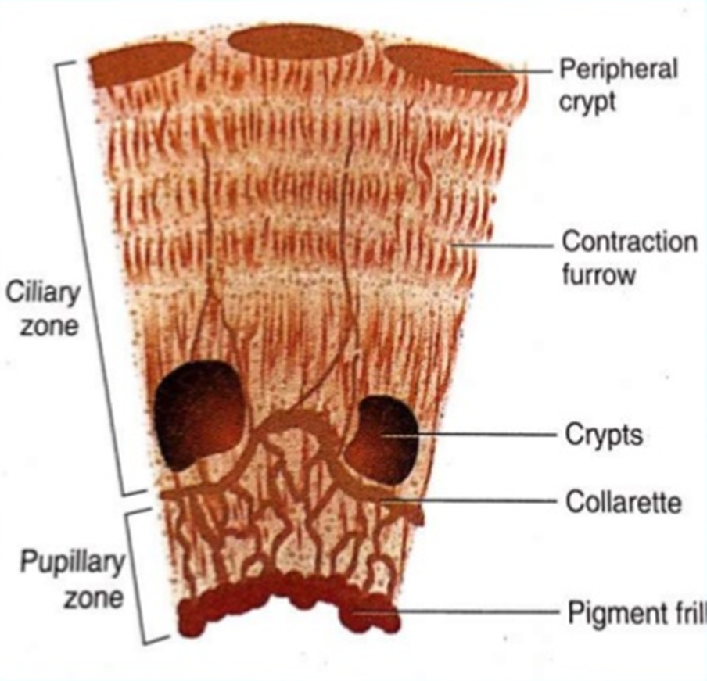

Gross anatomy

Slide 6
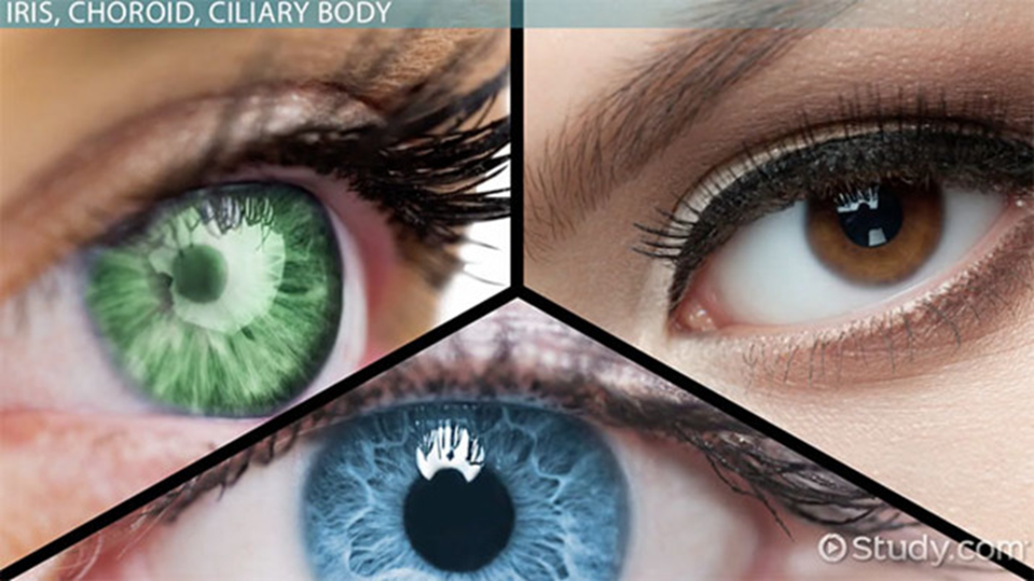
Color of iris is determined by the character of melanin & amount of pigmentation, not by number of melanocytes.
Blue iris is relatively free of pigmentation that absorbs long wavelength of light but reflects short one.
Brown iris has abundant stromal pigmentation.

Slide 7
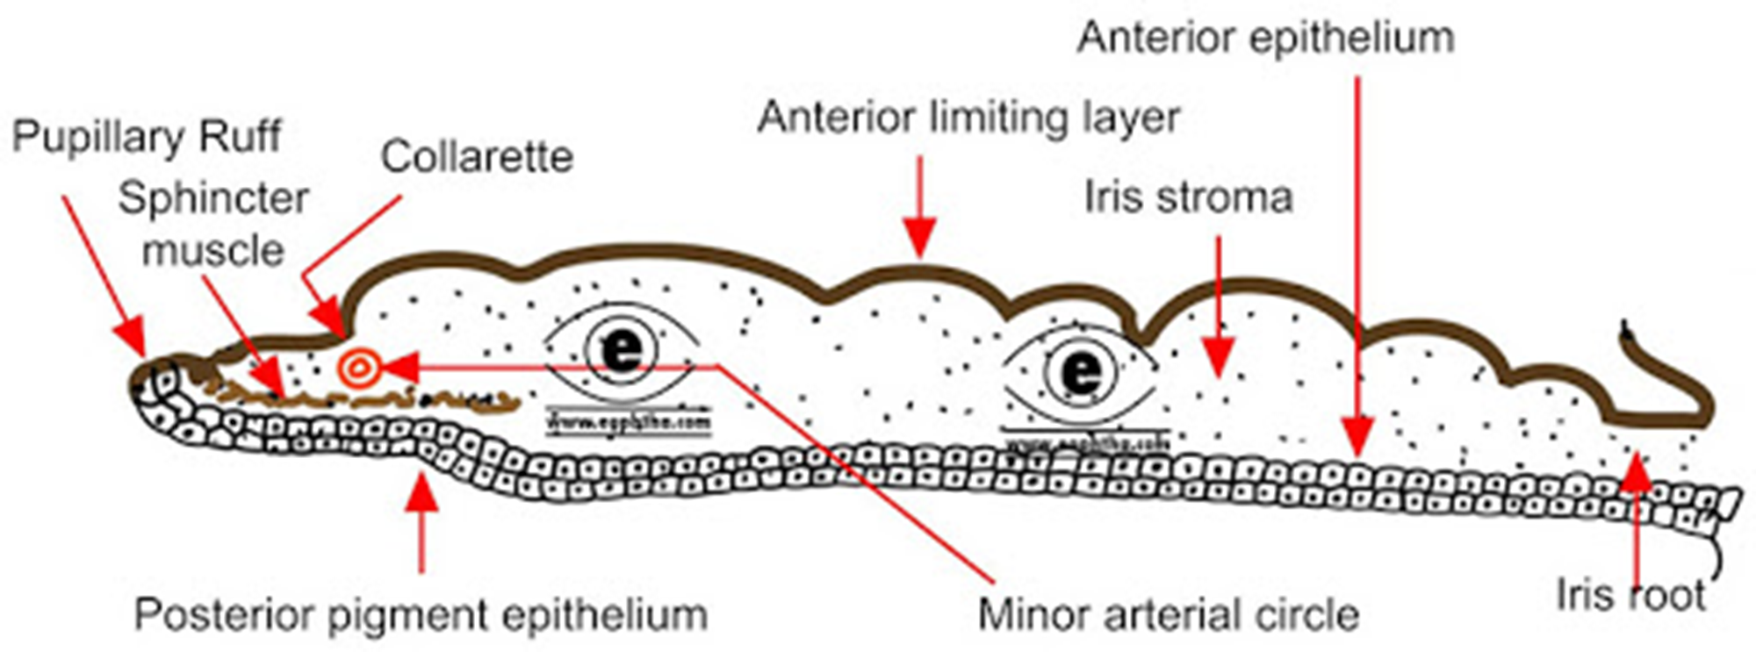
Microscopic anatomy
4 layers:
1.Anterior limiting layer
Modified stroma consisting of fibroblasts, melanocytes & few collagen fibers
Thin, discontinuous (crypts) , condensed layer ( collarette).
The definitive color of iris depends on this layer.

Slide 8
2. Iris sroma
Loose C.T, containing :
➢pigmented cells melanocytes
➢Non-pigmented cells lymphocytes, macrophages, fibroblastes, mast cells
➢ muscles: Sphincter pupillae muscle & Dilator pupillae muscle
➢ collagen fibrils , nerves & vessels
3.Anterior epithelial layer
Myoepithelial cells of dilator muscle.
Anterior continuation of pigment epithelium of retina & ciliary body.
4.Posterior pigment epithelial layer
Anterior continuation of non-pigmented layer of C.B.
At pupillary margin, it forms the pigmented frill.

Slide 9
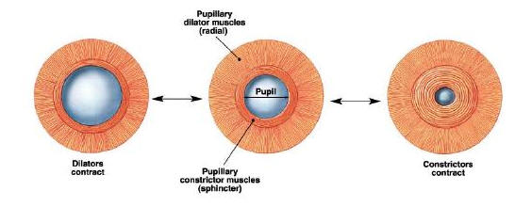
Sphincter pupillae muscle
Dilator pupillae muscle
Smooth muscle fibers
Pupillary zone
Circumfrential
Parasympathetic ( III CN)
Consricts pupil on bright light
Myoepithelial cells
Ciliary zone
Radial
Sympathetic
Dilates pupil on dim light

Slide 10
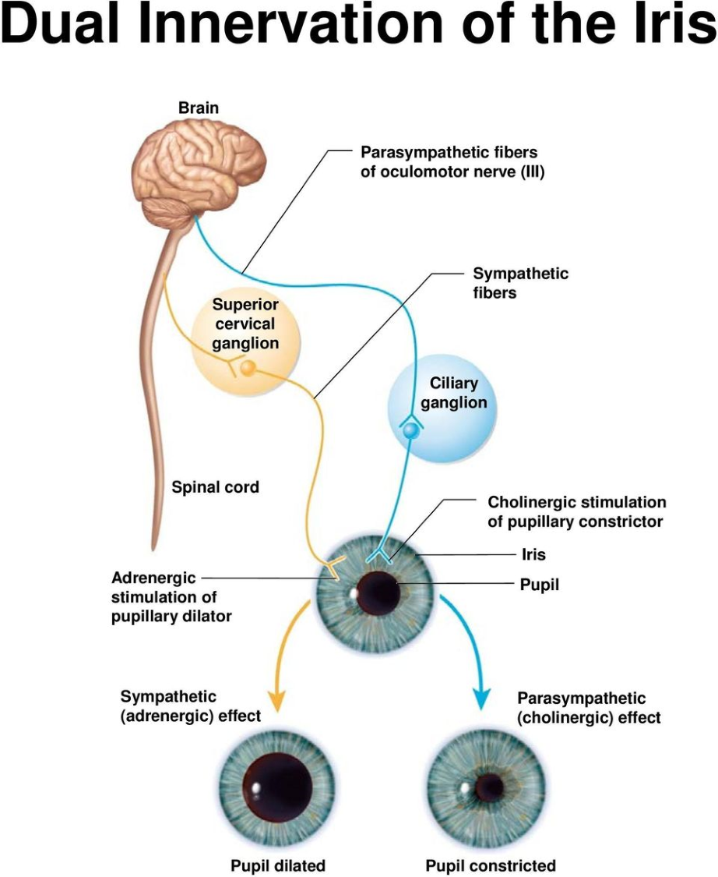

Slide 11
Sensory innervation
Short ciliary nerves , branches of nasociliary nerve ( ophthalmic division of the trigeminal).
Blood supply of iris
from incomplete major arterial circle at root , is derived from anterior ciliary arteries.
Incomplete minor arterial circle at the level of collarette.
Function
the iris is responsible for regulating the amount of light that gets into the eye.

Slide 12
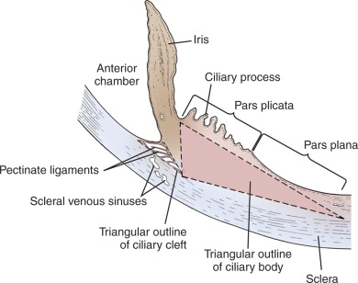
Ciliary body
Gross anatomy
Anterior view: ring-shaped structure
Sagittal view: triangular shape
Base faces A/C
Apex at ora serrata
2 surfaces:
Pars plicata: 2mm wide
Wider anterior portion containing
70-80 ciliary processes extending
into P/C.
Pars plana: 4mm wide zone, flatter region extending from posterior of pars plicata to ora serrata.

Slide 13
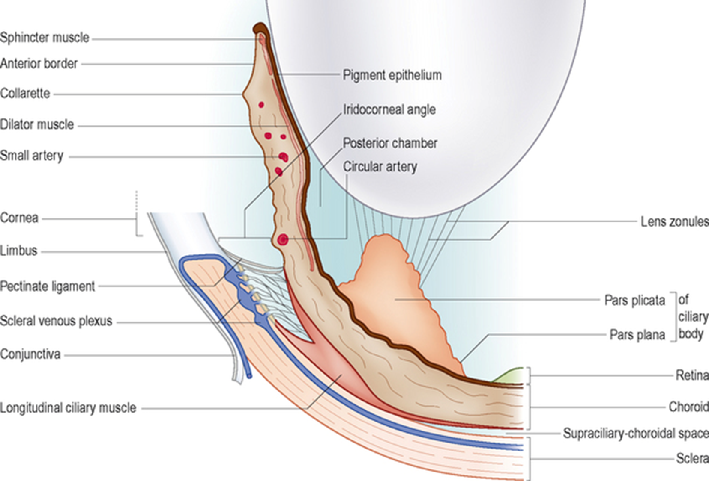
Microscopic anatomy
3 structures:
1.Ciliary stroma
Highly vascularized loose CT
Anteriorly continuous with iris stroma.
Posteriorly continuous with choroidal stroma.
Thin in pars plana.

Slide 14
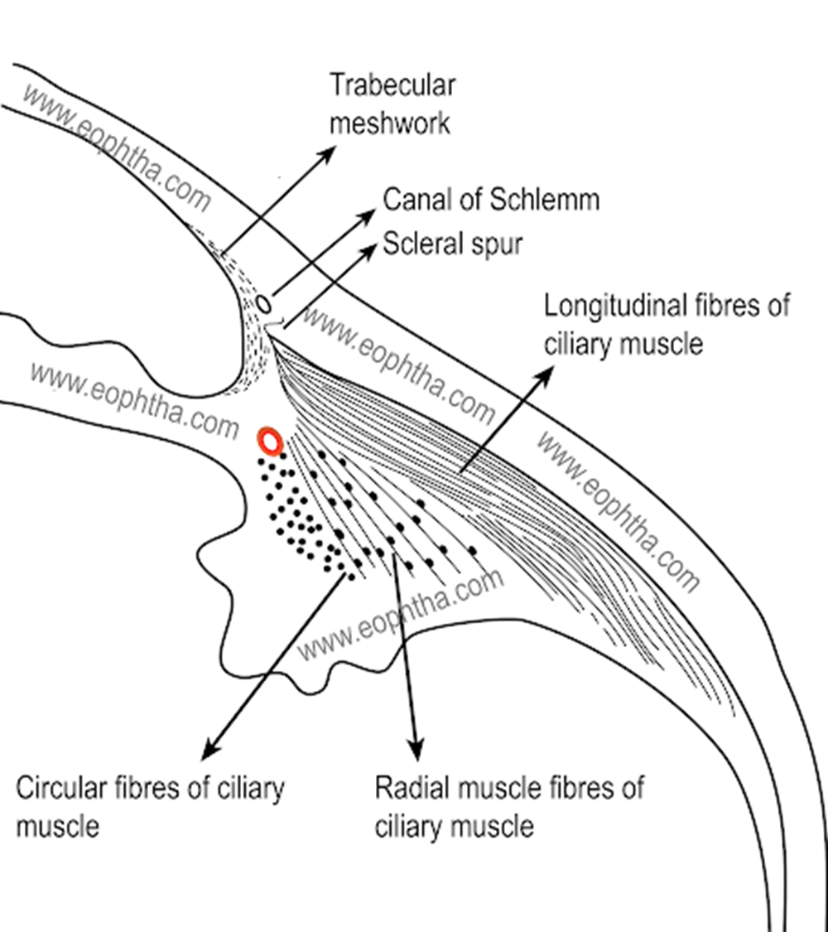
2.Ciliary muscles:
3 groups of smooth muscle fibers:
Longitudinal muscle (outermost)
Contraction of this muscle, opens the trabecular meshwork and Schlemm`s canal.
Radial muscle
Contraction of these fibers may widen the uveal trabecular spaces.
Circular muscles (innermost)
When these fibers contract, the zonules relax, increasing the lens axial diameter and its convexity.

Slide 15
3. Ciliary epithelium:
The inner surfaces of the ciliary processes and the pars plana are lined by two layers of epithelium:
The outer layer is the pigmented epithelium, which is continuous with the retinal pigmented epithelium.
The inner layer is formed by the non-pigmented epithelium, adjacent to the aqueous humor in the posterior chamber and continuous with the retina.
These two layers of the epithelium are appositioned in their apical surfaces.

Slide 16
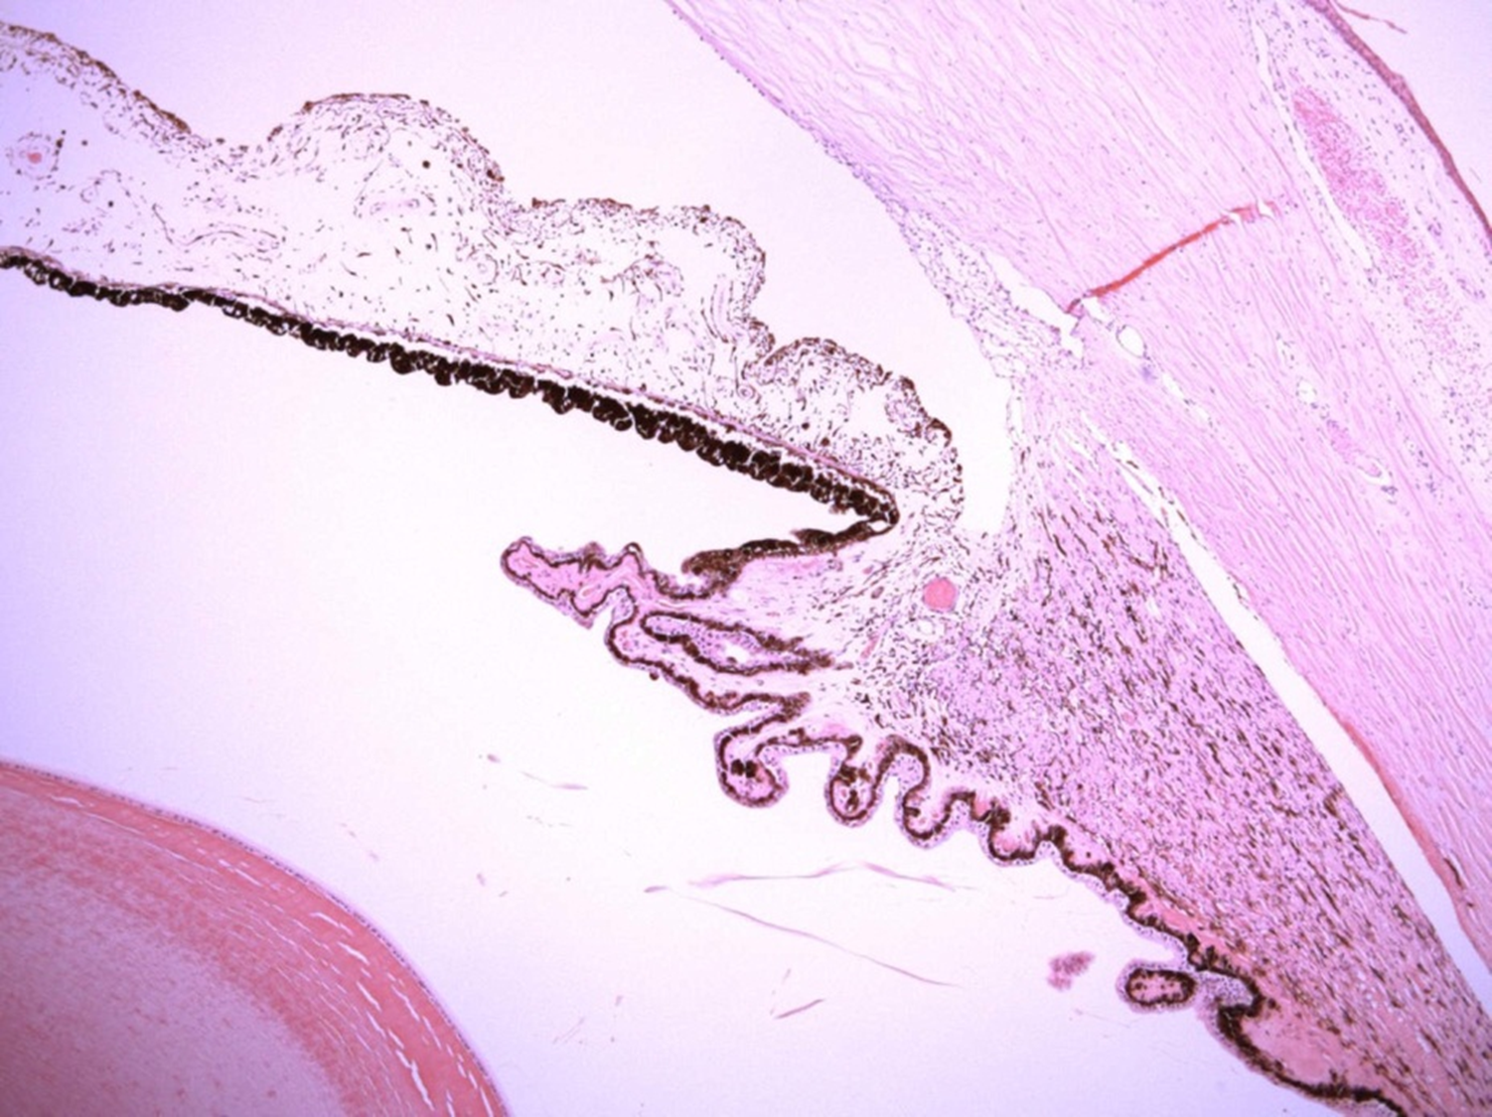
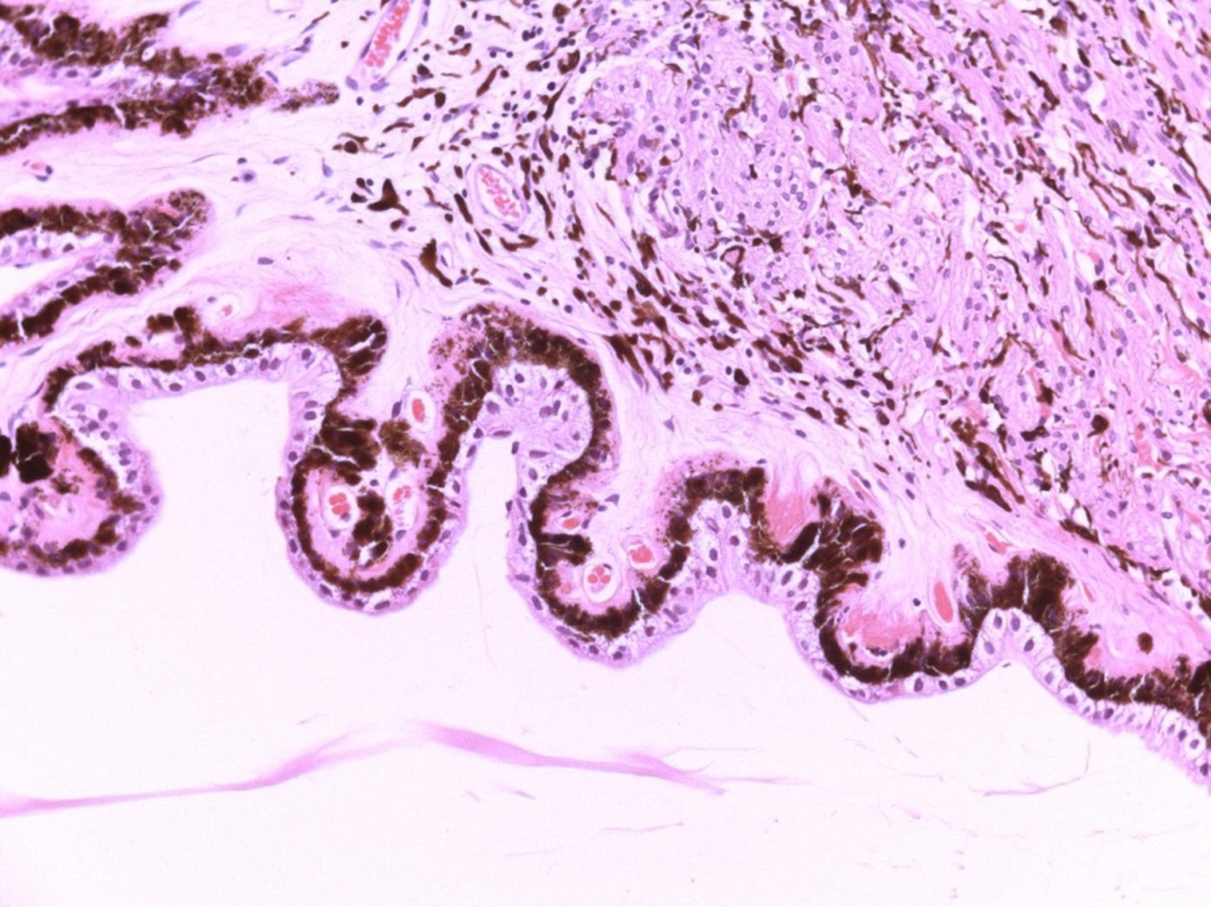

Slide 17
Blood-aqueous barrier :
is formed by tight junctions located between the non-pigmented layer of the ciliary epithelium and between the posterior pigmented epithelium of iris , and between the endothelium of non-fenestrated iris vasculature.
Barrier dysfunction can contribute to the pathophysiology of inflammatory ocular diseases in a passive way by the vascular leakage of blood-borne molecules and inflammatory cells into the anterior segment of the eye.

Slide 18
Function
Accommodation
Production of aqueous humor
which is actively secreted by inner non-pigmented ciliary epithelium
Production of zonules, vitreal collagen,& vitreal hyaluronic acid.

Slide 19
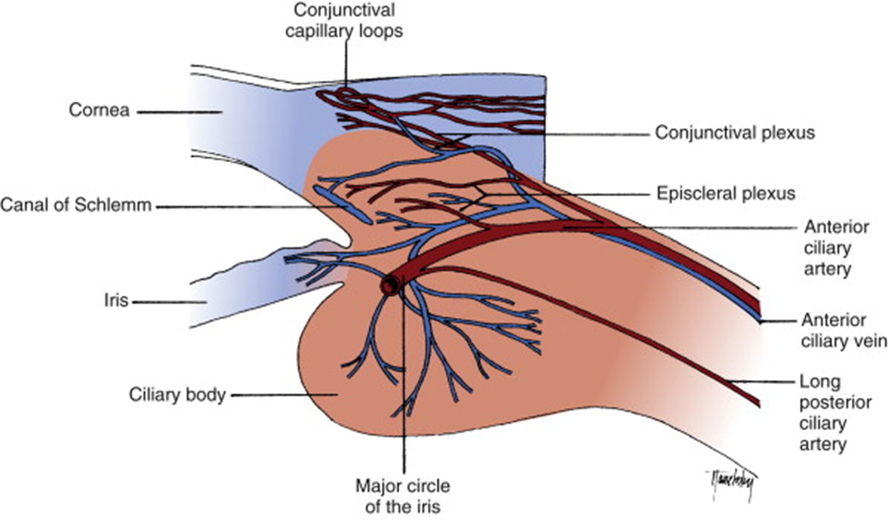
Blood supply of ciliary body

Slide 20
CHOROID
Gross anatomy
Thin, highly pigmented, vascular loose CT
Rich in melanocytes gives characteristic dark color
Situated between sclera & retina
Extends from optic nerve to ciliary body (at ora serrata)
Thickness decrease from post ( 0.22mm) to ant (0.1mm)

Slide 21
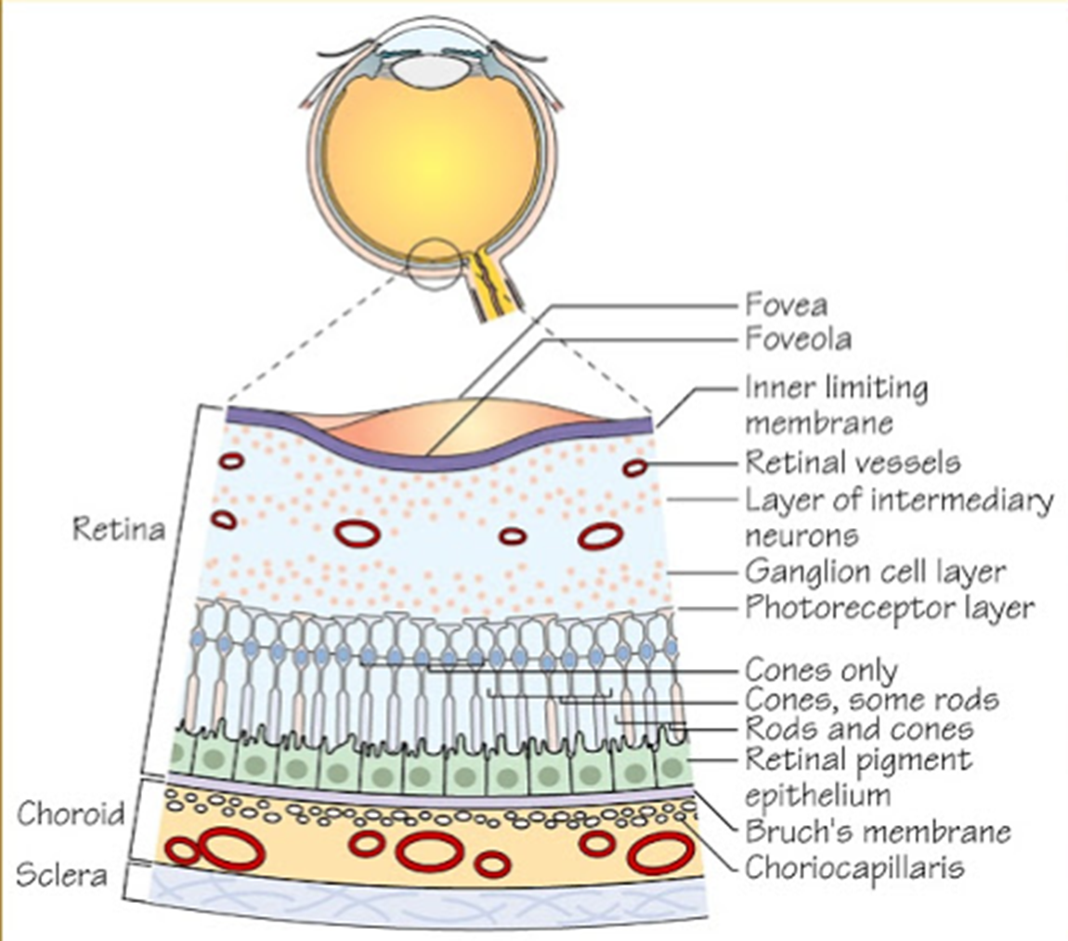
Microscopic anatomy
4 histological parts:
1.Suprachoroidal lamina
Transition zone of choroid & sclera
Consists of melanocytes, fibroblasts
& CT fibers
Carries long post ciliary arteries &
nerves

Slide 22
2.Choroid stroma
Layer of pigmented, vascularized loose CT
Contains melanocytes, fibroblasts, macrophages, mast cells
Arteries are branches of short post ciliary arteries
Veins drain via vortex veins into ophthalmic veins
3.Choriocapillaris layer
Consists of rich capillary network, fenestrated
Nourish outer retina
Extends anteriorly to ora serrata
Greatest density of capillaries at macula

Slide 23
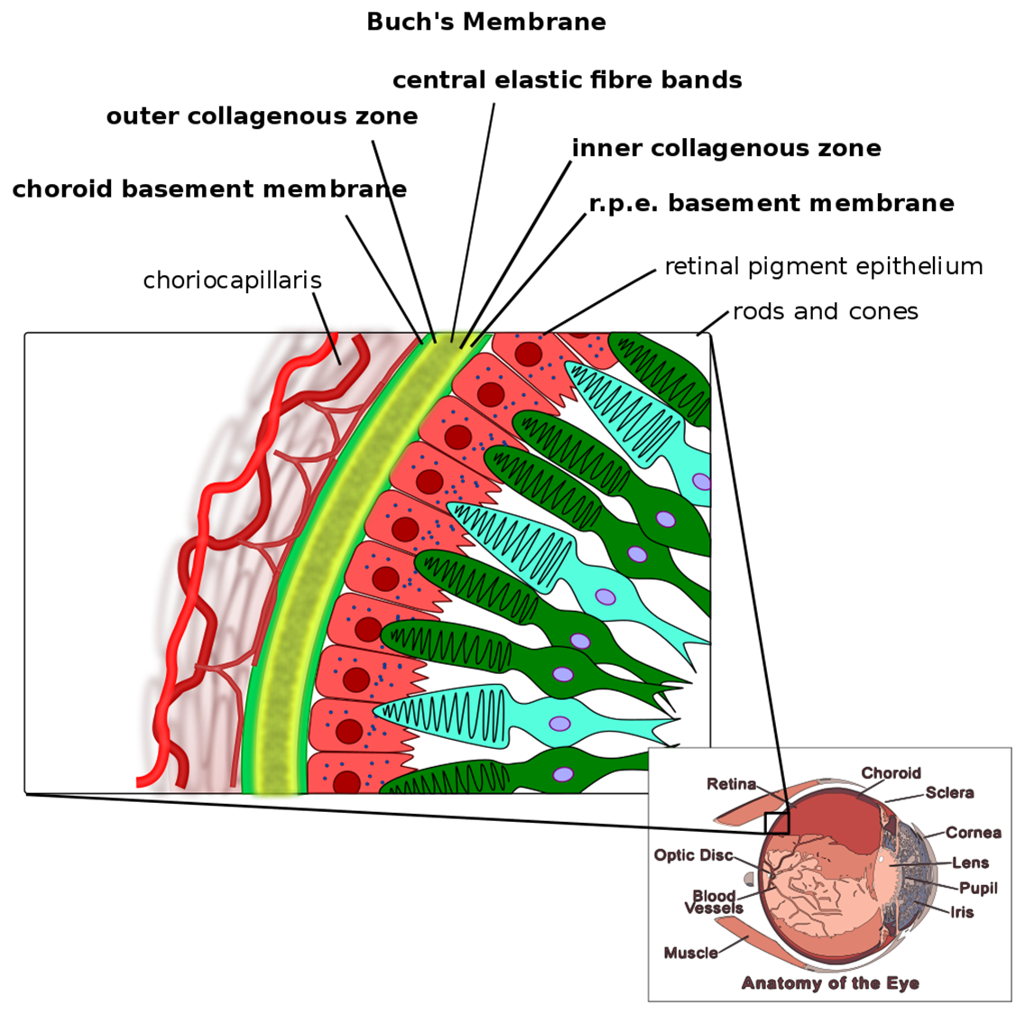
4.Bruch’s membrane
Thin refractile CT membrane
Between choriocapillaris (choroid)
& RPE(retina)
Prevents ch. vessels from penetrating
the retina but allows nutrients,
protiens …

Slide 24
FUNCTION
Nourishment for adjacent retina (outer 4 layers).
Pigment absorbs excess light so, avoiding reflection.
Regulate retinal heat.
Assist in the control of I O P.

Slide 25
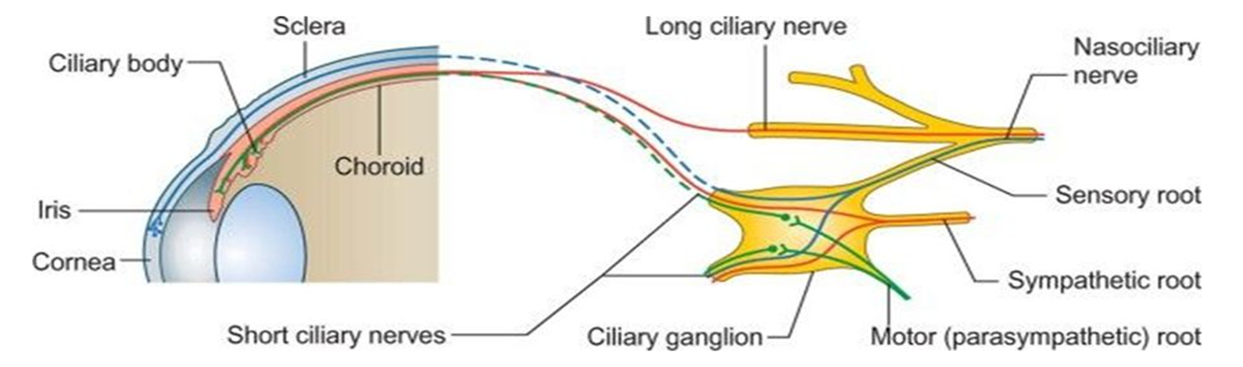
INNERVATION Ciliary ganglion
Parasympathetic innervation
Postganglionic fibers in short ciliary nerves supply sphincter muscle & ciliary muscle.
Sympathetic innervation: postganglionic fibers
Direct branches from internal carotid plexus
By joining opth. division of trigeminal ( nasociliary nerve)
Sensory innervation from nasociliary nerve

Slide 26
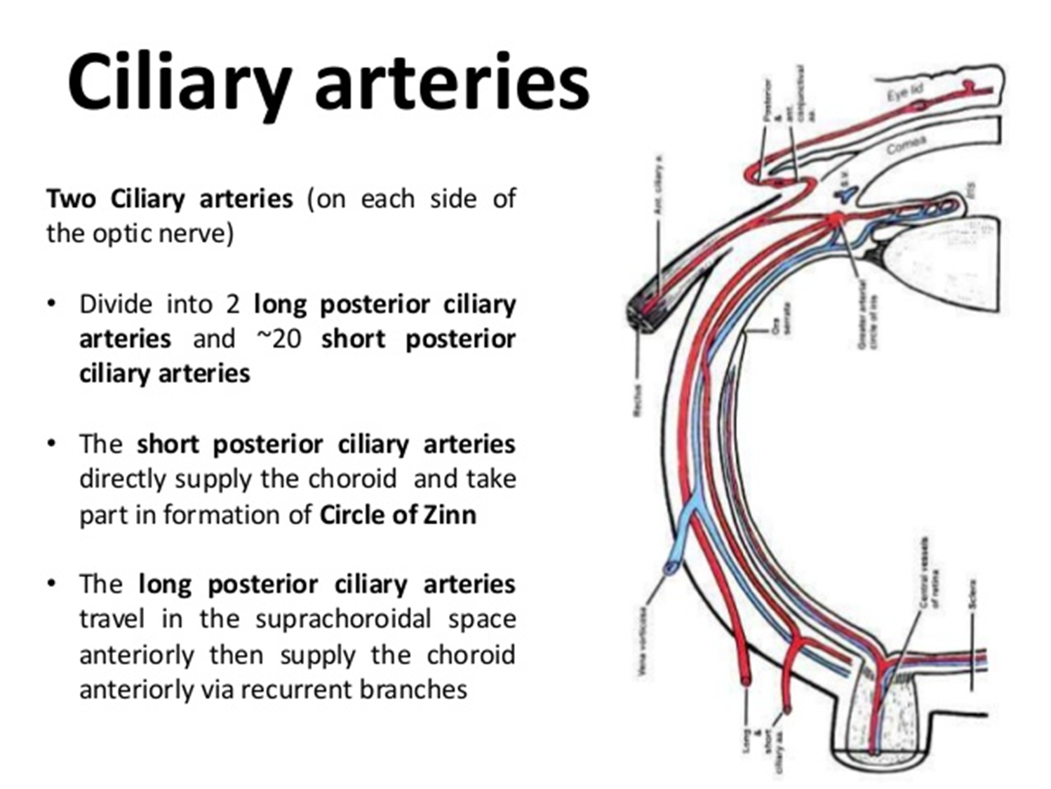
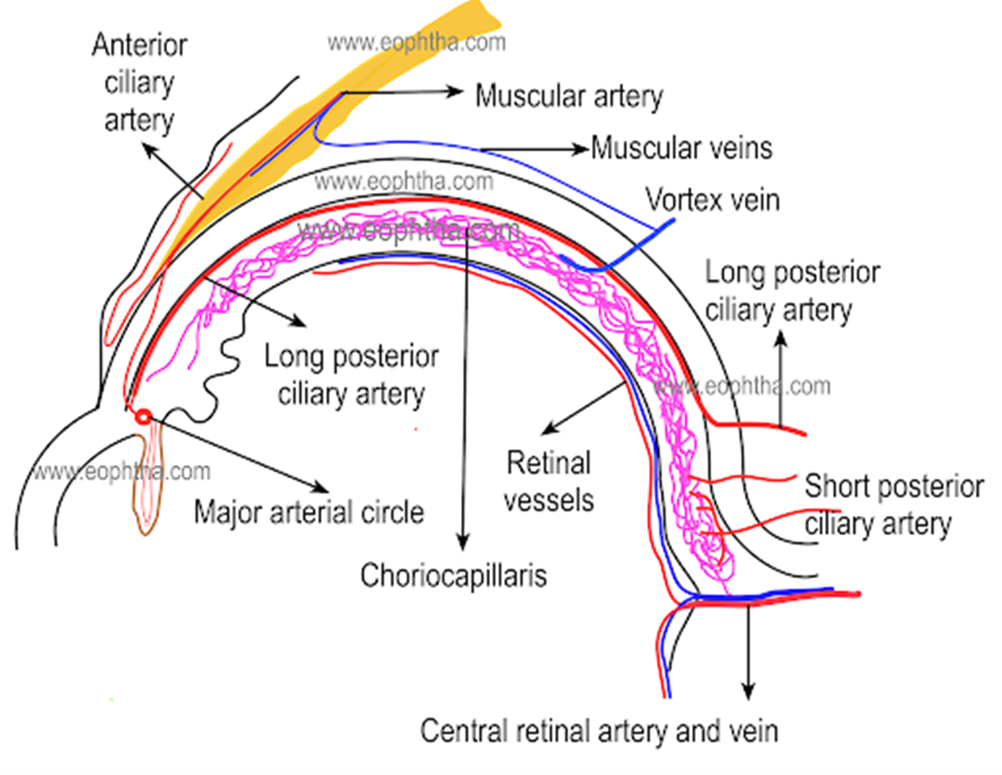

Slide 27
PART II

Slide 28
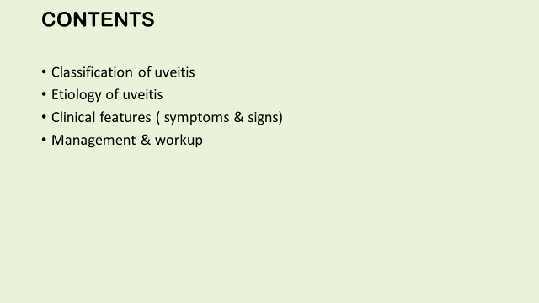

Slide 29
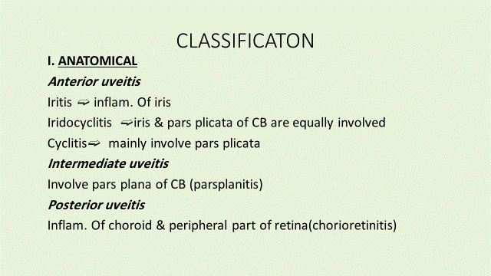

Slide 30
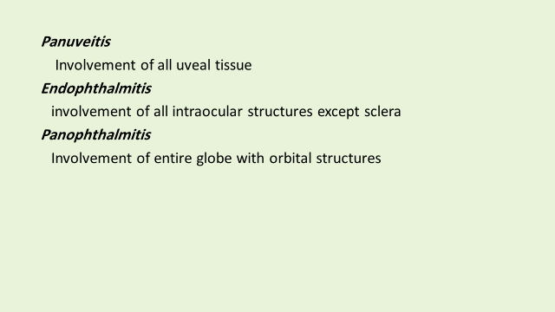

Slide 31
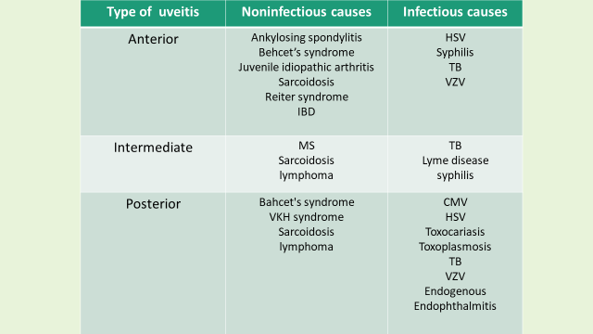

Slide 32
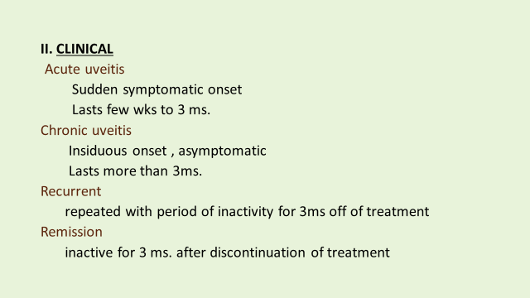

Slide 34
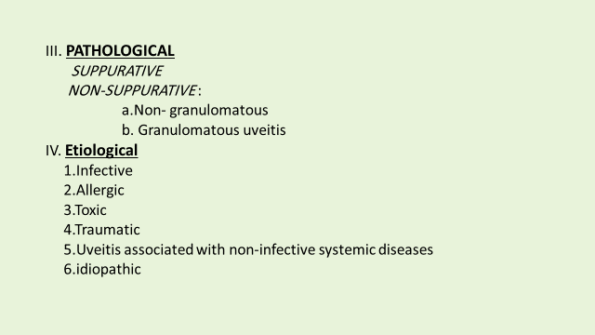

Slide 35
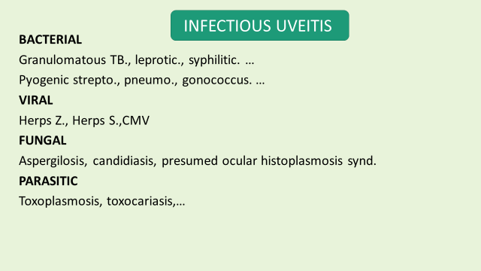

Slide 36
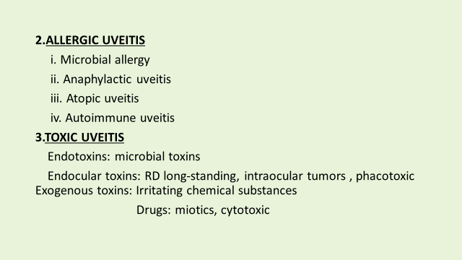

Slide 37
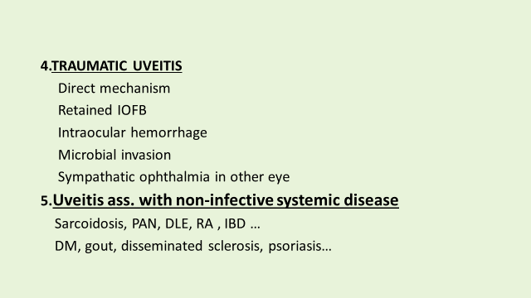

Slide 38
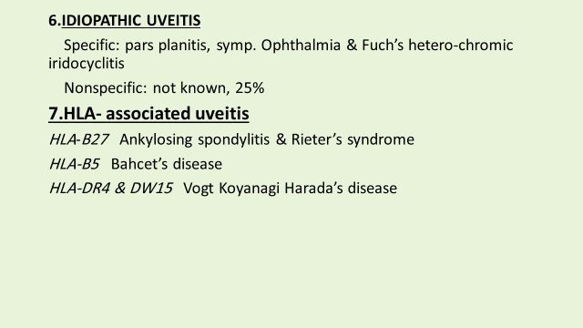

Slide 39
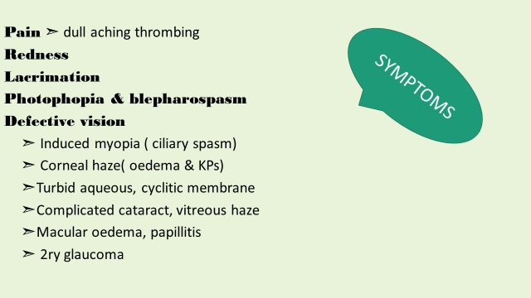

Slide 40
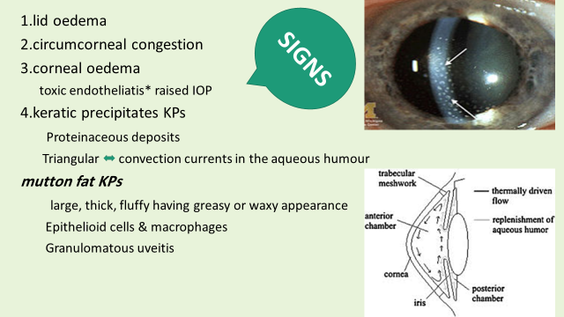

Slide 41
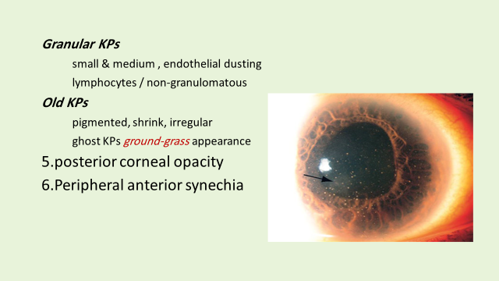

Slide 42
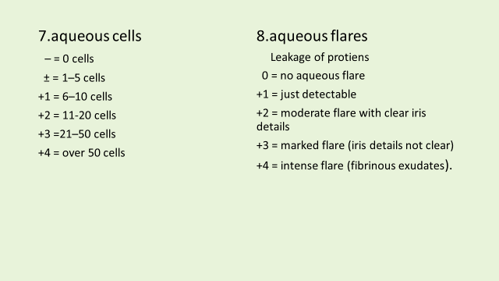

Slide 43
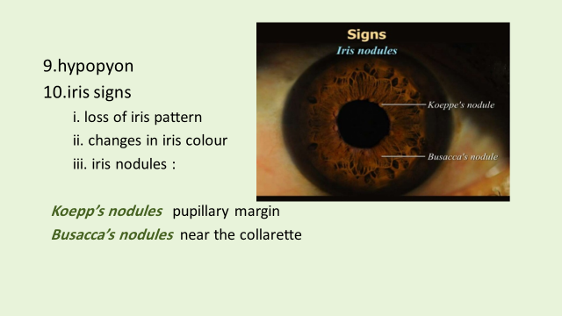

Slide 44
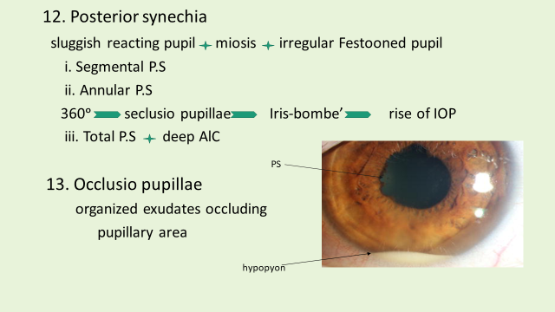

Slide 45
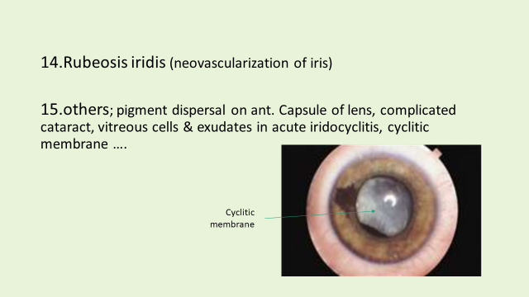

Slide 46
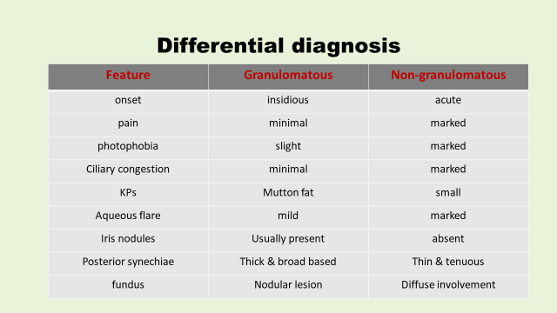

Slide 47
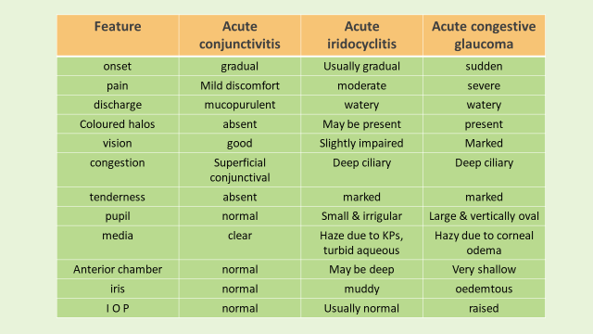

Slide 48
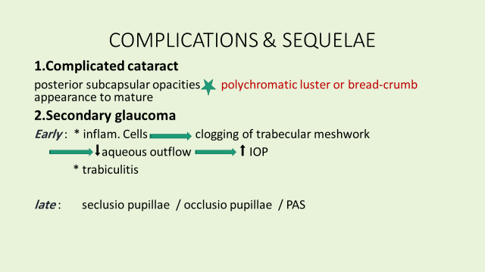

Slide 49
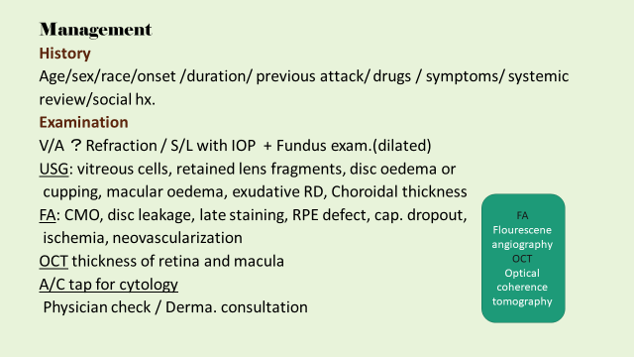

Slide 50
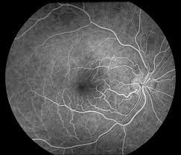
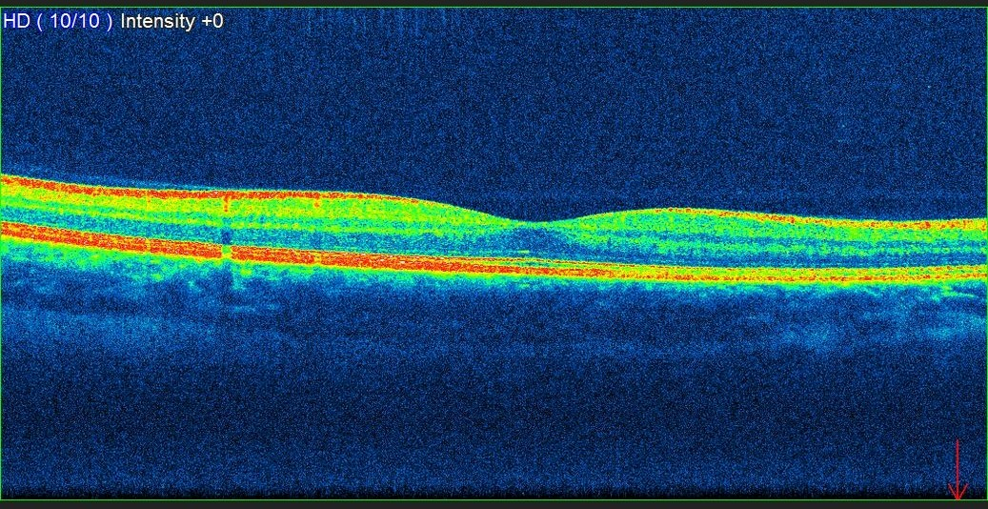
Optical coherence tomography
Flourescene angiography

Slide 51
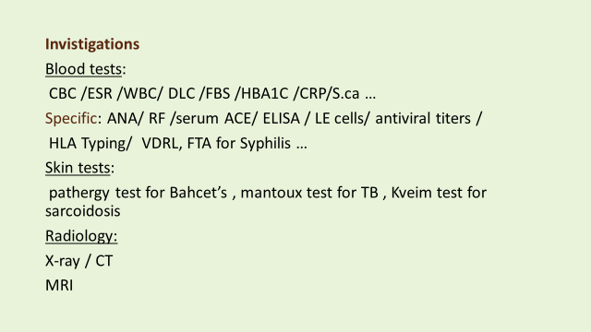

Slide 52
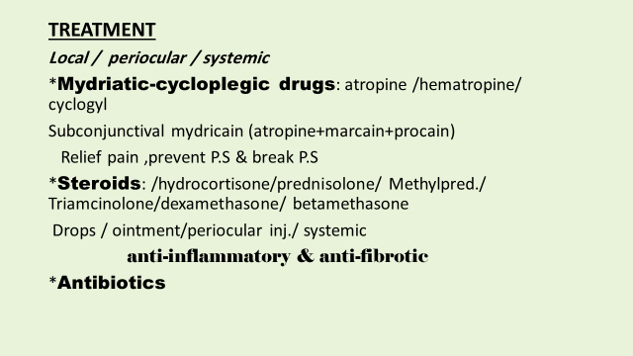

Slide 53
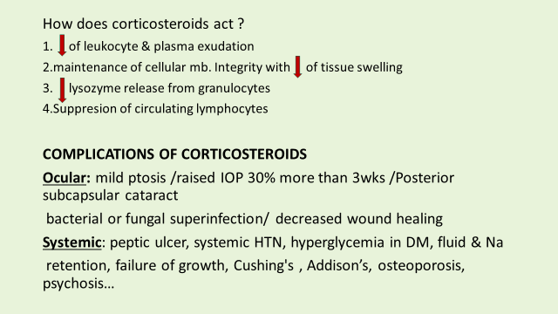

Slide 54
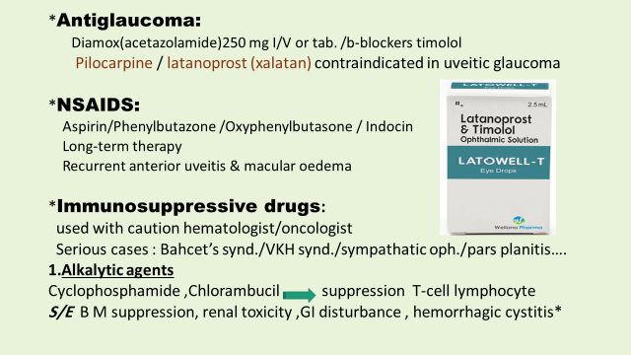

Slide 55
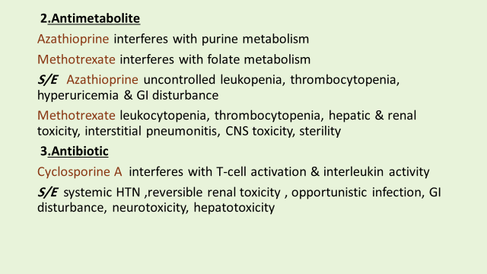

Slide 56
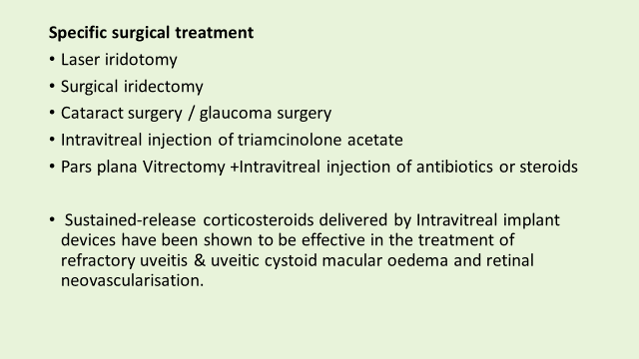

Slide 57
Uveitis associated with
Non-infectious diseases
Arthritis / Sarcoidosis / Bahcet’s
Infectious diseases
Bacterial / viral / Parasitic
Specific uveitis
VKH / Fuch’s uveitis syndrome / lens induced
PART III

Slide 58
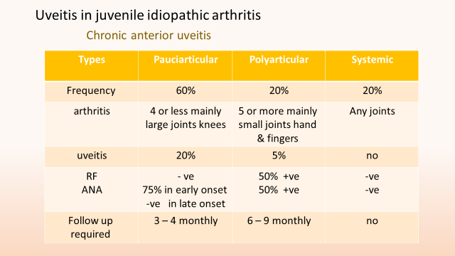

Slide 59
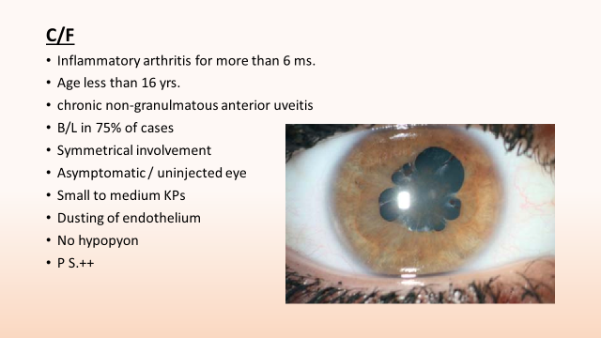

Slide 60


Slide 61


Slide 62


Slide 63


Slide 64


Slide 65


Slide 66


Slide 67


Slide 68


Slide 69


Slide 70


Slide 71


Slide 72


Slide 73


Slide 74


Slide 75


Slide 76


Slide 77


Slide 78


Slide 79


Slide 80


Slide 81


Slide 82


Slide 83


Slide 84


Slide 85


Slide 86


Slide 87


Slide 88


Slide 89


Slide 90


