Slide 1


Community outreach activity
2021-2022
By: Dr Iman Elmahdi
Head of Community and Environment
Serves Office

Slide 2

aims
To celebrate world water day.
To highlight the rationalized use of water.
To educate people how to protect drinking water.
To Digging a water well in a country in Africa.

Slide 3
World water day
United nation celebrate world water day on 22 March each year.
Each year has a specific theme.
The aim of celebration to highlight the importance of water.
Our theme will be water for life.

Slide 4
process
Arrange for digging a water well in a country in Africa.
Advertising poster about the activity with logo of united nation & the Libyan organization.
Brochures, posters, articles, and video.

Slide 5
Topics
Sources of drinking water.
Rationalize consumption of water.
Water pollution causes, effect, and prevention.
The importance of water.
Recycling of water.
Desertification in Libya.
Digging a water well in a country in Africa.

Slide 6
Topics
Water and climate change.
Water and sustainable development.
Groundwater the invisible resource.

Slide 7
Activities per topic
Topic | Activity | Responsible Year/ Group
Sources of drinking water. | Oral Presentation in English | Second year group A
Sources of drinking water. | Oral Presentation in Arabic | Second year group B

Slide 8
Activities per topic
Topic | Activity | Responsible Year/ Group
Water pollution causes. | Oral Presentation in English | Second year group C
Water pollution and Drinking water. | Oral Presentation in Arabic | Second year group D
Water pollution and Drinking water. | Article in English | Second year group E

Slide 9
Activities per topic
Topic | Activity | Responsible Year/ Group
The effect of water pollution on the environment | Oral Presentation in English | Second year group F
The effect of water pollution on the environment | Oral Presentation in Arabic | Second year group G
How to overcome /prevent water pollution | Oral Presentation in English | Second year group H

Slide 10
Activities per topic
Topic | Activity | Responsible Year/ Group
Rationalize consumption of water. | Brochures in English | Third year group A
Rationalize consumption of water. | Brochures in Arabic | Third year group B

Slide 11
Activities per topic
Topic | Activity | Responsible Year/ Group
Recycling of water | Brochures in English | Third year group C
Recycling of water | Brochures in Arabic | Third year group D

Slide 12
Activities per topic
Topic | Activity | Responsible Year/ Group
Desertification in Libya | Poster in English | Fourth year group A
Desertification in Libya | Poster in Arabic | Fourth year group B
Water and climate change | Brochures in English | Fourth year group C

Slide 13
Activities per topic
Topic | Activity | Responsible Year/ Group
The importance of water | Poster in English | Fifth year group A
Water and climate change | Poster in Arabic | Fifth year group B

Slide 14
Activities per topic
Topic | Activity | Responsible Year/ Group
Water and sustainable development | Poster in English | Fifth year group C
Groundwater the invisible resource. | Poster in English | Fifth year group D

Slide 15
Activities per topic
First year students are free to select any topic and submit video or Art about it per Group.

Slide 16
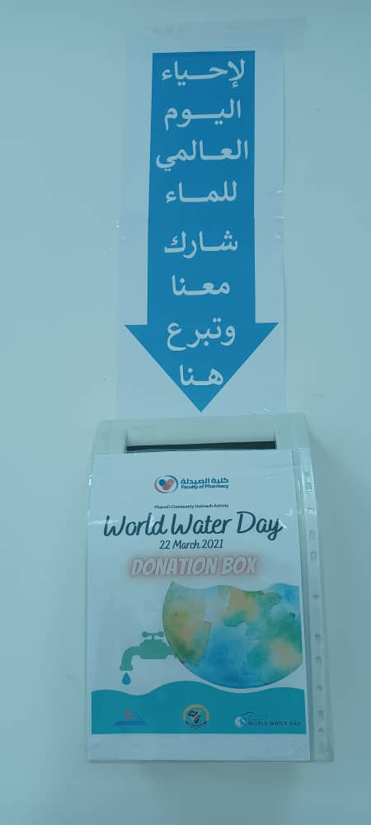
Activities per topic
Digging a water well in a country in Africa.
Money will be collected to digging a water in poor African country with giving it the name of PharmD/ Libyan international Medical university.
There will be a box for donor money collection.

Slide 17
Note
Each group have to submit their finished task to their tutor. Tutor will review his group’s work Then share it with Miss Eman Alyamani.
Deadline 07/01/2021.

Slide 18
Thank you
Water for life

