Slide 1


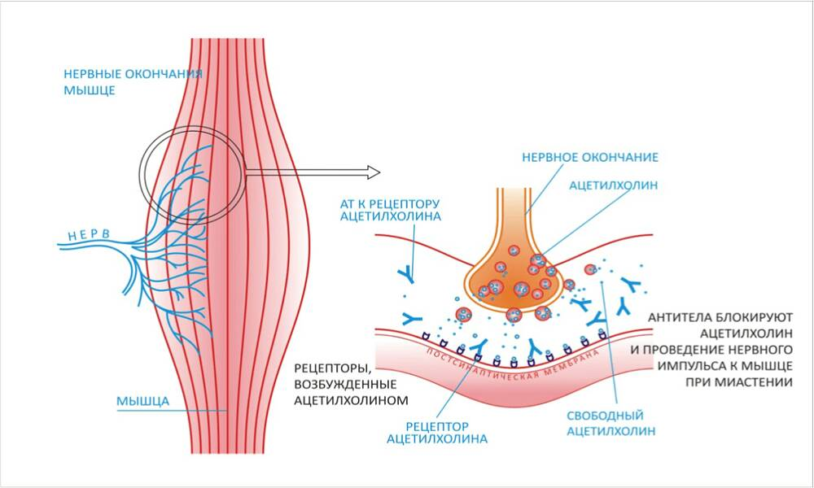
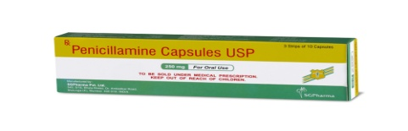


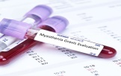
Libyan International Medical University
My muscle is suffering!
Introduction
Pathophysiology
Treatment
Myasthenia gravis (MG) is a disease of the neuromuscular junction characterized by weakness and fatigability . In MG, an autoimmune process characterized by acetylcholine-receptor antibodies leads to a decreased number of active and functional acetylcholine receptor at the postsynaptic membrane( 1)
Fatima jalal alajeeli ,2ed medical student
The pathogenesis of myasthenia gravis depends upon the target and isotype of the autoantibodies. Most cases are caused by immunoglobulin (Ig)G1 and IgG3 antibodies to the acetylcholine receptor (AChR). They produce complement-mediated damage and increase the rate of AChR turnover, both mechanisms causing loss of AChR from the postsynaptic membrane. (3)
Anticholinesterase ( Neostigmine )
Glucocorticoids
Steroids , Azathioprine
Plasmapheresis
Clinical Manifestations
(3IV immunoglobulin(
Conclusion
Muscle weakness and fatigability
Diplopia and ptosis
Difficulty in swallowing
Mushy speech
Snarling when smiling (2)
There is no cure for myasthenia gravis, but treatment can help relieve signs and symptoms , Not everyone will have every symptom, and the degree of muscle weakness can change from day to day. The severity of the symptoms typically increases over time if left untreated.
Causes
Genetic
Congenital myasthenia syndrome
Drugs induced myasthenia gravis
(D-penicillamine) studies revealed that
there is an association between patient of Rheumatoid arthritis who are taking D-penicillamin and myasthenia gravis (2 )
References
Diagnosis
Bever ct jr , et al. (2018). Nihgov. Retrieved 19 March, 2018,
Mayoclinicorg. (2018). Mayo Clinic. Retrieved 19 March, 2018, from diseases-conditions/myasthenia-gravis/symptoms-causes/syc-20352036
Healthlinecom. (2018). Healthline. Retrieved 19 March, 2018, from health/myasthenia-gravis
X ray and Computerized tomography for Chest
Electromyogram (EMG)
Lab Investigation Acetylcholine –Receptor Antibody
The edrophonium (tensilon) test ( 3)

