Slide 1

Human papillomavirus vaccine
Faculty of applied medical science
- Student name : Yakeen Elkadiki
- 2nd year MED student
- Student NO. : 2948
- Date : 27/3/2022
1

Slide 2
Objectives :
1
Define human papillomavirus
2
List routes of transmission of HPV
3
Outline types of vaccine for HPV
4
Mention risks of not vaccinating
2

Slide 3
About HPV
HPV is the most common STI. There were about 43 million HPV infections in 2018, many young people in their late teens and early 20s. There are many different types of HPV. Some types can cause health problems
3

Slide 4
Types of HPV virus
Oncogenic or high risk types
Non-oncogenic or low risk types
4

Slide 5
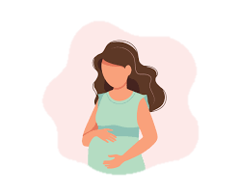
Transmission of HPV
Non-sexual
Vertical
Horizontal
Sexual
Routes
5

Slide 6
ABOUT THE VACCINE
6

Slide 7

Types of vaccine for HPV
Gardasil 9
Bivalent
Quadravalent
7

Slide 8
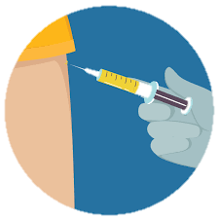
Quadravalent vaccine
The quadravalent human papillomavirus vaccine protects against infection with HPV types 6,11, 16, and 18 . It contains no viral DNA and is not infectious
Clinical trials have revealed the vaccine to be highly immunogenic, safe, and well tolerated in males and females 9 through 26 years of age.
8

Slide 9
Who should get vaccinated
Should
Should not
Children with 11-12 years old starting form age 9
Teens and young adults starting from 15 to the age of 26
For people over 26 years old
People with severe allergy reaction
People with allergy against yeast
Pregnant women
9

Slide 10
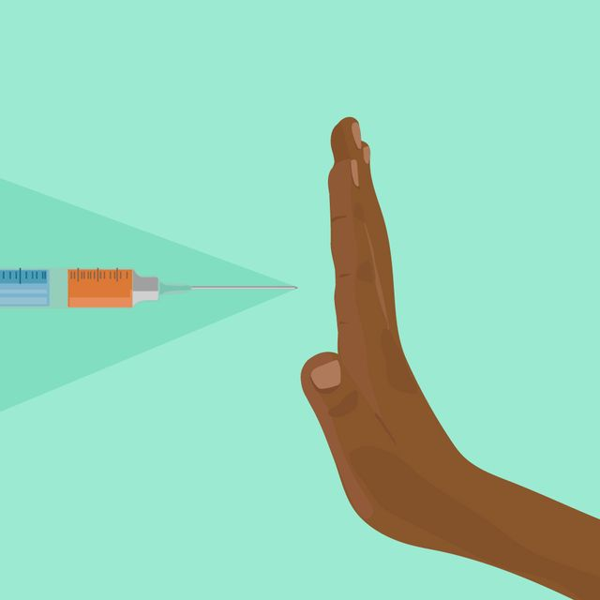
Risks of not vaccinating
Genital warts
Cervical cancer
Oropharyngeal cancer
10

Slide 11
Effect of vaccine
ASCUC
PERSISTANT INFECTION
93%
74%
15-25
15-25
11

Slide 12
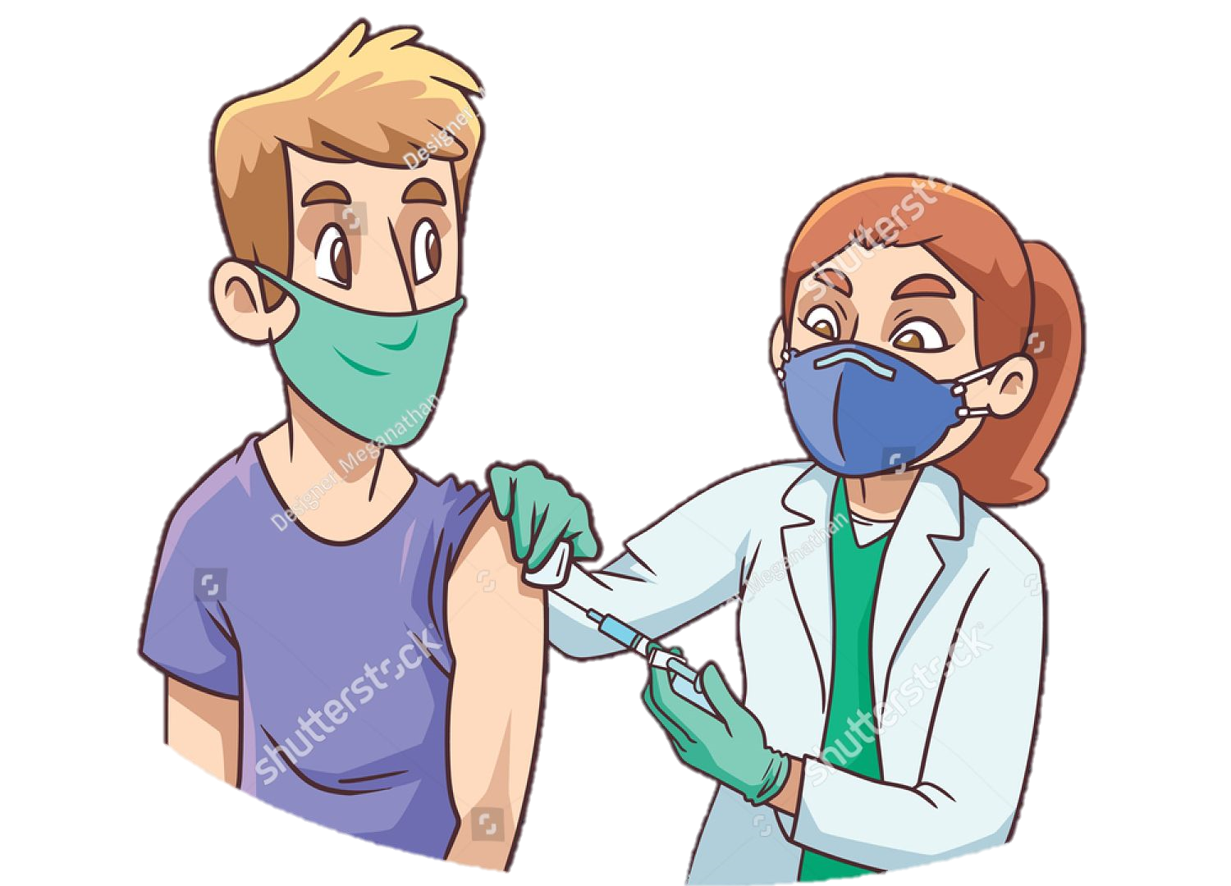
RECOMMENDATIONS
How can I avoid HPV and the health problems it can cause?
Get screened for cervical cancer.
Get vaccinated
12

Slide 13
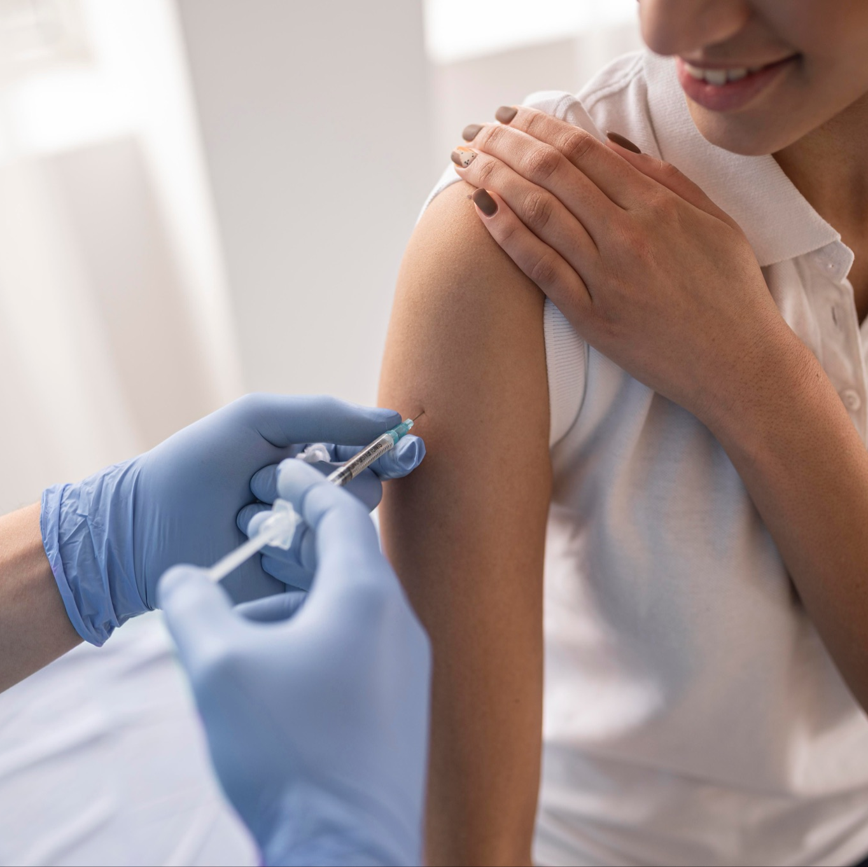

CONCLUSIONS
Vaccines are the most cost-effective way available to date as they play an important role in the primary prevention of infectious diseases with a high percentage of efficacy and safety.
13

Slide 14

“A dollar spent on a childhood vaccination not only saves a life, but greatly reduces spending on future health care”
Ezekiel Emanuel
14

Slide 15
REFERENCES
1. Durán-Méndez A, Jardínez-Vera AC, Jiménez-Muñoz E, Peón AN. A brief history of vaccines and an overview of their benefits. Revista de la Sociedad Española de Beneficencia.;2(6).
2. Pichichero ME. Who should get the HPV vaccine?. Journal of family practice. 2007 Mar 1;56(3):197.
3. Braaten KP, Laufer MR. Human Papillomavirus (HPV), HPV-Related Disease, and the HPV Vaccine. Rev Obstet Gynecol. 2008;1(1):2-10.
4. Committee on Infectious Diseases. HPV vaccine recommendations. Pediatrics. 28
012;129(3):602-605. doi:10.1542/peds.2011-3865
5. Roden, R., Wu, TC. How will HPV vaccines affect cervical cancer?. Nat Rev Cancer 6, 753–763 (2006). https://doi.org/10.1038/nrc1973 https://rdcu.be/cJNFS
15

Slide 16
THANKS
16

