Slide 1
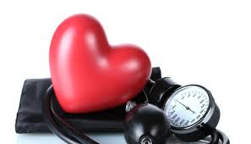
Arterial Hypertension
Dr . Zaki Bettamer
Zikoecho@yahoo.com
Wednesday, March 27, 2019
cardiologist MD,MSc critical care, ER speciality

Slide 2
60 years old black male frequently suffering from headache and blurring vision with history of high BP reading, his mother is hypertensive.
On examination : BP 175 / 110 , pulse 80 beat / minute regular, fundal examination show grade II hypertensive retinopathy otherwise normal, Echo and RFT are normal.
the best starting medication of this patient is :

Slide 3
Definition
Hypertension, or high blood pressure (BP), is defined as a persistent systolic blood pressure (SBP) > 140 mm Hg, diastolic blood pressure (DBP) > 90 mm Hg.

Slide 4
White coat hypertension: rise of B.P when measured in the clinic, but normal readings at home or with ambulatory B.P recordings.
Hypertension is generally an asymptomatic condition. Individuals who remain undiagnosed and untreated for hypertension present the greatest challenge and opportunity for health care providers

Slide 5
Classification of hypertension
Prehypertension: BP 120 to 139 / 80 to 89 mm Hg
Stage 1 (mild): BP 140 to 159 / 90 to 99 mm Hg
Stage 2 (Moderate):SBP >160 or DBP >100 mm Hg.
Stage 3 ( severe): SBP >180 or DBP>110.

Slide 6
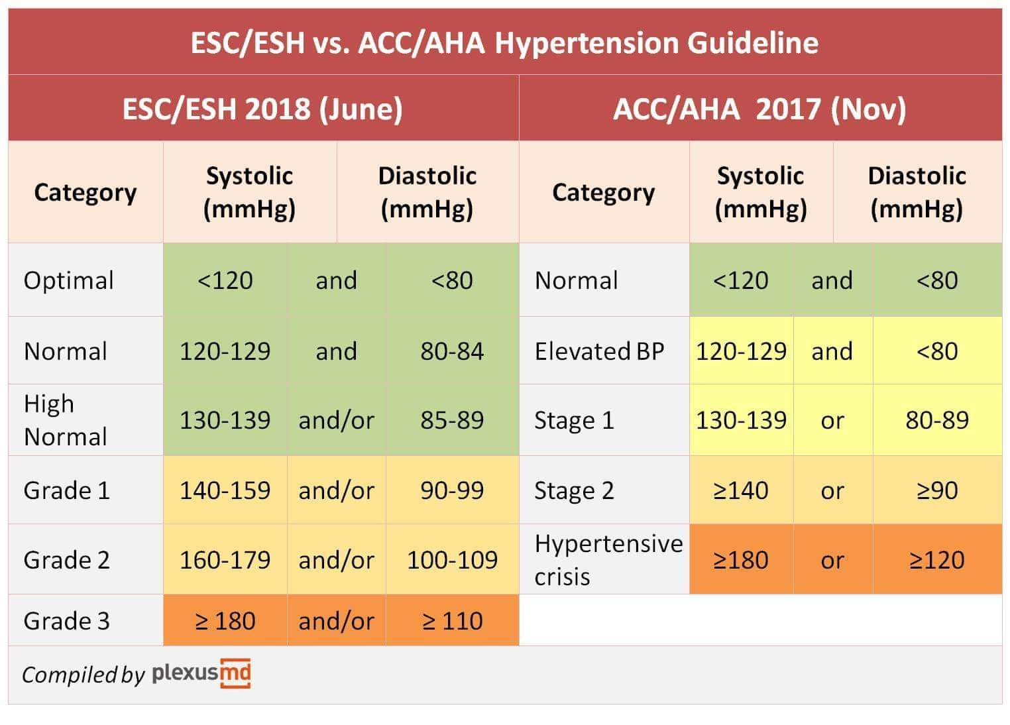

Slide 7
ETIOLOGY OF HYPERTENSION
Primary (essential or idiopathic) hypertension: elevated BP without an identified cause; accounts for 90% to 95% of all cases of hypertension.
Secondary hypertension: elevated BP with a specific cause; accounts for 5% to 10% of hypertension in adults.

Slide 8
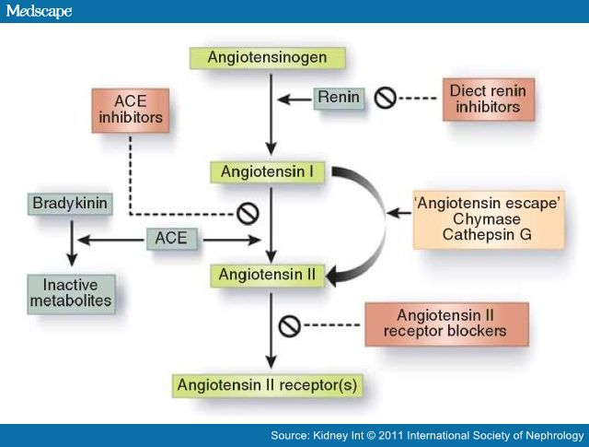

Slide 9
Pathogenesis
of primary
HTN
Insulin Resistance
Obesity
RAS
CardiacOutput
Na Intake
Genetics
Peripheral Resistance
Na Excretion
CM Alterations
Endothelial
dysfunction
Stress

Slide 10
Theories of primary hypertension:
Renal Theory: There is increase of renin secretion.
2. Increased adrenal gland activity Aldosterone secretion.
3. Increased activity of VMC sympathetic discharge
Blood pressure.
4. Multifactorial theory:
Stress
+ VMC
Vasospasm (sympathetic)
Renal ischaemia
return to normal
blood pressure
renin increase
by time
Persistent hypertension.
VMC : VasoMotor Center

Slide 11
5. Barroreceptors resetting.
6. Impaired pressure natriuresis.
7. COP - P.R.
8. Genetic factors, hypertension tends to run in families and children of hypertensive parents.
9. Insulin resistance, obesity.
IO.Alcohol intake, excessive sodium intake or salt sensitivity.

Slide 12
Causes of secondary hypertension
Renal disease:
Renal artery stenosis.
Glomerulonephritis
polycystic kidney disease.
Endocrine:
Phaeochromocytoma.
Cushing’s syndrome, acromegaly, primary hypothyroidism, thyrotoxicosis.
Drugs: O.C.P, steroids, NSAIDs, sympathomimetic drugs.
Coarctation of aorta.
Pregnancy.

Slide 13
CLINICAL MANIFESTATIONS OF HYPERTENSION
Often called the “silent killer” because it is frequently asymptomatic until it becomes severe and target organ disease occurs.
Rarely can present with headache or encephalopathy.

Slide 14
Target organ damage
The heart:
Atrial fibrillation.
Left ventricular hypertrophy and failure.
Coronary artery disease.
The blood vessels:
Atherosclerosis.
Aortic aneurysm.
Aortic dissection.

Slide 15
Target organ damage
The brain:
Stroke.
Subarachnoid hemorrhage.
Hypertensive encephalopathy.
The kidneys:
Protenuria.
Renal failure.

Slide 16
Target organ damage
Retina:
Grade 1:arteriolar thickening (silver wiring).
Grade 2: grade 1 plus constriction of veins at arterial crossing (A.V. nipping).
Grade 3: grade 2 plus retinal hemorrhage (flame shaped) & cotton wool exudate.
Grade 4: grade 3 plus papilloedema.

Slide 17
Malignant hypertension
Accelerated microvascular damage with necrosis in small arteries walls (fibrinoid necrosis) & intravascular thrombosis.
High B.P with rapidly progressive end organ damage ( Grade ¾ retinopathy, renal failure, or encephalopathy ).

Slide 18
History
Family history of HTN.
Risk factors of CAD: DM, hyperlipidemia, smoking.
Symptoms of secondary HTN.
Complications of HTN: CAD, CVA,PVD.

Slide 19
Examination
Radiofemoral delay: coarctation of aorta.
Enlarged kidneys: polycystic kidneys.
Abdominal bruits: renal artery stenosis.
Central obesity.
Heart: S4, accentuation of aortic component of S2.

Slide 20
Investigations of hypertension
All patients should have:
Urinalysis for blood, protein, glucose.
Renal function test.
Blood glucose.
Serum lipids.
ECG.

Slide 21
Optimal target B.P. control
Non diabetic: <140/85
Diabetic: <130/80

Slide 22
Hypertension: investigation of selected patients
• Chest X-ray: to detect cardiomegaly, heart failure, coarctation of the aorta
• Ambulatory BP recording: to assess borderline or ‘white coat’ hypertension
• Echocardiogram: to detect or quantify left ventricular hypertrophy
• Renal ultrasound: to detect possible renal disease
• Renal angiography: to detect or confirm presence of renal artery stenosis
• Urinary catecholamines: to detect possible phaeochromocytoma
• Urinary cortisol and dexamethasone suppression test: to detect possible Cushing’s syndrome
• Plasma renin activity and aldosterone: to detect possible primary aldosteronism

Slide 23
Approach to newly diagnosed HTN
To obtain accurate measurement of B.P.
To identify underlying cause.
To assess other risk factors & quantify C.V. risk.
To detect complications (target organ damage).
To identify comorbidity that influence the choice of antihypertensive drug.

Slide 24
Non pharmacological treatment
Risk factors modification:
Stop smoking.
Treat hyperlipidemia and diabetes.
Weight reduction.
Low salt diet.

Slide 25
Pharmacological treatment
A: Angiotensin converting enzyme inhibitors (ACEI),Angiotensin receptor blockers.
B: beta blockers.
C: Calcium channel blockers.
D: Diuretics.
Others:Alpha blockers, centrally acting drugs (methyldopa, clonidine).

Slide 26
ACE inhibitors.
ACE inhibitors (e.g. enalapril 20 mg daily, ramipril 5–10 mg daily or lisinopril 10–40 mg daily)
inhibit the conversion of angiotensin I to angio-tensin II and are usually well tolerated.
They should be used with particular care in patients with impaired renal function or renal artery stenosis because they can reduce the filtration pressure in the glomeruli and precipitate renal failure.
Electrolytes and creatinine should be checked before and 1–2 weeks after commencing therapy.
Side-effects include first-dose hypotension, cough, rash, hyperkalaemia and renal dysfunction.

Slide 27
Angiotensin receptor blockers
Angiotensin receptor blockers (e.g. irbesartan 150–300 mg daily, valsartan 40–160 mg daily)
block the angiotensin II type I receptor
have similar effects to ACE inhibitors
however, they do not cause cough and are better tolerated.

Slide 28
Beta-blockers.
These are no longer used as first line antihypertensive therapy, except in patients with another indication for the drug (e.g. angina).
Metoprolol (100–200 mg daily), atenolol (50–100 mg daily) and bisoprolol (5–10 mg daily).
preferentially block cardiac β 1 adrenoceptors, as opposed to the β 2 -adrenoceptors that mediate vasodilatation and bronchodilatation.
Labetalol and carvedilol. Labetalol (200 mg–2.4 g daily in divided doses) and carvedilol (6.25–25 mg twice daily) are combined β- and α-adrenoceptor antagonists which are sometimes more effective than pure β-blockers.
Labetalol can be used as an infusion in malignant phasenhypertension .

Slide 29
Calcium channel antagonists.
The dihydropyridines (e.g. amlodipine 5–10 mg daily, nifedipine 30–90 mg daily) are effective and usually well-tolerated antihypertensive drugs that are particularly useful in older people.
Side-effects include flushing, palpitations and fluid retention.
The rate limiting calcium channel antagonists (e.g. diltiazem 200–300 mg daily, verapamil 240 mg daily) can be useful when hypertension coexists with angina but they may cause bradycardia.
The main sideeffect of verapamil is constipation.

Slide 30
Other drugs
A variety of vasodilators may be used.
These include the α 1 -adrenoceptor antagonists (α-blockers), such as prazosin (0.5–20 mg daily in divided doses), indoramin (25–100 mg twice daily) and doxazosin (1–16 mg daily).
drugs that act directly on vascular smooth muscle, such as hydralazine
(25–100 mg twice daily) and minoxidil (10–50 mg daily).
Side-effects include first dose and postural hypotension, headache, tachycardia and fluid retention.
Minoxidil also causes increased facial hair and is therefore unsuitable for female patients.

Slide 31
Thiazide and other diuretics
The mechanism of action of these drugs is incompletely understood and it maytake up to a month for the maximum effect to be observed.
daily dose is 2.5 mg bendroflumethiazide or 0.5 mg cyclopenthiazide.
More potent loop diuretics, such as furosemide (40 mg daily) or bumetanide (1 mg daily), have few advantages over thiazides in the treatment of hypertension, unless there is substantial renal impairment or they are used in conjunction with an ACE inhibitor.

Slide 32
Aged < 55 yrs
Aged > 55 yrs or
black person
of any age
Step 1
A
C
Step 2
A + C
Step 3
A + C + D
Step 4
Resistant hypertension
A + C + D + consider
further diuretic or α- or β-blocker 5
Consider seeking expert advice

Slide 33
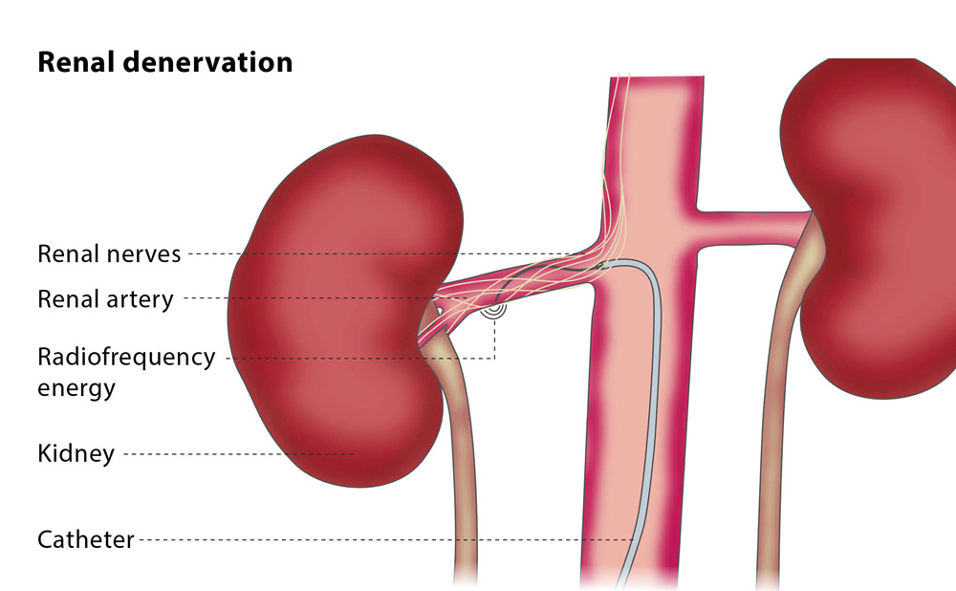

Slide 34
Choice of antihypertensive
Old age: diuretic/ CCB.
Pregnant: Methyldopa, beta blocker.
Angina: beta blocker.
Diabetic: ACEI

Slide 35
Hypertensive crises
are classified as emergencies or urgencies , based on the presence or absence of progressive target organ dysfunction.
• Urgencies: severe ↑ BP without evidence of acute or progressive target organ dysfunction

Slide 36
If no acute organ damage, does not necessarily require hospital admission.
Rest the patient in a quite room.
Repeat BP after 1 – 2 h to confirm. If DBP still > 130mmHg treat.
Use the same oral agents as in emergency.
Start with a single agent.

Slide 37
Aim for diastolic BP 100 – 110mmHg at first.
Recheck BP after 24 – 48h.
If still uncontrolled, increase dose, or add in second agent.
Recheck after every 2 – 3 days until BP at desired level.
Treat according to guidelines.

Slide 38
•
Emergencies: severe ↑ BP complicated by evidence of acute or progressive target organ damage, such as
Cardiac ischaemia (ACS)
Encephalopathy
Stroke
Pulmonary oedema
Renal failure.

Slide 39
Initial aim of treatment is to d DBP to 110 115mmHg.
Aim to achieve this in 2 – 6 hours.
Parenteral agents are often required
Sodium nitroprusside, Labetalol , Glyceryl trinitrate
Once BP within target range, transfer to oral agent, and wean IV
infusion over 4 – 8h.

Slide 40
Regarding the investigation of patient with hypertension : Renal ultrasound is good indicator for primary hypertension. Ambulatory BP recording to assess white coat hypertension. Urinary catecholamines to detect possible Cushing’s syndrome. Echocardiogram to detect mitral valve stenosis as cause of hypertension. Plasma renin activity and aldosterone to detect phaeochromocytoma.

Slide 41
60 years old black male frequently suffering from headache and blurring vision with history of high BP reading, his mother is hypertensive. On examination : BP 175 / 110 , pulse 80 beat / minute regular, fundal examination show grade II hypertensive retinopathy otherwise normal, Echo and RFT are normal. the best starting medication of this patient is : Calcium Chanel Blockers ( CCB ) B - Blockers Alpha 1 Blockers Angiotensin Receptor Blockers ( ARBs ) Methyldopa

Slide 42
THANKS

