Slide 1

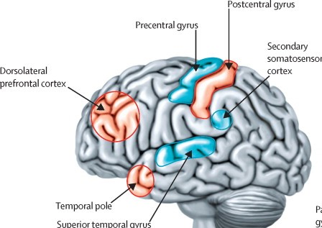
Touch Me To Be Your Mirror
Libyan International Medical University
Faculty of Basic Medical Science
Mohammed Abduljalil . 2nd Year Medical Student.
Introduction
Discussion
Conclusion
Neurological condition known as mirror-touch synesthesia, a rare disorder that results in a person feeling the pain or touch that they see another person experience (like looking in the mirror).(1)
Mirror-touch synesthesia is a particular form that involves feeling the sensations other people feel, as if something were happening to you, Not only feeling the feelings of others, but also the feeling of touch, for example, if someone beat himself, the patient feels the same blow and says to the person why you hit me actually
who have mirror-touch synesthesia can also feel emotions such as sadness, anxiety, and anger.
When the patient watches shows like Game of Thrones or War Films, he says he can literally feel the pain of others.
The patient says when someone laughs with him and when he cries, I represent him accurately and when he is afraid of something I feel like I am a mirror to him even when he plays a sport I feel that my body represents him involuntarily.
Patients with this syndrome say that when they go to a comedy theater, drama or even dance they rise up and imitate the actors on the stage, beat the chairs, or cry or dance like them I have the idea that it will be difficult to hide your feelings in front of these patients. Remember that your duty is to always make a smile on the patient's face.(3)
Perhaps one of the days comes to you a patient with a kind of diseases will be difficult to diagnose what he has and comes coincidence that your patient has this syndrome also be careful patients are liars or imitators.
Is a very rare syndrome (affects 2 of 100 people around the world).
Symptoms appear at the age of 16 years and over.
The patient imitates the most dominant person among the people.
Mirror-touch synesthesia might sound a lot like empathy, which allows us to imagine ― and sometimes even have a physical reaction to ― what another person might be feeling.
Causes
References
This condition is typically a developmental disorder.
Also been known to affect individuals who have lost one of their extremities.
The somatosensory mirror syndrome (or sensory receptors) are hyperactive in some people, causing them to be able to feel what others feel.
These sensory receptors are all over your body and are all connected to neurons in your central nervous system. figure 1.
Maybe it is genetic condition.(2)
1- Banissy, M. J., & Ward, J. (2007). Mirror-touch synesthesia is linked with empathy. Nature neuroscience, 10(7), 815.
2- Banissy, M. J., Garrido, L., Kusnir, F., Duchaine, B., Walsh, V., & Ward, J. (2011). Superior facial expression, but not identity recognition, in mirror-touch synesthesia. Journal of Neuroscience, 31(5), 1820-1824.
3- Banissy, M. J., & Ward, J. (2013). Mechanisms of self-other representations and vicarious experiences of touch in mirror-touch synesthesia. Frontiers in human neuroscience, 7, 112.
Figure 1, Hyperactivity

