Slide 1


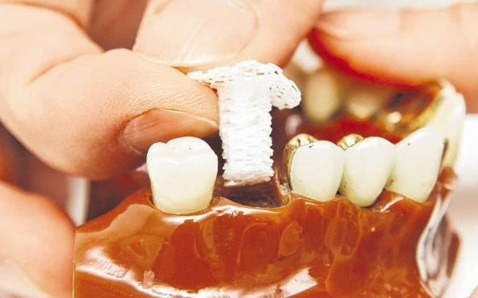
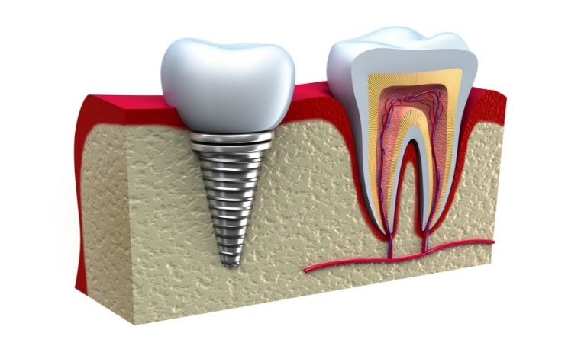
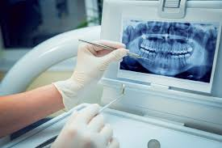
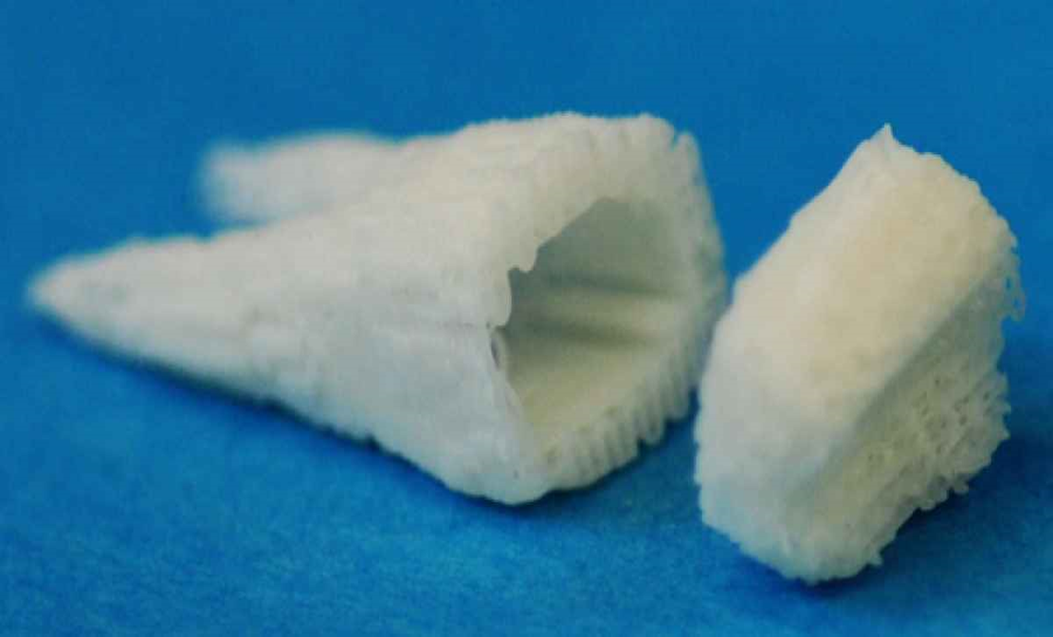
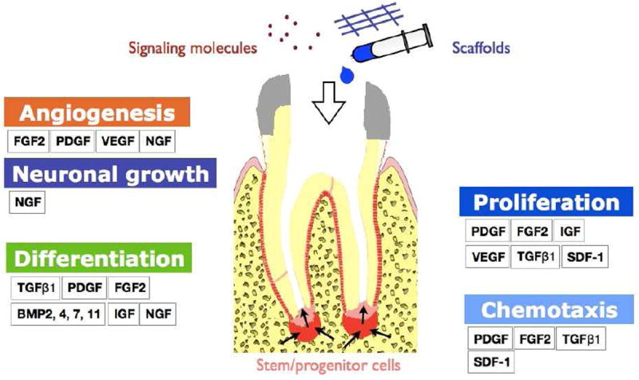
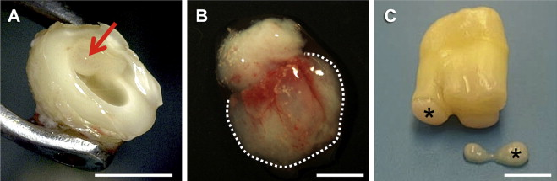
Stem Cell Dental Implants Can Grow New Teeth
By : Marwa Ahmad Al-hag /2nd year dental
Faculty of Basic Medical Sciences
Libyan international medical university
Introduction
procedures
The new advancements don’t work from the perspective of replacing teeth that are damaged or fall out due to trauma,
cavities, or gum disease.
Instead, the stem cells
are used to actually
regenerate the teeth .
Stem cells are undifferentiated cells, capable of renewing themselves. Via differentiation, they have the potential to develop into many different cell lineages. There are different kinds of stem cells, depending on the type of cells they can create and the location in
the body .
tissue engineering therapies and stem cells are a promising way to achieve alveolar bone regeneration and solve large periodontal tissue defects and finally to substitute a lost tooth itself .
1. Low level laser therapy that activated the stem cells and created new teeth :
first drilled holes in mouse molars than add adult stem cells they had grown in the laboratory to the pulp of the tooth ,They lasered the area to stimulate the growth factors,the teeth were sealed with a temporary cap for 12 weeks.
What happened in the procedure is that laser
induces the production of free radicals in the area.
These free radicals then activate
a growth factor called TGF-B1.
It’s this TGF-B1 that then causes the differentiation
of the human dental stem cells.
That’s how they got the new tooth to appear.
2. The creation of a 3-D scaffold with a collagen sponge upon which the stem cells and growth factors were added, and new teeth formed. Sometimes a drug is used to start the process .
-Also in this process there is a drug that is called Tideglusib , they discovered that the drug regrew enough dentin in the tooth to fill a cavity in rats, The drug can also regenerate the nerve and blood vessel in the pulp of the tooth .
Tideglusib works in a unique way. It switches off an enzyme called glycogen synthase kinase-3, or GSK-3. This enzyme is responsible for regulating multiple cellular functions and also the creation of dentin.
and it only took about 9 weeks for the tooth to appear and Since the sponge was made of collagen , the body could handle it and the sponge didn’t need to be removed at a later .
Conclusion
The goal from research shows that stem cells for dental implants and tooth regrowth and could provide painless ways of saving and restoring teeth .
When, and if, these two new treatments are successful on humans, they could end up totally replacing the dental composite and dental implants industries .
stem cells in dentistry
Types of adult stem cells have been characterized in dental tissues :
Epithelial stem cells (ESCs).
Mesenchymal progenitor or stem cells ( MSCs).
Dental pulp stem cells (DPSCs).
Periodontal ligament stem cells (PDLSCs) .
Dental follicle stem cells(DFSCs).
Stem cells from the apical papilla (SCAP) .
figure : adult stem cells in dental tissues.
References :
1-Egusa, Hiroshi et al. Stem Cells In Dentistry – Part I: Stem Cell Sources. 2019.
2-Kim, Sahng G. et al. Effects Of Growth Factors On Dental Stem/Progenitor Cells. 2019.
3-Magazine, Stem. "Stem Cells For Dental Implants And Tooth Regrowth". Stem Cell: The Magazine, 2019.
https://stemcellthemagazine.com/2018/06/stem-cells-for-dental-implants-and-tooth-regrowth/.

