Slide 1


Overweight and Obesity Link between obesity and cardiovascular diseases
Libyan International Medical University
Applied Medical sciences
Year 1
PTS block
by : Ali Alrokh
Date:2022/5/18

Slide 2
Objectives
1- Definition of obesity and overweight.
2- Outline causes of obesity.
3- Outline Pathophysiology of obesity and cardiovascular diseases.
4- Mention the general and cardiac complications of obesity.
5- List Treatment of obesity.
1

Slide 3
Introduction
-Obesity is a public health problem.
-The obesity and the overweight are risk for number of chronic disease.
-Overweight and obesity are fifth leading risk for global death.
-The prevalence of obesity has increase at alarming rate.
2

Slide 4
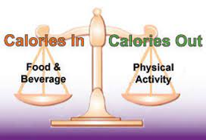
Definition of obesity
Obesity : is a medical condition in which excess body fat has accumulated with the BMI of over 30.
Overweight : is a condition where the person weighs more than what is considered normal for that height , age and sex with a BMI between 25 to 29.9.
*Generally excess fat results from the imbalance between calorie intake and calorie output.
4

Slide 5
Causes of obesity
1
6
2
5
Sex and age
3
4
Medical conditions
Genetic
Diet
Physical inactivity
Emotional stress
5

Slide 6

Genetic predisposition
Recently, scientists discovered the ADP gene (Adipose gene).
6

Slide 7

Diet
Major cause of obesity Regular consumption of high calorie food such as those rich in fat or in sugars.
7

Slide 8
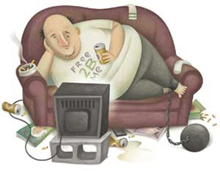
Physical inactivity
Physical inactivity is a major element in the development of obesity, sedentary lifestyles.
8

Slide 9
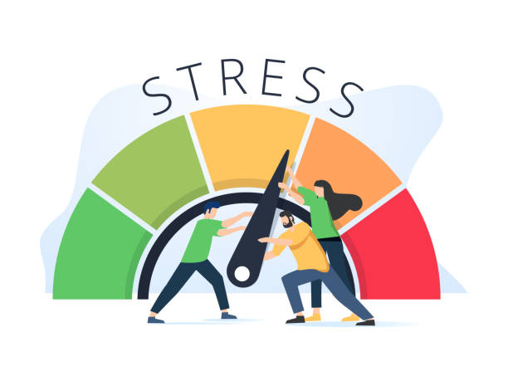
Emotional stress
Some people overeat because of depression, anger, boredom, and many other reasons that have nothing to do with hunger.
9

Slide 10
Sex and age
Men have more muscle than women, on average because muscle burns more calories than other types of tissue.
Age: People tend to lose muscle and gain fat as they age. Their metabolism also slows down...
10

Slide 11
Medical conditions
1) Hypothyroidism.
2) Cushing’s syndrome.
3) pancreatic insulinoma.
4) growth hormone deficiency, and hypothalamic insufficiency.
5) cardiovascular diseases.
11

Slide 12
Pathophysiology of obesity and CVD
insulin resistance which cause type 2 diabetes
endothelial dysfunction
sodium retention by alteration in the renin angiotensin - aldesterone system
promotes platelet aggregation
promotes atherosclerosis
resistance leptin levels
increase in LDL and decrease in HDL thus leads to
dislipidemia
increase heart rate
promotes thrombosis and increases blood pressure and heart rate.
hypertention, heart faluire , coronary artery disease and sudden death
12

Slide 13
General complications of obesity
1) Osteoarthritis (OA).
2) Type 2 diabetes.
3) Certain cancers.
4) Digestive problems.
5) Sleep apnea.
6) Mortality.
7) Cardiovascular diseases.

Slide 14
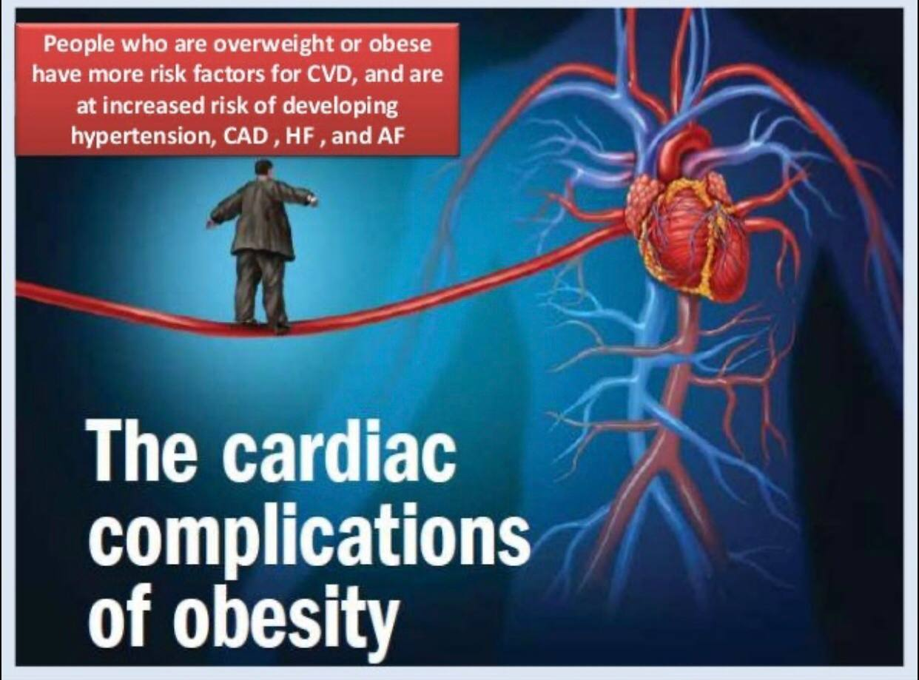
13

Slide 15
Cardiac complications of obesity.
1) Coronary artery disease (ischemic heart disease).
2) Hypertension.
3) Dysrythmia.
4) Cardiomyopathy.
5) Atrial fibrillation.
6) Heart failure.
14

Slide 16
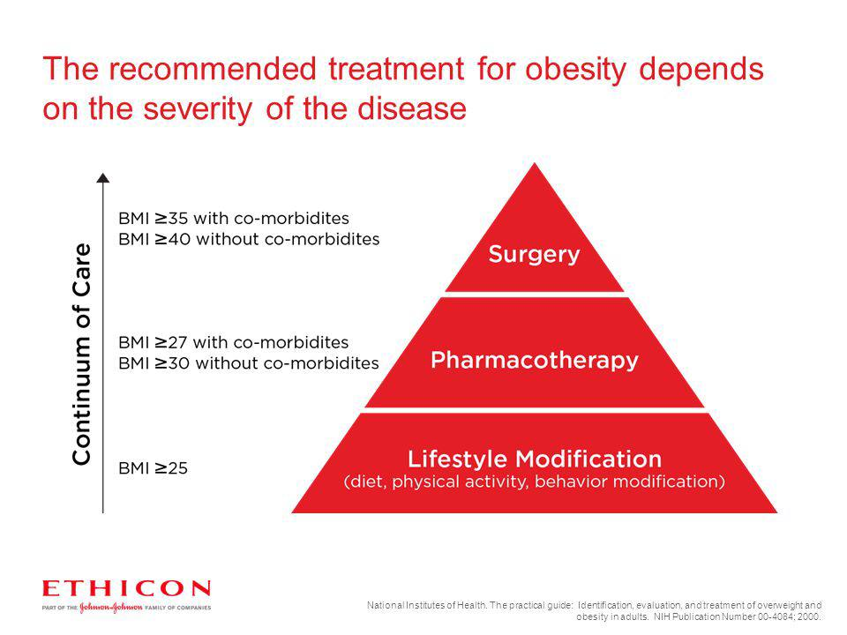
Treatment of obesity comes into three categories
1) Behaviour modifications.
2) Pharmacotherapy .
3) Surgical intervention.
15

Slide 17

16

Slide 18

17

Slide 19
References
1- Statistics - EASO. (2022). Retrieved 11 May 2022, from https://easo.org/media-portal/statistics/.
2- https://www.who.int/news-room/fact-sheets/detail/obesity-and-overweight.
3- Cercato, C., & Fonseca, F. (2019). Cardiovascular risk and obesity. Diabetology &Amp; Metabolic Syndrome, 11(1). doi: 10.1186/s13098-019-0468-0Fruh S. M. (2017).
4- Obesity - Symptoms and causes. (2022). Retrieved 13 May 2022, from https://www.mayoclinic.org/diseases-conditions/obesity/symptoms-causes/syc-20375742.
5- Obesity: Risk factors, complications, and strategies for sustainable long-term weight management. Journal of the American Association of Nurse Practitioners, 29(S1), S3–S14. https://doi.org/10.1002/2327-6924.12510.
18

Slide 20

19

