Slide 1
Ophthalmic diagnostic tools
Tools &Instrument &drugs
By dr. Eman Enweigi

Slide 2
Snellen chart:
an eye chart that can be used to measure visual acuity
the standard chart distance is 6 metres (20 ft), and normal acuity is designated "6/6

Slide 3
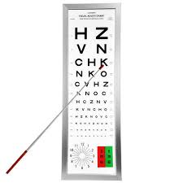
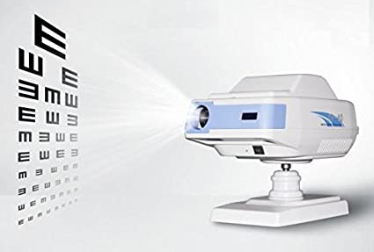
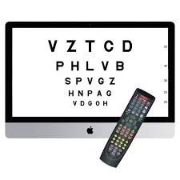

Slide 4
Retinoscopy
a technique to obtain an objective measurement of the refractive error of a patient's eyes Manually.
The examiner uses a retinoscope to shine light into the patient's eye and observes the reflection (reflex) off the patient's retina.
While moving the streak or spot of light across the pupil the examiner observes the relative movement of the reflex and manually places lenses over the eye (using a trial frame and trial lenses) to "neutralize" the reflex.

Slide 5
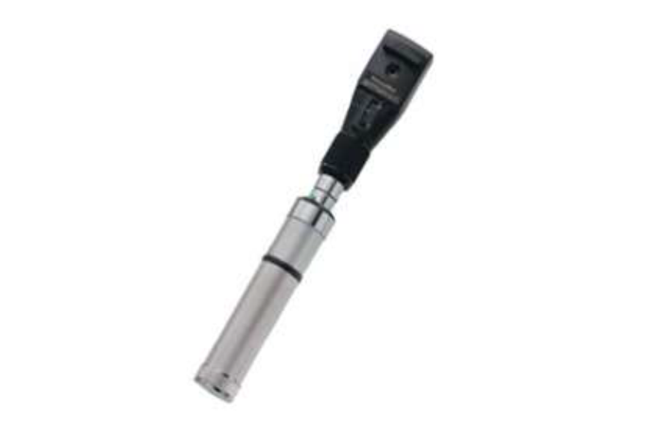
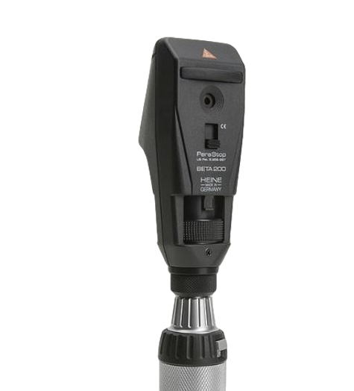
Retinoscope
objective measurement of the refractive error of a patient's eyes Manually.

Slide 6
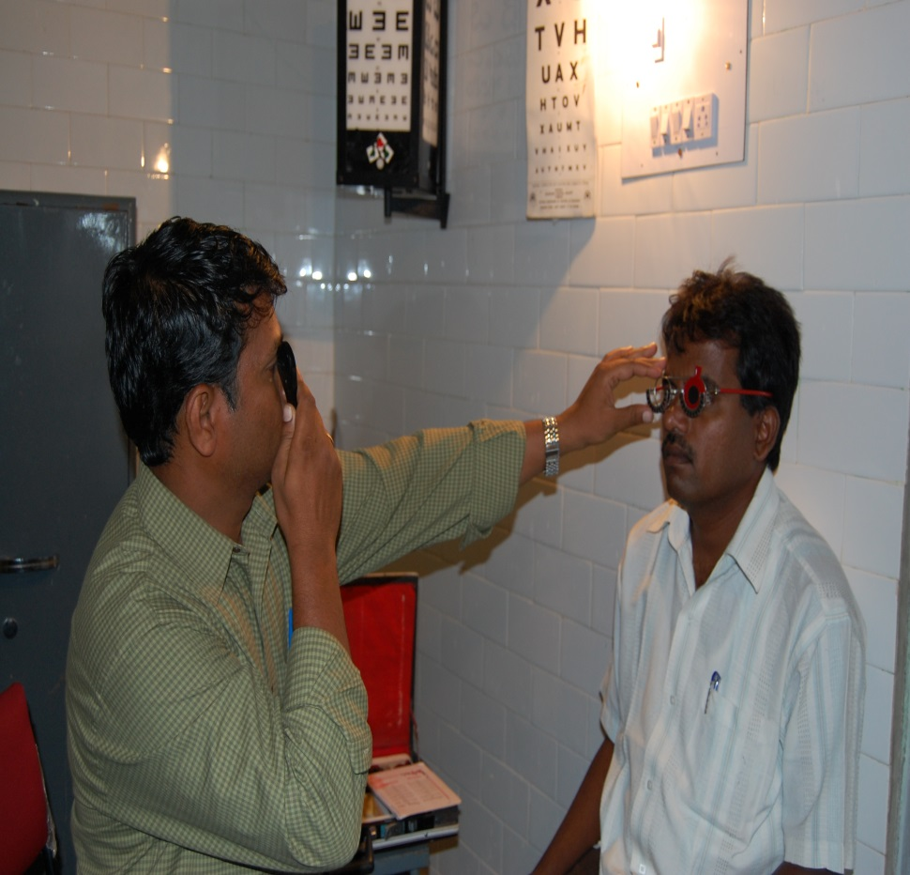
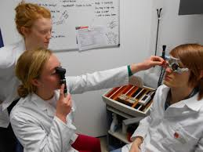
Retinoscopy

Slide 7
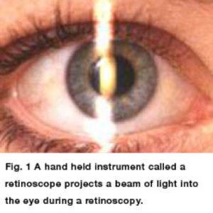
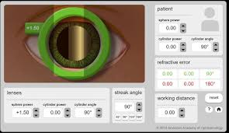
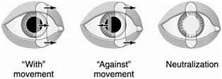
Myopes display an "against" reflex
Hyperopes, on the other hand, display a "with" movement

Slide 8
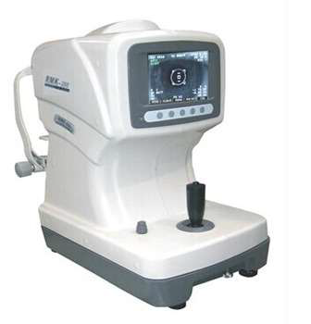
Auto refractometer
a computer-controlled machine used during an eye examination to provide an objective measurement of a person's refractive error and prescription for glasses or contact lenses.

Slide 9
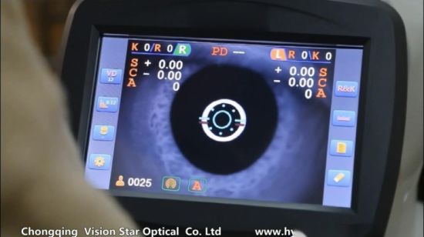

Slide 10
Trial Box
Uses:
Objective Refraction
Subjective Refraction
Diagnosis Of Squint

Slide 11
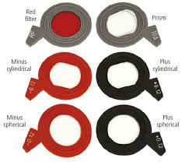
Trial lens
Minus spherical for myopia correction
Plus spherical for hypermeteropia correction
Minus cylinder for myopic stigmatism
Plus cylinder for hpermateropic stigmatism

Slide 12
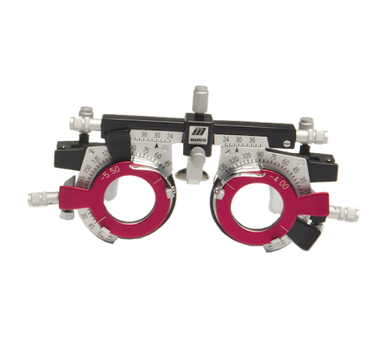
TRIAL FRAME
eyeglass frame designed to permit insertion of different lenses used in correcting refractive errors

Slide 13
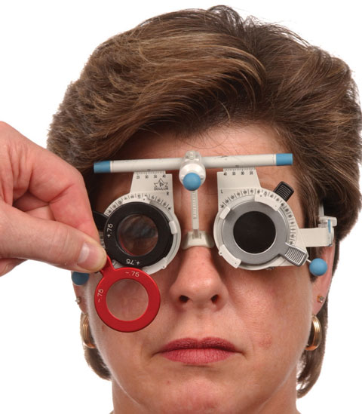

Slide 14
Occluder
It is an opaque plastic disc to Occlude one eye
Used to dissociate fusion
Used to close one eye while the other eye can be tested for visual acuity

Slide 15
Pin Hole Disc
Opaque disc with pinhole of 1-2 mm diameter in its centre.
To find out if the loss of vision is due to an error of refraction or some organic lesion

Slide 16
Douchrome Test:
a test commonly used to refine the final sphere in refraction, which makes use of the chromatic aberration of the eye.
Because of the chromatic aberration of the eye, the shorter wavelengths (green) are focused in front of the longer red wavelengths

Slide 17
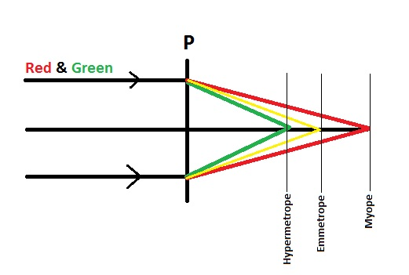
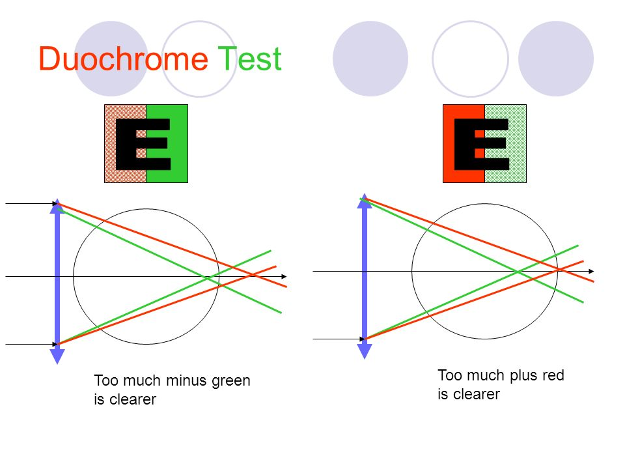

Slide 18
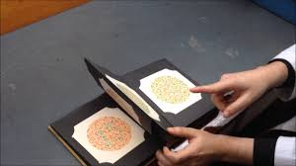
Color Vision Testing
performed using Ishihara polychromatic plates

Slide 19
Amsler Grid
Amsler grid evaluate central 20 degree of visual field
Mainly for macular diseases screening and monitoring

Slide 20
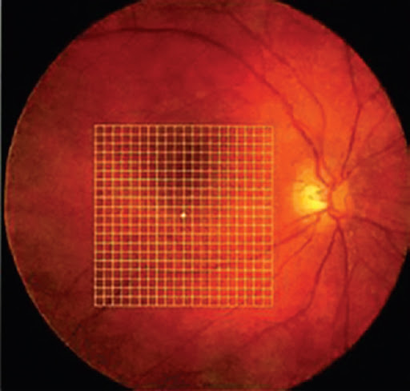

Slide 21
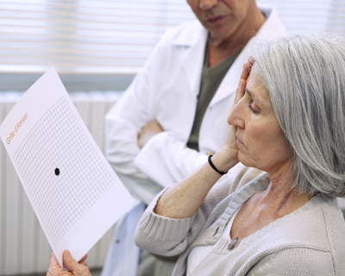
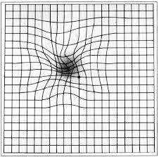

Slide 22
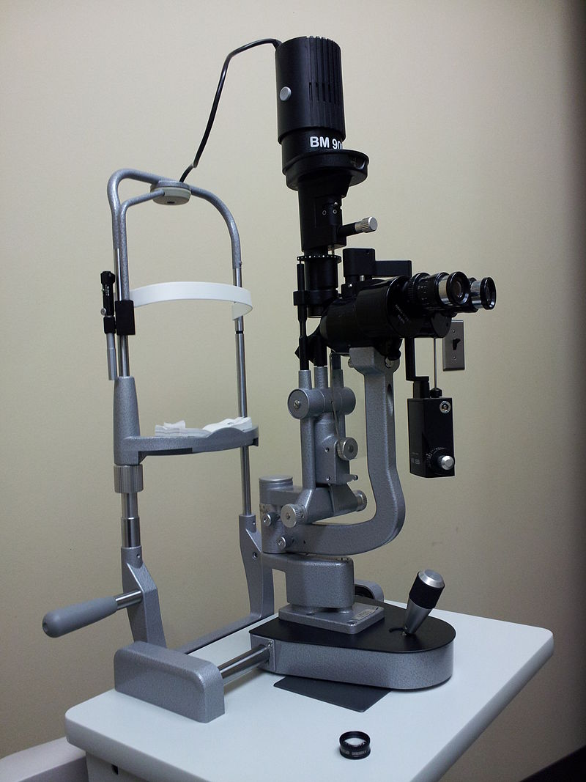
Slit Lamp biomicroscope

Slide 23
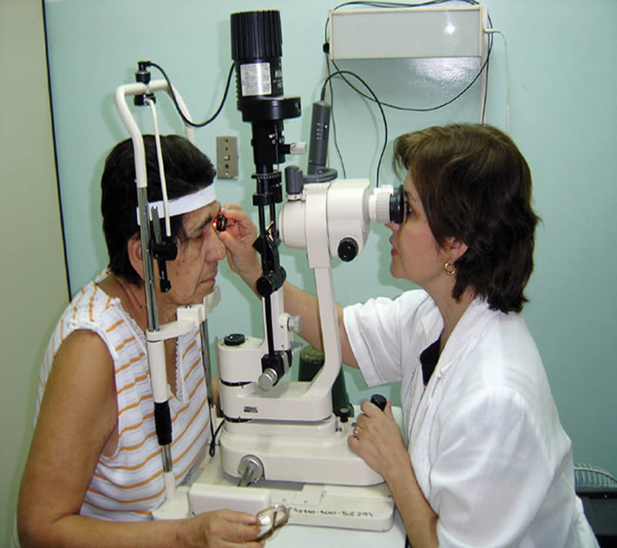
Siltlamp with +90 +78 +60 For fundoscopy

Slide 24
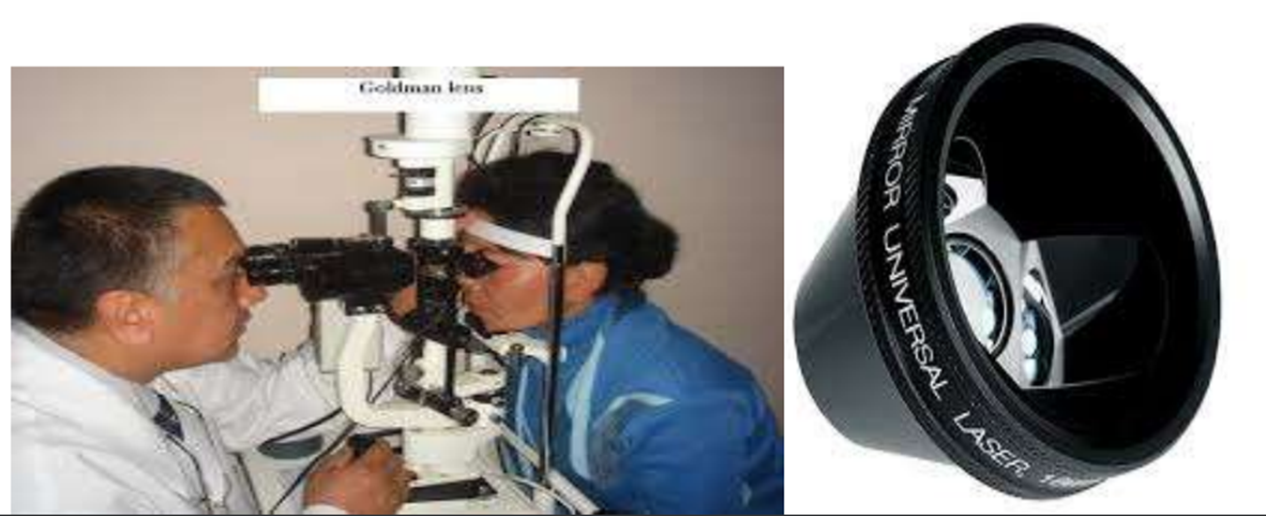
Slit Lamp Biomicriscopy With Contact Goldman 3 Mirror Lens for fundus examination

Slide 25
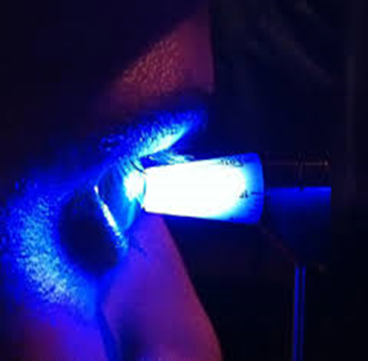
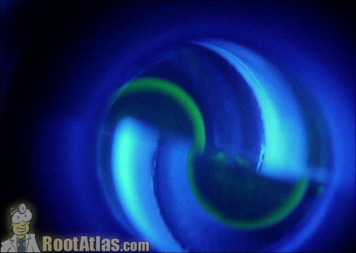
Goldmann’s Applanation tonometer: for the measurement of IOP
Fluorescein rings

Slide 26
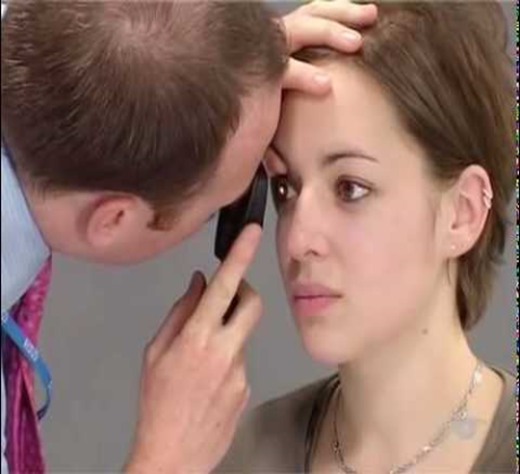

Ophthalmoscope:

Slide 27
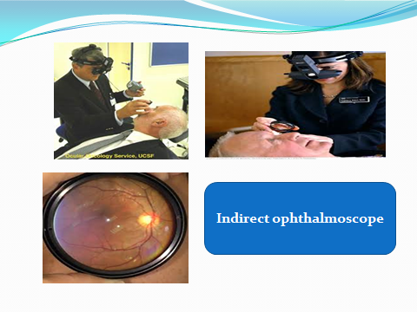

Slide 28
Optical coherence tomography (OCT)
is a non-invasive imaging test.
uses light waves to take cross-section pictures of retinal layers .

Slide 29
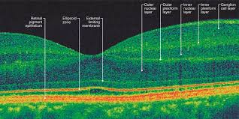

Slide 30
Fluorescein Angiography
It is an invasive procedure in which fluorescein dye is injected, usually into an antecubital vein.
Within 10 to 15 seconds, this dye can be seen coursing through the retinal vessels.
Over a 10-minute period, serial black-and-white photographs are taken of the retinal vasculature

Slide 32
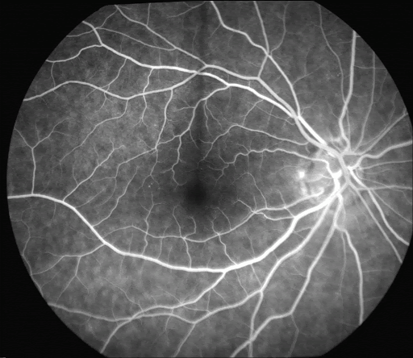
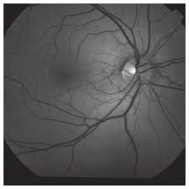
Fluroscene angiography photo
Red free fundus photo

Slide 33
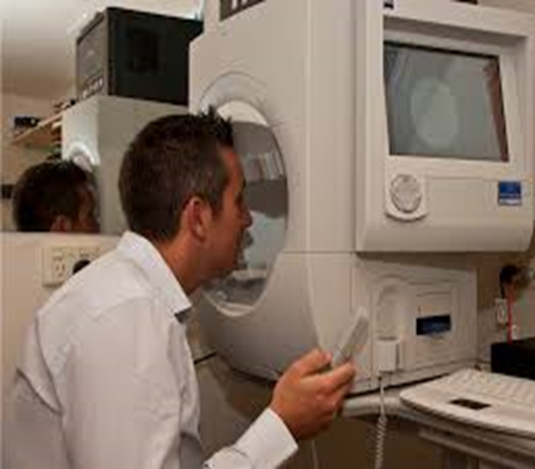
Perimeter:
Perimetry (visual field test )
For assessment of visual field loss

Slide 34
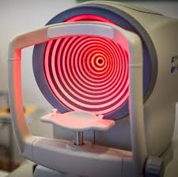
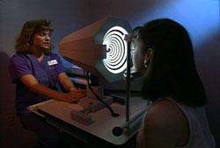
Corneal topography
is a computer assisted diagnostic tool that creates a three-dimensional map of the surface curvature of the cornea

Slide 35
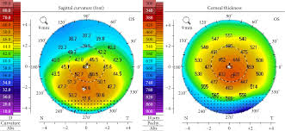
Topographical map of the cornea
Blue color represent flat areas
Red represent steeper cornea

Slide 36
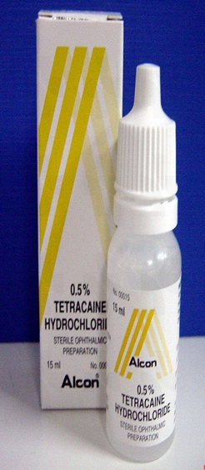
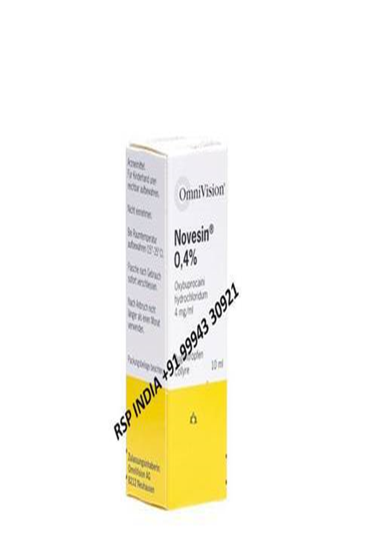
Diagnostic agents
Topical anesthesia
Tonometry (measurement of intraocular pressure)
removal of corneal foreign bodies,
removal of sutures
Gonioscopy , triple mirror

Slide 37
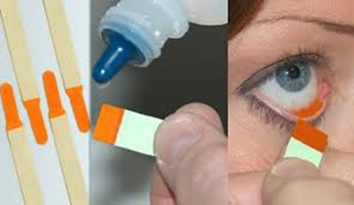
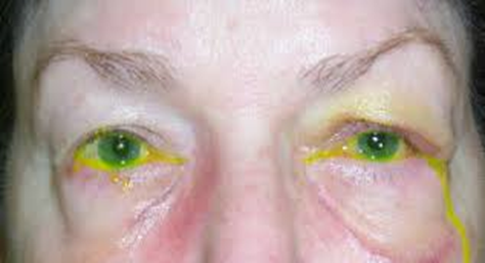
Fluorescein dye
Uses
Corneal epithelial defects & corneal ulcers.
Intraocular pressure measurement
Seidel's test: Concentrated fluorescein dye
Jones dye test for assessment of lacrimal passage functional potency
Tear film break up time(TBUT) dry eye

Slide 38
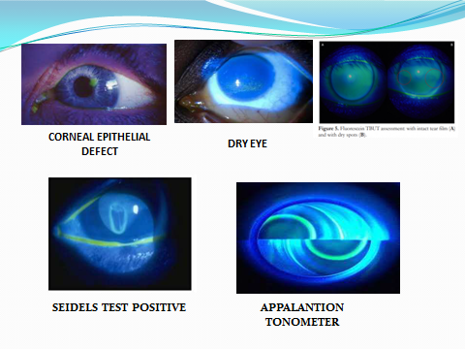

Slide 39
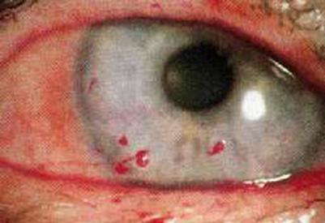
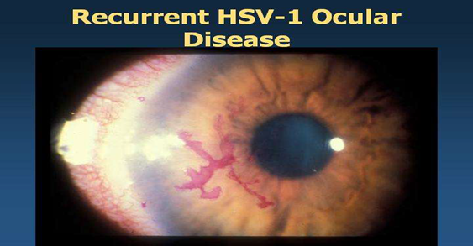
Rose bengal is actually a derivative of fluorescein
Stains the devitalized cells only
It aids in evaluation of
Keratoconjunctivitis sicca
Corneal defects . Dendritic ulcers

Slide 40
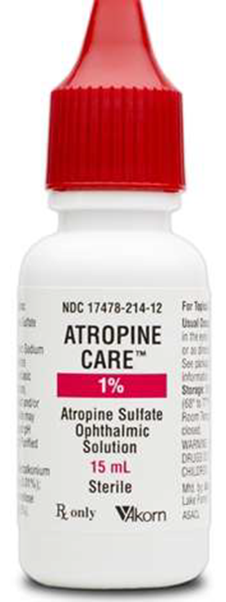
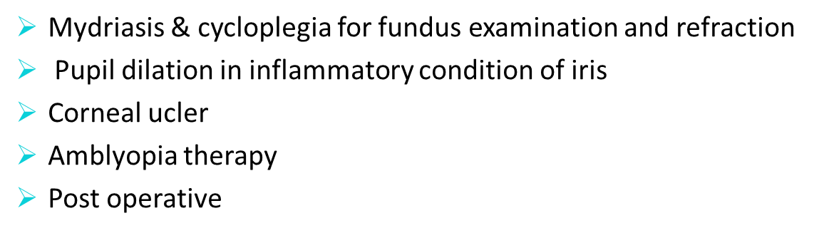
Cycloplegic &mydriatic

Slide 41
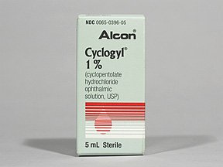
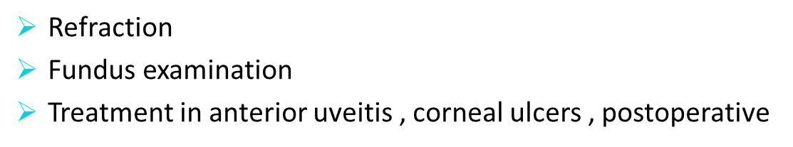

Slide 42
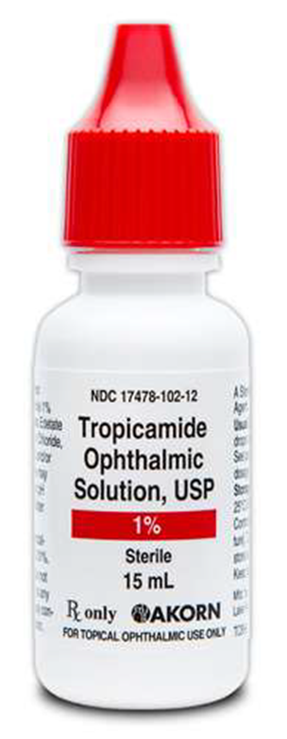
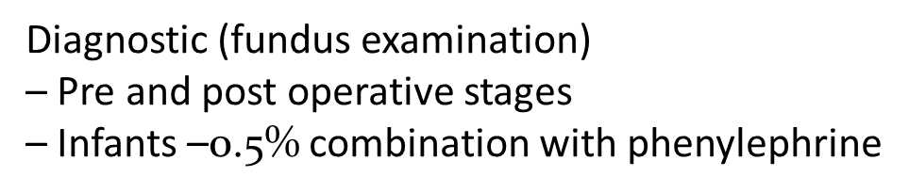

Slide 43
Thank you

