Slide 1


Immunization in
virology of BCG
No: 3480 / Y1 Med
Date: 9/5/2022
Name: MUAD ALFURJANI
01

Slide 2
Objective
01
02
03
Definition
Classifications
history
04
05
06
type
Bcg
Complication
What is the immunization
Classify of the immunization
Of the vaccine
Classify of vaccine
Introduction of BCG
Complications of BCG
2

Slide 3
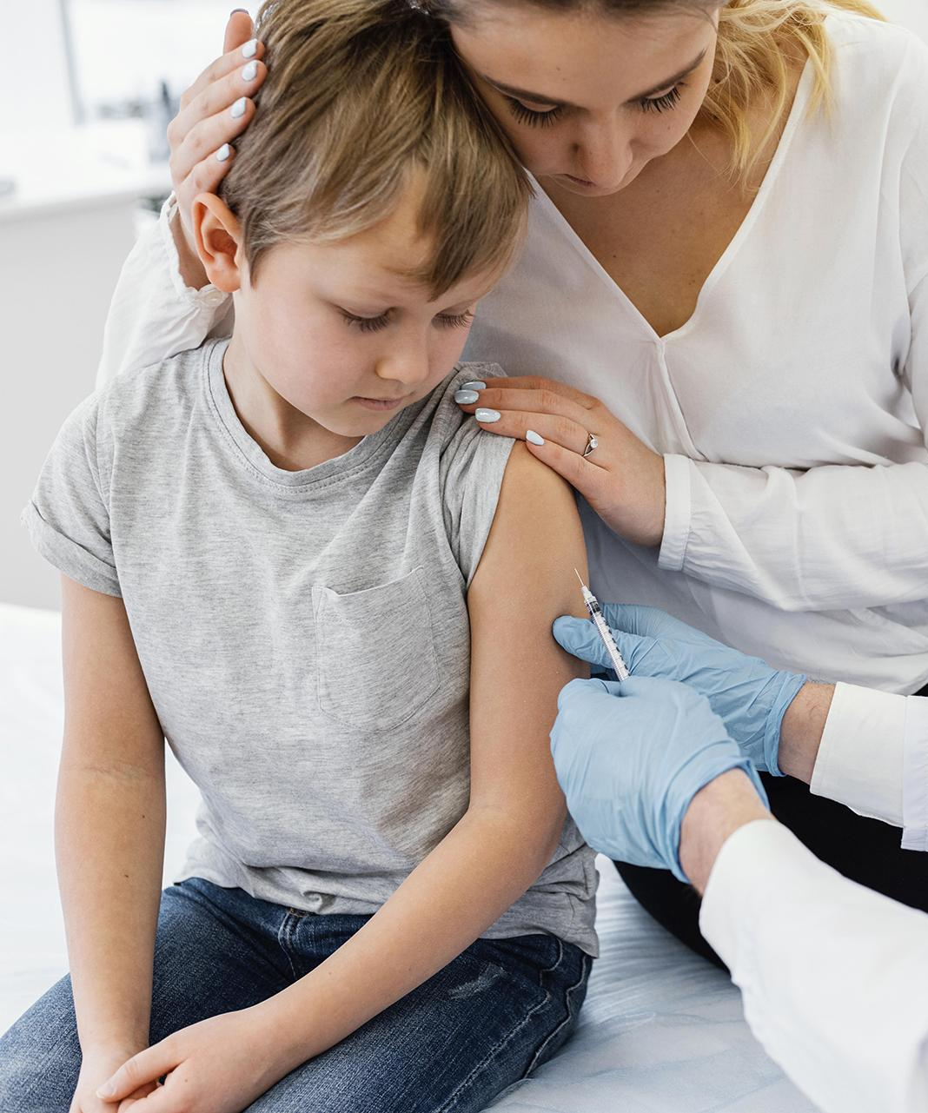
immunization
A process by which a person becomes protected against a disease through vaccination. This term is often used interchangeably with vaccination or inoculation.
3

Slide 4
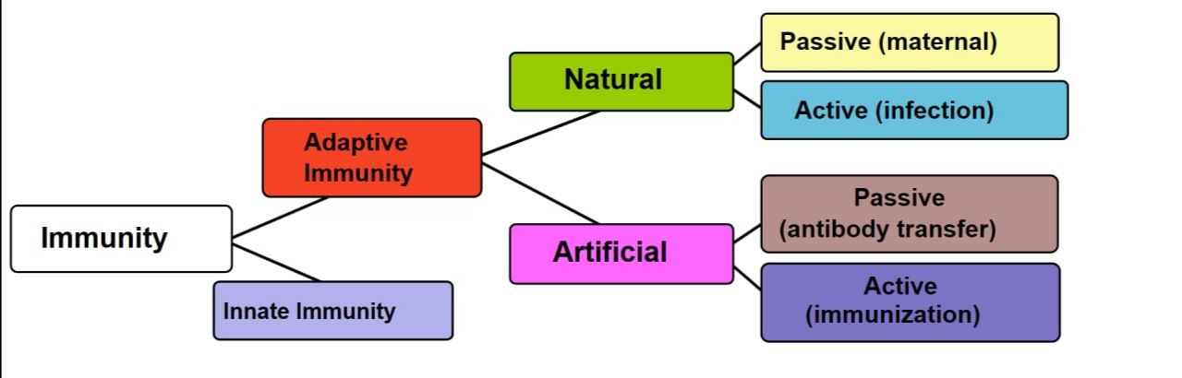
Type of immunization
4

Slide 5
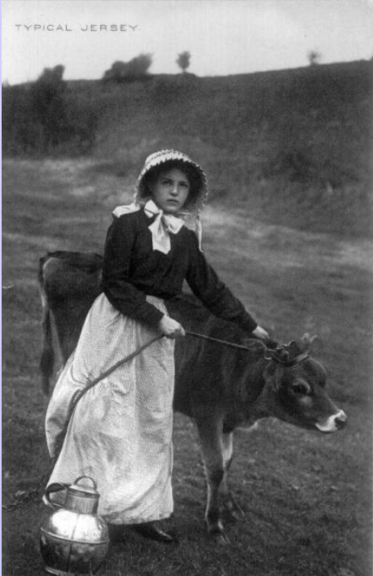
History
• Vacca .. Cow ??? The concept dates back into the 1100s when the Chinese practiced the art of variolation. However, the practice is credited to Edward Jenner in 1798, when he used a strain of cowpox virus to protect a child from smallpox.
5

Slide 6




TYPE OF VACCINEC
1 Live attenuated
2 Inactivated
3 Subunit
contain weakened pathogen; require 1-2 doses. Ex. MMR, rotavirus, varicella and TB .
contain killed pathogen; require several doses (booster shots). Ex. Hepatitis A, rabies, inactivated poliovirus vaccine
contain killed, antigenic component of pathogen; require several doses (booster shots). Ex. Hib, HPV, pneumococcal
4 Toxoid
contain toxin made by pathogen; may require booster shots. Ex. Diphtheria, pertussis
6

Slide 7
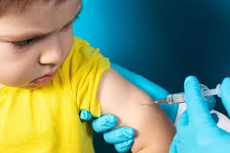
BCG VACCINE ?
Bacilli CALMETTE-GUERIN (BCG)
is a vaccine for tuberculosis (TB) disease .
it is often given to infants and small children
in countries where TB is common.
BCG does not always protect people
from getting TB.
.
7

Slide 8
CONTRAINDICATION
Immunosuppression. BCG vaccination should not be given to persons who are immunosuppressed or who are likely to become immunocompromised .
Pregnancy. BCG vaccination should not be given during pregnancy. Even though no harmful effects of BCG vaccination on the fetus have been observed, further studies are needed to prove its safety.
8

Slide 9
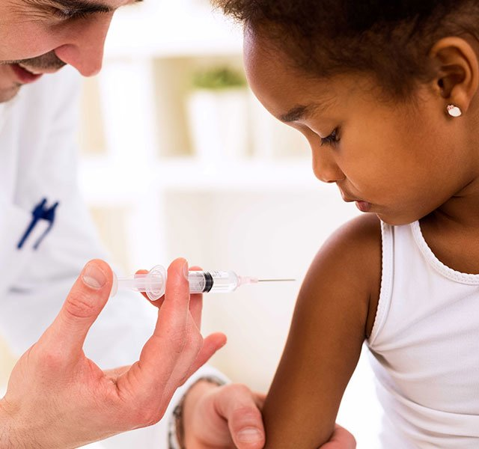
How to administer BCG
The BCG is given intradermally as a single
Dose of vaccine , The recommended site of
vaccination Is on the left arm over where
The deltoid muscle inserts into the hummers.
If active eczema . Psoriasis is present at the
Site of injection , vaccination should be deferred until the skin can be treated
And is clear of symptoms
9

Slide 10
Side effect
swollen glands under the armpit in the arm where the injection was given
High temperature (fever)
Generalized rash
1
3
5
2
4
Headache
shortness of breath
10

Slide 11
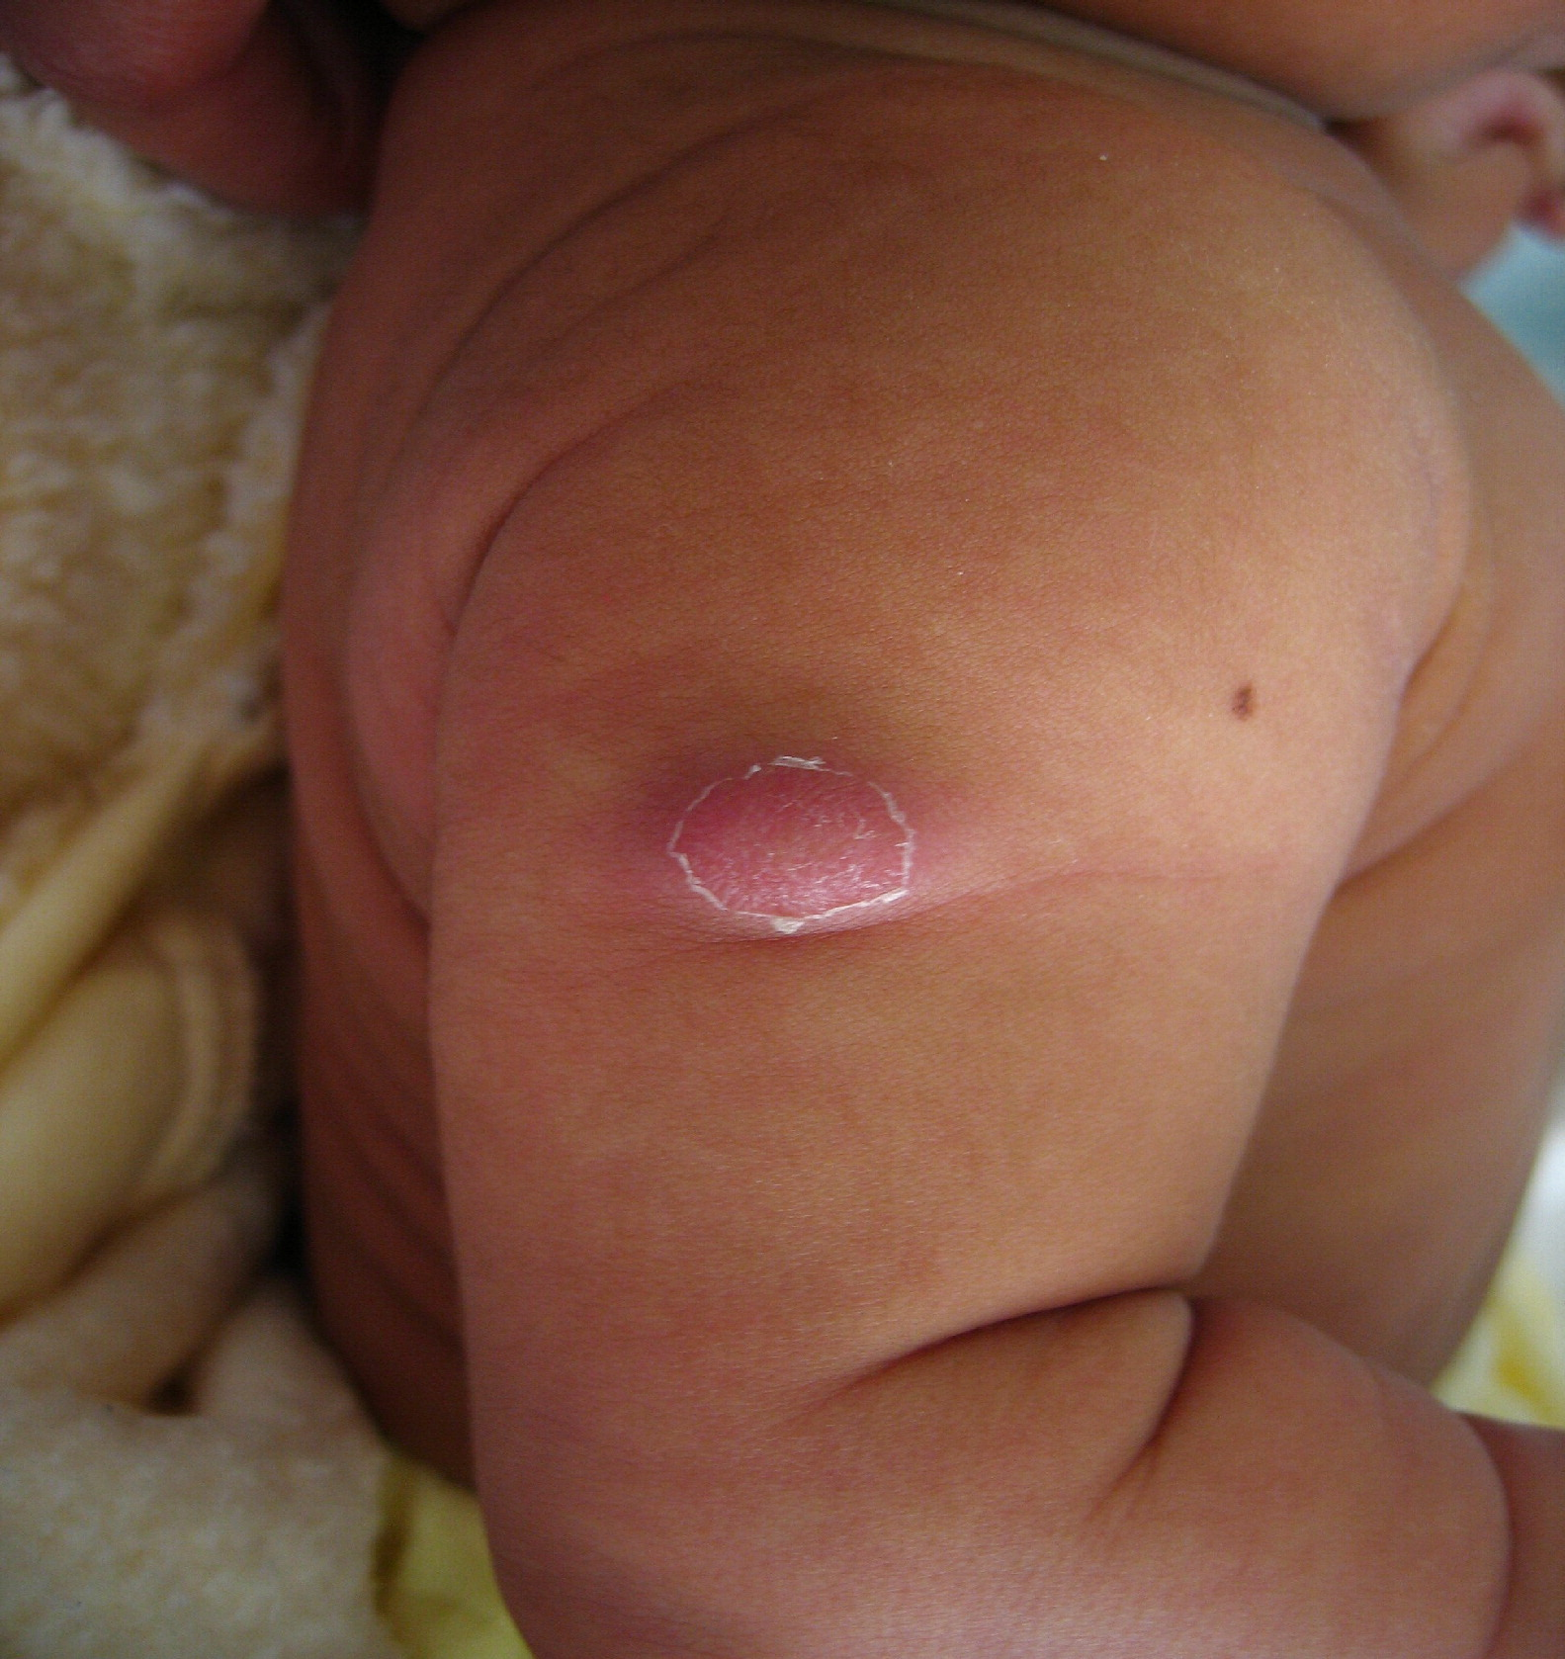
COMPLICTION
1.Prolonged severe ulceration.
2. Supportive lymphadenitis.
3. Osteomyelitis.
11

Slide 12
Conclusion
Immunization >> protected against a disease through vaccination.
Type of immunization
Type of vaccine >>1. Live attenuated 2. Inactivated 3. Subunit 4. Toxoid.
Bacilli Calmette-Guérin (BCG) >> is a vaccine for tuberculosis (TB) disease . .
Compaction >> 1.Prolonged severe ulceration 2. Suppurative lymphadenitis 3. Osteomyelitis .
12

Slide 13
references
Levinson, Warren. Review of medical microbiology and immunology. 23rd ed. The McGraw-Hill Companies, 2008.
www.nhs.uk/conditions/vaccinations/bcg-tuberculosis-tb-vaccine/
www.cdc.gov/tb/publications/factsheets/prevention/bcg.htm
13

Slide 14
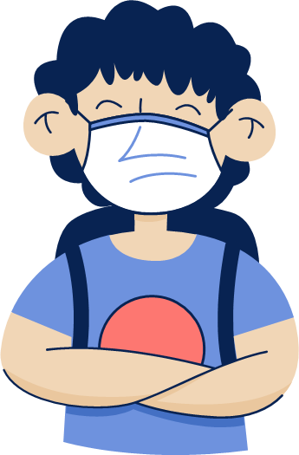
Thank you

