Slide 1
Preoperative assessment

Slide 2
Goals of assessment
Overview
When?
Pre-op Visit Components
Preoperative preparation
Preoperative fasting
Postponing surgery
Periop Medication Management

Slide 3
Goals of assessment
Screen for and manage co-morbid disease.
To assess and minimise risks of anaesthesia.
To identify need for specialised techniques.
To identify need for advanced post-op care.
To educate about anaesthesia.
To obtain informed consent.

Slide 4
To avoid unnecessary delays/cancellations.
Enhance and optimise quality of patient care.
Minimise last minute cancellations.
At all times ensure patient safety.

Slide 5
Overview
Preoperative testing
Components of the preoperative visit
History
Physical Examination [emphasis on Airway]
Perioperative Medication Management
Stopping patient medications….or not
Premedication

Slide 6
Overview
The anaesthetist
is uniquely qualified to assess risk
is responsible for deciding fitness for anaesthesia
must see all patients before operation
The aim of assessment is to improve outcome
Fasting

Slide 7
When?
Before planned admissions
After planned admissions
After unplanned admissions

Slide 8
Pre-op Visit Components
I - History:
Medical, anaesthesia and medication.
II - Appropriate physical examination.
III - Review of diagnostic data (ECG, labs, x-rays).
IV - Assignment of ASA physical status.
V - Formulation and discussion of anesthesia plan
VI - Informed Consent.

Slide 9
I - History
Medical problems (current & past)
Previous anaesthesia & related problems
Family anaesthesia history
Allergies and drug intolerances
Medications, alcohol & tobacco
Review of systems (include snoring and fatigue)
Exercise tolerance and physical activity level

Slide 10
Medical problems (current & past)
The presence and severity of known underlying medical problems must be investigated, such as:
- CVS disease: IHD, H/T, HF, VHD.
- Resp. disease: COPD, BA.
- Endocrine disease: DM, Thyroid dis.
- Renal disease: RF.
- hematological dis.: Anemia.
- CNS disease: CVA, TIA.
- Musculoskeletal dis.: MG

Slide 11
Previous anaesthesia & related problems
History of major anaesthetic related complication (Aspiration Pneumonia).
Documented difficult intubation.
Anticipated difficult intubation.

Slide 12
Family anaesthesia history
A family history of anesthetic problems may suggest a familial problem such as:
Malignant hyperthermia.
Atypical cholinesterase (Scoline apnea).
Porphyria.

Slide 13
Allergies and drug intolerances
An attempt must also be made to distinguish between:
True drug allergies: (often manifested as dyspnea or skin rashes)
And drug intolerances: (usually gastrointestinal upset).

Slide 14
Medications, alcohol & tobacco
Any prior or current treatments, because of the potential for drug interactions with anesthesia, a complete medication history should be elicited from every patient, This should include the use of tobacco and alcohol as well as illicit drugs such as heroin.

Slide 15
Review of systems
A general review of organ systems is important in identifying undiagnosed medical problems.
Questions should emphasize cardiovascular, pulmonary, endocrine, hepatic, renal, and neurological function.
A positive response to any of these questions should prompt more detailed inquiries to determine the extent of any organ impairment.

Slide 16
II - Physical examination
The history and physical examination complement one another.
The examination helps detect abnormalities not apparent from the history and the history helps focus the examination on the organ systems that should be examined closely.

Slide 17
Physical examination
Airway
Heart & lungs
Vital signs including O2 saturation
Height & weight (BMI)

Slide 18
Airway Examination
Teeth and bite
Ability to protrude lower incisors beyond upper
Mouth opening (inter-incisor distance)
Mallampati score
Facial hair
Thyromental distance
Length & thickness of neck
Range of motion of head & neck

Slide 19
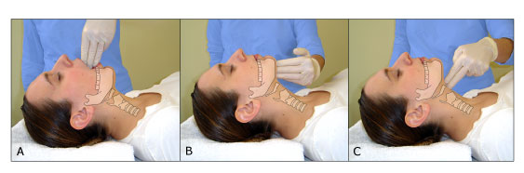
Evaluate: 3-3-2 rule Mouth opening Tip of mentum to hyoid bone Thyromental distance

Slide 20
Difficult intubation
Edentulous patients.
Significant facial abnormalities.
Micrognathia (a short distance between the chin and the hyoid bone).
Prominent upper incisors.
A large tongue.
Limited range of motion of the temporomandibular joint or cervical spine.
A short neck.

Slide 21
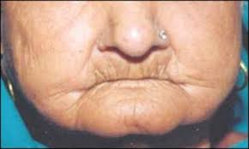
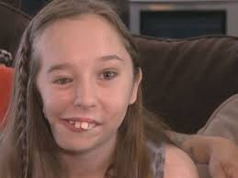
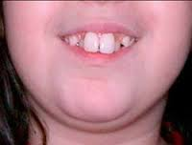
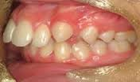

Slide 22
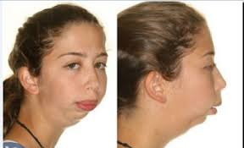
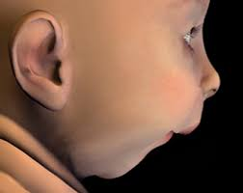
Micrognathia (a short distance between the chin and the hyoid bone).

Slide 23
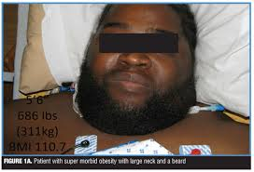
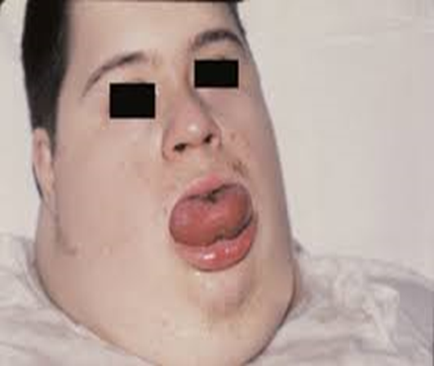

Slide 24
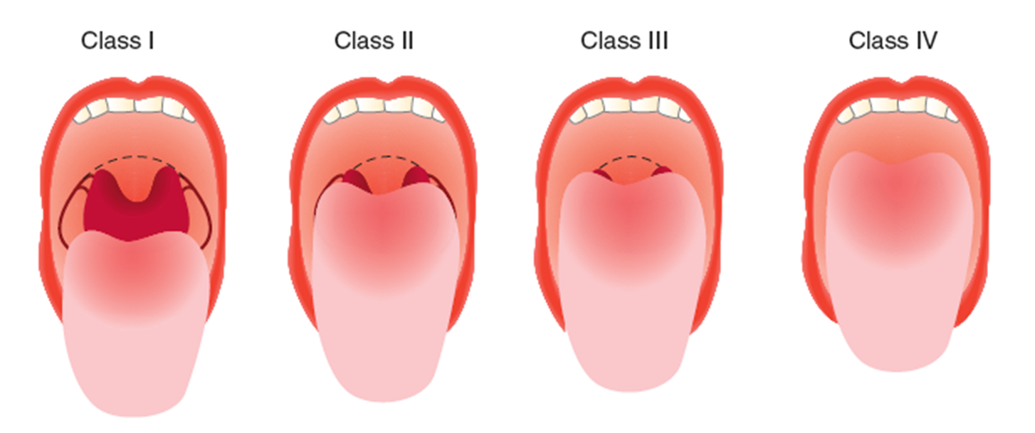
Mallampati Score

Slide 25
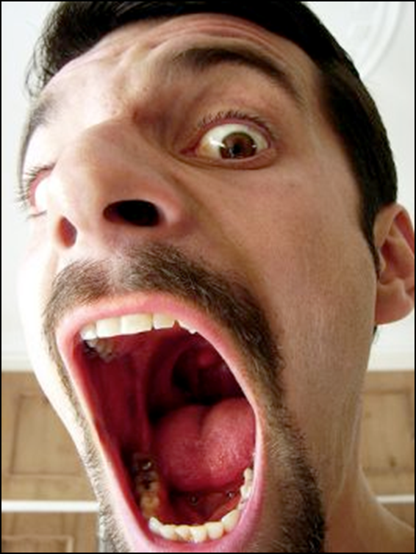
Mallampati Class 1 !!!!

Slide 26
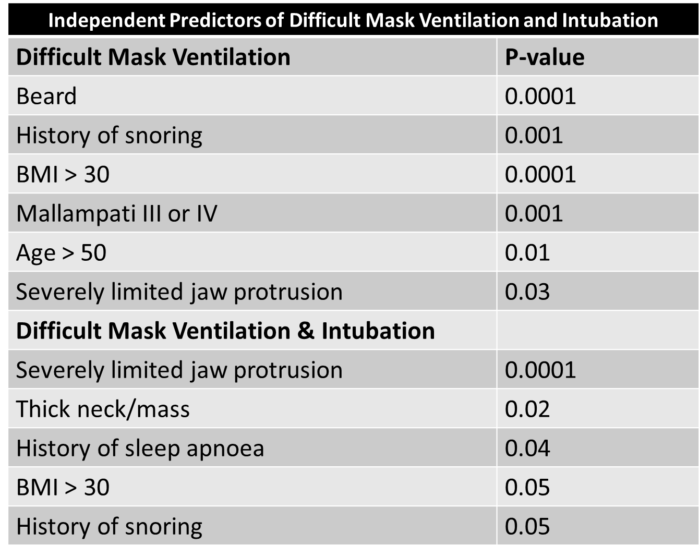

Slide 27
III - Review of diagnostic data
Blood tests and ECGs less than 3 months old do not routinely need repeating as long as there have been no changes in symptoms and no new acute events during that time.
All patients over 60 yrs old require a minimum of: FBC, U+E and ECG.

Slide 28
Laboratory Evaluation
Routine laboratory testing for healthy asymptomatic patients is not recommended when the history and physical examination fail to detect any abnormalities.
Such routine testing is expensive and rarely alters perioperative management.

Slide 29
Laboratory Evaluation
Routine: Specific:
- CBC. - Coagulation studies.
- FBG. - Bl. Group & X match.
- Urea & creatinine. - LFT.
- S. electrolyte. - HbA1C.
- CXR > 40 yr. - TFT, Ca.
- ECG > 40 yr. - Echo.
- Serology test. - Pregnancy test.
- MSU.

Slide 30
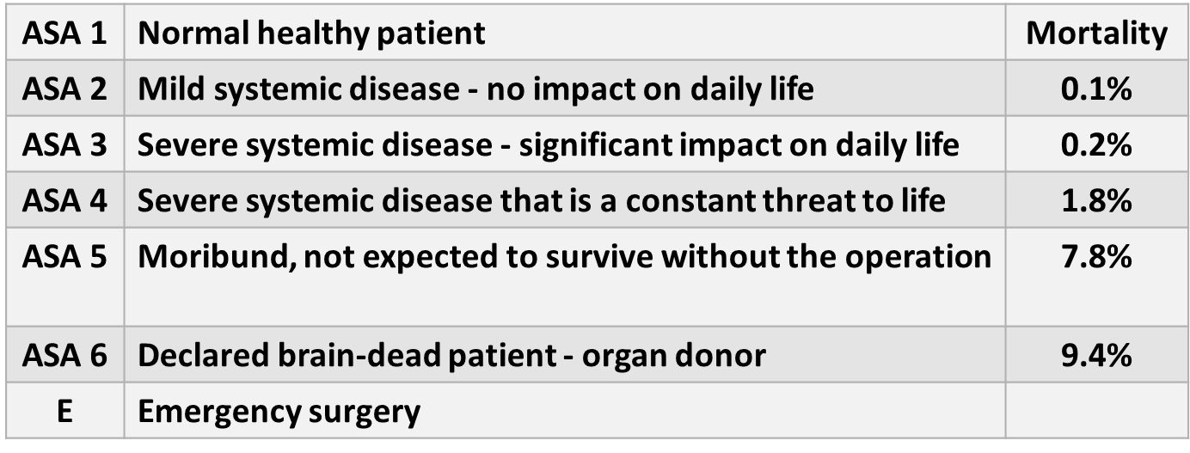
IV - Assignment of ASA physical status

Slide 31
V - Formulation and discussion of anesthesia plan
An anesthetic plan should be formulated that will optimally accommodate the patient's baseline physiological state, including any medical conditions, previous operations, the planned procedure, drug sensitivities, previous anesthetic experiences, and psychological makeup.
Inadequate preoperative planning and errors in patient preparation are the most common causes of anesthetic complications.

Slide 32
Anesthesia plan
Following the assessment, the anesthesiologist must discuss with the patient realistic options available for anesthetic management. The final anesthetic plan is based on that discussion and the patient's wishes.

Slide 33
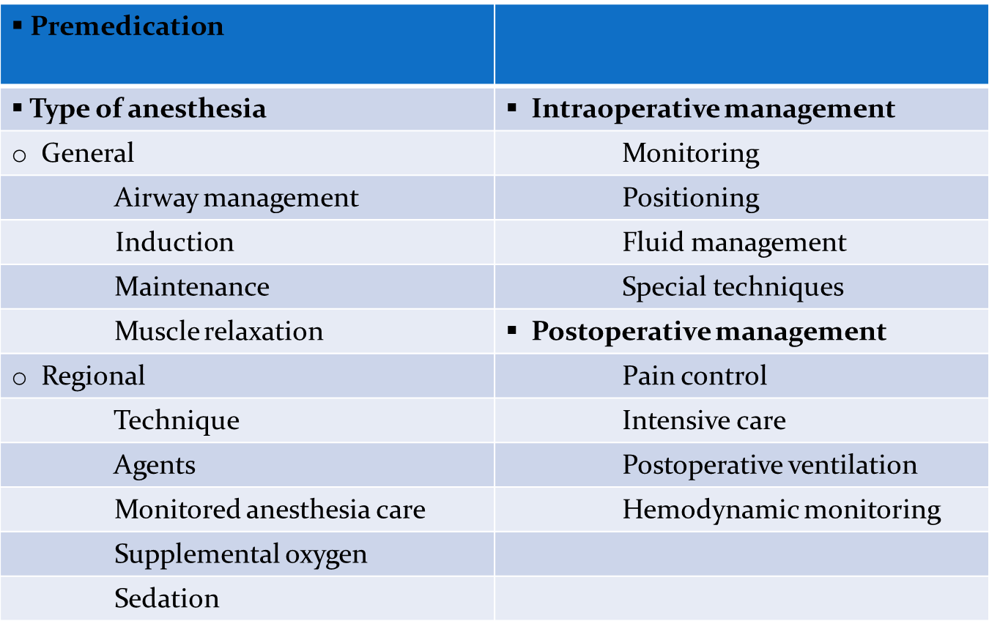
Anesthesia plan

Slide 34
VI - Informed Consent
The preoperative assessment result in giving the patient a reasonable explanation of the options available for anesthetic management.
If any procedure is performed without the patient's consent, the physician may be liable for assault.
Written consent is usually advisable for medicolegal purposes.

Slide 35
Preoperative preparation
The anaesthetist should decide if further measures are required to prepare the patient satisfactorily before proceeding to anaesthesia and surgery.

Slide 36
Preoperative fasting
The time of last oral intake of solid and fluid must be established. One of the commonest causes of anaesthetic-related mortality and morbidity is aspiration of gastric contents.

Slide 37
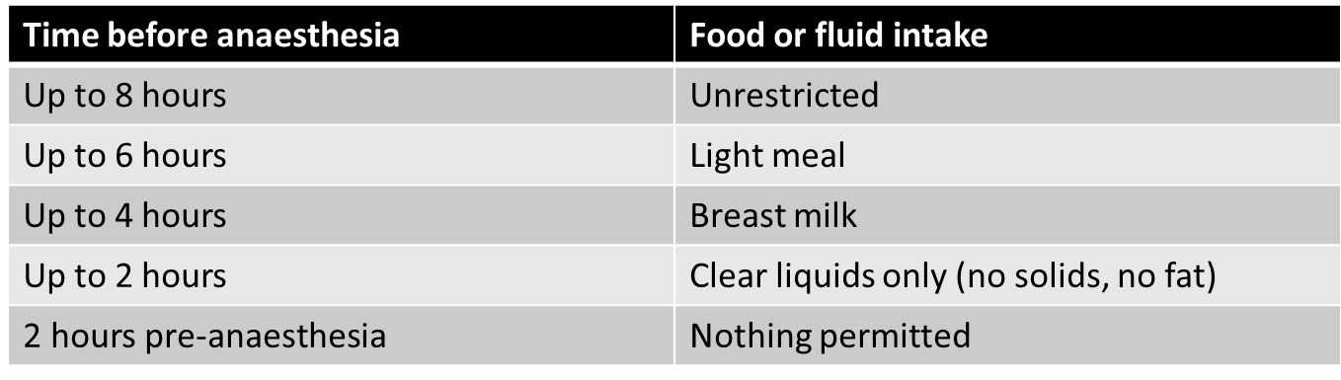
Fasting Guidelines

Slide 38
Postponing surgery
e.g.
Acute upper respiratory tract infection.
Coexisting severe medical disease and drug therapy.
Recent ingestion of food.
Failure to obtain consent.

Slide 39
Periop Medication Management
What to stop
What to keep
What else to give

Slide 40
Hold on day of surgery
Diuretics
- unless thiazide for hypertension
- unless severe heart failure
Insulin & OHA - see hospital diabetic protocol
Vitamins & iron
ACEI’s or ARB’s (individual choice)
- depends on procedure/risk of hypotension

Slide 41
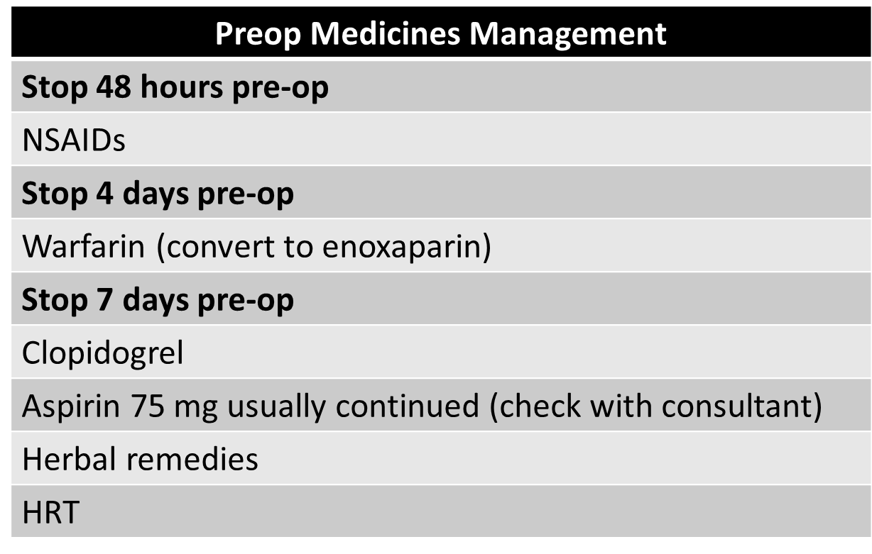

Slide 42
Premedication
Alleviate anxiety/sedation/amnesia
e.g. diazepam 10-20 mg, midazolam pre-induction
Reduce risk of reflux
e.g. ranitidine/lansoprazole/citrate/metoclopramide
Manage pain
e.g. paracetamol, gabapentin, topical LA
Control perioperative risk
e.g. β blockade, α-2 agonists
Dry secretions
e.g. glycopyrollate
Decrease anaesthetic requirements
e.g. clonidine

