Slide 1


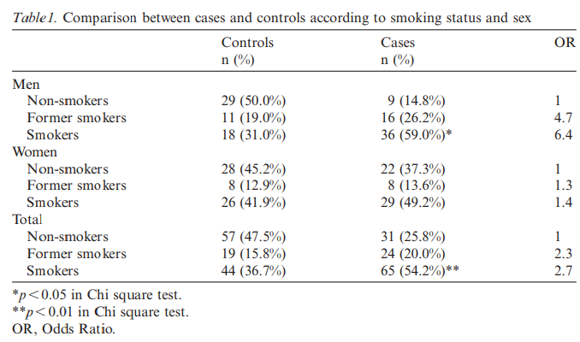
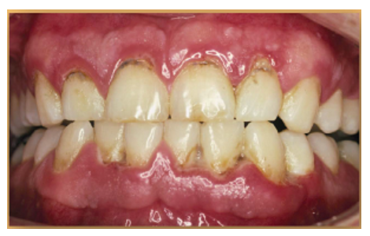
Libyan international medical university faculty of Applied Medical Science
Year : 2nd year Dent.
Effects of smoking on periodontal tissues
student name : Shahad Essam Aljazwi
Student number: 2863
introduction
Results / discussion
Although periodontal diseases are infections caused by dental plaque risk factors could modify the periodontal response to microbial aggression
Tobacco smoking is considered one of these factors and is strongly associated with both attachment and bone loss. Smokers are more susceptible than nonsmoker's to advanced and aggressive forms of periodontitis
When case-control comparisons were made related to tobacco consumption, it was found that cases had been smoking for a significantly longer time (15.6 years) than controls (9.9 years)
The majority of periodontal healthy patients were nonsmoker's and former smokers.
There was a greater percentage of smokers in the case group (54.2%) than in the control group (36.7%), the differences being significant.
Regarding gender differences, there were twice as many men smokers in the case group (59%) in the control group (31%).
among women, the percentages were similar (41.9% control and 49.2% cases
The results of this study demonstrated that tobacco affected most periodontal clinical variables studied, depending on the number of cigarettes smoked daily and the number of years of consumption
This is in agreement with previous studies. Arno et al. (1959) first found the relationship between increased consumption of tobacco and periodontal disease. Haber & Kent (1992) found that there was a higher percentage of smokers and former smokers in advanced periodontal patients that in healthy individuals
references
Materials and method
Arno, A., Shei, O., Lovdal, A. & Waerhaug, J. (1959) Alveolar bone loss as a function of tobacco consumption. Acta Odontologica Scandinavica 17, 3–10
Patients had to be at least 20 years good general health, not having taken any medications in the last 3 months
According to it, the patients were classified as being: non-smokers (individuals who had never smoked), former smokers (individual's who were no longer smoking) and smokers (individuals smoking at the time of the study)
, the final sample consisted of 119 men and 121 women, between 20 and 71 years of age, of whom 120 were cases (mean age 41.8 years) and 120 controls (mean age 40.3 years)
conclusion
Smoking is a risk factor strongly associated with periodontitis.
The effects of smoking on periodontal tissues depend on the number of cigarettes smoked daily and the duration of the habit.
The effect of tobacco on the periodontium seems to be more pronounced in men than in women
Acknowledgment

