Slide 1


The Total Revenue Test
Libyan International Medical University Faculty of Business Administration
Abdullah-4354@limu.edu.ly
Abdalla Hammuda
ID: 4354

Slide 2

Content
Introduction
What it does
How it works
Using it to price your products
Conclusion
1

Slide 3
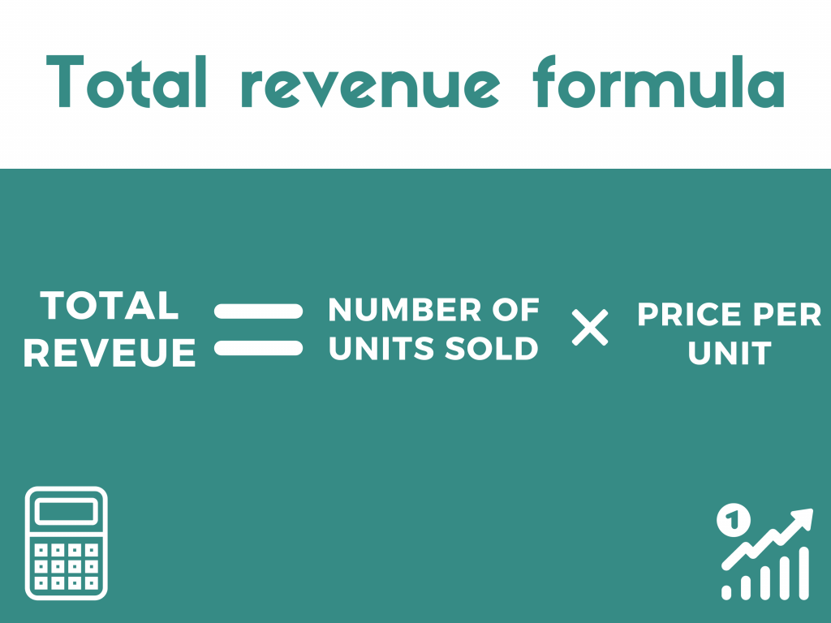
2

Slide 4

Introduction
What is a total revenue test? It's a test that determines whether product's or service's demand is elastic or inelastic. Price elasticity refers to the extent to which the price of a product or service affects consumer demand for it.
3

Slide 5

What it Does
Total revenue test can increase or decrease the price of your product or services. When demand is high prices go up when demand is low prices go down.
4

Slide 6

How it Works
The test approximates a product's price elasticity of demand by measuring the change in the total revenue against a change in the price.
5

Slide 7
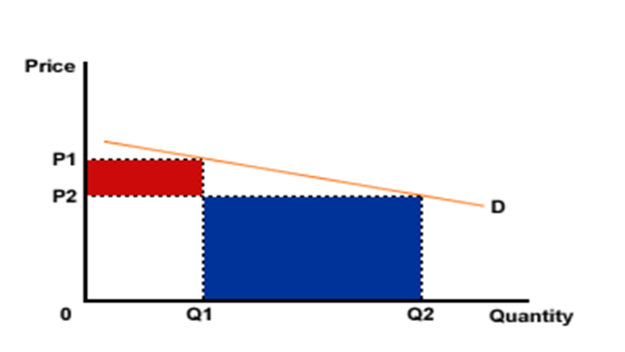
Example
P1=$3
P2=$2
6

Slide 8
Using it to Price Your Products
There are two steps:
Hypothesize
Execute
7

Slide 9
Conclusion
Total revenue test can be used as a pricing strategies and it can be very helpful for the business if they ever need to sell products fast
8

Slide 10
Reference
Investopedia, 6 Nov 2023
Definition & Formula to Calculate Elasticity. paddle. 6 Nov 2023
9

Slide 11


