Slide 1


Market
Positioning
Name : Ahmed Khalid ELThanie
ID : 2976
Email: ahmed_2976@limu.edu.ly

Slide 2
Table of contents
01
02
03
04
05
06
Introduction
Define
types of positioning in marketing
Conclusion
Reflection
References

Slide 3
Introduction
01

Slide 4

Introduction
Simply put, positioning in marketing is a strategic process that involves creating an identity/ image of the brand or product within the target customers’ minds.

Slide 5
Define
02

Slide 6
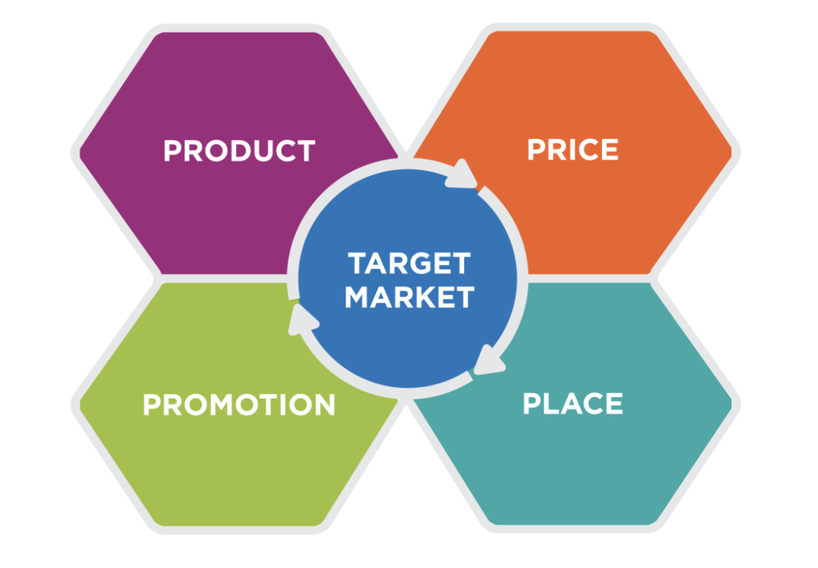
Define
Market positioning is a strategic activity that we employ to develop a brand's or product's image in the minds of consumers.

Slide 7


Positioning is not what you do to a
product. Positioning is what you do
to the mind of the prospect
— Ai Ries

Slide 8
Types of positioning in marketing
03

Slide 9

Types of Positioning in Marketing
Pricing
Quality
Differentiation
Convenience
Customer service

Slide 10
Conclusion
04

Slide 11
Conclusion
Finally, positioning refers to how you want consumers to view your brand, products (and services), or price, as well as the techniques you use to achieve that perception.

Slide 12
Reflection
05

Slide 13
Reflection
My Reflection About Market positioning is , How I can Market my Product or my Brand very well and How I can win more and More customers with good Quality and Unique Price and Be Differential .

Slide 14
References
06

Slide 15
References
According to new research… (Positioning in Marketing: Definition, Types, Examples, Benefits & How To, 2022).
(Positioning in Marketing: Definition, Types, Examples, Benefits & How To, 2022).
(What Is Market Positioning?, n.d.)

