Slide 1



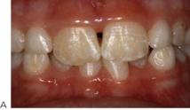
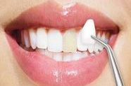

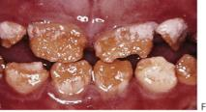
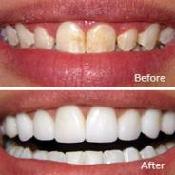
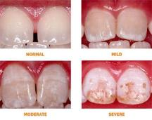
Does my teeth look mottled to you ?!
Libyan International Medical University
2nd Year Faculty Of Basic Medical Science
Fayza Nassif Halloum
Introduction
Causes of dental fluorosis
Therapeutic management
Conclusion
Fluoride ” nature’s cavity fighter ’’ is the most effective caries preventive agent currently available
the World Health Organization suggested a level of fluoride from 0.5 to 1.5 mg/L .
.
Dental fluorosis is an extremely common disorder characteristic by hypomineralization of tooth enamel.
People with fluorosis are relatively resistant to dental caries.
In moderate to sever fluorosis teeth are physically damaged.
Prevents should take necessary measures for preventing dental fluorosis on their children teeth
people with fluorosis are resistant to dental caries
fluoride is needed regularly through out life to protect tooth against tooth decay
Excess fluoridation of drinking water
Ingestion of fluoride toothpaste
Overuse of fluoride tablets
Consumption of processed foods made with fluoridation water
The disease is easily preventable if diagnosed early and steps are taken to prevent intake of excess fluoride through provision of safe drinking water, promote nutrition and avoid foods with high fluoride content.
tooth whitening for mild fluorosis cases
composite bonding
Porcelain veneers
Dental fluorosis
Fluorosis is the most frequently seen and most reliable sign of excess fluoride in the drinking water.
Effects dependent on dose on dose, duration , and timing of exposure.
Mottled appearance of the teeth, usually widespread throughout the dentition.
Hypomineralization of subsurface enamel: hypoplastic pitting in severe cases.
Reference
https://www.medicalnewstoday.com/articles/154164.php
https://www.aimu.us/2017/08/15/fluorosis-causes-diagnosis-management-and-prevention/
https://www.sciencedirect.com/topics/biochemistry-genetics- and-molecular-biology/dental-fluorosis
(F) A more severe appearance with significant loss of enamel.

