Slide 1


The Principles of Dialogue
Libyan International Medical University
Faculty of Business Administration
Name: Jude Boughalia 3766
Email: joud_3766@limu.edu.ly

Slide 2
TABLE OF CONTENTS
01
02
03
Introduction
Definition of Dialogue
Definition of Monologue
04
The Principles of Dialogue
05
Conclusion
06
Reflection
07
References
02

Slide 3
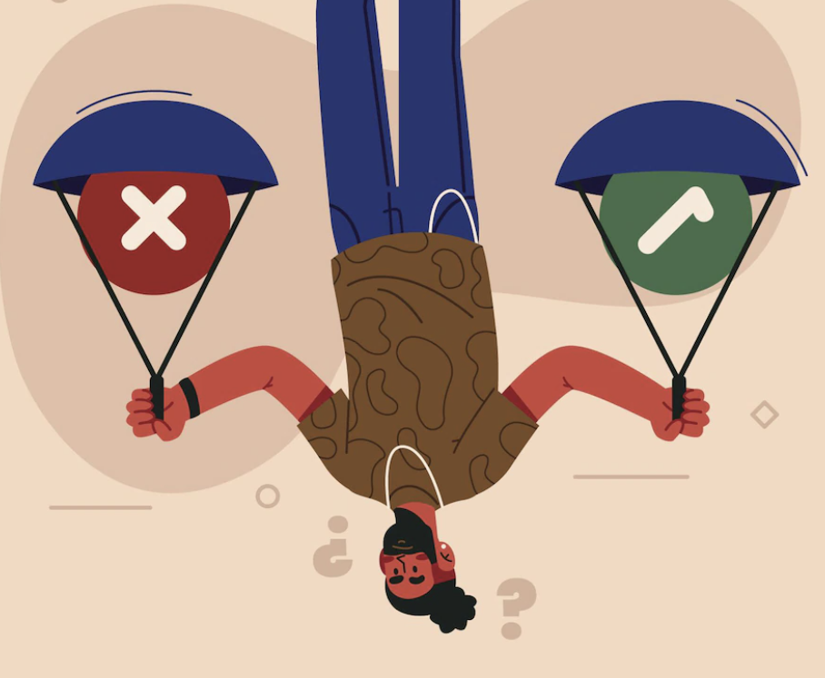
Learning Objectives
01
By the end of this presentation you’ll be able to:
Define a Dialogue
02
Identify The Principles of Dialogue
03

Slide 4
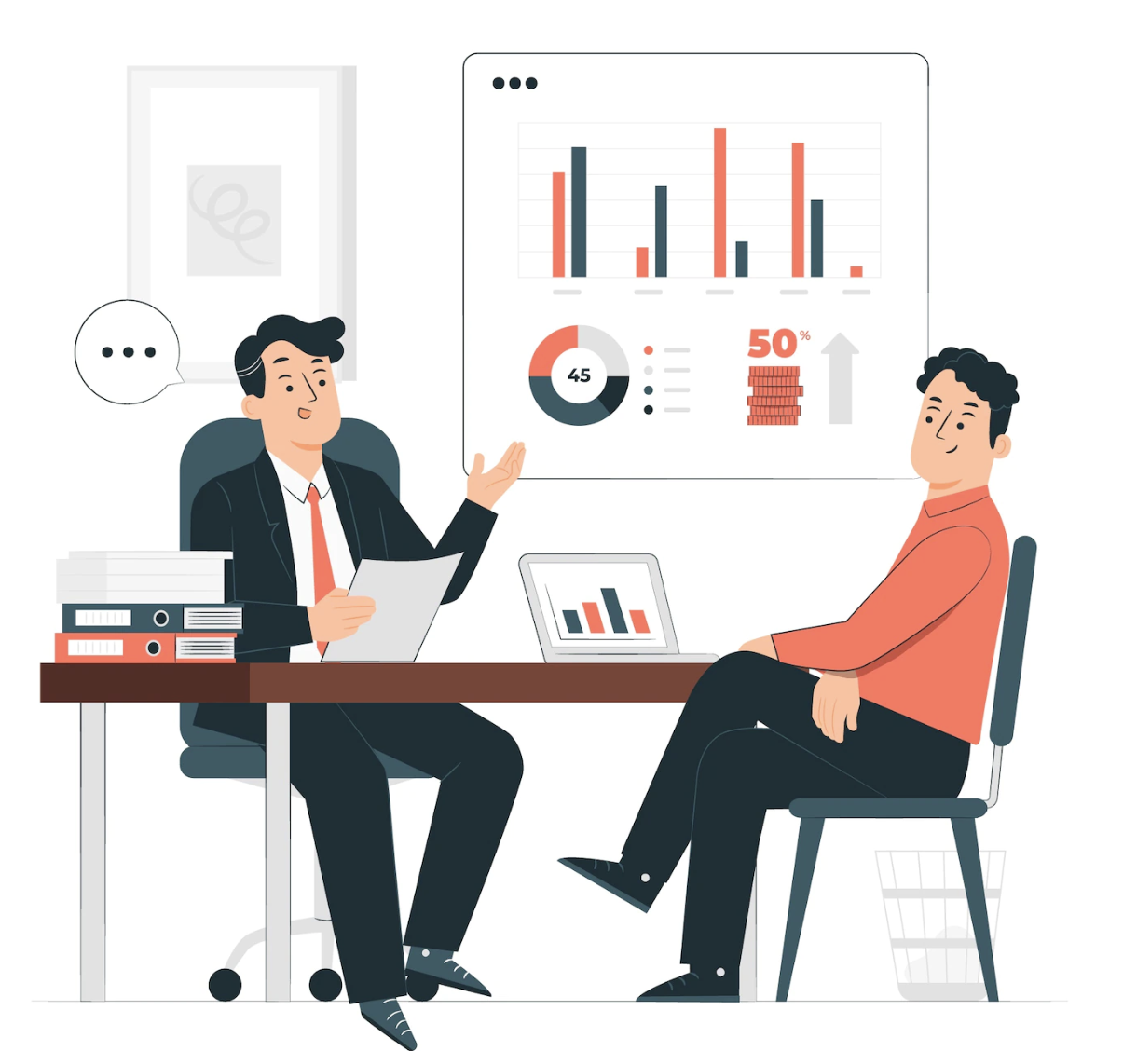
Introduction
Each individual in a dialogue is both a speaker and a listener, a sender and a receiver. It's a style of communication in which the other person and their relationship are really engaged.
04

Slide 5
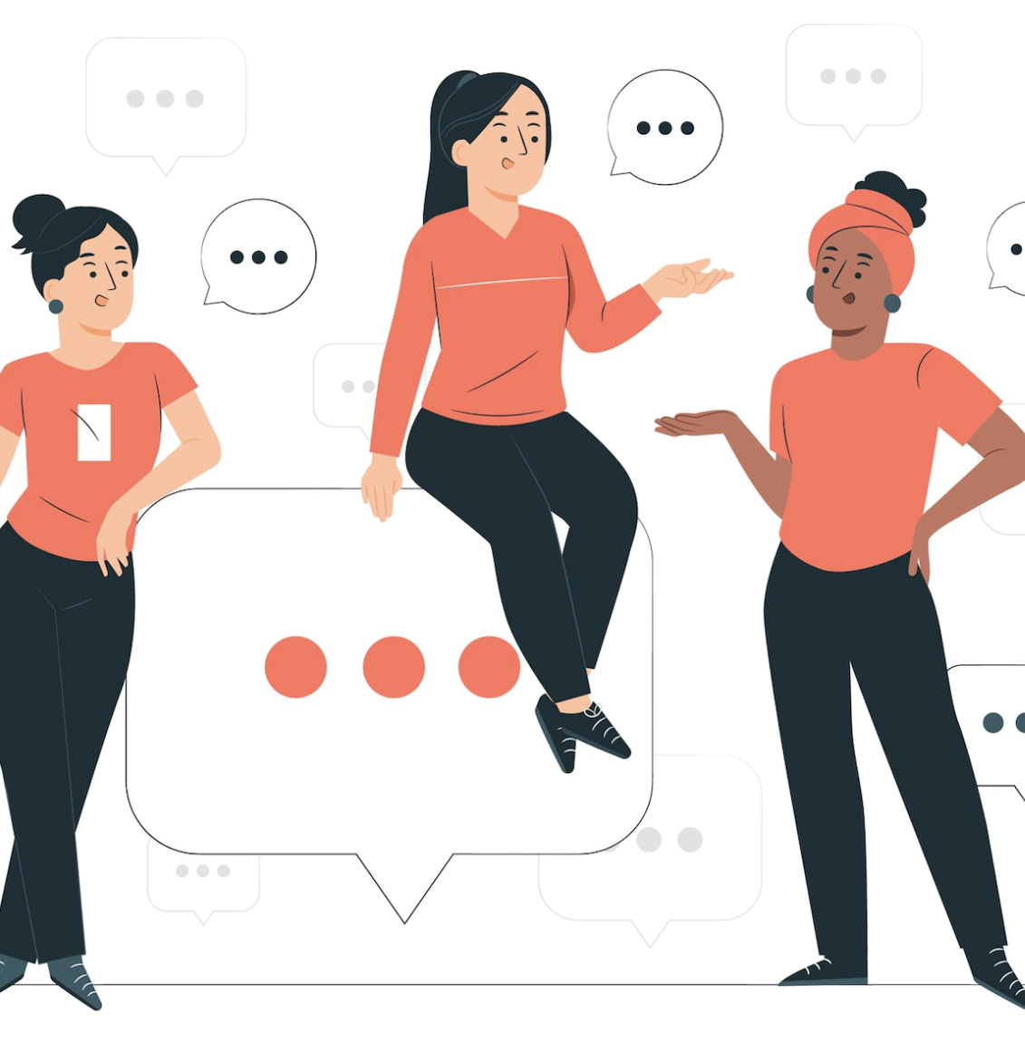
Dialogue
A dialogue is a conversation between two or more people Also, an exchange of ideas and opinions between a person and something else.
05

Slide 6
Monologue
Monologue is the opposite of dialogue, it’s communication in which one person is speaking and the other listens—there is no actual connection between individuals.
06

Slide 7
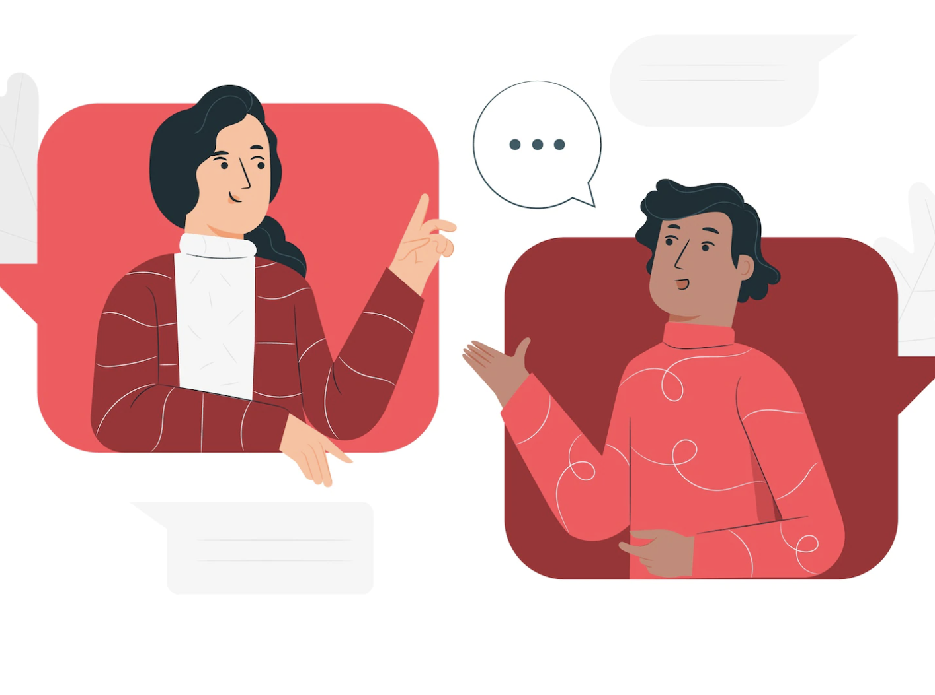
Principles of Dialogue
Demonstrate respect for the other person.
Avoid negative criticism.
Keep the channels of communication open.
Acknowledge the presence and importance of the other person.
Avoid manipulating the conversation.
07

Slide 8
Conclusion
08

Slide 9
Conclusion
To sum up the whole idea, The goal of these principles is not only to show the need of such dialogue, but also to provide realistic tips on how to achieve it.
09

Slide 10
Reflection
10

Slide 11

Reflection
Dialogue is an organized conversation with the goal of gaining knowledge, discussing problems, and exposing thoughts and behaviors.
11

Slide 12
References
Merriam-Webster. (n.d.). Dialogue definition & meaning. Merriam-Webster. Retrieved December 13, 2022, from https://www.merriam-webster.com/dictionary/dialogue
Brown, T. (2021, June 11). 10 principles for good dialogue. Medium. Retrieved December 13, 2022, from https://medium.com/practicing-politics/10-principles-for-good-dialogue-c5a11a5b8f29
Difficult dialogues. What is Dialogue? | Difficult Dialogues | Clark University. (n.d.). Retrieved December 13, 2022, from https://www2.clarku.edu/difficultdialogues/learn/index.cfm
12

Slide 13
THANKS!

