Slide 1
Dr Mousa Tuwati Alfakhri
Diabetes Mellitus

Slide 2
Objectives
Definition of DM
epidemiology
general homeostasis of blood glucose
types of DM
pathogenesis of the symptoms, signs
Contrasting type 1 and type 2
investigations and WHO criteria for diagnosis
non pharmacologic , and phamacologic measures
Assessing control of DM
complications of Dm and plan long term preventive care measures

Slide 3
Definition of DM
Diabetes mellitus is a clinical syndrome characterised by an increase in plasma blood glucose (hyperglycaemia).either due to Inadequate production of insulin or inadequate sensitivity of cells to the action of insulin

Slide 4
epidemiology
The incidence of diabetes is rising. Globally, it is estimated that 425million people had diabetes in 2017 (approximately 8.3% of the world population, or 3 new cases every 10 seconds)
and this figure is expected to reach 629 million by 2045.

Slide 5
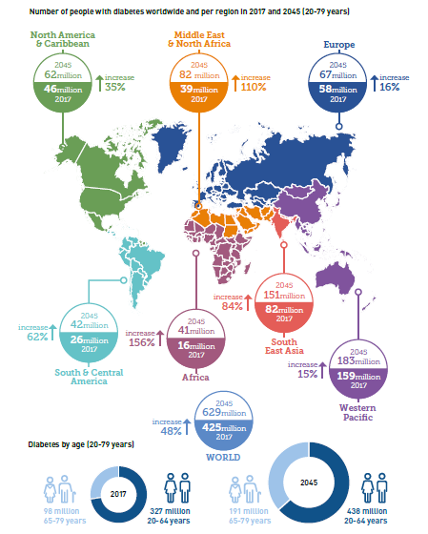

Slide 6
According to the international diabetes federation(IDF) in 2017
Prevalence of diabetes in Libya 11.2%
Total cases of diabetes in libya :442,500

Slide 7
Diabetes is a major burden upon health-care facilities in all countries. Globally, diabetes caused 4.6 million deaths in 2017
health-care expenditure attributed to diabetes was estimated to be at least US$727 billion,or 11% of total health-care expenditure.

Slide 8
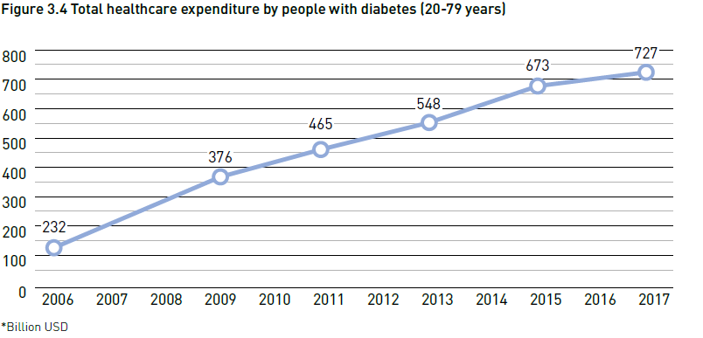

Slide 9
homeostasis of blood glucose
Blood glucose is tightly regulated and maintained within narrow range
Essential for ensuring continuous supply of glucose to CNS.
Brain has little capacity to store energy in the form of glycogen or triglyceride and the blood–brain barrier largely impermeable to fatty acids, so brain depends on liver for constant supply of glucose

Slide 10
homeostasis of blood glucose(Cont’d)
Postprandial glucose metabolism in normal individuals:
  After food is ingested, blood glucose concs rise and stimulate insulin release.
Insulin action:
    glucose uptake by the tissues
    liver glycogen formation
    lipid synthesis and inhibits fatty acid breakdown to ketone bodies
    Promotes protein synthesis

Slide 11
Incretin eefect
A number of other factors released from gut following food intake can augment insulin release, including amino acids and hormones such as glucagon-like peptide 1 (GLP-1) and gastrointestinal peptide (GIP).
insulin release is greater when glucose is administered by mouth than when same rise in plasma glucose is achieved by intravenous glucose infusion, phenomenon termed ‘incretin’ effect

Slide 12
homeostasis of blood glucose(Cont’d)
Fasting glucose metabolism in normal individuals:
  In the fasting state, insulin release is inhibited.
  Hormones that promote an increase in blood glucose are released:
    Glucagon, epinephrine, growth hormone, glucocorticoids, and thyroid hormones.
  Glycogenolysis
  Gluconeogenesis: amino acids are transported from muscle to liver and converted to glucose.
  Triglyceride are broken down into free Free fatty acids as an alternative fuel source.

Slide 13
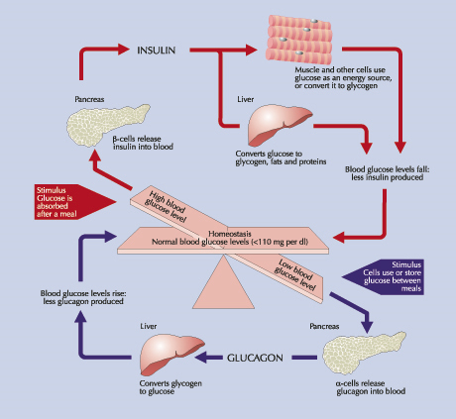

Slide 14
Classification of DM

Slide 15
Type 1 diabetes is caused by autoimmune destruction of insulin-producing cells (β cells) in the pancreas, resulting in absolute insulin deficiency
Type 2diabetes is characterised by resistance to the action of insulin and an inability to produce sufficient insulin to overcome this ‘insulin resistance’.

Slide 16
Gestational Diabetes Mellitus (GDM)
Gestational Diabetes Mellitus developing during pregnancy but usually disappears after pregnancy.

Slide 17
Other specific types
Genetic defects of beta-cell function
Genetic defects in insulin action (mainly receptor mutations)
Diseases of the exocrine pancreas(Pancreatitis Trauma/pancreatectomy,Neoplasia ,Cystic fibrosis, Haemochromatosis)
Endocrinopathies (Acromegaly,Cushing’s syndrome ,Glucagonoma, Phaeochromocytoma, Hyperthyroidism)
Drug- induced(Glucocorticoids,Ciclosporin, Beta-blockers,Thiazides,Phenytoin)

Slide 18
Other genetic syndromes associated with diabetes
Down’s syndrome
Friedreich’s ataxia
Huntington’s chorea
Klinefelter’s syndrome
Laurence–Moon–Biedl syndrome
Myotonic dystrophy
Porphyria
Prader–Willi syndrome
Turner’s syndrome

Slide 19
Pathophysiology
Type 1 DM
  Type 1 DM is characterized by absolute deficiency of insulin due to immune- mediated destruction of pancreatic β-cells
  In rare cases β-cell destruction is not due to immune mediated reaction (idiopathic type 1 DM)
  Usually develops in childhood or early adulthood
  It accounts for upto 10% of all DM cases
  Develops as a result of exposure of a genetically susceptible individual to environmental agent
  In individual with a genetic predisposition, an event such as virus or toxin triggers autoimmune destruction of β-cells probably over a period of several years.

Slide 21
Pathophysiology
  There are four stages in the development of Type 1 DM:
    Preclinical period with positive β-cell antibodies
    Hyperglycemia when 80-90% of the
    β- cells are destroyed.
    Transient remission (honeymoon phase).
    Establishment of the disease

Slide 22
Pathophysiology
Birth
Time (years)
Notes:
Figure 74-3, 72-4 (new book)

Slide 23
Autoimmunity of type 1 DM
Antibodies to
Insulin
Glutamic acid decarboxylase(anti GAD antibodies)
Insulinoma-associated protein 2(IA-2)
Zinc transporter ZnT8

Slide 24
Type 2 DM
Type 2 DM is characterized by the presence of both insulin resistance (tissue insensitivity) and some degree of insulin deficiency or b- cell dysfunction
Both genetic and enviromental factors are involved
Type 2 DM occurs when a diabetogenic lifestyle (excessive calories, inadequate caloric expenditure and obesity) is superimposed upon a susceptible genotype
Insulin may be low, normal or high!
About 30% of the Type 2 DM patients are undiagnosed (they do not know that they have the disease) because symptoms are mild.
It accounts for up to 90% of all DM cases

Slide 25
2. Etiology of Type 2 Diabetes

Slide 26
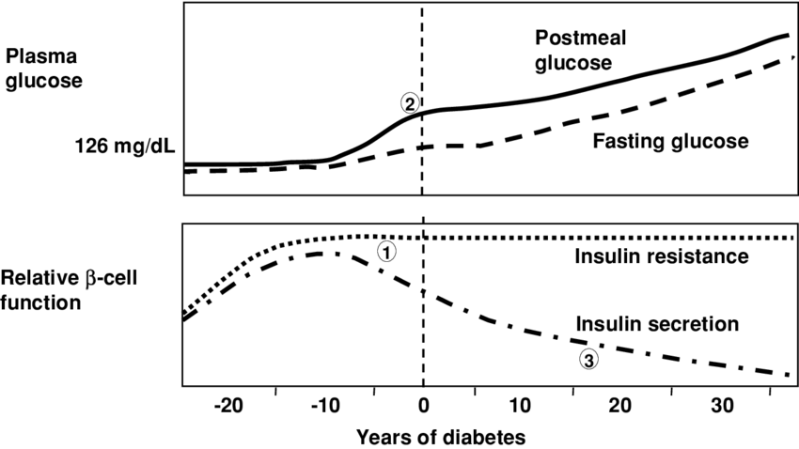
Pathophysiology of type 2 DM

Slide 27
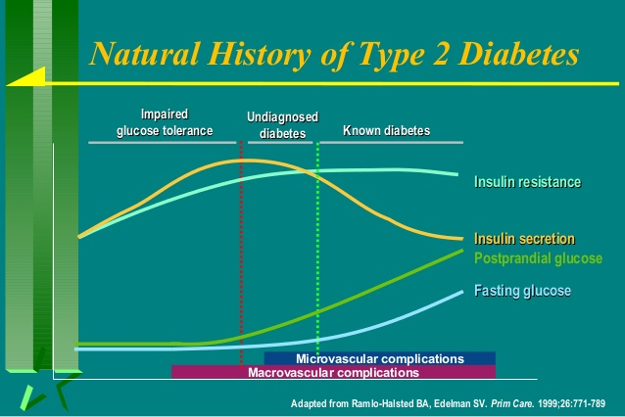

Slide 28
Risk Factors for type 2 DM
  Increasing age
  Family History
  Obesity
  Habitual physical inactivity
  Previously identified impaired glucose tolerance (IGT) or impaired fasting glucose (IFG)
  history of gestational diabetes
  polycystic ovary syndrome
  Hypertension
  Hyperlipidemia
Notes:
IFG: > or = 110 and <126
IGT: > or = 140 and <200

Slide 29
Pathogenesis of symptoms and signs of diabetes

Slide 31
ALTERED CHO METABOLISM
↓ Insulin
↓
↓ Glucose Utilization
+
↑ Glycogenolysis
↓
Hyperglycemia
↓
Glucosuria
(osmotic diuresis)
Polyuria
(and electrolyte imbalance)
↓
Polydipsia

Slide 32
ALTERED PROTEIN METABOLISM
↓ Insulin
↓
↑ Protein Catabolism
↓
↑ Gluconeogenesis
(amino acids → glucose)
↓
Hyperglycemia
↓
Weight Loss and Fatigue

Slide 33
ALTERED FAT METABOLISM
↓ Insulin
↓
↑ Lipolysis
↓
↑ Free fatty acids + ketones
↓
Acidosis + Weight Loss

Slide 34
Symptoms of hyperglycaemia
Thirst, dry mouth
Polyuria
Nocturia
Tiredness, fatigue, lethargy
Change in weight (usually weight loss)
Blurring of vision
Pruritus vulvae, balanitis (genital candidiasis)
Nausea
Headache
Hyperphagia; predilection for sweet foods
Mood change, irritability, difficulty in concentrating, apathy

Slide 35
Characteristics
Type 1
Type 2
% of diabetic pop
5-10%
90%
Age of onset
Usually < 30 yr + some adults
Usually > 40 + some obese children
Pancreatic function
Usually none
Insulin is low, normal or high
Pathogenesis
Autoimmune process
Defect in insulin secretion, tissue resistance to insulin,
Family history
Generally not strong
Strong
Obesity
Uncommon
Common
History of ketoacidosis
Often present
Rare except in stress
Clinical presentation
moderate to severe symptoms: 3Ps, fatigue, wt loss and ketoacidosis
Mild symptoms: Polyuria and fatigue. Diagnosed on routine physical examination
Treatment
Insulin
Diet ,Exercise
Oral antidiabetics,Insulin
Notes:
Applied Therapeutics: Table 48-1
Oral antihyperglycemic

Slide 36
INVESTIGATIONS
Urine testing
Glucose
Ketones
Protein
Blood testing
Glucose
Ketones
Glycated haemoglobin

Slide 37
Urine testing Glucose
Testing urine for glucose with dipsticks is common screening procedure for detecting diabetes
disadvantage of urinary glucose measurement is individual variation in renal threshold for glucose
frequent cause of glycosuria is low renal threshold, which is common during pregnancy and in young people

Slide 38
Urine testing ketones
Ketone bodies can be identified by nitroprusside reaction, which measures acetoacetate, using dipsticks
Ketonuria found in normal people who been fasting or exercising for long periods
Ketonuria is therefore not pathognomonic of diabetes but, if associated with glycosuria, diagnosis of diabetes is highly likely

Slide 39
Urine testing for protien
Standard dipstick testing for albumin detects urinary albumin at concentrations above 300 mg/L
smaller amounts (microalbuminuria, can only be measured using specific albumin dipsticks or by quantitative biochemical laborator measurement.
Microalbuminuria or proteinuria, in absence of urinary tract infection, is important indicator of diabetic nephropathy

Slide 40
Blood testing for glucose
When a person has symptoms of diabetes, the diagnosis can be confirmed with either a fasting ≥ 7.0 mmol/L (126 mg/dL) or a random glucose ≥ 11.1 mmol/L (200 mg/dL) .
Asymptomatic individuals should have a second confirmatory test.

Slide 41
Measuring ketones in blood
Blood ketone monitoring is increasingly available.
Whole blood ketone monitoring detects beta-hydroxybutyrate( β-OHB )and is useful in assisting with insulin adjustment during intercurrent illness or sustained hyperglycaemia to prevent or detect DKA.
Blood ketone monitoring is also useful in monitoring resolution of DKA in hospitalised patients

Slide 42
Interpretation of capillary blood ketone measurements
Interpretation | Measurement
Normal; no action required | < 0.6 mmol/L
Suggests metabolic control may be deteriorating | 0.6–1.5 mmol/L
With high blood glucose (> 180 mg /dl), there is a high risk of diabetic ketoacidosis | 1.5–3.0 mmol/L
Severe ketosis; in the presence of high glucose (> 180 mg /dl) suggests presence of diabetic ketoacidosis | 3.0 mmol/L

Slide 43
Glycated haemoglobin
Glycated haemoglobin provides accurate objective measure of glycaemic control over period of weeks to months.
In diabetes slow non-enzymatic covalent attachment of glucose to haemoglobin increases amount in HbA1c fraction relative to nonglycated adult haemoglobin (HbA0).
formation of HbA1c is directly proportional to blood glucose conc. rise of 1% in HbA1c corresponds to increase of 36 mg/dLin blood glucose.
Various methods used to measure HbA1c, most laboratories reporting HbA1c values (as %)
HbA1c estimates may diminished in anaemia or during pregnancy, and difficult to interpret with in uraemia or haemoglobinopathy

Slide 44
The diagnostic criteria for diabetes
fasting plasma glucose ≥ 7.0 mmol/L (126 mg/dL)
or glucose 2 hours after an oral glucose challenge ≥ 11.1 mmol/L (200 mg/dL)
HbA1c ≥ 6.4%

Slide 45
Pre-diabetes
Impaired fasting glucose = fasting plasma glucose ≥ 6.0 (108 mg/dL) and < 7.0 mmol/L (126 mg/dL)
• Impaired glucose tolerance = fasting plasma glucose < 7.0 mmol/L (126 mg/dL) and 2-hr glucose after 75 g oral glucose drink 7.8–11.1 mmol/L (140–200 mg/dL)

Slide 46
oral glucose tolerance test (OGTT)
Which patients to test
Fasting plasma glucose 6.1–7.0 mmol/L (110–126 mg/dL)
Uncertainty about diagnosis of diabetes
For diagnsis of GDM
Preparation before the test
Unrestricted carbohydrate diet for 3 days
Fasted overnight for at least 8 hrs
Rest for 30 mins
Remain seated for the duration of the test, with no smoking

Slide 47
oral glucose tolerance test (OGTT)
Sampling
• Measure plasma glucose before and 2 hrs after a 75 g oralglucose drink
Interpretation (venous plasma glucose)
2 hrs after glucose load | Fasting
< 7.8 mmol/L (< 140 mg/dL) | 6.1–6.9 mmol/L (110–125 mg/dL) | Impaired fasting glucose
7.8–11.0 mmol/L (140–199 mg/dL) | < 7.0 mmol/L (< 126 mg/dL) | Impaired glucose tolerance
≥ 11.1 mmol/L (> 200 mg/dL) | ≥ 7.0 mmol/L ≥ 126 mg/dL) | Diabetes

Slide 48
Treatment
Goals of diabetes management:
  Reduce symptoms
  Promote well-being
  Prevent acute complications
  Delay onset and progression of long-term complications

Slide 49
How to achieve the goals ?
Patient teaching
Nutritional therapy
Drug therapy
Exercise
Self-monitoring of blood glucose (Near normal glycemic control reduce the risk of developing microvascular disease complications)
Control of the traditional CV risk factors such as smoking, management of dyslipidemia, intensive BP control and antiplatelet therapy.

Slide 50
Educating patients
essential that people with diabetes understand their disorder and learn to handle all aspects of their management
this can be achieved by multidisciplinary team (doctor, dietitian, specialist nurse and podiatrist)
Those requiring insulin need to learn how to measure doses of insulin accurately with insulin syringe or pen device, how to inject, and how to adjust dose on basis of blood glucose values and in relation to factors such as exercise, illness and episodic hypoglycaemia.
They have to be familiar with symptoms of hypo and hyperglycemia

Slide 51
Diet and lifestyle
lifestyle changes such as
regular physical activity
healthy diet
stope smoking and alcohol consumption

Slide 52
healthy diet
Dietary constituents and recommended % of energy intake | Aims of dietary management
• Carbohydrate: 45–60% • Fat (total): < 35% n-6 Polyunsaturated: < 10% n-3 Polyunsaturated: eat 1 portion (140 g) oily fish once or twice weekly Monounsaturated: 10–20% Saturated: < 10% • Protein: 10–15% (do not exceed 1 g/kg body weight/day) • Fruit/vegetables: 5 portions daily | Achieve good glycaemic control • Reduce hyperglycaemia and avoid hypoglycaemia • Assist with weight management: Weight maintenance for type 1 diabetes and non-obese type 2 diabetes Weight loss for overweight and obese type 2 diabetes • Reduce risk of micro- and macrovascular complications • Ensure adequate nutritional intake • Avoid ‘atherogenic’ diets or those that aggravate complications, e.g. high protein intake in nephropathy

Slide 53
Exercise
All patients with diabetes should be advised to achieve a significant level of physical activity and to maintain this in the long term.
This can include activities such as walking, gardening, swimming or cycling.
aerobic (moderate-intensity) activity should be performed for at least 30 minutes on at least 5 days of the week.
In type 1 diabetes, exercise can increase risk of hypoglycaemia, should seek specialist advice on taking extra carbohydrate, reducing insulin doses and choosing an injection site.

Slide 54
Self-assessment of glycaemic control
In people with type 2 diabetes there is not usually need for regular self-assessment of blood glucose, unless the patient is treated with insulin, or at risk of hypoglycaemia while taking sulphonylureas.
Blood glucose testing can be used for self-education (i.e. demonstrating how different food and exercise regimes affect blood glucose), and may be useful in acute illness.
Blood glucose targets vary according to individual circumstances, but, in general, pre-meal values between 80 and 130 mg/dL) and 2-hour post-meal values less than 180 mg/dl represent optimal control.
Insulin-treated patients should be taught how to monitor their own blood glucose using capillary blood glucose meters. Immediate knowledge of blood glucose levels can be used by patients to guide their insulin dosing and to manage exercise and illness.

Slide 55
Pharmacological treatment of diabetes mellitus

Slide 56
Noninsulin Agents Available for Treatment of Type 2 Diabetes
Class | Primary Mechanism of Action | Agent | Available as
Sulfonylurea | Increase insulin secretion | glipinclamide | Doanil
 |  | Glimepiride | amaryl
 |  | glicizide | daimicron
Biguanide | Decrease HGP Increase glucose uptake in muscle | Metformin | Glucophage
DPP-4 inhibitors | Increase glucose-dependent insulin secretion Decrease glucagon secretion | Alogliptin | Nesina
 |  | Linagliptin | Tradjenta
 |  | Saxagliptin | Onglyza
 |  | Sitagliptin | Januvia
α-Glucosidase inhibitors | Delay carbohydrate absorption from intestine | Acarbose | Precose
HGP, hepatic glucose production.
Inzucchi SE, et al. Diabetes Care. 2012;35:1364-1379.

Slide 57
Noninsulin Agents Available for Treatment of Type 2 Diabetes
Class | Primary Mechanism of Action | Agent | Available as
Glinides | Increase insulin secretion | Nateglinide | Starlix
 |  | Repaglinide | Prandin
GLP-1 receptor agonists | Increase glucose-dependent insulin secretion Decrease glucagon secretion Slow gastric emptying Increase satiety | Exenatide | Byetta
 |  | Exenatide XR | Bydureon
 |  | Liraglutide Semaglutide Dulaglutide
SGLT2 inhibitors | Increase urinary excretion of glucose | Canagliflozin emagliflozin | Invokana jardiance
Thiazolidinediones | Increase glucose uptake in muscle and fat Decrease HGP | Pioglitazone | Actos
 |  | Rosiglitazone* | Avandia
HGP, hepatic glucose production.
Inzucchi SE, et al. Diabetes Care. 2012;35:1364-1379.

Slide 58
Insulins Available for the Treatment of Type 2 Diabetes
Class | Primary Mechanism of Action | Agent | Available as
Basal | Increase glucose uptake Decrease HGP | Detemir | Levemir
 |  | Glargine | Lantus
 |  | Neutral protamine Hagedorn (NPH) | Generic
Prandial |  | Aspart | NovoLog
 |  | Glulisine | Apidra
 |  | Lispro | Humalog
 |  | Regular human | Humulin, generic
Premixed |  | Biphasic aspart | NovoLog Mix
 |  | Biphasic lispro | Humalog Mix
Inzucchi SE, et al. Diabetes Care. 2012;35:1364-1379.

Slide 59
Complications of diabetes
Hyperglycaemia results in both acute and long-term problems. Acutely, high glucose and lack of insulin can result in marked symptoms, metabolic decompensation and hospitalisation.
Acut complication
hypoglycemia
Diabetes ketoacidosis
hyperglycaemic hyperosmolar state
Chronic complication
Microvascular complication
Macrovascular complication

Slide 60
Microvascular complication
Retinopathy, cataract
• Impaired vision
Nephropathy
• Renal failure
Neuropathy
1- sensory neuropathy
2- Distal somatic sensory/motor polyneuropathies involving predominantly large fibers
3- Autonomic neuropathy
Erectile dysfunction,Gastroparesis ,Postural hypotension
4- mononeuropathy
entrapment neuropathies (CTS)
Cranial neuropathies
5- Proximal motor neuropathy ( diabetic amyotrophy)

Slide 61
Macrovascular complication
Coronary circulation
• Myocardial ischaemia/infarction
Cerebral circulation
• Transient ischaemic attack
• Stroke
Peripheral circulation
• Claudication
• Ischaemia

Slide 62
Preventing diabetes complications
Glycaemic control
Control of other risk
Control of Blood pressure
Treatment of dyslipidemia

Slide 63
Preventing diabetes complications
Glycaemic control
improved glycaemic control decreases risk of developing microvascular complications of diabetes was established by Diabetes Control andComplications Trial (DCCT) in type 1 diabetes, and UK Prospective Diabetes Study (UKPDS) in type 2 diabetes.
From DCCT There was 60% overall reduction in the risk of developing diabetic complications in patients with type 1 diabetes on intensive therapy with strict glycaemic control, compared with those on conventional therapy
from UKPDS , every 1% reduction in HbA1c, there is 21% reduction in death related to diabetes, 14% reduction in myocardial infarction and 30–40% reduction in risk of microvascular complications

Slide 64
Preventing diabetes complications
Control of other risk
Randomised controlled trials have shown that aggressive management of blood pressure minimises the microvascular and macrovascular complications of diabetes.
Angiotensin-converting enzyme (ACE) inhibitors
are valuable in improving outcome in heart disease and in treating diabetic nephropathy .
The management of dyslipidaemia with a statin limits macrovascular disease in people with diabetes .

Slide 65
Long-term supervision of diabetes
Diabetes is complex disorder which progresses in severity with time, so people with diabetes should be seen at regular intervals in the
diabetes clinic

Slide 66
How to review a patient in the diabetes clinic
Glycaemic control • (HbA1c); individualised target between (6.5 and 7.5%) • Inspection of home blood glucose monitoring record | Lifestyle issues • General health,Smoking,Alcohol intake • Stress or depression, Sexual health • Exercise Body weight and BMI
Hypoglycaemic episodes • Number and cause of severe (requiring assistance for treatment) events and frequency of mild (self-treated) episodes and biochemical hypoglycaemia | Blood pressure • Individualised target of 130–140/70–80 mmHg, depending on risk factors and presence of nephropathy
Eye examination • Visual acuities (near and distance) • Ophthalmoscopy (with pupils dilated) or digital photography | Urinalysis • for glucose, ketones, albumin (both macro- and micro-albuminuria)
Examination of lower limbs and feet Peripheral pulses palpation Assessment of foot risk | Biochemistry • Renal, liver and thyroid function • Lipid profile and estimated 10-yr cardiovascular risk to guide need for lipid-lowering therapy

Slide 67
key components of the diabetic foot examination
Neurological assessment
      10 g monofilament to assess pressure perception
      Vibration using 128 Hz tuning fork
      Superficial pain (pinprick) ortemperature sensation
      Position sense
      Ankle reflexes
Vascular assessment
    Foot pulses, capillary refilling time
    Ankle brachial index
Inspection
Skin status: color, thickness, dryness, cracking, examine the nails
Infection: check between toes for fungal infection
Ulceration
Calluses/blistering
Deformity, eg, claw toes, prominent metatarsal heads, Charcot joint
Muscle wasting (guttering between metatarsals)

Slide 68
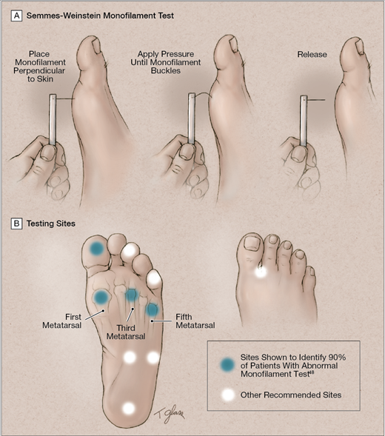
Assessment of Pressure sensation
quantitative assessment of the cutaneous pressure perception threshold
(10 g) monofilament is placed at a right angle to the skin on the plantar surface of the foot; pressure is then increased until the filament buckles
patient is asked if he or she felt pressure induced by the monofilament.

Slide 69
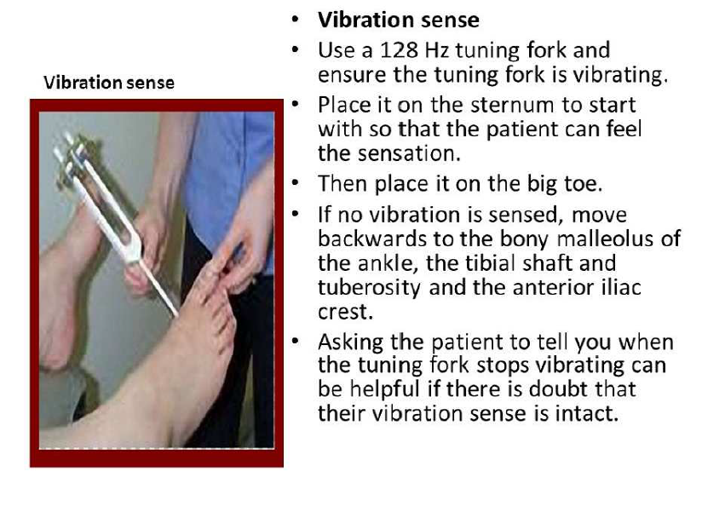

Slide 70
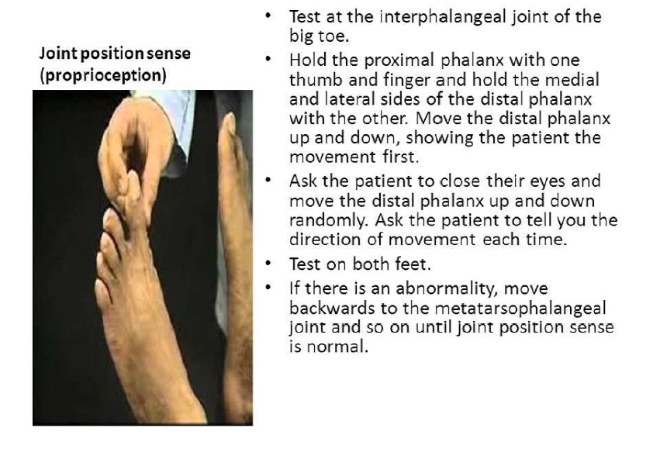

Slide 71
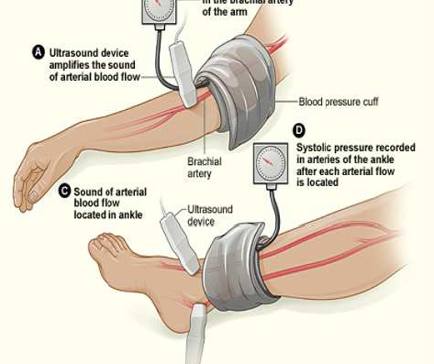
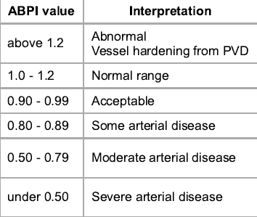
    Ankle brachial Pressure index
ABPI = P_{Leg} ⁄ P_{Arm}
Where P_{Leg} is the systolic blood pressure of dorsalis pedis or posterior tibial arteriesand P_{Arm} is the highest of the left and right arm brachial systolic blood pressure

Slide 72
Thanks

