Slide 1
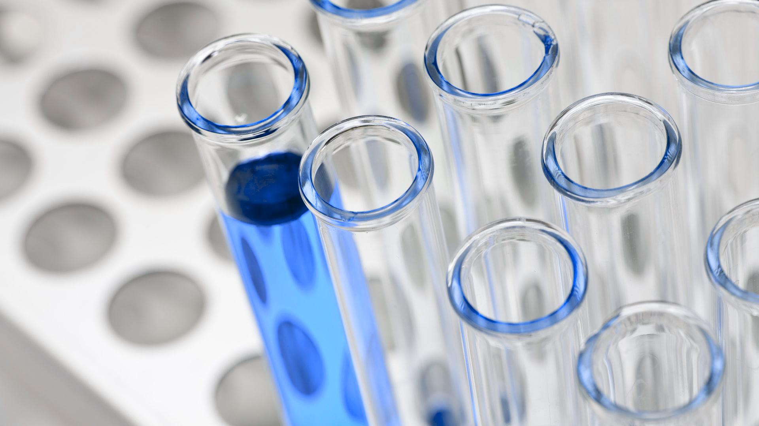


Immunization
Name Abdulrahman Salem Alnajar
ID. 3419
Date 4th JUN 2022
Supervisor Dr Marwa Alfaitory

Slide 2
Objectives
Define Immunization
Discuss Types of Immunization
Describe Types of Vaccines
Outline Mechanism of Vaccine working

Slide 3
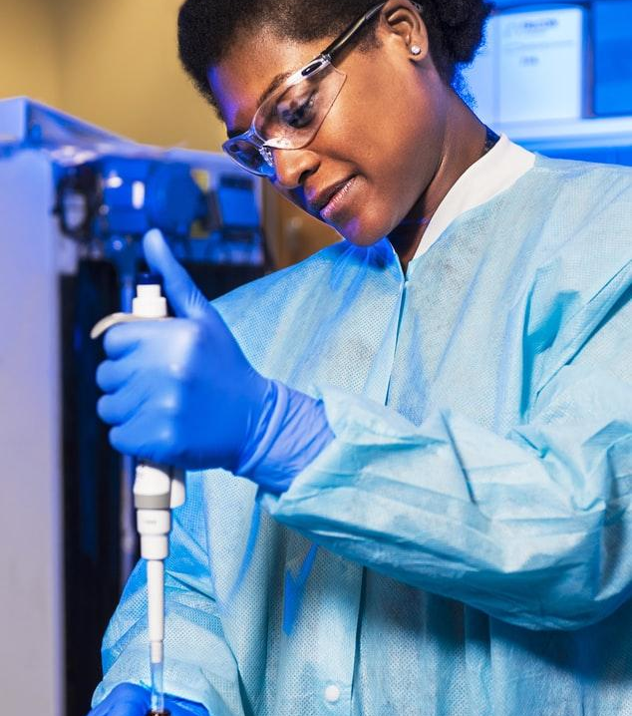
Introduction
Immunization is a global health and development success story, saving millions of lives every year. Vaccines reduce risks of getting a disease by working with the body’s natural defence to build protection.

Slide 4
Immunization
Immunization is defined as the procedure by which the body is prepared to fight against a specific disease. It is used to induce the immune resistance of the body to a specific disease. Immunization is of two types:
Active immunization.
Passive immunization

Slide 5
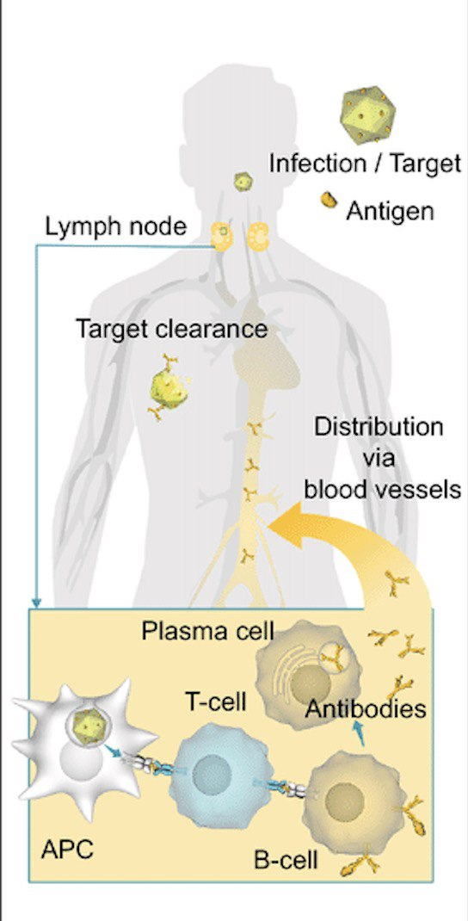
Active Immunization
Acquired by activating immune system of the body. Body develops resistance against disease by producing antibodies following the exposure to antigens.

Slide 6
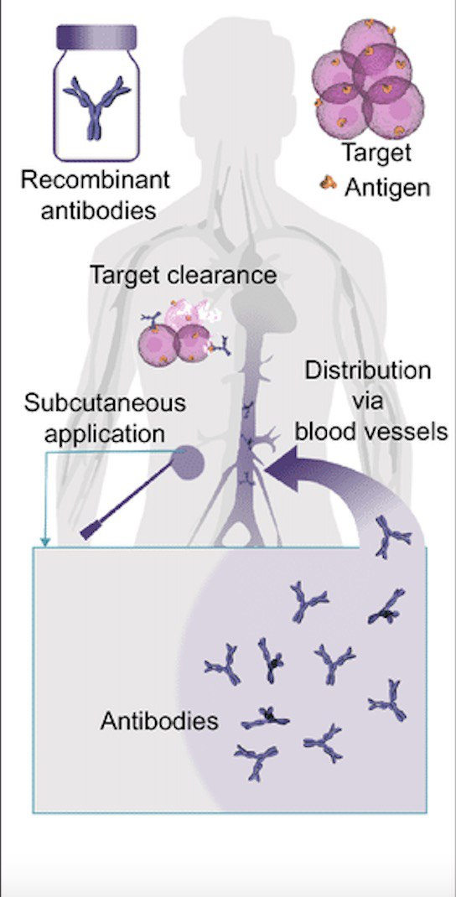
Passive Immunization
produced without challenging the immune system of the body. It is done by administration of gamma globulins from a person who is already immunized (affected by the disease) to a non-immune person.

Slide 7
Difference between Vaccination and Immunization
Vaccination | Immunization
Injection of killed or weakened microorganism that produce immunity in the body | Any process by which a person become protected from disease
9

Slide 8
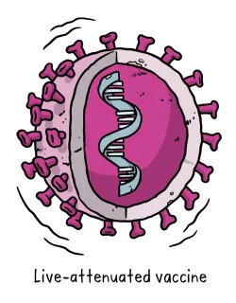
Live, Attenuated Vaccines
To produce an immune response, live, attenuated vaccines must replicate in the vaccinated person.
Although live, attenuated vaccines replicate, they usually do not cause disease such as that caused by the unweakened form of the organism.

Slide 9
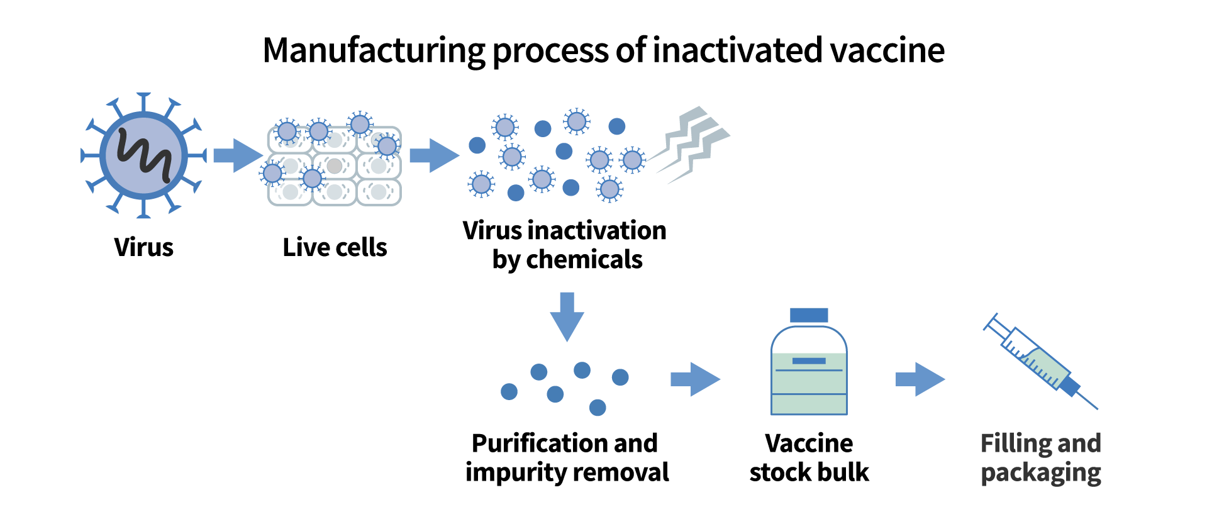
Inactivated Vaccines
Inactivated vaccines are not live and cannot replicate. These vaccines cannot cause disease,
Subunit vaccines contain a portion of the bacteria or virus. The portion of the organism selected is the part needed to produce a protective immune response.

Slide 10
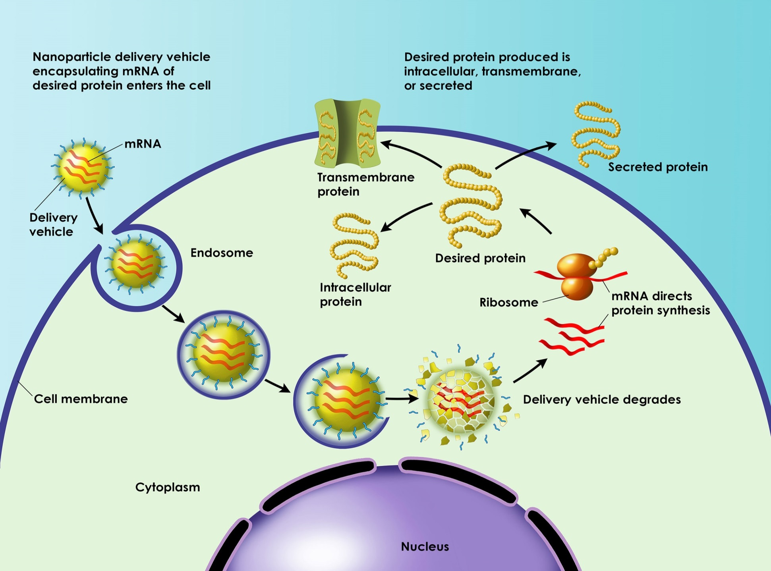

Slide 11
3,460,229 millions got vaccinnated against COVID -19 in Libya

Slide 12
Summary
Now there are vaccines to prevent more than 20 life-threatening diseases, helping people of all ages live longer, healthier lives.
Immunization prevents 3.5-5 million deaths every year from diseases

Slide 13
References
1- Vaccines and immunization [Internet]. Who.int. 2022 [cited 3 June 2022]. Available from: https://www.who.int/health-topics/vaccines-and-immunization#tab=tab_1
2- Kaushic C, Jerse A, Beagley K. Animal Models of Immunity to Tract Infections and Vaccine Development. 2022.
3- Ritchie H, Mathieu E, Rodés-Guirao L, Appel C, Giattino C, Ortiz-Ospina E et al. Vaccination ( types ) [Internet]. Our World in Data. 2022 [cited 3 June 2022]. Available from: https://ourworldindata.org/covid-vaccinations

Slide 14
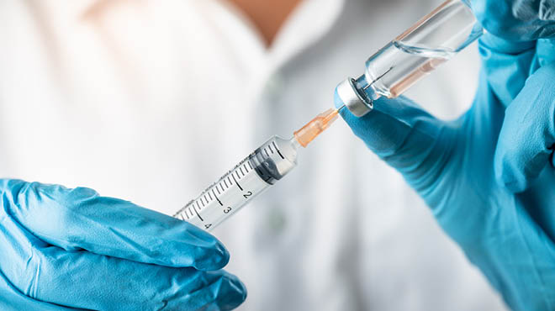
Thanks!

