Slide 1


Tuberculosis association with smoking
Libyan International Medical University
Faculty Of AMS
2021_2022
NAME : Zainab Abdelfatah
STUDENT NO. : 2818
BLOCK : PTS
DATE : 16/5/2022
.
1

Slide 2
Objectives
-
Outline the risk factors of TB
Discuss relationship between TB and smokers
Outline Management of TB
-
List prevention of TB
-
Describe prevealance of TB in adult smoking men
-
-
2

Slide 3
Introduction :
Introduction
3

Slide 4
Risk factor of TB :
Immunosuppressive Conditions:
HIV coinfection is the most potent immunosuppressor risk factor for developing active TB disease.
2. Malnutrition :
Studies have shown that malnutrition increases the risk of TB because of an impaired immune response.
3. Young Age :
Children are at higher risk of contracting TB infection and disease.
4. Diabetes:
Diabetes has been shown to increase the risk of active TB disease.
5. Tobacco Smoke:
TB related mortality rates are significantly higher in smokers than in never smokers.
4

Slide 5
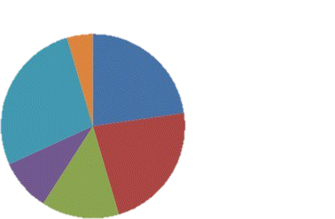
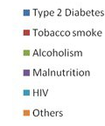
Risk factors of TB
5

Slide 6
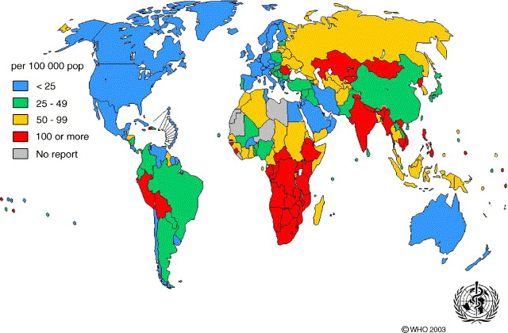
Prevalence of TB
6

Slide 7
Relation between TB and smoking
Tobacco is a risk factor for tuberculosis and TB death.
TB patients have extremely high smoking rates, several studies have shown that smoking increases the rates of TB infection in both the incidence and severity.
They also found a dose-response relationship between the number of cigarettes smoked daily, duration of smoking and the risk of active pulmonary TB.
This is consistent with the knowledge that long-term exposure to cigarette smoking has an adverse effect on the lung’s defence mechanisms.
7

Slide 8
In Doll's study, which investigated the impact of tobacco on total and cause specific mortality, the ratio of death for tuberculous smokers to non-smokers was 2.8, compared with the ratio of 2 for tuberculous ex-smokers.
8

Slide 9
Exposed of the smoking
Acute
Chronic
Acute inhalation of cigarette smoke results in reduced ciliostasis and mucociliary clearance.
Chronic inhalation of smoke alter clearance by converting ciliated epithelium to non-ciliated epithelium. By altering the amount and character of the mucus products, and by inflammatory and emphysematous narrowing of the airway
9

Slide 10
Management of TB
First Line management
Isoniazid
Rifampin
Pyrazinamide
Ethambutol
Second Line management
Amikacin
Aminosalicylic acid
Bedaquiline
Capreomycin
Clofazimine
Cycloserine
Ethionamide
Levofloxacin
Linezolid
Moxrfloxacin
Rifabutin
Rifapentine
Streptomycin
10

Slide 11
Prevention of TB
Important components of prevention are:
The use of the purified protein derivative skin test (PPD skin test)
to detect recent converters and to institute treatment for latent infections
2. The bacille Calmette-Guérin vaccine (BCG vaccine) can be used:
To induce partial resistance to tuberculosis.
Is effective in preventing the appearance of tuberculosis as a clinical disease, especially in children, although it does not prevent infection by M. tuberculosis.
11

Slide 12
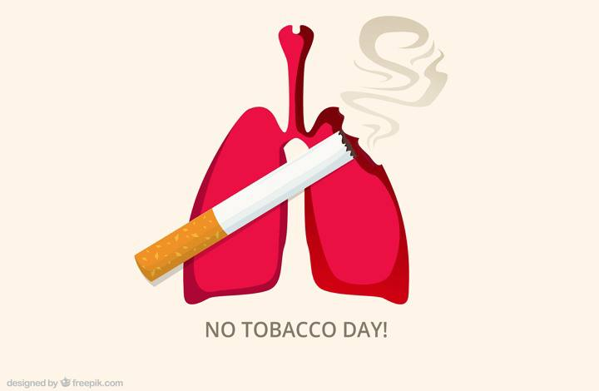
Conclusion:
Introduction
There is association between tuberculosis and smoking.
Since the smoking is a risk factor for tuberculosis, I advice all the people to stop smoking or even staying with people while they’re smoking.
12

Slide 13
Reference
Silva, D. R., Muñoz-Torrico, M., Duarte, R., Galvão, T., Bonini, E. H., Arbex, F. F., Arbex, M. A., Augusto, V. M., Rabahi, M. F., & Mello, F. C. de Q. (2018, April). Risk factors for tuberculosis: Diabetes, smoking, alcohol use, and the use of other drugs. Jornal brasileiro de pneumologia : publicacao oficial da Sociedade Brasileira de Pneumologia e Tisilogia. Retrieved May 15, 2022, from https://www.ncbi.nlm.nih.gov/pmc/articles/PMC6044656/
https://www.chestmed.theclinics.com/article/S0272-5231(05)00010-9/fulltext
de Vargas, K. R., Freitas, A. A., Azeredo, A. C. V., & Silva, D. R. (2021, August 27). Smoking prevalence and effects on treatment outcomes in patients with tuberculosis. Revista da Associação Médica Brasileira. Retrieved May 15, 2022, from https://www.scielo.br/j/ramb/a/SGtLdSGqVB6Gd7TwM3L79Cq/?lang=en
13

Slide 14
Stop smoking before smoke stops you
Thank you
Introduction
14

