Slide 1



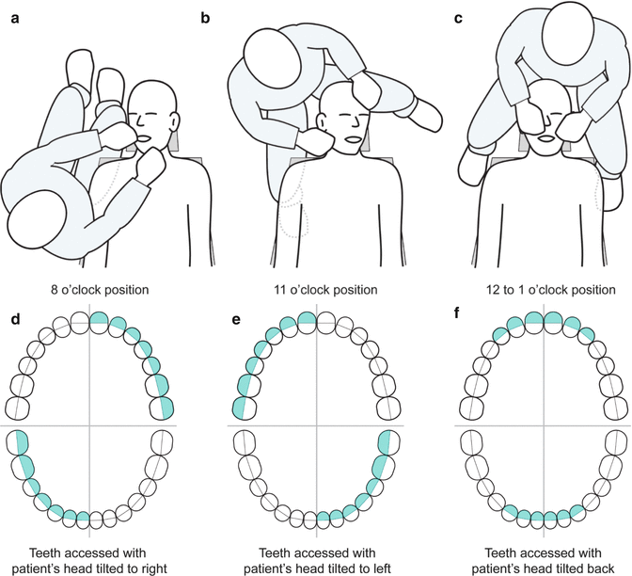
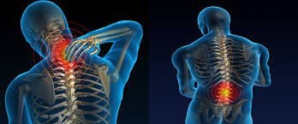
Dentist sitting position
Alzahra Elbijou 3126
Libyan international medical university
Results
Introduction
-Dentist professional causes muscle pain, and the dentist usually neglect the symptoms into chronic condition and become permanent injury to incorrect site of position
-During procedure , the forearms and thighs should remain parallel to the floor, the hip angle should be of 90 degrees
- the correct positioning when treating the patient:
7 o clock, 9 o clock, 10 to 11 or 12 o clock positions when right handed.
5 o clock, 3 o clock, 2 to 10 o clock or 12 o clock positions when left handed.
-Dentist are prone to musculoskeletal disorders, due to their job characteristics such as the need for high attention, concentration and being in the one posture for a long time .
Conclusion
A dentist can spend up to 60.000 hours in a lifetime working in tense and distorted position, with consequent musculoskeletal problems.
Dentistry does not lend itself to good posture; however, it is possible with instruction and practice to correct the harmful posture habits that may be the causes of such stress and pain.
Methodology
Good working ergonomics is essential so that work capability, Efficiency and high clinical level of treatment can be maintained throughout the working life of dental professional
Statistics of a group of dentists who suffer from problems as a result of incorrect sitting on the dental chair during work
References
.
1. Gupta G, Gupta A, Mohammed T, Bansal N. Ergonomics in Dentistry. International Journal of Clinical Dentistry. 2014;7(1):30-34.
2. Naseem M, Khurshid Z, Khan H, Niazi F, Zohaib S, Zafar M. Oral health challenges in pregnant women: Recommendations for dental care professionals. The Saudi Journal for Dental Research. 2016;7(2):138-146.

