Slide 1


Come to terms with the meaning of political socialization
Libyan International Medical University
Faculty Of Business Administration
By:wesam suweidi
E-mail:wesam_2880@limu.edu.ly
Date: dec/3/2020

Slide 2
Contents
The meaning of political socialization
political socialization Influence
Conclusion
References

Slide 3
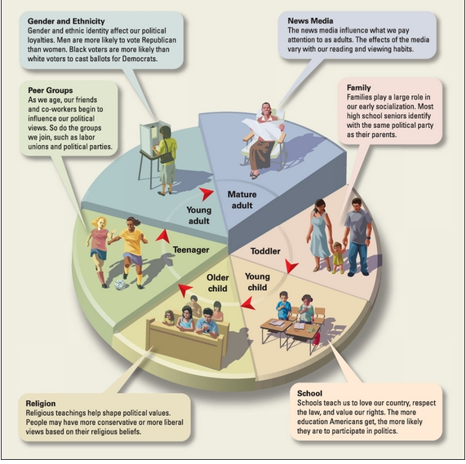
The meaning of political socialization
It’s the process which a person develops political beliefs and opinions that influence their behavior in social spheres.

Slide 4
Political socialization influence
Like any other subject on which people develop opinions, many factors contribute to a person's political socialization. Because it is a development that occurs over the course of many years.
As is the case with many of the things that we believe, our families are the most significant influence on our political beliefs and opinions.

Slide 5
Conclusion
Political socialization is extremely important because it defines us as human beings with thoughts and opinions and beliefs so we can make up our own minds so we’re not misguided to believe in something that is not right.

Slide 6
References
What is Political Socialization? - Definition, Factors, Process & Examples. (2016, June 7). Retrieved from https://study.com/academy/lesson/what-is-political-socialization-definition-factors-process-examples.html.

Slide 7
THANK YOU

