Slide 1


Relation between Air Pollution and global warming
2end year medicine
3/4/2022
Presented by: Salem Mahmoud
ID:2840 2end year med
1

Slide 2
Objectives
Define Air Pollution
List causes of air pollution
01
02
Mention the relation between air pollution and global warming
Outline effect of air pollution in Libya
03
04
2

Slide 3
Definition of Air pollution
Air pollution : is a mixture of solid particles and gases in the air. Car emissions , chemicals from factories, dust, pollen and mold spores may be suspended as particles.
- Some air pollutants are poisonous, which can cause life threatening diseases and complications to either
3

Slide 4
Causes of Air Pollution
Common causes: Air pollution is caused by solid and liquid particles and certain gases that are suspended in the air. These particles and gases can come from cars, factories, dust, pollen and wildfires.
Road traffic is one of the most significant sources of gases and air pollution.
4

Slide 5
Global warming is accelerated by greenhouse gases caused by human activity.
- The main greenhouse gases are (CO₂), (CH₄) and (N₂O).
CO₂ is the main gas contributing to climate change, it is not harmful to human health.
5

Slide 6
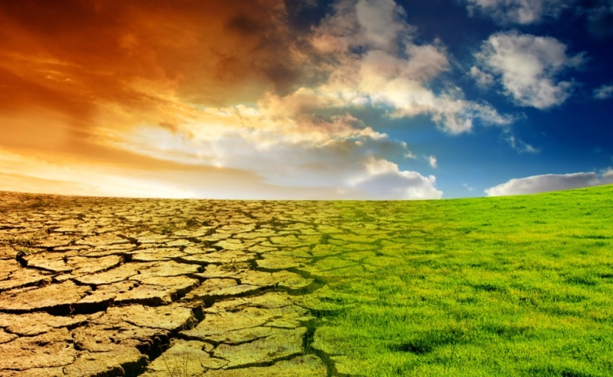
The Relation Between Air Pollution and Global Warming
- Climate change has many effect with global impact
- mainly due to:
1- changes in climate patterns
2- rising sea level
3- extreme weather change phenomena.
6

Slide 7
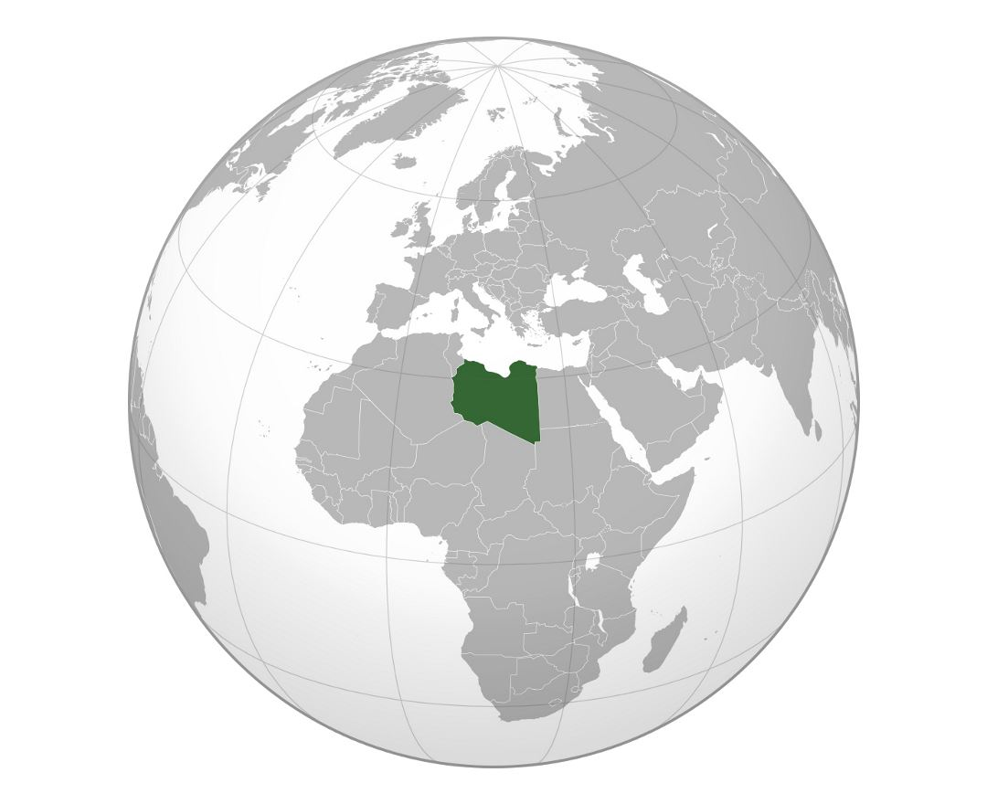
Effect of Air Pollution in Libya
Most common causes of air pollution in Libya
- Natural : such as dust and sandstorms.
-Stationary sources: such as thermal power generating
- mobile sources : such as vehicles
- emissions from various industrial processes.
7

Slide 8
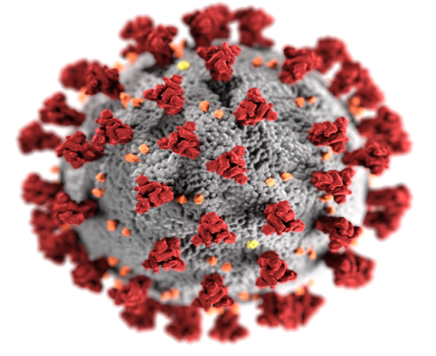
- COVID-19 has a dark cost to our lives, healthcare systems, and mental health of people around the world .
- There has been a great positive impact of covid-19
Which contributed to reducing the closure of large factories from work
8

Slide 9
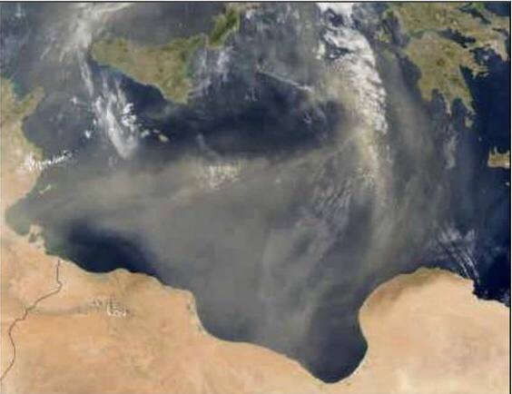
NASA(2003)
9

Slide 10
Conclusion
Air pollution can cause life threatening disease and so much mortality
Cars , factories , dust are main cause of air pollution
covid-19 has a great positive impact on reducing global warming
10

Slide 11
Reference
D’Amato G, Cecchi L, D’Amato M, Annesi-Maesano I. Climate change and respiratory diseases. Eur Respir Rev. 2014;23:161–9
PhD Diss, University of Johannes Gutenberg, Mainz, Germany, 2005
11

Slide 12
Thank you for attention
Do you have any questions?
12

