Slide 1



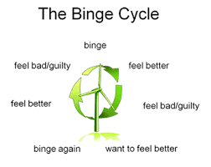
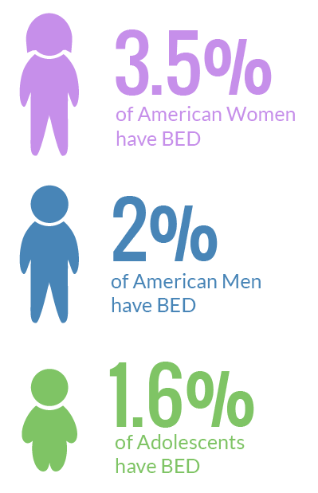
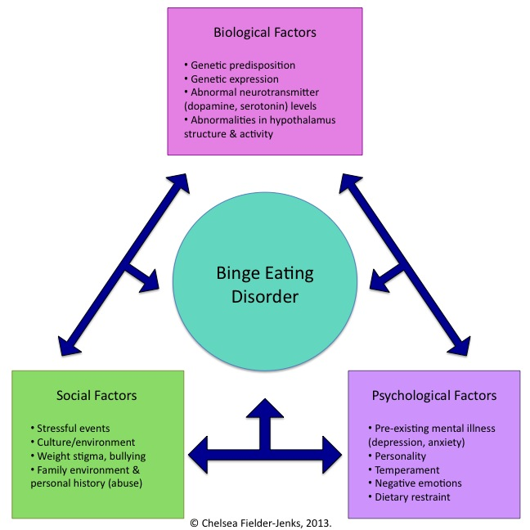
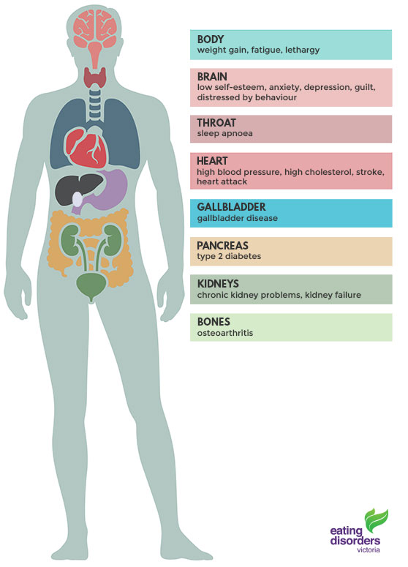
Libyan International Medical University
I cant Stop Eating do you know why?
By : Reem Naji
Third year BMS
What is binge eating disorder (BED)?
Binge Eating Disorder(BED) is commonly known by compulsive overeating or consuming abnormal amounts of Food while feeling unable to stop and at loss of control.
(BED) was first explained in 1959 by Albert Stunkard a pschiatrist and researcher as (Night Eating Syndrome)
The term Bing Eating Disorder was created to define similar binge eating without the nocturnal aspect
Discussion
What is the causes of BED?
Because little is known about the predictors of binge eating (a risk factor for obesity), a set of putative risk factors for binge eating was investigated in a longitudinal study of adolescent girls. Results verified that binge eating predicted obesity onset. Elevated dieting, pressure to be thin, modeling of eating disturbances, appearance overvaluation, body dissatisfaction, depressive symptoms, emotional eating, body mass, and low self-esteem and social support predicted binge eating onset with 92% accuracy, Classification tree analysis revealed an interaction between appearance overvaluation, body mass, dieting, and depressive symptoms, suggesting qualitatively different pathways to binge eating and identifying subgroups at extreme risk for this outcome. Results support the assertion that these psychosocial and biological factors increase risk for binge eating
Complications of BED
of American adults will struggle with BED during their lifetime. Close to 43% of individuals suffering from Binge Eating Disorder will obtain treatment2.8 %
5.2% of individuals suffering from eating disorders not otherwise specified the former diagnosis that BED, among other forms of disordered eating)
die from health complications
Summary
Binge eating disorder is a serious disorder in which you frequently consume unusually large amounts of food and unable to stop eating the people will often have feeling of guilt and disgust at their lack of control after binge eating .
References
/http://authoritycure.com
http://WWW.eatingdisorderhope.com
http://WWW.hullinstitute.com/default.aspx
https://www.eatingdisorderhope.com
https://www.edreferral.com/home/

