Slide 1
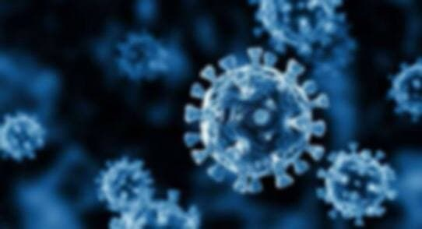


COVID-19 & Dental Field
Presented by : Dania Alwerfli
2862 / 2nd year Dental student
10/05/2022

Slide 2

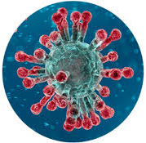
OBJECTIVES :
Describe dental clinics HOSTPOST for transmission COVID-19 .
Describe the connection between oral health and COVID-19 .
Outline COVID-19 prevention methods in dental clinics .
Discuss the risk of using local anesthesia after COVID-19 vaccination .

Slide 3
Introduction ..
The COVID-19 pandemic has become a worldwide , significant public health challenge . Dental care providers are at high risk !!

Slide 4
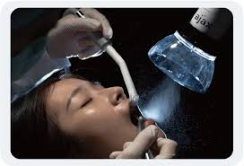
Dental clinics HOSTPOST for transmission COVID-19
In dental practices , COVID-19 transmission is expected via droplets & aerosols generated during clinical procedures .

Slide 5
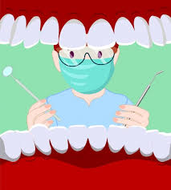
Splatters created during oral surgery procedures , like aerosols are also contaminated by respiratory pathogens

Slide 6

Another important potential mode of transmission in dental practice could be contact with contaminated environment surfaces .

Slide 7
Is there connection between oral health & COVID-19 ?

Slide 8
COVID-19 & Periodontitis ..
There is a group of researchers from Qatar’s university with collaboration with researchers from Spain & Canada , do a search and found the patients with chronic periodontitis are three times more likely to be at risk of severe symptoms and enter to ER and can also cause death from COVID-19 .
Source : Collage of Dentistry at Qatar University with Hamad Medical corporation Lee.04/02/2021

Slide 9
“ CYTOKINE STORM ”
Dangerous immune response occur
Immune cells are overproducing
Enter to the lungs → cause deterioration in the body
Leading to shortness of breath & pneumonia , which can eventually lead to death .

Slide 10
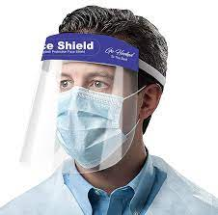
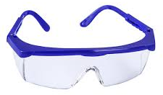
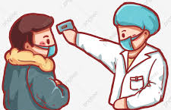
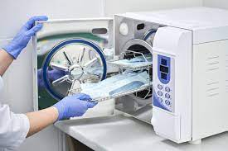
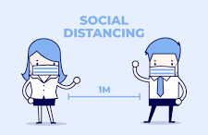

prevention methods in dental clinics ..
Measuring body temperature
Wearing face shields
Wearing dental eye protection
Wear protective suit
Keep distance between patients in waiting room
Sterilizating instrument , surfaces and environment .

Slide 11
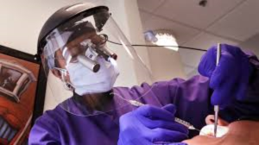

Slide 12
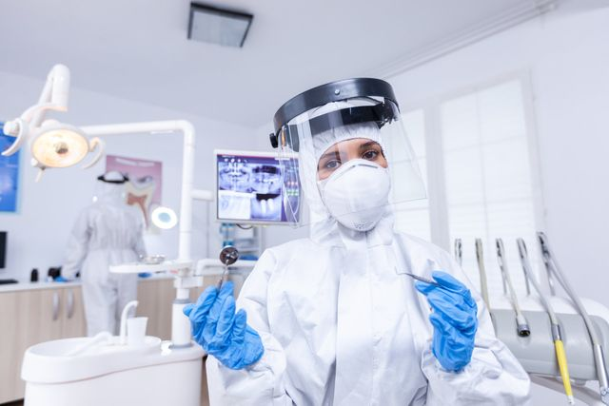

Slide 13


Slide 14
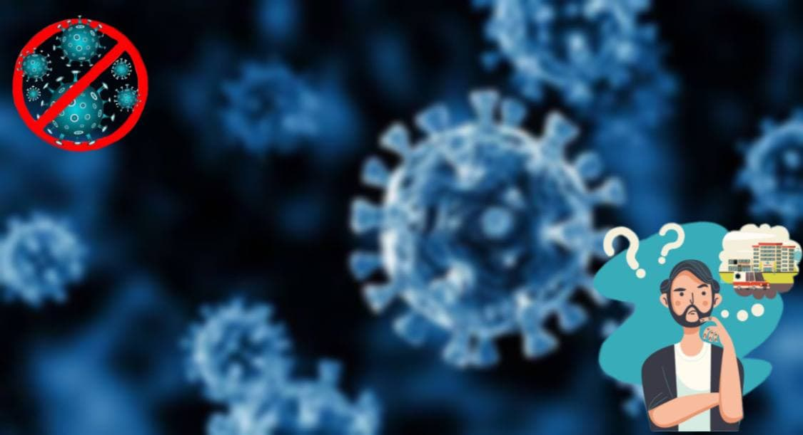
Anesthesia and COVID-19 vaccine !!
Anesthesia could make a COVID-19 vaccine less effective !!
There is no risk in getting anesthesia after COVID-19 vaccine !!

Slide 15
Anesthesia could make
COVID-19 vaccine less effective !!
Vaccine interacts with the immune system , and so does anesthesia , which can interfere with how vaccine teaches the body to fight infection .
American society of Anesthesiologists recommends waiting at least two weeks after final dose of vaccination before getting surgery that will use anesthetics .
Source :THE AMERICAN SOCIETY OF ANESTHESIOLOGISTS Lee, March 14, 2021

Slide 16
Conclusion …
it is necessary to be careful when dealing with patients and need to deal with them as a COVID-19 patients .

Slide 17
Thank you

Slide 18
References :
Gurzawska-Comis K, Becker K, Brunello G, Gurzawska A, Schwarz F. Recommendations for dental care during COVID-19 pandemic. Journal of clinical medicine. 2020 Jun;9(6):1833.
Dos Santos MB, Pires AL, Saporiti JM, Kinalski MD, Marchini L. Impact of COVID-19 pandemic on oral health procedures provided by the Brazilian public health system: COVID-19 and oral health in Brazil. Health policy and technology. 2021 Mar 1;10(1):135-42.
Lin C, Vazquez‐Colon C, Geng‐Ramos G, Challa C. Implications of anesthesia and vaccination. Pediatric Anesthesia. 2021 May;31(5):531-8.

