Slide 1



Adolescence characteristic and problems
Name of student : Raghad khalil
Number of student : 2931
Block : PTS
Date : 16-5-2022
1

Slide 2

Objectives
List the problems they may encounter
discuss the physical changes in this stage of life
List tips for parents of teengers to overcome this profitable safely
Define the period of adolescence
2

Slide 3

Introduction
3

Slide 4

Definition of Adolescence
Adolescence is the phase of life between childhood and adulthood, from ages 10 to 19 It is a unique stage of human development and an important time for laying the foundations of good health.
4

Slide 5

The physical changes in girls
1- Breasts will start developing.
3- The body shape will change.
2- A growth spurt occurs. Some parts of the body – like the head, face and hands – might grow faster than limbs and torso.
5

Slide 6

The physical changes in Boys
1- The teenager will become taller and his chest and shoulders will become wider.
2- The larynx (‘Adam’s apple’ or voice box) will become more obvious.
3- The appearance of the beard, facial hair and other parts of the body
6

Slide 7



Brain
Hormone production mechanism :
Gonadotropin releasing hormone
Pituitary gland
Girls
Boys
LH , FSH
Testosterone and Sperm
Estrogen
7

Slide 8
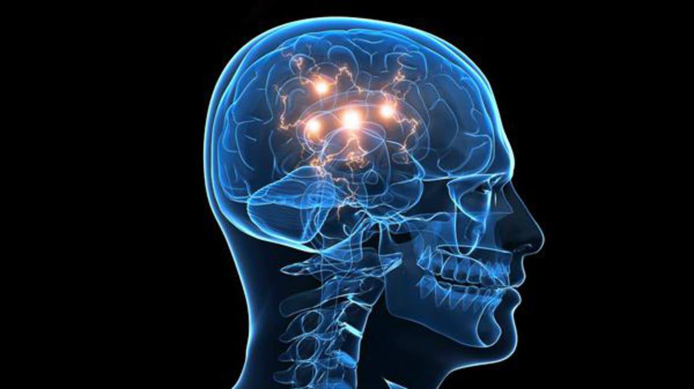

Other physical changes in Adolescence ( for the Both )
Brain :
Weight :
Teenage brain development affects the adolescents behavior and social Skills
They may gain Weight and may need more healthy food
8

Slide 9
Sweat
Teeth
Skin and hair
A new type of sweat gland in the armpit and genital area develops during puberty.
Children will get their second molars at around 13 years of age.
Glands in the skin on the face, shoulders and back start to become more active during puberty, producing more oil.
9

Slide 10





10

Slide 11






11

Slide 12






12

Slide 13





13

Slide 14






14

Slide 15

3) Respect their views
Your teenager is more likely to respect your views if you respect theirs.
5) Spend time together
4) Show interest
Let your teenager know that you are interested in what they do
15

Slide 16
8) Encourage them
6) Make time for talking and listening
Praise them for their efforts and let them know when they do something that pleases you
Let your teenager know that you have time to talk and Share your values
9) Share your life experiences
7 ) Give them space
16

Slide 17
Conclusions
We need to understand the Concept of Adolescence and this Concept including the problems , and tips for parents to understanding of their teenagers and physical changes in this stage of life
17

Slide 18
Reference
[Internet]. Amazon.com. 2018 [cited 15 May 2022]. Available from: https://www.amazon.com/Home-Among-Strangers-Exploring-Community/dp/1563681412
Gelman S, Tardif T. Generic noun phrases in English and Mandarin: An examination of child-directed speech [Internet]. Philpapers.org. 2022 [cited 15 May 2022]. Available from: https://philpapers.org/rec/GELGNP
Spencer P. The Expressive Communication of Hearing Mothers and Deaf Infants. 2022.
[Internet]. 2022 [cited 15 May 2022]. Available from: https://scholar.google.com/citations?user=scNoS_cAAAAJ
5. A Cognitive/Functional Perspective on the Acquisition of “Classifiers” [Internet]. Taylor & Francis. 2022 [cited 15 May 2022]. Available from: https://www.taylorfrancis.com/chapters/edit/10.4324/9781410607447-25/cognitive-functional-perspective-acquisition-classifiers-dan-slobin-nini-hoiting-marlon-kuntze-reyna-lindert-amy-weinberg-jennie-pyers-michelle-anthony-yael-biederman-helen-thumann
18

Slide 19

Thanks
Do you have any question?
19

