Slide 1
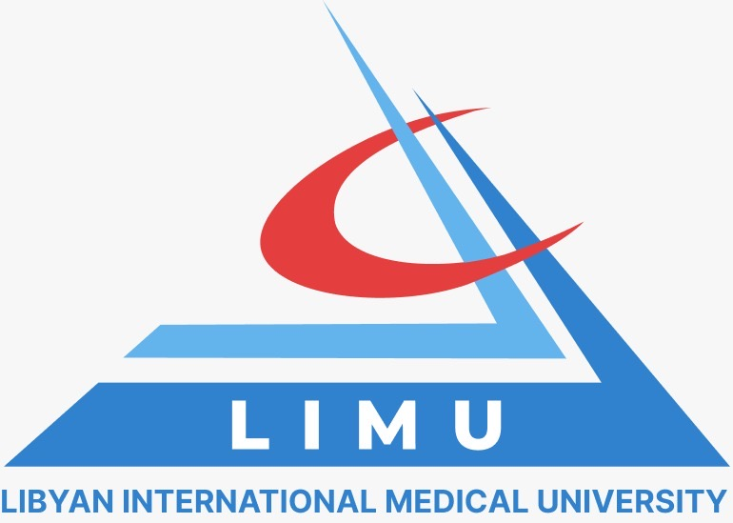
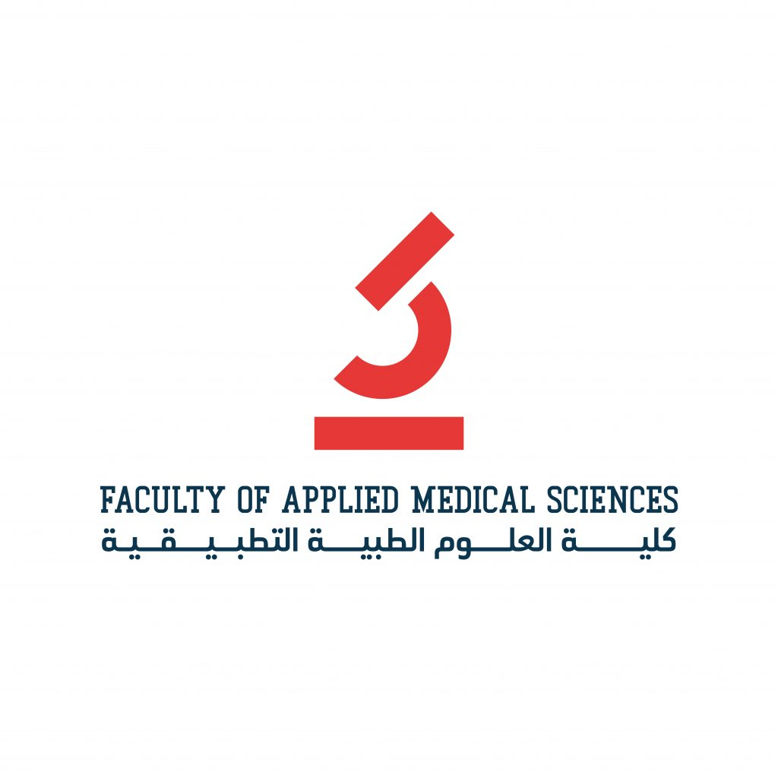
Stem Cells the future of xerostomia
Ahmed Ali Mersal (2883)
04-04/2022
2nd year Dentistry
1

Slide 2
Objectives
Overview of stem cell therapy
Stem cell therapy as a future solution to xerostomia
Compairson between stem cell therapy and traditional treatment
Roadblocks that slow down stem cell therapy research
Overview of xerostomia
2

Slide 3
Introduction
xerostomia
- mee
zee
- stow
- uh
- ruh
Xeros = dry
Stoma = mouth
3

Slide 4
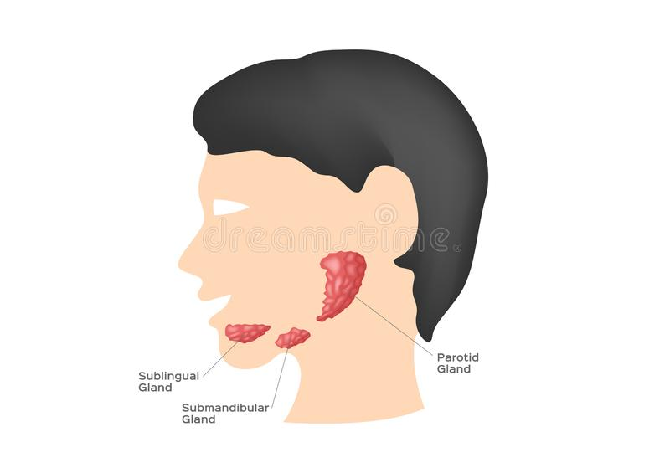
What is xerostomia
“dry mouth”
condition in which the salivary glands in your mouth don't make enough saliva resulting in dry mouth
4

Slide 5
What xerostomia
causes
Medication side effects
Sjogren Syndrome
Radiotherapy
Autoimmune disease
Smoking
5

Slide 6
What will xerostomia
cause
oral discomfort, especially for denture wearers
↑ risk of developing dental caries
↓ social interaction
malnutrition
6

Slide 7
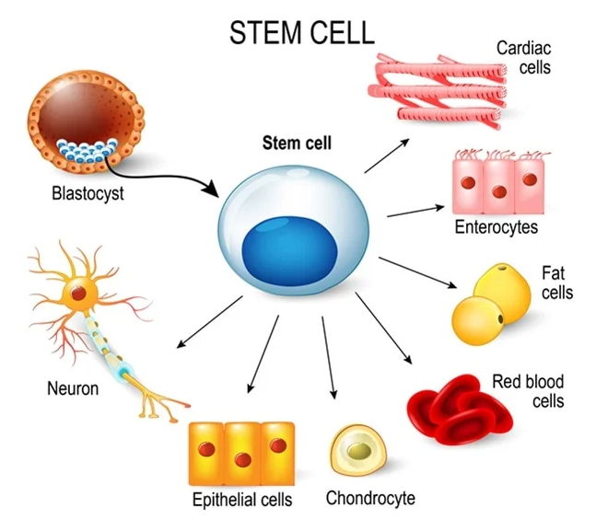
Stem Cell therapy
Overview
Invented in 1960s at University of Toronto and first demonstrated on mice
also known as regenerative medicine
promotes the repair response of dysfunctional or injured tissue using stem cells
This usually takes the form of a bone-marrow transplantation
Stem cells. These inner cell mass from a blastocyst. These stem cells can become any tissue in the body. for example: neuron, chondrocyte, enterocytes, red blood cells, muscle, fat or epithelial cells. Image Credit: Designua / Shutterstock
7

Slide 8
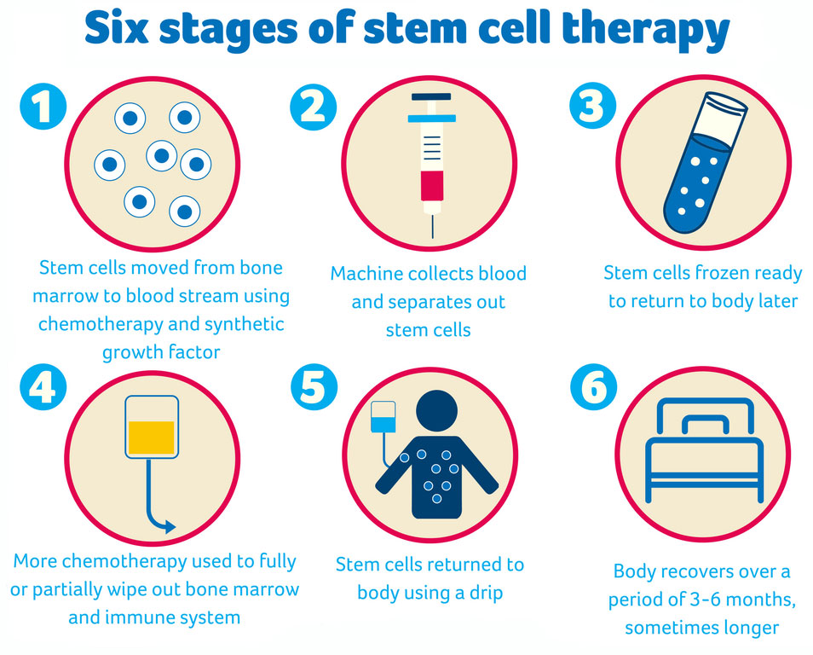
Stem Cell therapy
Stages
Stem cells. These inner cell mass from a blastocyst. These stem cells can become any tissue in the body. for example: neuron, chondrocyte, enterocytes, red blood cells, muscle, fat or epithelial cells. Image Credit: Designua / Shutterstock
8

Slide 9
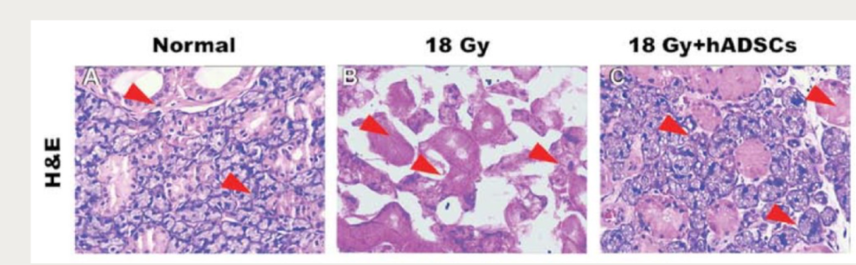
Stem cell therapy in xerostomia
stem cells have shown promising results in recent studies
The results indicate that stem cells improve the amount of saliva by 45% after four weeks and up to 80% after four months
9

Slide 10
Traditional treatment vs stem cell therapy
Effective Saliva restoration after 6 weeks of treatment
Cost per treatment plan without insurance (US)
Stem Cells could cost anywhere from $5,000 to $50,000
Pilocarpine and other traditional medicine cost roughly $400 per treatment
60%
33%
Stem Cell
Pilocarpine
10

Slide 11
Traditional treatment vs stem cell therapy
Stem cell therapy
Side Effects
Traditional therapy
Side Effects
Graft-versus-host disease
Infections
Mouth and throat pain
Graft Failure
Nausea
Runny nose
Diarrhea
Chills
11

Slide 12
Roadblocks against stem cell research
Cannot be grown for long periods of time in culture
Usually, a very small number in each tissue making them difficult to find and purify
Currently there is no technology available to generate large quantities of stem cells in culture
Methods for ensured reproducibility and maintenance, as differentiated tissues are not certain.

Slide 13
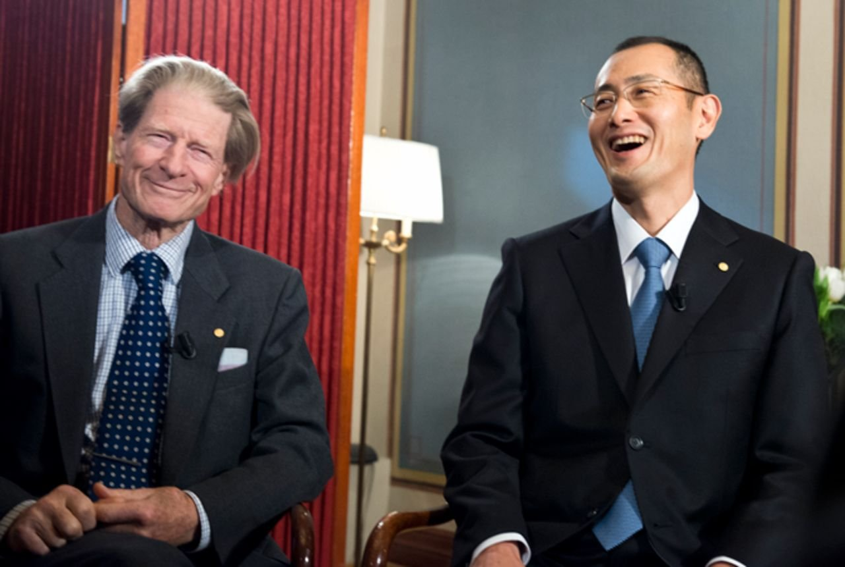
Silver Lining
The future still looks bright
John B Gurdon and Shinya Yamaka recently won a Nobel prize in Physiology
For the ability to generate Stem cells from already differentiated cells
This could reduce the cost of stem cell therapy by over 20X
Sir John B. Gurdon (Left) and Shinya Yamanaka (Right) during an interview with Nobelprize.org on December 6, 2012. Image Copyright Nobel Media AB 2012/Niklas Elmehed.

Slide 14
Conclusion
Xerostomia is condition in which the salivary glands in your mouth don't make enough saliva resulting in dry mouth
Stem cell therapy show great promise in the next 5 to 10 years to eradicate xerostomia

Slide 15
Xiong, X., Shi, X., & Chen, F. (2014). Human adipose tissue derived stem cells alleviate radiation induced xerostomia. International journal of molecular medicine, 34(3), 749-755.
2.Grønhøj, C., Jensen, D. H., Vester-Glowinski, P., Jensen, S. B., Bardow, A., Oliveri, R. S., ... & Jensen, M. (2018). Safety and efficacy of mesenchymal stem cells for radiation-induced xerostomia: a randomized, placebo-controlled phase 1/2 trial (MESRIX). International Journal of Radiation Oncology* Biology* Physics, 101(3), 581-592.
3. Tanasiewicz M, Hildebrandt T, Obersztyn I. Xerostomia of Various Etiologies: A Review of the Literature. Adv Clin Exp Med. 2016;25(1):199-206. doi:10.17219/acem/29375
4. Jensen DH, Oliveri RS, Trojahn Kølle SF, et al. Mesenchymal stem cell therapy for salivary gland dysfunction and xerostomia: a systematic review of preclinical studies. Oral Surg Oral Med Oral Pathol Oral Radiol. 2014;117(3):335-342.e1. doi:10.1016/j.oooo.2013.11.496
5. Jensen SB, Vissink A, Limesand KH, Reyland ME. Salivary Gland Hypofunction and Xerostomia in Head and Neck Radiation Patients. J Natl Cancer Inst Monogr. 2019 Aug 1;2019(53):lgz016. doi: 10.1093/jncimonographs/lgz016. PMID: 31425600
References

Slide 16
Thank You
Ahmed Mersal
2883

