Slide 1
Pleural disorders

Slide 2
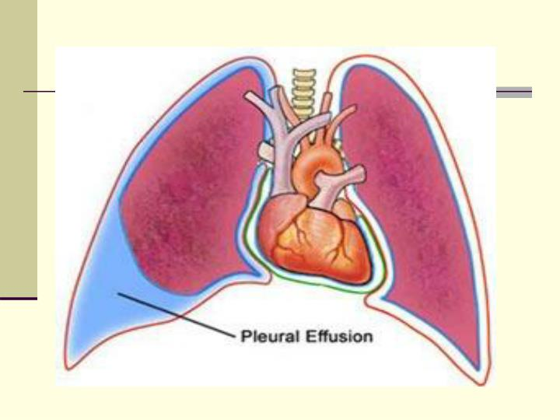
Pleural effusion

Slide 3
pathogenesis
An increase in hydrostatic pressure in the microvascular circulation (CCF).
A decrease in oncotic pressure in the microvascular circulation (hypoalbuminemia).
Increase permeability of the microvascular circulation (pneumonia).
Impaired lymphatic drainage from the pleural space (malignancy).
Movement of fluid from the abdomen into the pleural space (cirrhosis)

Slide 4
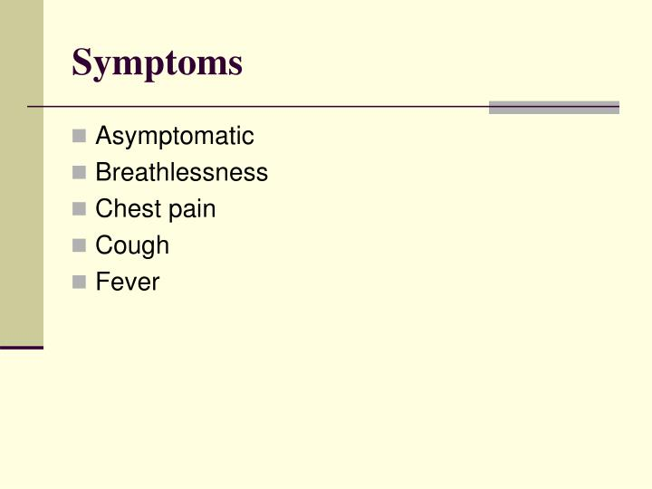

Slide 5
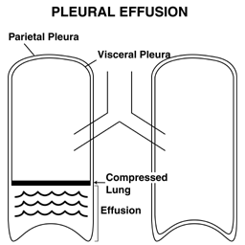
Physical exam
decrease chest expansion in the affected side , absent,decreased tactile fremitus, stony Dullness to percussion, Decreased breath sounds and Egophony.

Slide 6
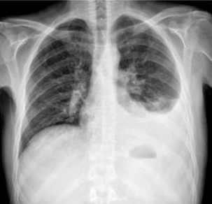
Radiology

Slide 7
or a lateral and decubitus views

Slide 8
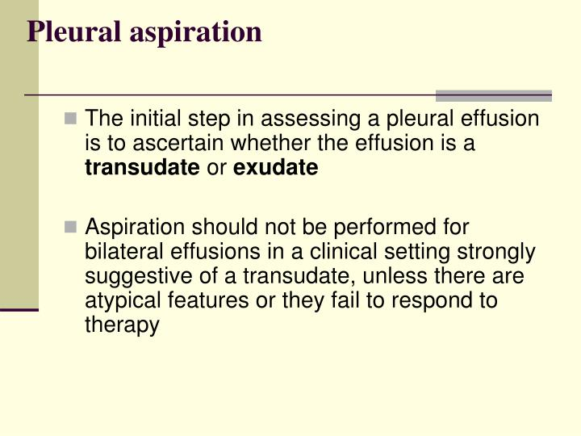

Slide 9
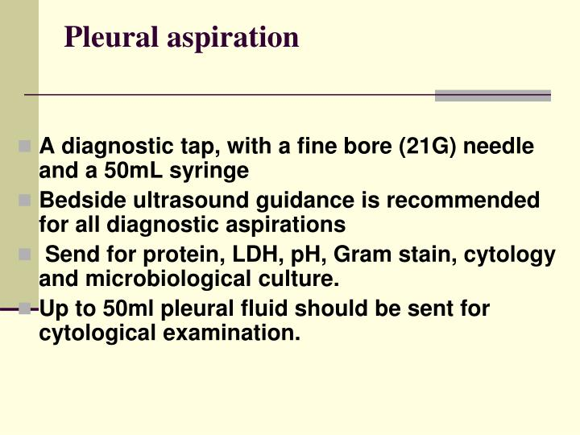

Slide 10
Investigations
pleural fluid microbiology 1)gram stain c/s
2)Afb smear and c/s
Pleural fluid cell count and diff cell count
Biochemstry protein ,LDH and glu
Pathology for malignant cells
Other specific pcr /ct/autoantibodies depend on case .

Slide 11
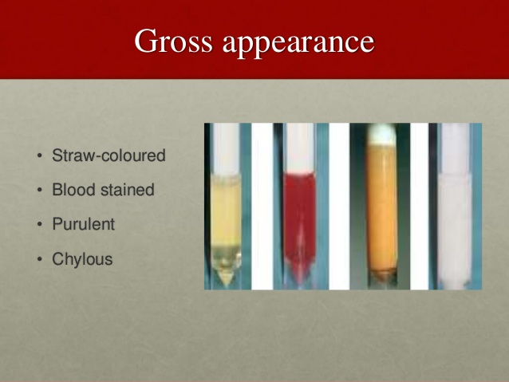

Slide 12
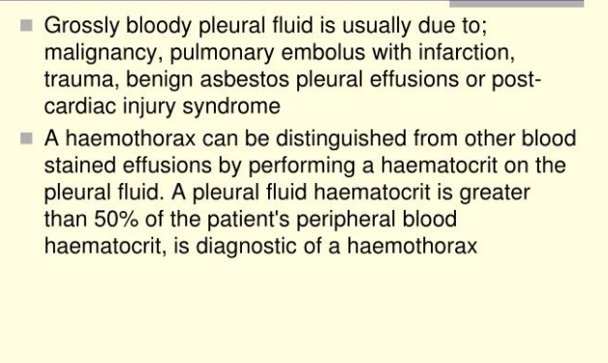

Slide 13
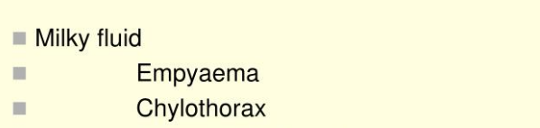

Slide 14
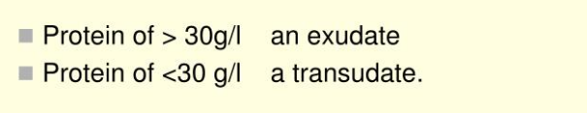

Slide 15
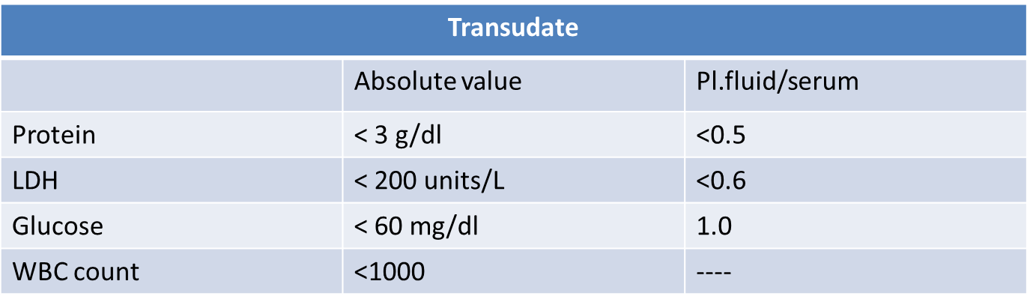
transudate
Causes:
Heart liver failure and nephrotic syndrome

Slide 16
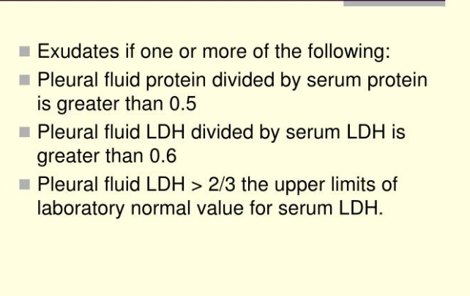

Slide 17
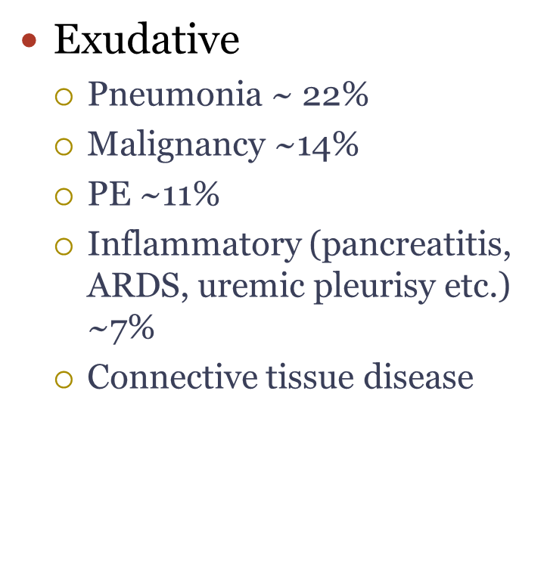

Slide 18
exudate
 | Appearance of fluid | Type of fluid | Predominant cells | Other DX feature
TB | CLOUDY BLOODY YELOW | Exudate | Lymphocytes- | + TT & pl.biopsy 80%
Malignant disease | often blood –stained | Exudate | lymphoctes | Positive pl .biopsy 40%
Pul. infarction | bl.stained | exudate | RBC | Source of embolism
Rheumatoid disease | Serous YELOW | Exudate | Lymphocyte) | RF , ANTI CCP
SLE | serous | Exudate | Lymph. | Anti-DNA
Obst. of thoracic duct | Millky | Chyle | None | Chylomicrons

Slide 19
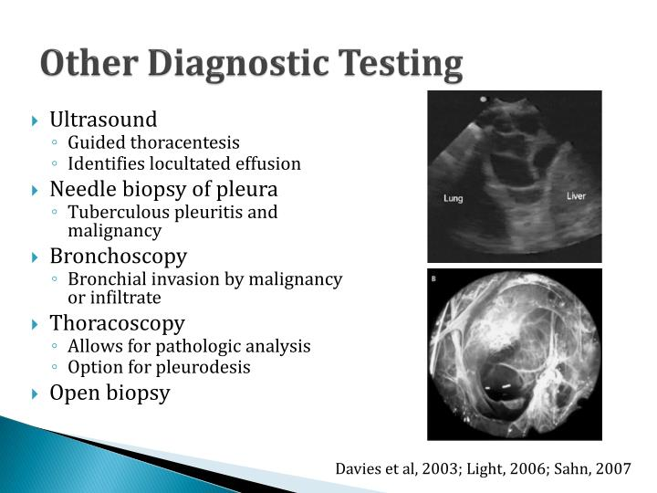

Slide 20
Empyema
Defined as pus in the pleural space .
low ph Intercostal tube & iv antibiotic +_decortication

Slide 21
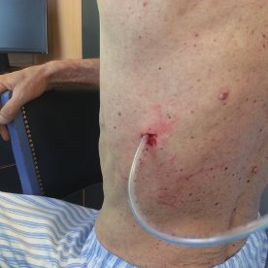
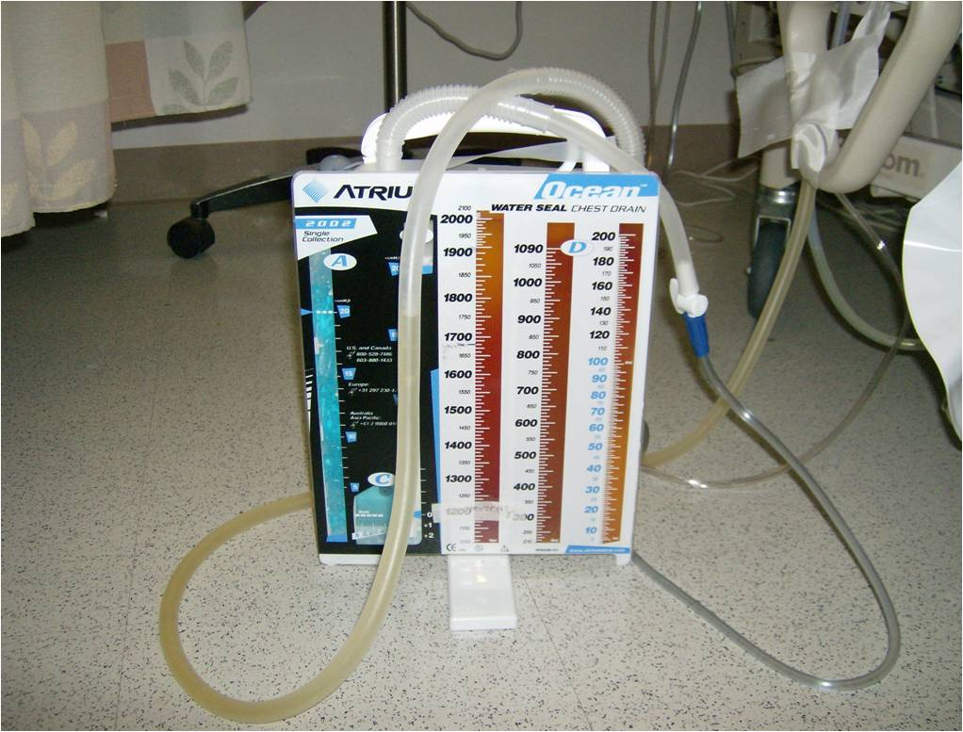
CHEST TUBE DRAINAGE SYSTEM

Slide 22
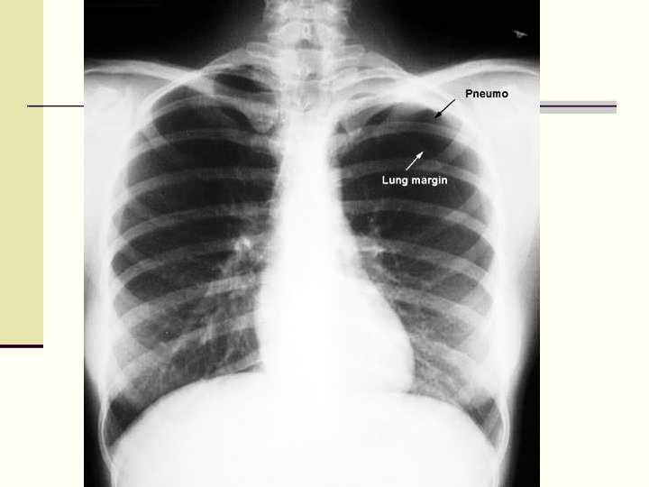
pneumothorax

Slide 23
Thank u

