Slide 1
The Traditional Square of Opposition
Lecture 4

Slide 2
The Traditional Square
All snakes are reptiles
No snakes are reptiles
A
Contrary
E
Contradictory
Contradictory
Truth
Subalternation
Subalternation
Contradictory
Contradictory
I
O
Some snakes are reptiles
Subcontrary
Some snakes are not reptiles
The contrary relation is one of partial opposition, that is, at least one contrary must be false (but both might be). In other words, two propositions are contrary if they cannot both be true but can both be false.
The subcontrary relation is also one of partial opposition. At least one subcontrary must be true, both both might be. They cannot both be false.
The subalternation relation is one in which inferences about truth valueT can be made according to the arrows illustrating the direction that truth or falsity can “flow.”

Slide 3
Contradictories:
They cannot both be true, and they cannot both be false.
example:
(All humans are mortal) and (some humans are not mortal).

Slide 4
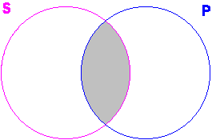
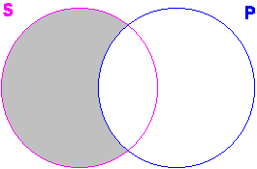
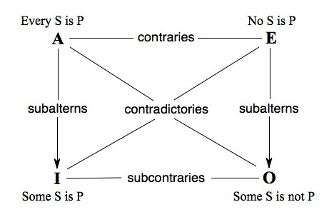
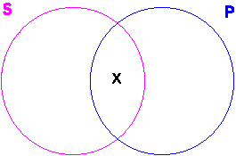
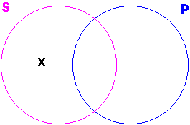
Square of opposition and Venn Diagrams

