Slide 1
Viral Hepatitis
DR. AHMED ELHADDAD
2-5-2019

Slide 2
A 18 year female was admitted for fever, weakness, vomiting and yellow discoloration of sclera. ALT 1200U/AST 750 U, Hb 140g/L, anti-HAV IgM(+) .Anti-HAV IgG(+) HBsAg(-) HCV-Ab(-). The diagnosis may be:
A. Acute hepatitis A(icteric type) and HBsAg chronic carrier.
B. Acute hepatitis C.
C. Chronic active hepatitis B.
D. Acute hepatitis A .
E. Acute hepatitis A &chronic persistent hepatitis B.

Slide 3
HEPATITIS
Inflammation of the liver
Acute hepatitis lasting < 6 months , chronic hepatitis lasting > 6 months

Slide 4
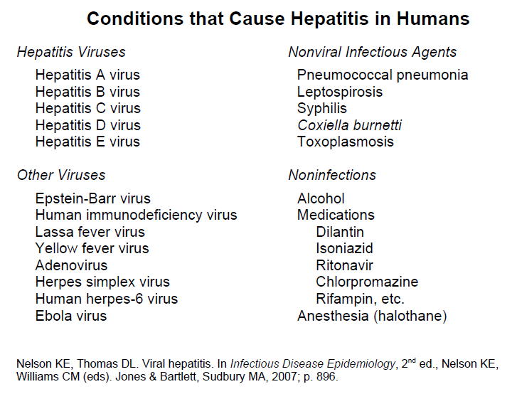

Slide 5
Acute Viral Hepatitis
Viral hepatitis is a group systemic infection affecting the liver predominantly, Almost all cases of acute viral hepatitis caused by
5 viral agents:
HAV, HBV, HCV, HDV, HEV
Although the agents can be distinguished by its antigenic properties, the 5 kinds of viruses may produce clinical similar illness

Slide 6
All types of viral hepatitis produce clinically similar illnesses
Asymptomatic to fulminant and fatal
acute infections common to all types

Slide 7
Blood Borne
(HBV, HCV, HDV)
Subclinical persistent infections
Rapidly progressive chronic liver disease with cirrhosis
Hepatocellular Carcinoma

Slide 8
Acute Viral Hepatitis
When they occur, the signs and symptoms of viral hepatitis can include:
  Fever
  Fatigue
  Loss of appetite
  Nausea
  Vomiting
  Abdominal pain
  Jaundice
  Dark urine
  Clay-colored stool
  Joint pain

Slide 9
Viral Hepatitis

Slide 10
Etiology
Hepatitis A virus (HAV)
HAV is one kind of picornavirus and used to be classified as enterovirus type72, but recently, it is considered to be classified as heparnavirus.
Consists of a genome of linear, single-stranded RNA,
During acute stage of infection, HAV can be found in blood and feces of infected human and primate.

Slide 11
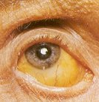
Hepatitis A
Abrupt onset.
Fever
Malaise
Anorexia
Abdominal discomfort
Jaundice

Slide 12
More than 90% are asymptomatic
Seroprevalence increases with age.
At age 15, 95% are seropositive.
Case fatality rate (CFR)= 0.3%.
If age > 40 years CFR=2%.

Slide 13
Agent: RNA virus
Reservior : Human (Clinical & subclinical
cases)
Incubation period: 15-35 days ( median
one month).

Slide 14
Period of communicability : Last two weeks of I.P. + one week of illness.
Modes of transmission:
Fecal-oral route.
Common source outbreaks.
Blood transfusion (rare).

Slide 15
Diagnosis, Treatment & Reservoir of Hepatitis A
Diagnosis: Anti-IgM detectable 5-10 days before
symptoms; disappears by six months
Anti-IgG – convalescent, life-long,confers protection
Treatment: Supportive

Slide 16
Hepatitis A
Diagnosis

Slide 17
Bed rest is not essential
many patients will feel better with restricted physical activity
A high-calorie diet is desirable, and because many patients may experience nausea late in the day, the major caloric intake is best tolerated in the morning
If severe Pruritus is present, the use of the bile salt-sequestering resin Cholestyramine is helpful

Slide 18
A
Because most patients hospitalized with hepatitis A excrete little, if any, HAV, the likelihood of HAV transmission from these patients during their hospitalization is low
Therefore, burdensome enteric precautions are no longer recommended. Although gloves should be worn when the bedpans or fecal material of patients with hepatitis A are handled

Slide 19
Prevention and Control
Good sanitation & personal hygiene.
“Careful hand washing”
Day- Care centers
Hand washing after every diaper
change and before eating.
Shellfish
heat 85-90C 4 minutes.
steam 90 seconds.

Slide 20
Prophylaxis HAV
Passive immunization with IG
Active immunization with killed vaccines
All preparations of IG contain anti-HAV concentrations sufficient to be protective
When administered before exposure or during the early incubation period, IG is effective in preventing clinically apparent hepatitis A

Slide 21
HAV vaccine IM, 3 Doses, 0,1 ,6
Routine hepatitis A vaccination of all children
Military personnel
Employees of day-care centers
Laboratory workers exposed to hepatitis A or fecal specimens
Chronic Liver Disease
Chronic Hepatitis C ,Chronic Hepatitis B

Slide 22
Hepatitis A vaccines
Safe, Immunogenic, Effective .
One Year Old
Adequate protection beginning 4 weeks after a primary inocubation
If it can be given within 4 weeks of an expected exposure, such as by travel to an endemic area,
vaccine is the preferred approach to pre-exposure immunoprophylaxis

Slide 23
Prognosis
HAV
Virtually all previously healthy patients recover completely with no clinical sequelae

Slide 24
Hepatitis B virus (HBV)
Four open reading frames (ORF) that encode five proteins
S region: include pre-s1, pre-s2 and S gene,
encoded pre-s1 protein, pre-s2 protein and HBsAg.
Pre-s1 protein + pre-s2 protein + HBsAg—large protein
Pre-s2 protein + HBsAg—middle protein
HBsAg—major protein
C region included pre-c and C gene, encode HBeAg and
HBcAg
X region encoded HBxAg
P region encoded DNA polymerase
Notes:
Humans are the only natural hosts of HBV. There is no animal reservoir

Slide 25
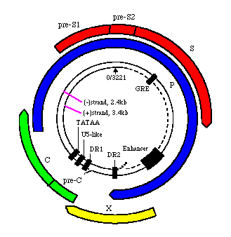

Slide 26
Hepatitis B
Incidous onset.
Anorexia.
Abdominal discomfort.
Nausia.
Vomiting.
Arthralgia.
Jaundice.

Slide 27
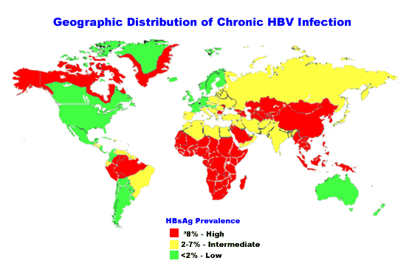
More than 500,000 death/year
2 billion people infected
360 million CHB

Slide 28
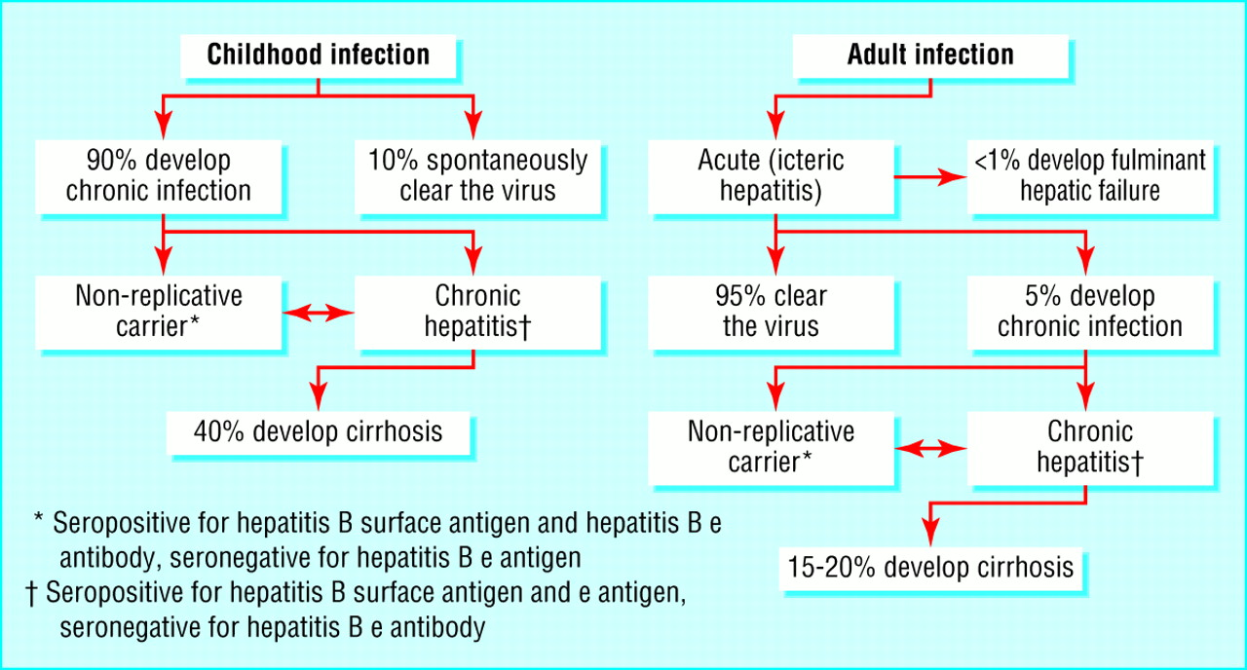
Natural History
  Gow, BMJ 2001

Slide 29
Agent: Double strand DNA.
Reservior: Human (case + carrier).
I.P. 2-3 months.
P.C. One week of I.P. + illness period + carriage.
Carriage depends on age.

Slide 32
Modes of transmission:
Percutaneous and permucosal exposure to infective body fluids.
Blood transfusion.
Organs transplants.
Sharing needles.
Haemodialysis.
Needlestick.
Tattooing.
Razors & toothbrushes.

Slide 33
Sexual transmission.
Perinatal transmission.

Slide 34
Hepatitis B Diagnosis
Hepatitis B is detected by looking for a number of different antigens and antibodies:
  Hepatitis B surface antigen (HBsAg):
    A protein on the surface of HBV; it can be detected in high levels in serum during acute or chronic HBV infection.
    The presence of HBsAg indicates that the person is infectious.
    The body normally produces antibodies to HBsAg as part of the normal immune response to infection.
    HBsAg is the antigen used to make Hepatitis B vaccine.

Slide 35
Hepatitis B Diagnosis
Hepatitis B is detected by looking for a number of different antigens and antibodies:
  Hepatitis B surface antibody (anti-HBs):
    The presence of anti-HBs is generally interpreted as indicating recovery and immunity from HBV infection.
    Anti-HBs also develops in a person who has been successfully vaccinated against Hepatitis B.
  Total Hepatitis B core antibody (anti-HBc):
    Appears at the onset of symptoms in acute Hepatitis B and persists for life.
    The presence of anti-HBc indicates previous or ongoing infection with HBV in an undefined time frame.

Slide 36
Hepatitis B Diagnosis
Hepatitis B is detected by looking for a number of different antigens and antibodies:
  IgM antibody to Hepatitis B core antigen (IgM anti-HBc):
    Positivity indicates recent infection with HBV (≤6 months).
    Its presence indicates acute infection.
  Hepatitis B e antigen (HBeAg):
    A secreted product of the nucleocapsid gene of HBV that is found in serum during acute and chronic Hepatitis B.
    Its presence indicates that the virus is replicating and the infected person has high levels of HBV.

Slide 37
Hepatitis B Diagnosis
Hepatitis B is detected by looking for a number of different antigens and antibodies:
  Hepatitis B e antibody (HBeAb or anti-HBe):
    Produced by the immune system temporarily
    During acute HBV infection or consistently during or after a burst in viral replication.
    Spontaneous conversion from e antigen to e antibody (a change known as seroconversion) is a predictor of long-term clearance of HBV in patients undergoing antiviral therapy and indicates lower levels of HBV.

Slide 38
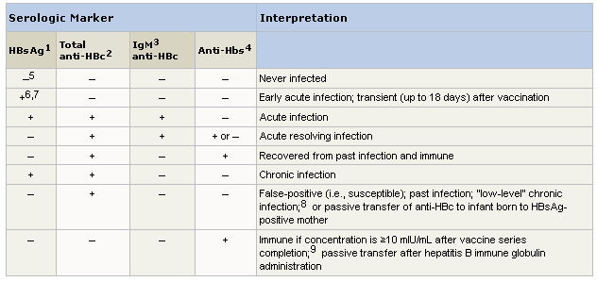
Hepatitis B
Typical interpretation of serologic test results for hepatitis B virus infection

Slide 39
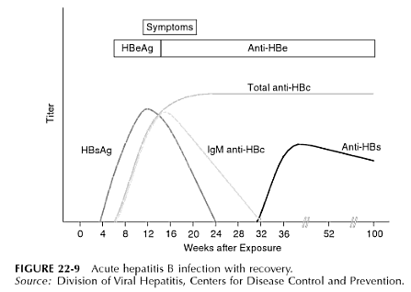

Slide 40
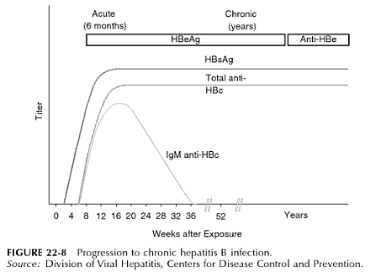

Slide 41
Prevention and control
Wide scale immunization of infants.
Immunization of high risk persons.
Haemodialysis patients.
Bleeding disorders.
Susceptible households.
Health care personnels.
Blood banks:
avoid donors from risky groups.

Slide 42
Education & history taking.
Testing for HBs Ag.
Discourage:
Tattooing, Drug abuse,
Extramarital sexual relations.
Needle stick
Single dose of HBIG (24 hours).
Vaccine series.

Slide 43
Infants to HBsAg +ve mothers.
0.5 ml HBIG im.
First dose of the vaccine.
2nd & 3rd doses at 1 & 6 months later.
Health care personnel.
Universal precautions

Slide 44
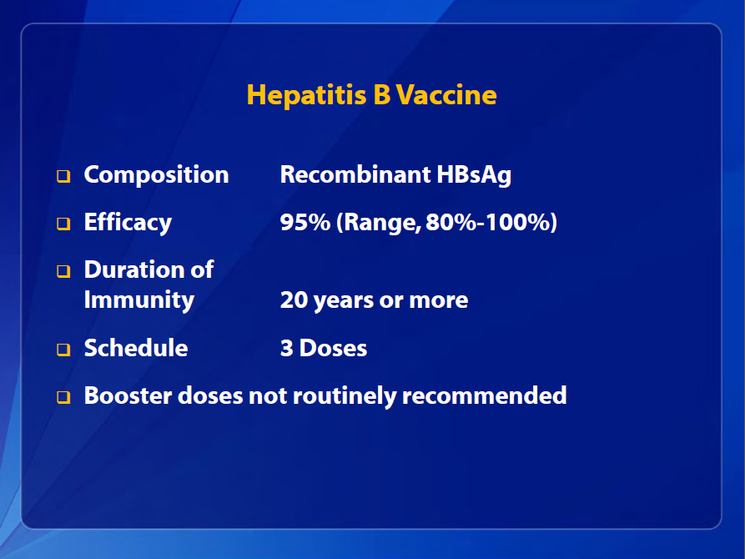

Slide 45
Prognosis
HBV
Acute : 95–99% of previously healthy adults have a favorable course and recover completely

Slide 46
Prognosis
HBV
Advanced age and with Serious underlying medical disorders
Prolonged Course
Severe Hepatitis

Slide 47
Prognosis
Case Fatality Rate
Hepatitis A and B
Very Low (0.1%)
increased by advanced age and underlying debilitating disorders
Among patients ill enough to be hospitalized for acute hepatitis B, the fatality rate is 1%

Slide 48
Fulminant hepatitis
Initial presenting features such as Ascites, peripheral Edema, and symptoms of hepatic Encephalopathy suggest a poorer prognosis. In addition, a Prolonged PT, Low-serum Albumin level, Hypoglycemia, and very high-serum Bilirubin values suggest severe hepatocellular disease. Patients with these clinical and laboratory features deserve prompt hospital admission

Slide 49
Hepatitis B
Treatment
For acute infection, no medication is available; treatment is supportive.
For chronic infection, several antiviral drugs (adefovir dipivoxil, interferon alfa-2b, pegylated interferon alfa-2a, lamivudine, entecavir, tenofovir and telbivudine) are available.
  Persons with chronic HBV infection require medical evaluation and regular monitoring to determine whether disease is progressing and to identify liver damage or hepatocellular carcinoma.

Slide 50
Etiology
Hepatitis C virus (HCV)
HCV is a member of flavivirus family.
HCV genome is a single stranded positive-sense RNA.
The genome contains 5’-non coding region, C region, E region and NS region
HCV genome may be divided into many types and subtypes.

Slide 51
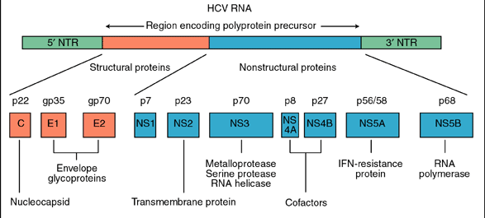
HCV genome
Cambridge University Press
Active drug targets

Slide 52
Natural History of HCV Infection
Exposure
(Acute phase)
15-25%
75-85%
HIV and
Alcohol
Resolved
Chronic
80%
20%
Stable
Cirrhosis
75%
25%
Slowly
Progressive
HCC
Transplant
Death
Notes:
Natural history of HCV Infection
The natural history of hepatitis C evolves over the course of decades and can be considered to have three distinct stages. The first is the stage of resolution of recovery. This is seen in approximately 15% of patient with viremia and acute hepatitis followed by resolution of viremia with the persistence of antibody. The second stage is the stable chronic course in which patients have viremia and acute hepatitis with subsequent decrease in ALT. The patient may experience periodic elevations of liver enzymes and persistent viremia for several years. This is the most common stage and is seen in approximately 80% of the patients. During this stage it is believed that patients may experience the emergence of quasispecies and relative ineffectiveness of neutralizing antibodies. The last stage is that of severe progression of the disease and occurs in approximately 20% of the patients. The patient will experience more persistent elevation of liver enzymes, persistent viremia, and a more rapid progression to cirrhosis and possibly even hepatocellular carcinoma.
HIV and alcohol should be considered as important cofactors in hepatitis C and the progression to cirrhosis. There is evidence to suggest a greater than 15 fold increase in the incidence of cirrhosis in alcoholic patients and a >5 fold increase with HIV.
References:
1. Alter MJ. Epidemiology of Hepatitis C in the West. Semin Liver Dis. 1995; 15: 5-14
2. Management of Hepatitis C. NIH Consensus Statement. 1997; March 24-26: 15(3).

Slide 53

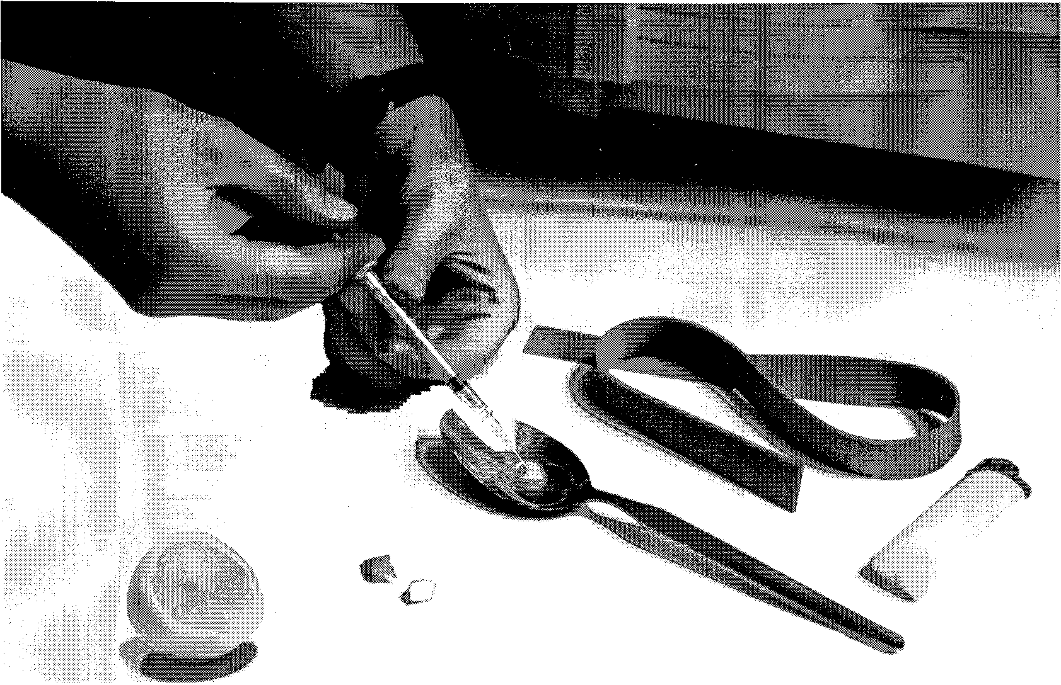
Important HCV Transmission Modes
Blood transfusion
IV drug abuse
80% infected in first year
1:100,000 in US

Slide 54
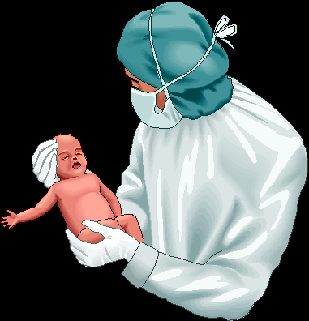





Uncommon HCV Transmission Modes
Household transmission
?
Vertical transmission mother - Child
1-5%
Needle stick injury
3%

Slide 55
Features of Hepatitis C Virus Infection
Incubation periodAverage 6 weeks
Range 2-24 weeks
Acute illness (jaundice) Mild (<20%)
Case fatality rate Low
Chronic infection 60%-85%
Chronic hepatitis 10%-70%
Cirrhosis <5%-20%
Mortality from CLD 1%-5%
Age-
related

Slide 56
Chronic Hepatitis C
Factors Promoting Progression or Severity
Increased alcohol intake
Age > 40 years at time of infection
HIV co-infection
Other
  Male gender
  Chronic HBV co-infection

Slide 57
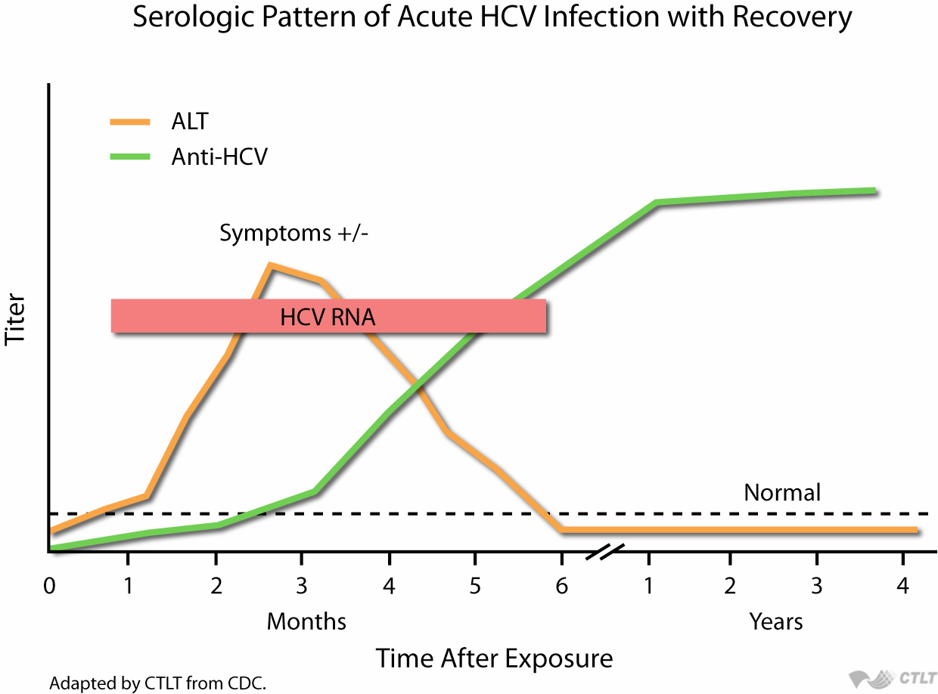
Hepatitis C
Diagnosis

Slide 58

Serologic Pattern of Acute HCV Infection with Progression to Chronic Infection
anti-HCV
Symptoms +/-
HCV RNA
Titer
ALT
Normal
0
1
2
3
4
5
6
1
2
3
4
Months
Years
Time after Exposure

Slide 59
HCV genome
Cambridge University Press
Active drug targets

Slide 60
Direct Acting Antivirals (DAAs)
Core | E1 | E2 | P7 | NS2 | NS3 | NS4A | NS4B | NS5A | NS5B
NS3-4A protease
Inhibitors
~previr
Telaprevir
Boceprevir
Simeprevir
Paritaprevir
grazoprevir
NS5A
Inhibitors
~asvir
Daclatasvir
Ledipasvir
Ombitasvir
Velpatasvir
Elbasvir
NS5B polymerase
Inhibitors
~buvir
Sofosbuvir
Dasabuvir

Slide 61
Prognosis
HCV
Less severe during the acute phase than hepatitis B and
More likely to be Anicteric
Fatalities are rare
Chronicity > 75%

Slide 62
Etiology
Hepatitis D virus (HDV)
HDV (Delta hepatitis virus) is a kind of defective virus
HDV is found in the nuclei of infected hepatocytes and replicate
HDV genome is a circular single strand RNA .
The replication of HDV depends on HBV or other hepadnavirus, coated by HBsAg in blood
HBV and HDV co-infection or superinfection may make the disease exacerbation and may lead to fulminant hepatitis

Slide 63
Patients with simultaneous acute hepatitis B and hepatitis D do not necessarily experience a higher mortality rate than do patients with acute hepatitis B alone; however, in several recent outbreaks of acute simultaneous HBV and HDV infection among injection drug users, the case fatality rate has been 5%

Slide 64
In the case of HDV superinfection of chronic hepatitis B, the likelihood of fulminant hepatitis and death is increased substantially
Although the case fatality rate for hepatitis D has not been defined adequately, in outbreaks of severe HDV super infection in isolated populations with a high hepatitis B carrier rate, the mortality rate has been recorded in excess of 20%.

Slide 65
Etiology
Hepatitis E virus (HEV)
HEV is a member of calicivirus family.
HEV genome is a single strand, positive –sense RNA

Slide 66
Hepatitis E - Clinical Features
Incubation period: Average 40 days
Range 15-60 days
Case-fatality rate: Overall, 1%-3% Pregnant women10-20%
Illness severity: Increased with age
Chronic sequelae: None identified
Notes:
27
27
27

Slide 67
Epidemiology
Source of infection
Hepatitis A and E: patients with acute hepatitis and person with sublinical infection
Hepatitis B, C and D: patients with acute, chronic hepatitis B, C, and D and carriers
Route of transmission
Hepatitis A and E:
fecal-oral route predominantly

Slide 68
Outbreak epidemic
  Due to food and water are contaminated lead to outbreak of HAV and HEV
Seasonal distribution
  HAV:most cases developed in autumn and winter
  HEV:most cases developed in summer and autumn

Slide 69
Type of Hepatitis
A
B
C
D
E
Source of
feces
blood/
blood/
blood/
feces
virus
blood-derived
blood-derived
blood-derived
body fluids
body fluids
body fluids
Route of
fecal-oral
percutaneous
percutaneous
percutaneous
fecal-oral
transmission
permucosal
permucosal
permucosal
Chronic
no
yes
yes
yes
no
infection
Prevention
pre/post-
pre/post-
blood donor
pre/post-
ensure safe
exposure
exposure
screening;
exposure
drinking
immunization
immunization
risk behavior
immunization;
water
modification
risk behavior
modification
Notes:
3

Slide 70
Laboratory examination
Liver function
  Serum transaminase
    ALT(alanine transferase) ↑↑↑
    AST(aspartase transferase) ↑↑↑
    ALP (Alkaline phosphatase) ↑
  Serum protein
    Albumin ↓
    In chronic hepatitis Ig ↑↑
    The ratio of A/G ↓
  Bilirubin
    Urobilinogen ↑in early stage of AIH

Slide 71
    Urobilinogen and urobilin ↑in icteric stage
  Prothrombin time may be prolonged especially in fulminant hepatitis
  Blood amonia examination

Slide 72
Determining aetiology of Jaundice
Total bilirubin and its conjugated and unconjugated levels help to determine nature of jaundice
Test | Pre-hepatic | Hepatic | Post-hepatic
Total bilirubin | + | ++ | +++
Conjugated bilirubin | Normal | Increased | Increased
Unconjugated bilirubin | Increased | Increased | Normal

Slide 73
Determining aetiology of jaundice
Liver Enzymes
    ALT/AST mainly present in hepatocytes
    ALP/GGT mainly present in bile cannaliculi biliary tree
Derrangement of particular liver enzymes in association with jaundice can determine nature of the jaundice
Test | Pre-hepatic | Hepatitis | Post-hepatic
ALT/AST | Normal | +++ | +
ALP/GGT | Normal | + | +++

Slide 74
Determining aetiology of Jaundice
Test | Pre-hepatic | Hepatitis | Post-hepatic
Urine Bilirubin | negative | Negative (but maybe increased depending on cause) | Increased
Urine urobilinogen | Increased | Normal (but maybe increased depending on cause) | Decreased/negative
Urine colour | Normal | Normal (but maybe dark depending on cause) | Dark
Stool colour | Normal | Normal | Pale

Slide 75
Ultra-sound examination
Liver biopsy
Other laboratory examination
  Blood routine
  Urine routine

Slide 76
A 18 year female was admitted for fever, A 18 18 year female was admitted for fever, weakness, vomiting and yellow discoloration of sclera. ALT 1200U/AST 750 U, Hb 140g/L, anti-HAV IgM(+) .Anti-HAV IgG(+) HBsAg(-) HCV-Ab(-).The diagnosis may be:
A. Acute hepatitis A(icteric type) and HBsAg chronic carrier.
B. Acute hepatitis C.
C. Chronic active hepatitis B.
D. Acute hepatitis A .
E. Acute hepatitis A &chronic persistent hepatitis B.

