Slide 1



Libyan international medical university
Faculty of basic medical science
OSTEOSARCOMA CANCER
NAME Buthina kity
ROLE NUMBER 3521
BLOCK PTS
YEAR one

Slide 2
OBJECTIVES
Definition of osteosarcoma
List causes and symptom of osteosarcoma
Discus diagnoses and treatment

Slide 3
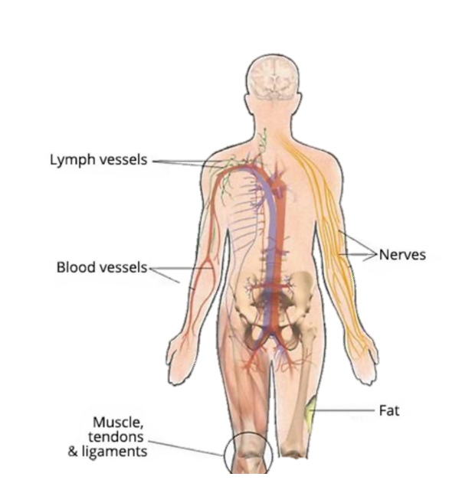
INRODUCTION
Sarcomas is malignant neoplasms coming in mesenchymal tissues
Occur in different location in the body
Can appear in all ages
Have numerous type over than 50 type one of the most common is osteosarcoma

Slide 4

Definition of osteosarcoma
Malicious tumor that occur mesenchymal bone which form immediately from the osteoid or bone
Is the most common type of cancer that starts in bone
Tend to occur in teenagers and young adults more than the other

Slide 5
List causes and symptom
CAUSES
Causes its not clear until this moment
Occur alteration in DNA
Factors that can make the risk higher of sarcoma such as
Preceding use of radiation therapy
Another bone disorders
Particular inherited or genetic conditions

Slide 6
List causes and symptom
symptom
Swelling near a bone
Bone or joint pain
Bone injury or bone break for no clear reason

Slide 7

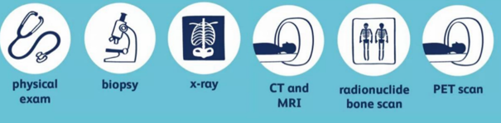
Discus treatment and diagnose
Diagnose

Slide 8

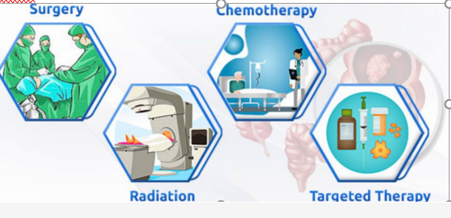
Discus treatment and diagnose
Treatment

Slide 9

In conclusion
Osteosarcoma one of the malicious tumor ever that can getting any one with no reason and early detection can save your life.

Slide 10


Slide 11


Slide 12
Reference
Robbins, Stanley Leonard et al. Robbins Basic Pathology. Elsevier, 2018.
Soft tissue sarcoma - Diagnosis and treatment - Mayo Clinic. Mayoclinic.org. https://www.mayoclinic.org/diseases-conditions/soft-tissue-sarcoma/diagnosis-treatment/drc-20377730. Published 2022. Accessed June 7, 2022.
Osteosarcoma - Diagnosis and treatment - Mayo Clinic. Mayoclinic.org. https://www.mayoclinic.org/diseases-conditions/osteosarcoma/diagnosis-treatment/drc-20351053. Published 2022. Accessed June 7, 2022.

