Slide 1


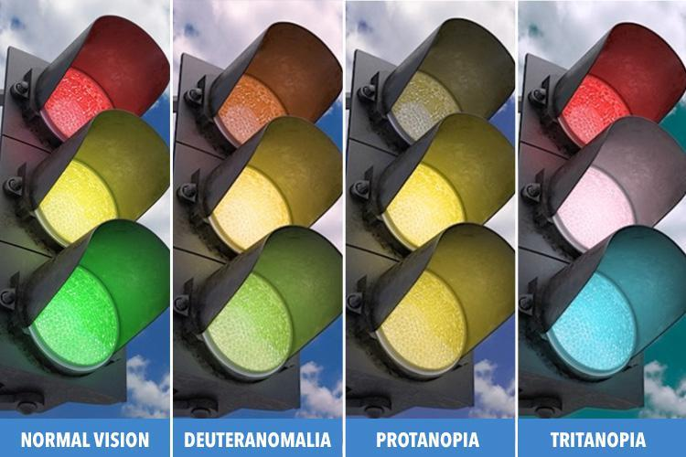
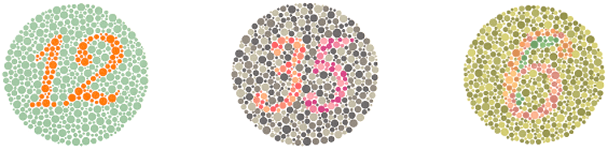
How does Colorblind Person See a Traffic light?
Zubaida Albishari, 2nd year medical student
Faculty of Basic Medical Science
Libyan International Medical University
Introduction
Different types
Curing of color blindness
Color blindness is the decrease ability to see colors or differences in colors.
When the cones have all the various pigments -- called photopigments -- your eye sees all possible colors. If there’s a problem with the pigments, you won’t see colors the way you should. This is called color deficiency or color blindness.
It affects approximately 1 in 12 men and 1 in 200 women in the world .¹
Red-green color blindness :deuteranomaly deuteranopia, protanopia ,and protanomaly.
Blue-yellow color blindness : tritanomaly and tritanopia.
Complete color blindness : cone monochromacy ,rod monochromacy. ²
There is no cure for color blindness. People with red-green color blindness may be able to use a special set of lenses to help them perceive colors more accurately.
Visual aids have also been developed to help people cope with color blindness.²
Conclusion
Causes of colorblindness
Color blindness is a deficiency in the way you see the colors ,there is a different types of colorblindness .
And the curing of colorblindness is impossible .
Color blindness is usually a genetic (hereditary) condition . Inherited forms of color blindness often are related to deficiencies or mutation in certain types of cones .
the gene which responsible for this condition is carried on the X chromosome and this is the reason why many more men are affected than women .
Other causes include : physical or chemical damage to the eye , multiple sclerosis ,diabetic , glaucoma , cataracts or injury to the optic nerve . ¹
Figure 1 show how a colorblind person see the traffic lights
Figure 2 show Ishihara
color test
References
How it diagnosed ?
Facts About Color Blindness | National Eye Institute. Nei.nih.gov. https://nei.nih.gov/health/color_blindness/facts_about. Published 2015.
What Is Color Blindness?. American Academy of Ophthalmology. https://www.aao.org/eye-health/diseases/what-is-color-blindness. Published 2018.
The Ishihara color test : is the most
common test for red-green color
blindness it consists of a series of coloredspots.
Farnsworth-Munsell 100 hue test : The patient is asked to arrange a set of color to form a gradual transition of color .²

