Slide 1


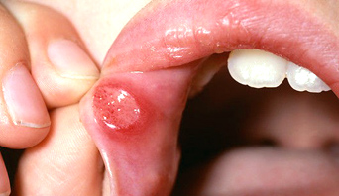
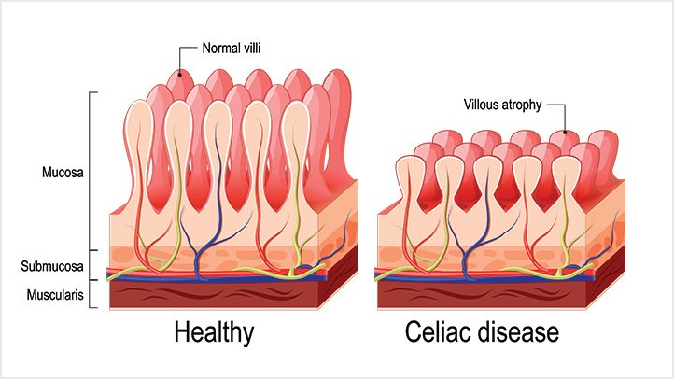
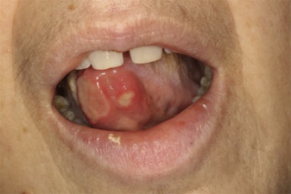
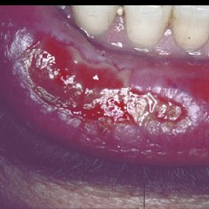
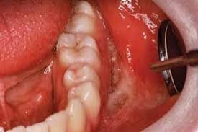
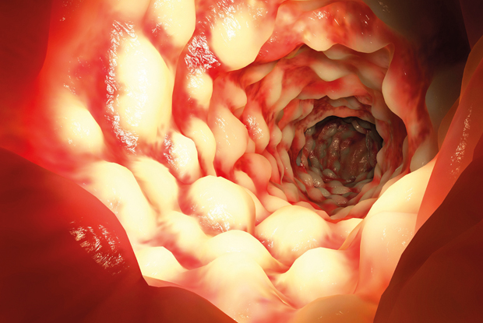
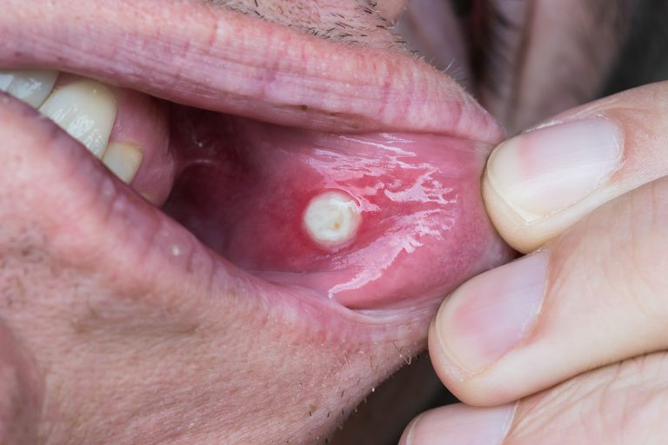
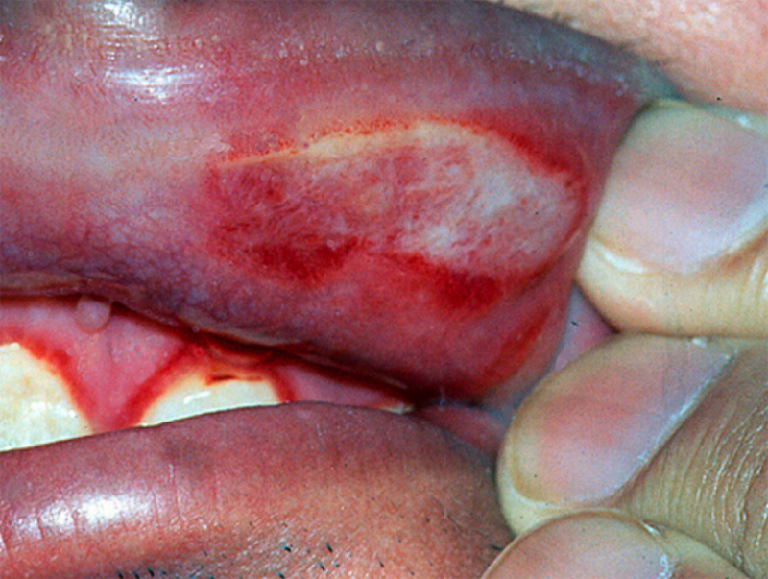
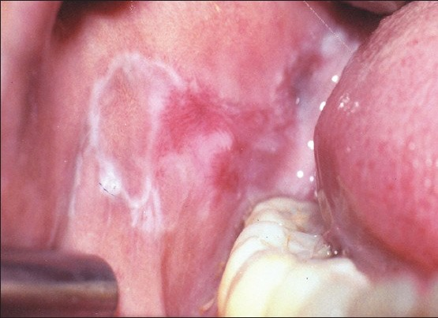
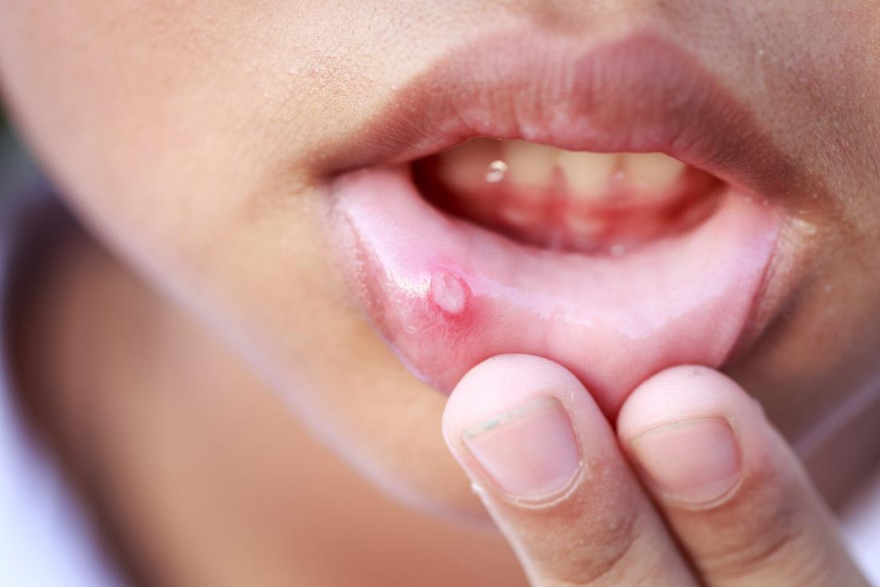
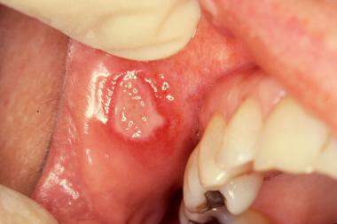
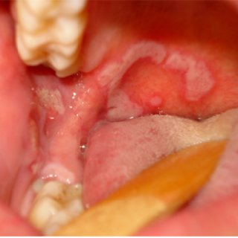
Causes of Oral Ulcer
MOHAMED AWAD ELBEGWO 2nd Year Dentistry
Faculty Of Basic Medical Science
Libyan International Medical University
Supervisor :
Dr. Rashad Shawgi .
Introduction :
B) Celiac disease, (Gluten sensitive enteropathy):
It causes malabsorption, resulting from a reduction
in small intestinal absorptive surface area , It may be
associated with recurrent aphtha ⁽¹⁾.
Non-Aphthous Ulcer :
3) Drug-induced oral ulcerations:
Oral ulcer: is discontinuity of oral
mucosa, that is produced by necrosis of
cells followed by shedding of
inflammatory necrotic tissue, classified
into aphthous and non-aphthous ulcer.
The traumatic oral ulcer is very common and can be caused by acute or chronic trauma, may result from accidentally biting or secondary to mastication, burn, sharp edges of food or to toothbrush⁽¹⁴⁾.
focal irritation due to low pH, allergic
hypersensitivity and chemotherapeutic
drugs cause stomatitis and oral ulceration⁽¹⁹⁾.
1) Autoimmune disease :
A) Pemphigus Vulgaris: Is a chronic autoimmune
mucocutaneous disease. Oral ulcers may be the
first manifestation of the disease in up to 90%
of cases⁽¹⁵⁾.
Aphthous Ulcer (Canker Sores) :
Picture A (6)Aphthous ulcer, Celiac disease.
Picture B (7)Celiac disease.
Picture (20) drugs causes oral ulcers.
C) Inflammatory bowel disease ( IBD )
Conclusion:
Small, painful, rounded, superficial ulcer covered with gray-white exudate It appear singly or in groups on the oral mucosa It is self-limited and usually resolve Within a few weeks⁽¹⁾.
Including Crohn's disease (CD) and ulcerative
colitis, Aphthous and stomatitis are among non-
specific oral manifestations of IBD⁽¹⁾ ⁽⁸⁾.
● Differentiation between aphthous and non-aphthous is based on the features of the ulcer.
● Non-Aphthous and Secondary Aphthous
may be due to autoimmune diseases,
infections, Nutritional Deficiencies or Drugs.
● Recurrent oral ulcers has high risk of
changing into malignant
● Opportunistic bacterial infections is an
indicator of immune deficiency.
● Dentists must be aware that oral ulcer may
be due to underlying disease which may be
fatal.
Picture A (9) IBD
Picture B (9) IBD
Picture (15) oral ulcer, Pemphigus Vulgaris
2) Infection :
B) Oral lichen planus :
Is (chronic) inflammatory condition that affects
skin and mucous membranes oral lichen
planus may appear as white, lacy patches or
as ulcers. ulcerative oral lichen planus
increases the risk of oral cancer⁽¹⁶⁾.
Human immunodeficiency
virus (HIV) patients often
suffer from persistent,
aphthous ulcers. viruses
(as herpes simplex),
bacteria and fungi have
been implicated as
possible causes of oral
ulcer in AIDS patient⁽¹⁰⁾⁽¹⁾.
.
Picture (2) Aphthous ulcer .
1) Associated with autoimmune disease :
A) Behçet’s disease : characterized by recurrent Aphthous stomatitis (RAS) ⁽³⁾ ⁽⁴⁾.
Picture A (11) (HIV)
References
It can be primary or secondary :
3) Nutritional Deficiency :
. Klatt, E., Kumar, V. and Robbins, S. (2010). Robbins and Cotran review of pathology. Philadelphia: Saunders/Elsevier.1
2.picture : Verywell Health. (2018). Canker Sore Remedies That Actually Work. [online] Available at: https://www.verywellhealth.com/canker-sore-remedies-that-actually-work-1058925 [Accessed 27 Nov. 2018].
3. Rogers RS 3rd. Recurrent aphthous stomatitis: clinical characteristics and associated systemic disorders. Semin Cutan Med Surg 1997;16:278–83
4. Dencyclopedia, 2018. Textbook of Oral Medicine 3rd Edition [WWW Document]. DENCYCLOPEDIA. URL https://www.dencyclopedia.com/textbook-of-oral-medicine-3rd-edition/ (accessed 11.28.18).
5. picture : Cochraneohg.wordpress.com. (2018). Behcet’s disease | Cochrane Oral Health. [online] Available at: https://cochraneohg.wordpress.com/tag/behcets-disease/ [Accessed 27 Nov. 2018].
6.(A) picture : Dr Sylvia Onusic. (2018). Canker Sores Related to Celiac Disease - Dr Sylvia Onusic. [online] Available at: http://drsylviaonusic.com/2015/09/cancer-sores-related-to-celiac-disease/ [Accessed 27 Nov. 2018].\
7.(B) picture : EverydayHealth.com. (2018). Celiac Disease Causes and Risk Factors: What to Know | Everyday Health. [online] Available at: https://www.everydayhealth.com/celiac-disease/causes-risk-factors-what-know/ [Accessed 27 Nov. 2018].
8. Crohn's disease [WWW Document], 2010. [WWW Document]. The demands of dental hygiene place stress on the human body. URL https://www.rdhmag.com/articles/print/volume-30/issue-7/columns/crohn-s-disease.html (accessed 11.28.18)
9.(A) picture : Rana, A., Dawson, J., n.d. Crohn's disease - Clinical review [WWW Document]. GP. URL https://www.gponline.com/crohns-disease-clinical-review/gi-inflammatory-bowel-disease/crohns-disease/article/1213250 (accessed 11.28.18).
10.Topic 2. Oral Manifestations [WWW Document], n.d. [WWW Document]. National HIV Curriculum. URL https://www.hiv.uw.edu/go/basic-primary-care/oral-manifestations/core-concept/all (accessed 11.28.18)
11.(A) picture :Topic 2. Oral Manifestations [WWW Document], n.d. [WWW Document]. National HIV Curriculum. URL https://www.hiv.uw.edu/go/basic-primary-care/oral-manifestations/core-concept/all (accessed 11.28.18)
12. Nolan, A., McIntosh, W.B., Allam, B.F., Lamey, P.J., 1991. Recurrent aphthous ulceration: vitamin B1, B2 and B6 status and response to replacement therapy. [WWW Document]. Current neurology and neuroscience reports. URL https://www.ncbi.nlm.nih.gov/pubmed/1941656 (accessed 11.29.18).
13. Oooojournal.net. (2018). [online] Available at: https://www.oooojournal.net/article/S2212-4403(14)01255-3/pdf [Accessed 27 Nov. 2018].
14. Visualdx.com. (2018). VisualDx Cookie Check. [online] Available at:
https://www.visualdx.com/visualdx/diagnosis/traumatic+oral+ulcer?diagnosisId=53682&moduleId=20 [Accessed 27 Nov. 2018].
15.Person. (2010, December 29). Oral Manifestations of Pemphigus Vulgaris: Clinical Presentation, Differential Diagnosis and Management. Retrieved from https://www.omicsonline.org/oral-manifestations-of-pemphigus-vulgaris-clinical-presentation-differential-diagnosis-and-management-2155-9554.1000112.php?aid=656
16. Oral lichen planus. (2017, August 08). Retrieved from https://www.mayoclinic.org/diseases-conditions/oral-lichen-planus/symptoms-causes/syc-20350869
17. Takahashi, N., Sekido, M., Fujita, K., Ohtani, T., 1981. A case of secondary syphilis of the oral mucosa. Japanese Journal of Oral & Maxillofacial Surgery 27, 1095–1098. doi:10.5794/jjoms.27.1095
18. picture : Qiao J, Fang H. Syphilitic chancre of the mouth. CMAJ. 2011;183(17):2015.
19. [WWW Document], n.d. [WWW Document]. Plague, Septicemic. URL https://www.visualdx.com/visualdx/diagnosis/drug-induced oral ulcer?diagnosisId=52972&moduleId=14 (accessed 11.28.18).
20. picture: Adverse drug events in the oral cavity [WWW Document], 2014. [WWW Document]. NeuroImage. URL https://www.sciencedirect.com/science/article/pii/S2212440314012553 (accessed 11.28.18).
Vitamin B1, B2, B6 and B12 deficiency is considered
to be a cause recurrent aphthous ulceration⁽¹²⁾.
Picture (16) Oral ulcer, lichen planus.
2) Infections :
4) Drugs :
cyclooxygenase-2 inhibitors, and the angiotensin
receptor blocker have been implicated in the
development of Aphthous like ulcers ⁽¹³⁾.
Syphilis: Irregular linear erosions termed
snail track ulcers, Syphilitic chancre may
occur in the oral mucosa as a consequence of orogenital contact ⁽¹⁷⁾.
picture (5) Aphthous ulcer in Behçet's disease.
Picture A (13) drugs causes aphthous like ulcers.
Picture (18) syphilis snail track ulcers

